Slide 1


XÂY DỰNG HỆ THỐNG QUYẾT ĐỊNH CHÍNH SÁCH ĐIỀU KHIỂN TRUY CẬP DỰA TRÊN THUỘC TÍNH BẢO VỆ TÍNH RIÊNG TƯ CHO DỮ LIỆU
NoSQL DOCUMENT STORE
Giảng viên hướng dẫn: TS. Trương Tuấn Anh
ThS. Trần Thị Quế Nguyệt
Giảng viên phản biện: ThS. Lê Thị Kim Tuyến
Sinh viên thực hiện: Lương Vạn Huy

Slide 2
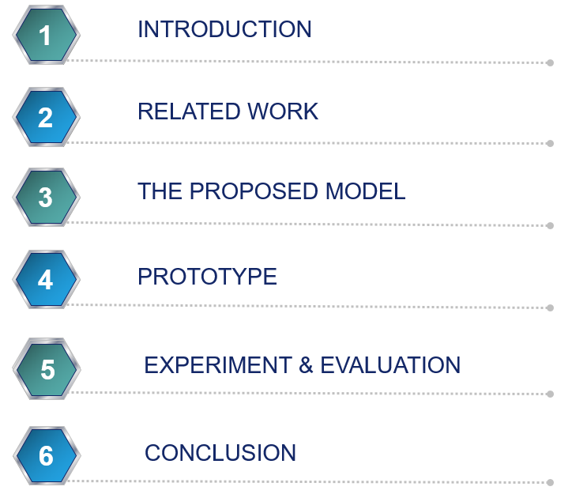
OUTLINE

Slide 3
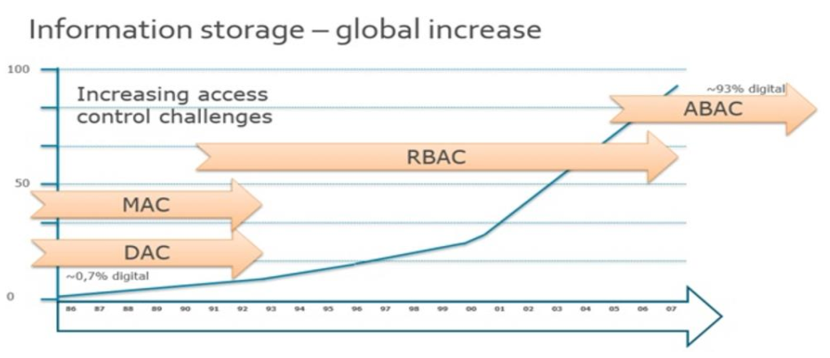
1. INTRODUCTION
Statement of problem
Disadvantages of traditional access controls for NoSQL.
The increasing of global information storage
Notes:
- disadvantages: applied for only closed system, role explosion, inflexibility in specifying dynamic policies.

Slide 4
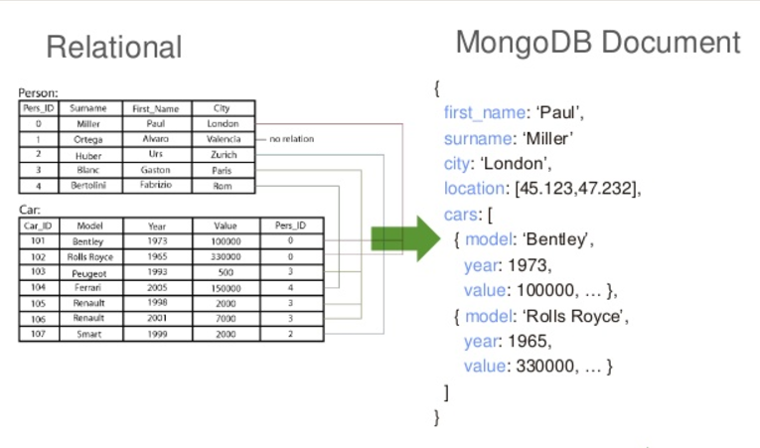
1. INTRODUCTION
Statement of problem
Disadvantages of traditional access controls for NoSQL.
Data structure in document database is more complex than in relational database.
Comparison between relational data and document

Slide 5
1. INTRODUCTION
Statement of problem
Disadvantages of traditional access controls for NoSQL.
Data structure in document database is more complex than in relational database.
Access Control is an Inadequate Framework for privacy protection.

Slide 6
1. INTRODUCTION
Contribution:
Proposed a model for access control and privacy protection.
Integrated “Attribute-based” concept into privacy policy.
Supported privacy protection up to field-level for document data.
Scope:
Focused on access control and privacy protection in NoSQL document stores.
Used MongoDB as a representative of NoSQL document stores.
Developed a framework and an application for administrator to define and manage policies.

Slide 7
2. RELATED WORK
Biswas, R.S., Krishnan: An Attribute-Based Protection Model for JSON Documents. Network and System Security, 303-317 (2016).
Byun, J.W., Li, N.: Purpose based access control for privacy protection in relational database systems. VLDB J. 17(4), 603–619 (2008).
Colombo, P., Ferrari, E.: Enforcement of purpose based access control within relational database management systems. IEEE Trans. Knowl. Data Eng. 26(11), 2703–2716 (2014).
Kabir, M.E., Wang, H.: Conditional purpose based access control model for privacy protection. In: Proceedings of the Twentieth Australasian Conference on Australasian Database, vol. 92, pp. 135–142. Australian Computer Society, Inc. (2009).
Notes:
Biswas, Sandhu, and Krishman have presented an attribute based protection model for JSON documents. Their approach is to add a new attribute called “securitylabel” to JSON elements and specify access control policies using these values. The advantage of the separation of labeling and authorization policies is that they can be specified and administered independently possibly by different level of administrators. However, the number of label assignments can be very large because it is calculated by the exponential function. Therefore, the space storage is a potential problem when the system is expanded.

Slide 8
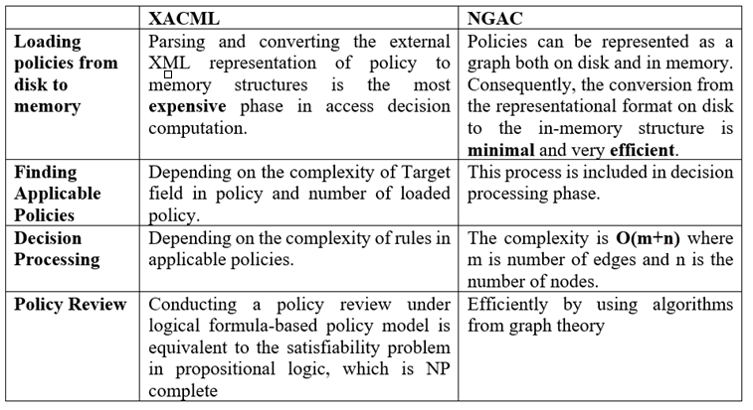
2. RELATED WORK
Comparison between XACML and NGAC
Notes:
Biswas, Sandhu, and Krishman have presented an attribute based protection model for JSON documents. Their approach is to add a new attribute called “securitylabel” to JSON elements and specify access control policies using these values. The advantage of the separation of labeling and authorization policies is that they can be specified and administered independently possibly by different level of administrators. However, the number of label assignments can be very large because it is calculated by the exponential function. Therefore, the space storage is a potential problem when the system is expanded.

Slide 9
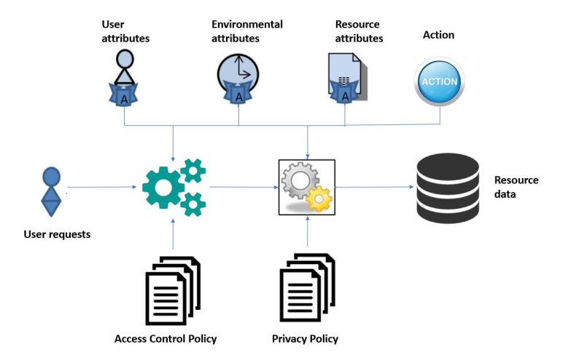
3. THE PROPOSED MODEL
General Attribute-based Policy Model

Slide 10
3. THE PROPOSED MODEL
Case Study:
Email and password field is hidden, birth date is shown only month and year, phone number is shown only the last three numbers when staff accesses Customer data with sharing purpose.
The user who has role is consultant can only view information of their own customer. The information includes year of birth date, city name in address field; the other fields are shown entirely.

Slide 11
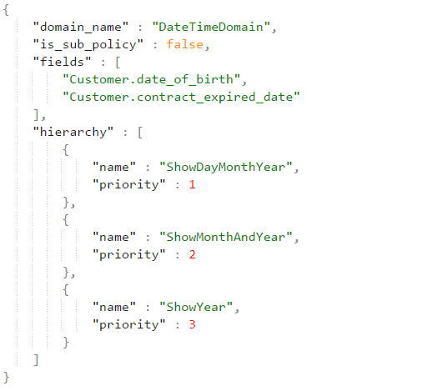
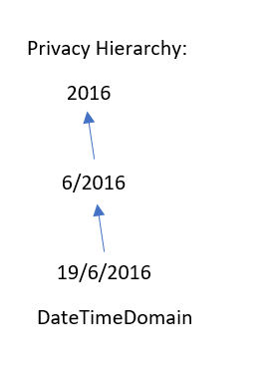
3. THE PROPOSED MODEL
Privacy Mechanism:
- Each field has its own domain. Each domain has multiple functions to support for privacy protection. Each function has its priority to solve conflict.

Slide 12
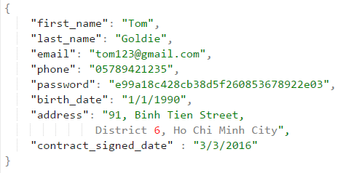
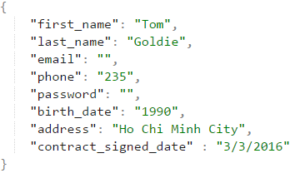
3. THE PROPOSED MODEL
Conflict Resolving:
Email and password field is hidden, birth date is shown only month and year, phone number is shown only the last three numbers when staff accesses Customer data with sharing purpose.
The user who has role is consultant can only view information of their own customer. The information includes year of birth date, city name in address field; the other fields are shown entirely.

Slide 13
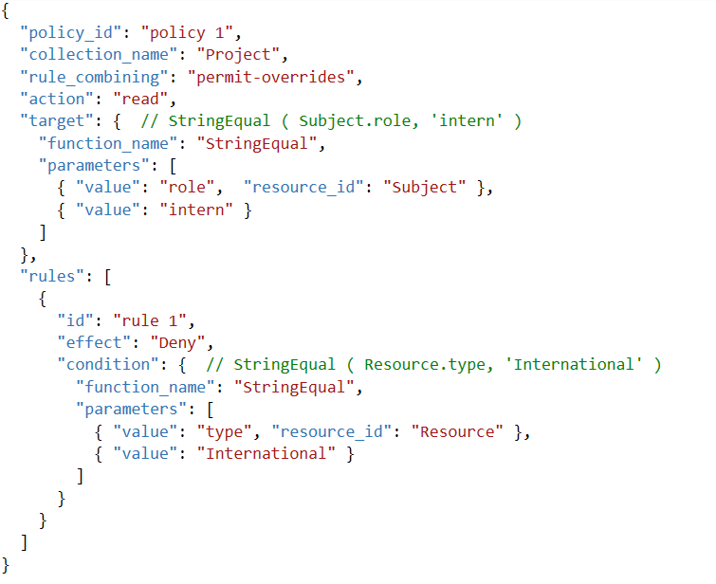
3. THE PROPOSED MODEL
Policy Structure:
Access Control Policy:
Example: Student interns can not access international projects.

Slide 14
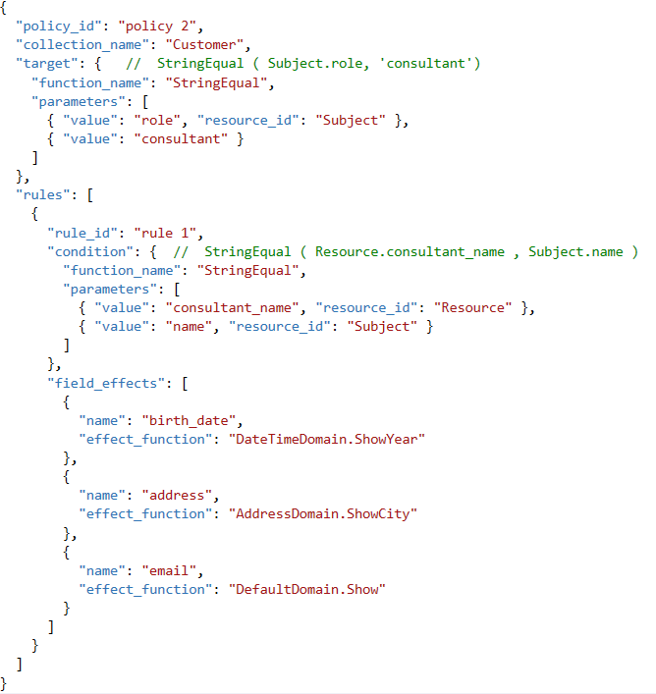
3. THE PROPOSED MODEL
Policy Structure:
Privacy Policy:
- The user who has role is consultant can only view information of their own customer. The information includes year of birth date, city name in address field; the other fields are shown entirely.

Slide 15
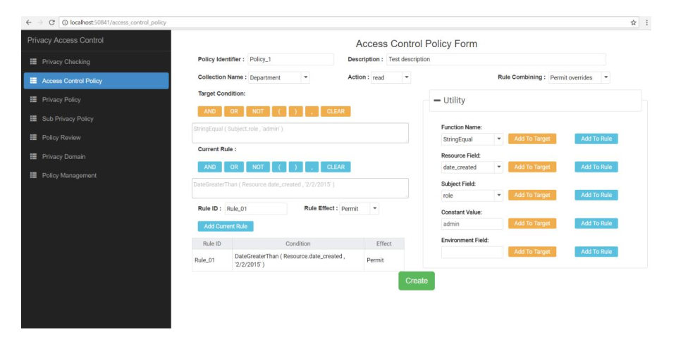
4. PROTOTYPE
UI for specifying Access Control Policy

Slide 16
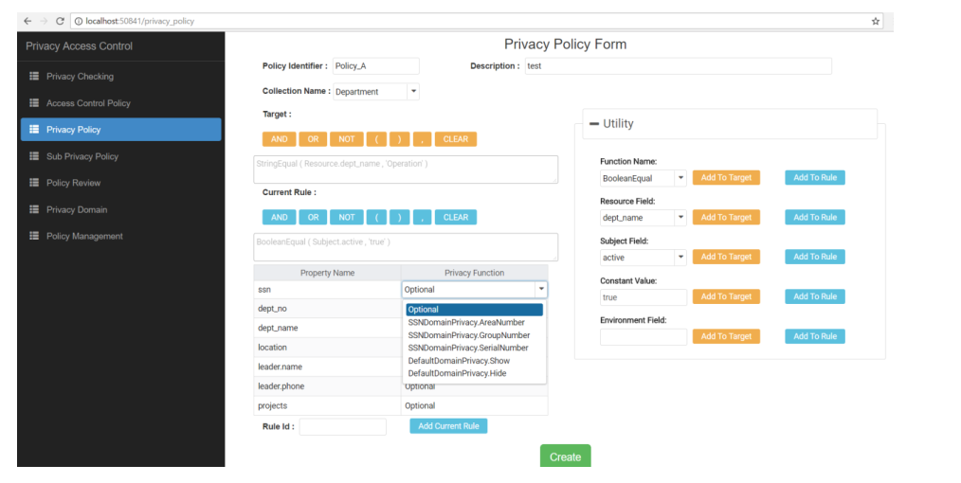
4. PROTOTYPE
UI for specifying Privacy Policy

Slide 17
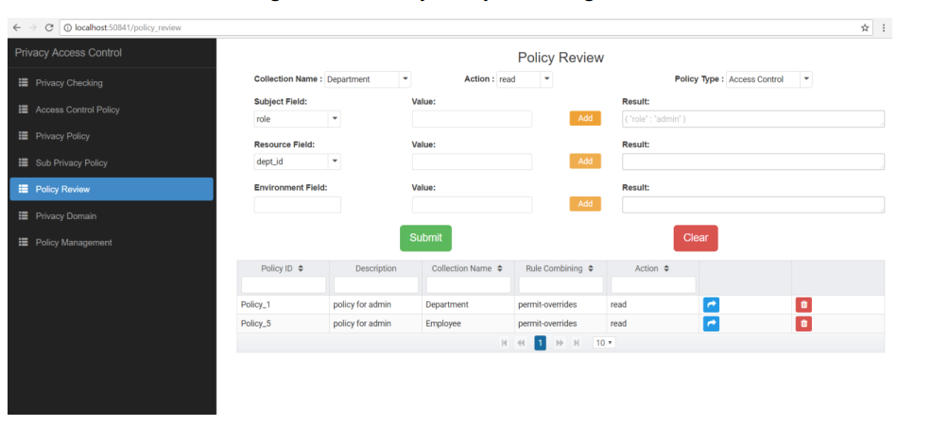
4. PROTOTYPE
UI for Policy Review

Slide 18
4. EXPERIMENT & EVALUATION
EXPERIMENT:
The performance of framework is evaluated based on three factors:
The complexity of policy.
The complexity of JSON data.
The quantity of JSON data.

Slide 19
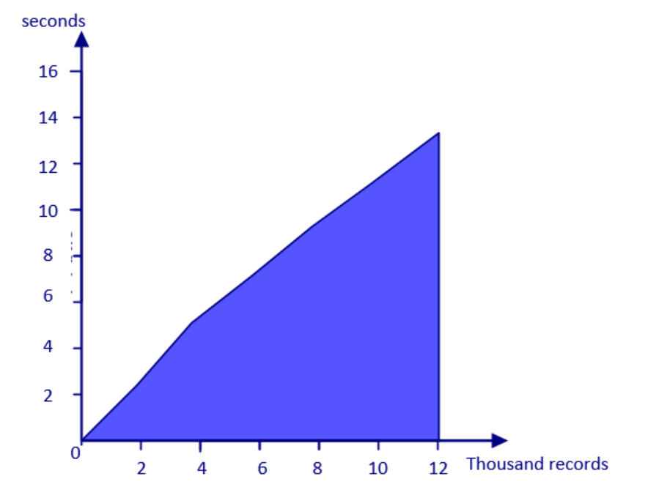
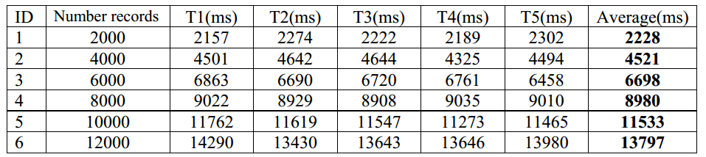
5. EXPERIMENT & EVALUATION
First experiment:
Increase the amount of data
JSON data contains single embedded document.
Five access control policies, five privacy policies. Each policy contains three rules and each rule contains five attributes.

Slide 20
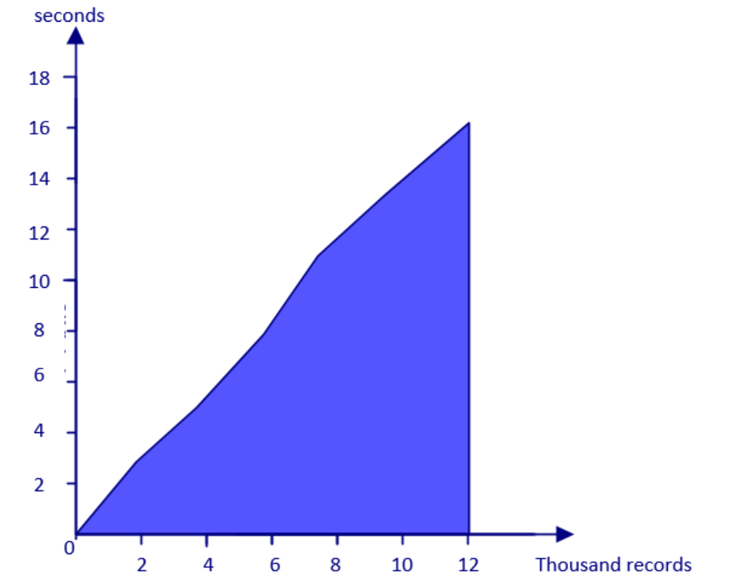
5. EXPERIMENT & EVALUATION
Second experiment:
Increase the amount of data
JSON data contains array of embedded documents.
Five access control policies, five privacy policies. Each policy contains three rules and each rule contains five attributes.

Slide 21
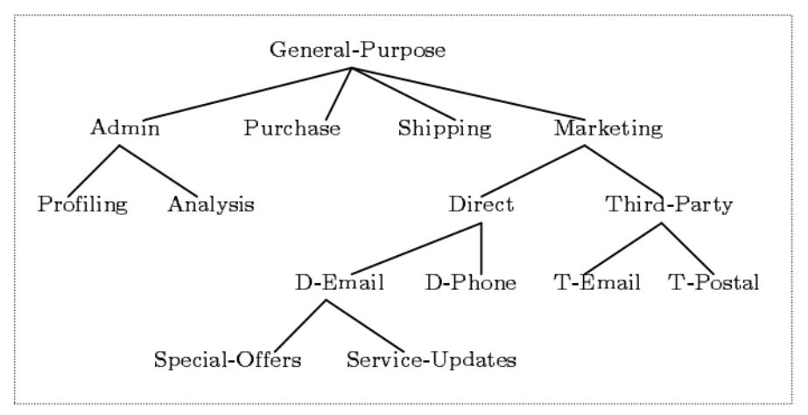
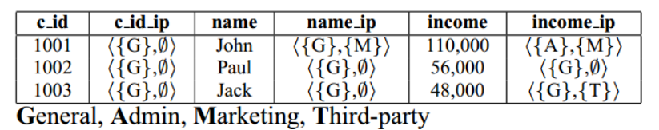
5. EXPERIMENT & EVALUATION
Evaluation:
Ji-Won Byun, Ninghui Li have presented an approach for privacy preserving access control based on the notion of purpose tree.
The size of data storage will be double.
A field has only a privacy value.

Slide 22
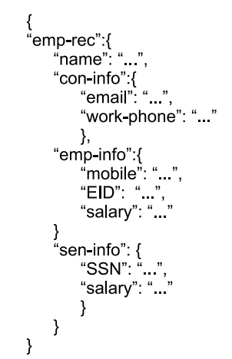
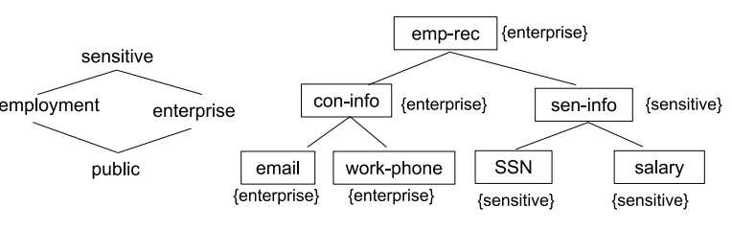
5. EXPERIMENT & EVALUATION
Evaluation:
Biswas, Sandhu, and Krishnan have presented an attribute based protection model for JSON documents. JSON elements are annotated with “securitylabel” attribute values with “labeling policies”..
=> Privacy rules are not specified dynamically.

Slide 23
5. CONCLUSION
Conclusion:
Proposed a comprehensive framework for enforcing attribute-based security policies stored in JSON document together with the feature of data privacy protection in the fine-grained level.
Supported privacy protection up to field-level for document data.
Developed a framework and an application for administrator to define and manage policies.
Future Approach:
Improve framework to work with other NoSQL database document stores.
Optimize the processing time by applying heuristic functions when evaluating conditional expression.

Slide 24
Thank you

