Slide 1


Introduction to Machine Learning
Jeffrey A. Chan Santiago

Slide 2
Goals
Introduce ML to a broader and general audience.
Cover the intuition behind of ML.
Help you to understand how to apply ML in your field.

Slide 3

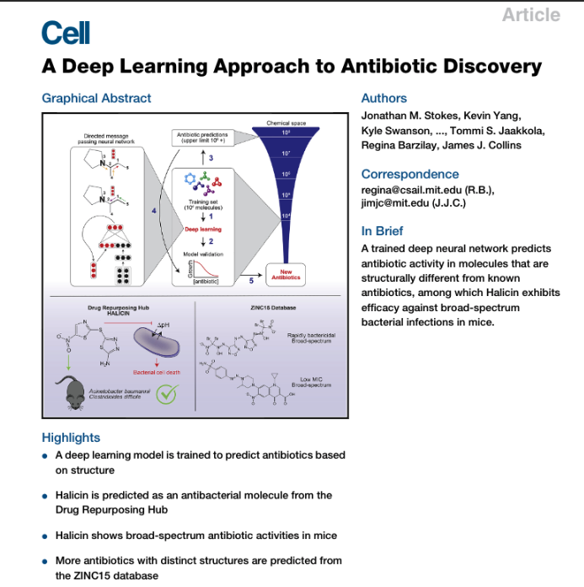
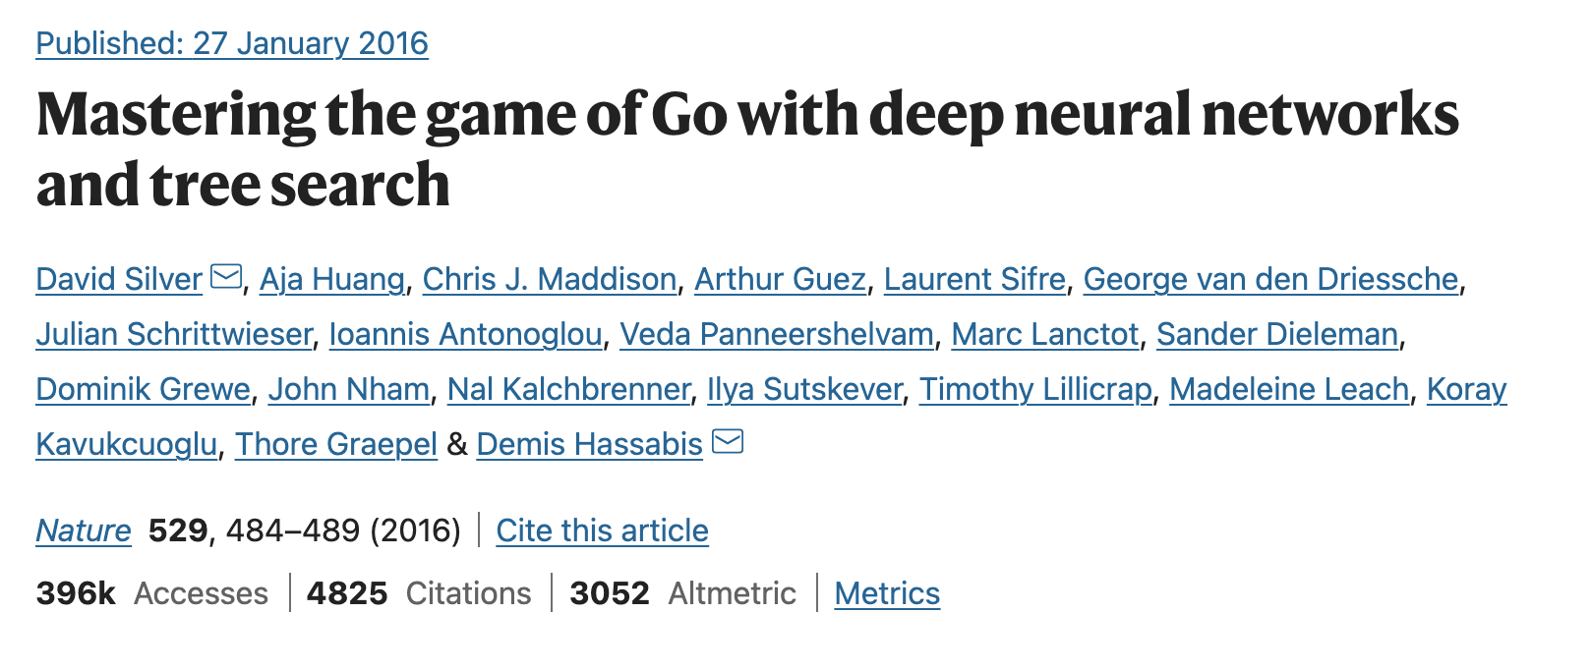
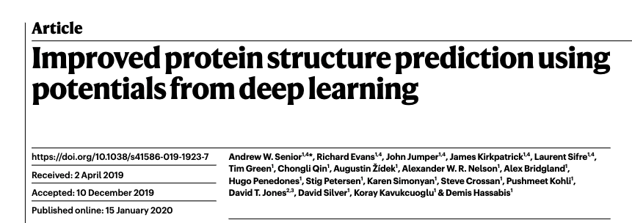
Applications

Slide 4
Population
Sample Data
Data Point
Probability
ML
Statistics

Slide 5
Population
Sample Data
Data Point
Statistics
ML
Puerto Rican median income
Prediction John’s income
Common words in spam email
Prediction of span email
Notes:
Alguien me pueden dar un ejemplo de esto en su campo de de studio?

Slide 6
Is today a good day to go to the Beach?
Good Day
Bad Day
Today
Rip Currents
Precipitation Probability

Slide 7
Is today a good day to go to the Beach?
Good Day
Bad Day
Today
Rip Currents
Precipitation Probability

Slide 8
Is today a good day to go to the Beach?
Good Day
Bad Day
Today
Rip Currents
Precipitation Probability

Slide 9
Is today a good day to go to the Beach?
Good Day
Bad Day
Today
Rip Currents
Precipitation Probability

Slide 10
Is today a good day to go to the Beach?
Good Day
Bad Day
Today
Rip Currents
Precipitation Probability

Slide 11
Good Features Matters
Good Day
Bad Day
Today
Rip Currents
Wind Speed

Slide 12
Type of learning
Supervised Learning

Slide 13
Type of learning
Supervised Learning
Unsupervised Learning

Slide 14

Type of learning
Supervised Learning
Unsupervised Learning
Reinforcement Learning

Slide 15
Basic Principles of ML

Slide 16
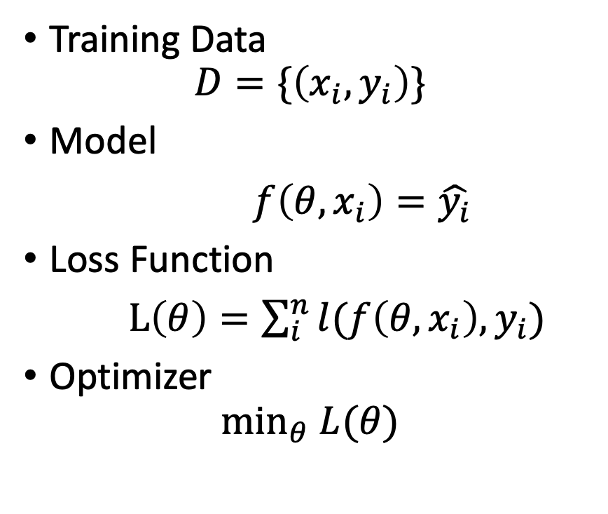


Machine Learning Components
Loss = 7.5
Loss = 4
Loss = 3
Training Data
$$D=\{\left(x_{i}, y_{i}\right)\}$$
Model
$f\left(θ, x_{i}\right)=\hat{y_{i}}$
Loss Function
$L\left(θ\right)=\sum_{i}^{n}{l(f\left(θ, x_{i}\right), y_{i})}$
Optimizer
$$\min_{θ} L(θ)$$
$$x_{2}$$
$$x_{1}$$

Slide 17


Training Model
Training Data
$$D=\{\left(x_{i}, y_{i}\right)\}$$
Model
$f\left(θ, x_{i}\right)=\hat{y_{i}}$
Loss Function
$L\left(θ\right)=\sum_{i}^{n}{l(f\left(θ, x_{i}\right), y_{i})}$
Optimizer
$$\min_{θ} L(θ)$$
$$L\left(θ\right)$$
$$θ$$

Slide 18


Is today a good day to go to the Beach?
Good Day
Bad Day
Today
Rip Currents
$$L\left(θ\right)$$
$$θ$$
Precipitation Probability

Slide 19
Is today a good day to go to the Beach?
Good Day
Bad Day
Today
Rip Currents
$$L\left(θ\right)$$
$$θ$$
Precipitation Probability

Slide 20
Is today a good day to go to the Beach?
Good Day
Bad Day
Today
Rip Currents
$$L\left(θ\right)$$
$$θ$$
Precipitation Probability

Slide 21
Is today a good day to go to the Beach?
Good Day
Bad Day
Today
Rip Currents
$$L\left(θ\right)$$
$$θ$$
Precipitation Probability

Slide 22
Is today a good day to go to the Beach?
Good Day
Bad Day
Today
Rip Currents
$$L\left(θ\right)$$
$$θ$$
Precipitation Probability

Slide 23
Model Evaluation and Generalization
Training Set
Trained model
Testing Set
Evaluation
Accuracy 1.0

Slide 24
Is today a good day to surf?
Good Day
Bad Day
Test Set
Swell size
Precipitation Probability

Slide 25
Is today a good day to surf?
Good Day
Bad Day
Test Set
Swell size
Overfitting
Precipitation Probability

Slide 26
Is today a good day to surf?
Good Day
Bad Day
Test Set
Swell size
Underfitting
Precipitation Probability

Slide 27
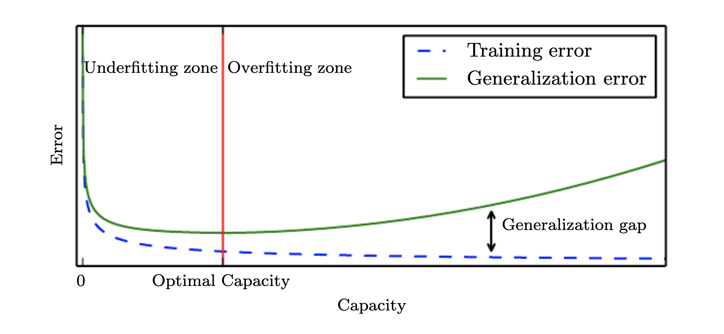
Overfitting

Slide 28
Code Demonstration
https://cutt.ly/fIsfsMX

Slide 29
Logistic Regression
Good Day
Bad Day
Test Set
Swell size
Precipitation Probability

Slide 30
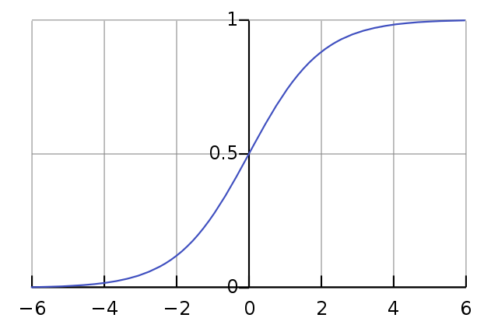
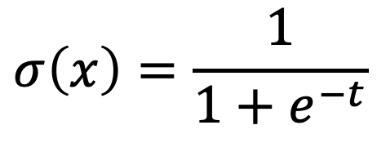

Logistic Regression
$$σ\left(x\right)=\frac{1}{1+e^{−t}}$$
$$t=w_{0}+w_{1}x$$

Slide 31
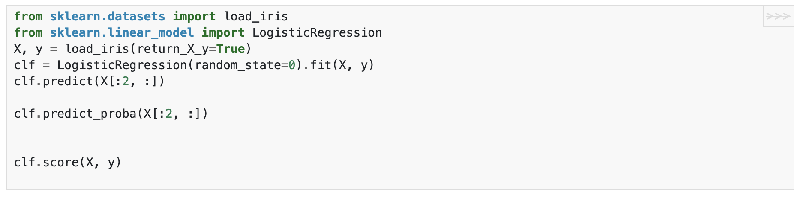
Code

Slide 32
K-Nearest Neighbors
Good Day
Bad Day
Test Set
Swell size
Precipitation Probability

Slide 33
3-Nearest Neighbors
Good Day
Bad Day
Test Set
Swell size
Precipitation Probability

Slide 34
5-Nearest Neighbors
Good Day
Bad Day
Test Set
Swell size
Precipitation Probability

Slide 35
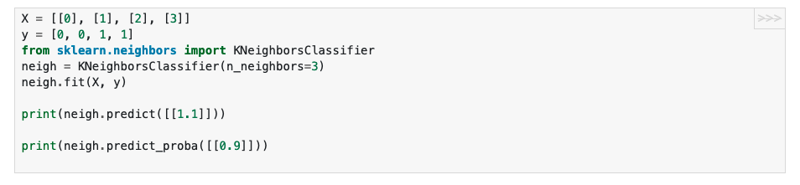
Code

Slide 36
Conclusion
Model learn from data.
Feature representation matters!
Test set helps to measure generalization.

