Slide 1

Air Quality Information
Week 11 Progress Update
April 4, 2024

Slide 2
Goal of the Capstone Project
The goal of the project is to is to provide people with information regarding air quality. A website will be created to inform people about air quality.
This can help the community by informing people about how air quality relates to their health and to their environment.

Slide 3
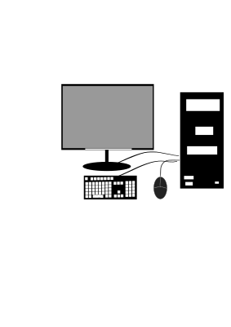
Resources Used
Github - Github can be used to store the files for the project as well as for verison control and easier collaborative team effort.
Github Pages - Pages allows for the website to be viewed on the internet.
React - React can help better organize the different parts of the website.
Google Documents - Google Documents can be used to write out the documentation needed for the project such as the Project Manual and Project Progress Documents.

Slide 4
Features
Feature | Feature Description | Software Used | Added, Improved, Already Existing, or Future Feature?
index.html | Informs the user about air quality | React, Github Pages | Added Feature
quiz.html | Allows the user to test out their knowledge after reviewing the website’s informative content | React, Github Pages | Added Feature
enivornmentalJustice.html | Informs the user about how air quality relates to the community. | React, Github Pages | Added Feature

Slide 5
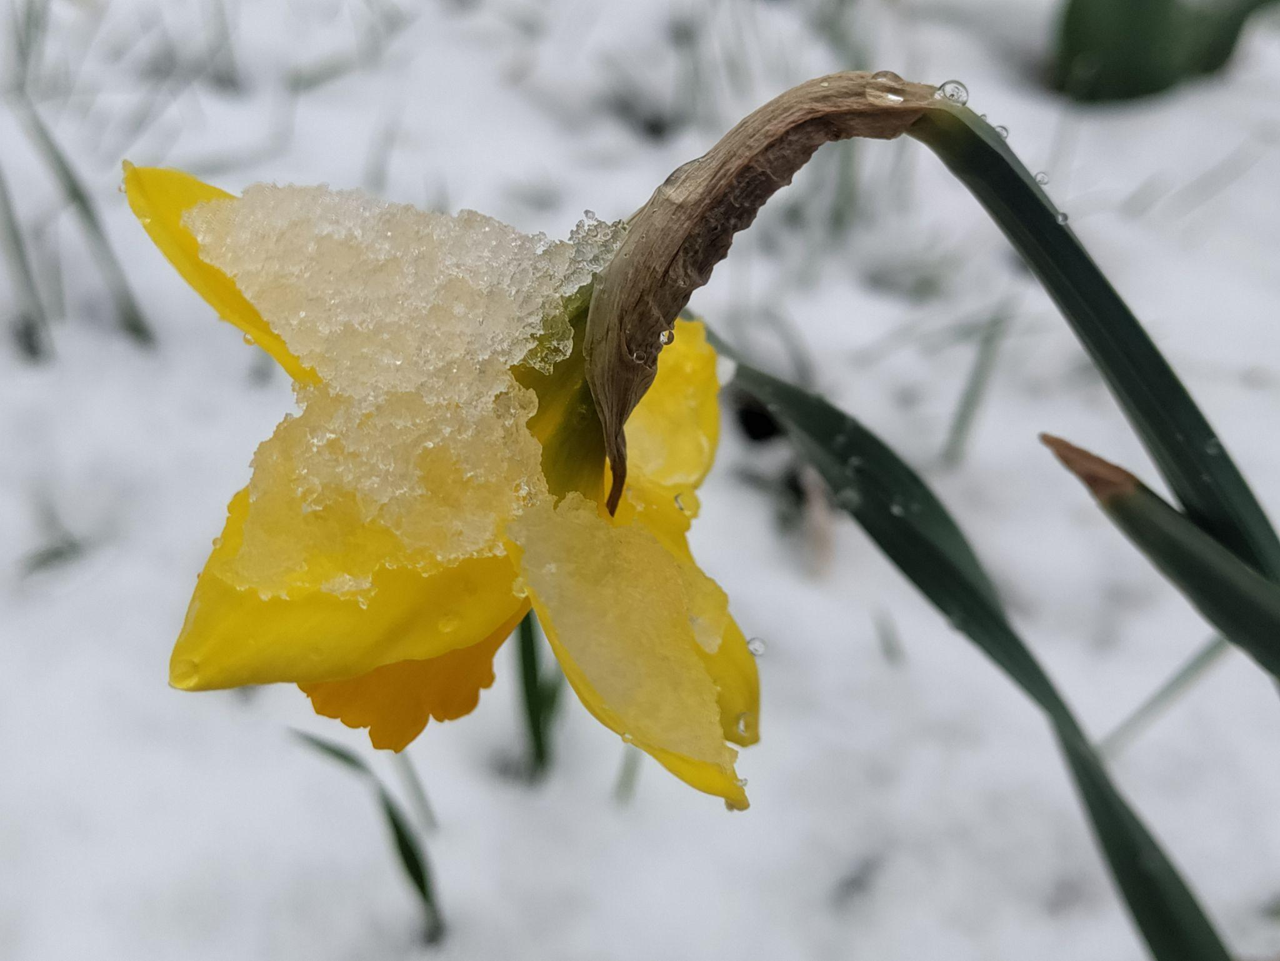
Test Planning
Although Google Chrome holds a huge share of the web browser market, it is important to check if one’s website functions on other browsers in order to include non-Google Chrome users. Testing potential web browsers include: Firefox, Duckduckgo, Edge, Safari, Brave, Vivaldi, Opera.
There should also be testing of the different features of the website’s navigation. Proper navigation is key for the functionality of the website.
Testing on mobile devices.

