Slide 1
Developing an App to collect data for people at risk of Alzheimer’s Disease
Yuan Shang
TA mentor:Michael Romano
CS6440, Spring 2024

Slide 2
Background
Alzheimer’s Disease (AD, here and after) is a chronic neurodegenerative disease and the most common cause of dementia.
The early signs of the disease include forgetting recent events or conversations. Over time, it progresses to serious memory problems and loss of the ability to perform everyday tasks. This whole process may last for over 20 years.
Timing of interventions to the disease are very critical to the clinical outcomes. However, there is no satisfying tool for the early diagnosis.
Linguistic performance has been shown to be useful as an early biomarker of AD.
A convenient tool that record the linguistic performance would largely fill the gap by: 1. Collect huge amount data of audio data, 2.establish the relations between audio data and cognitive function.

Slide 3
Development
The web based app:
Python flask as the development environment.
Python sqlite database to save data
Python fhirclient to communicate with FHIR server

Slide 4
Demo

Slide 5
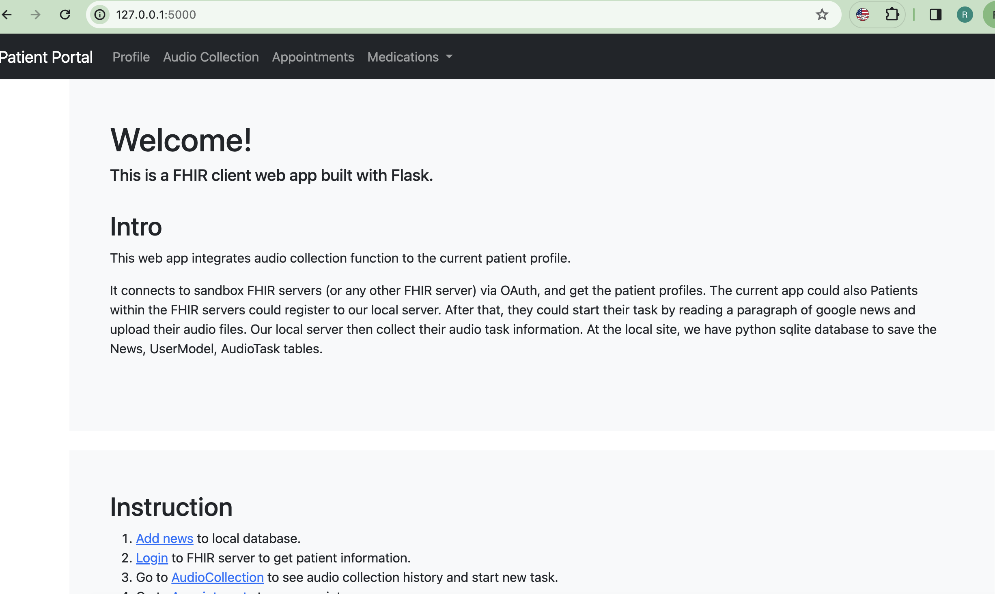
Welcome

Slide 6
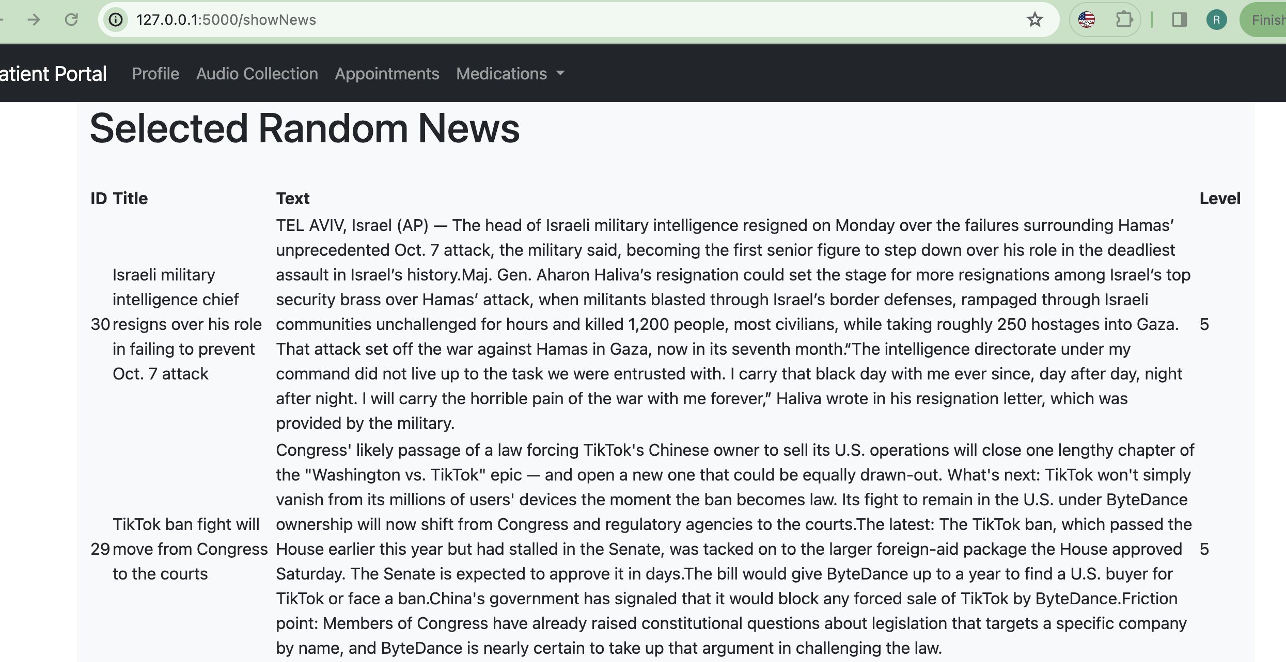
Show random news

Slide 7
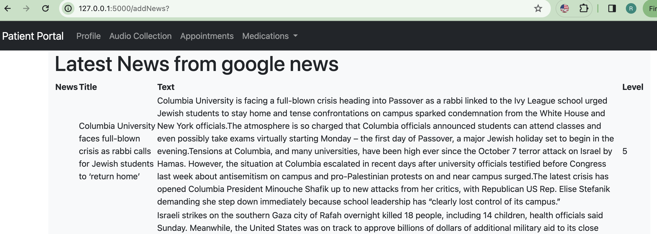
Add new google news

Slide 8
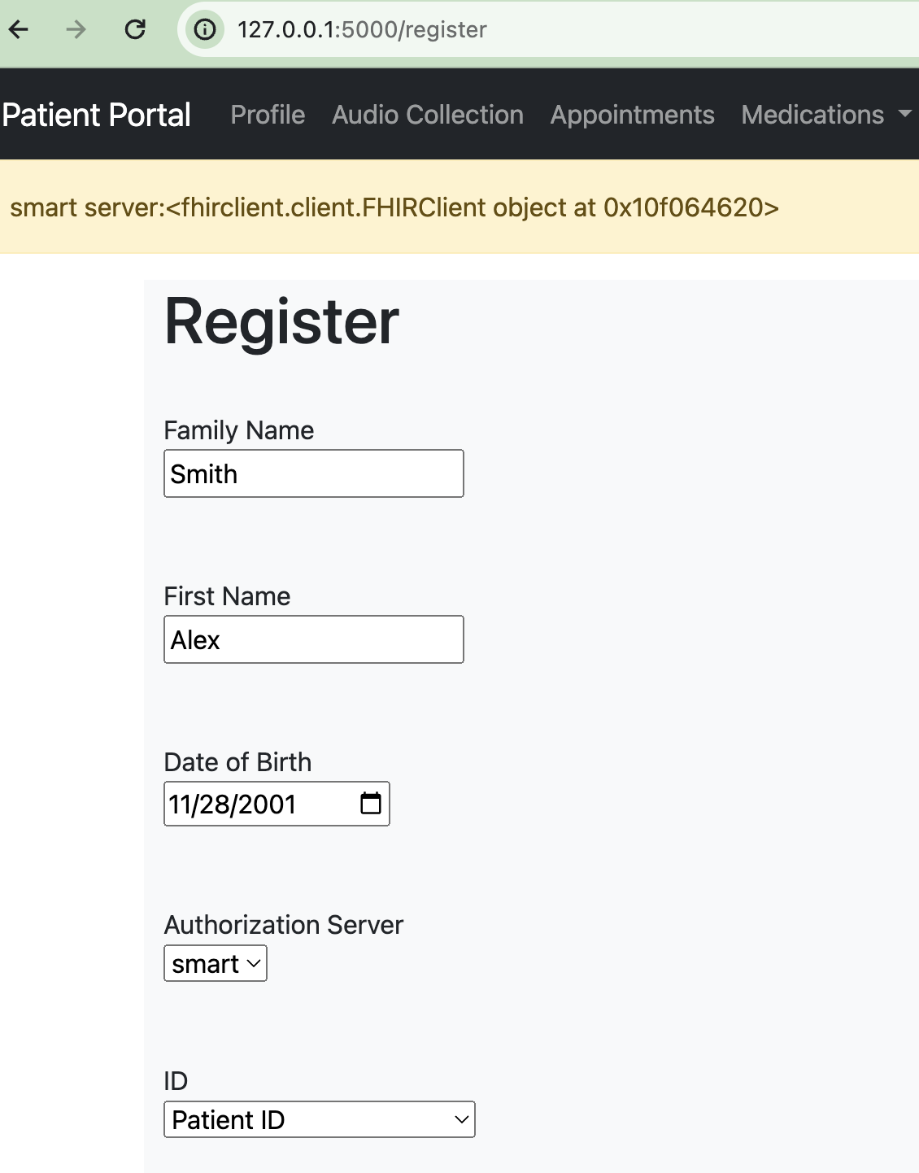
Patient registration
First check patient in FHIR. Only patient authorized at FHIR could register in the server

Slide 9
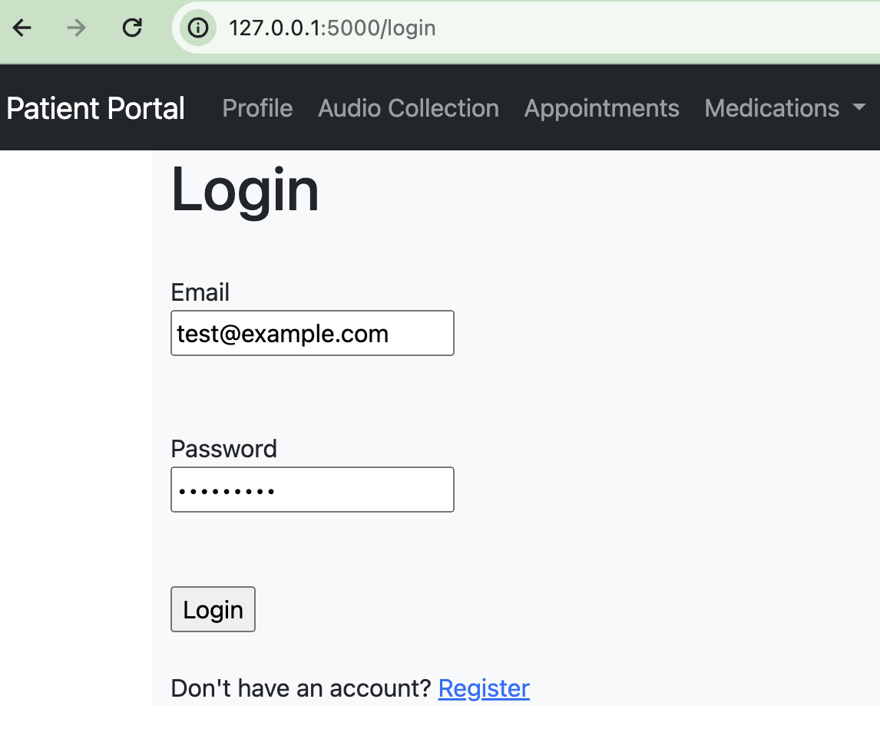
Patient login
Returning patient could login with their email and password

Slide 10
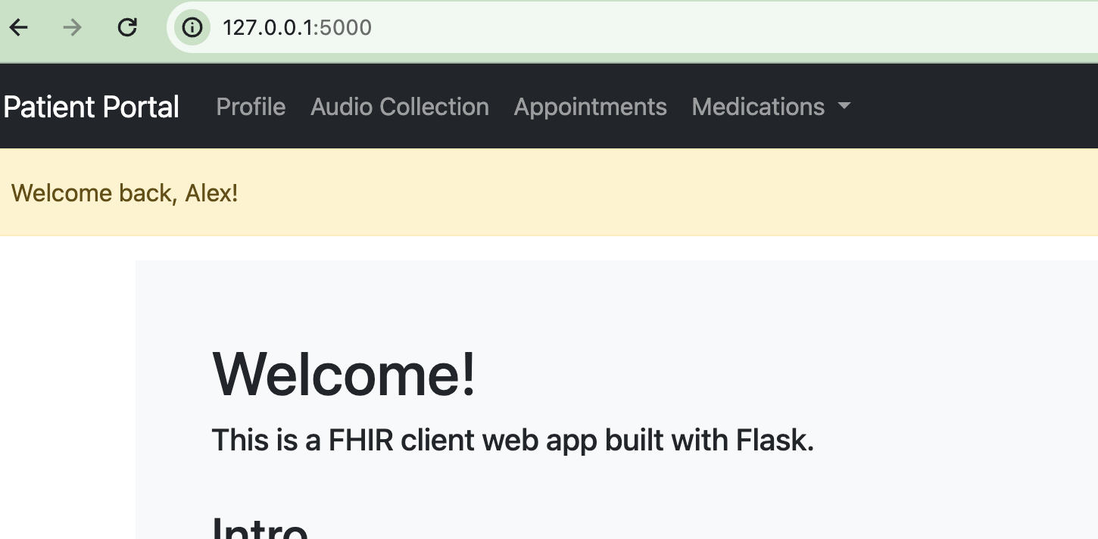
After login, show login credential

Slide 11
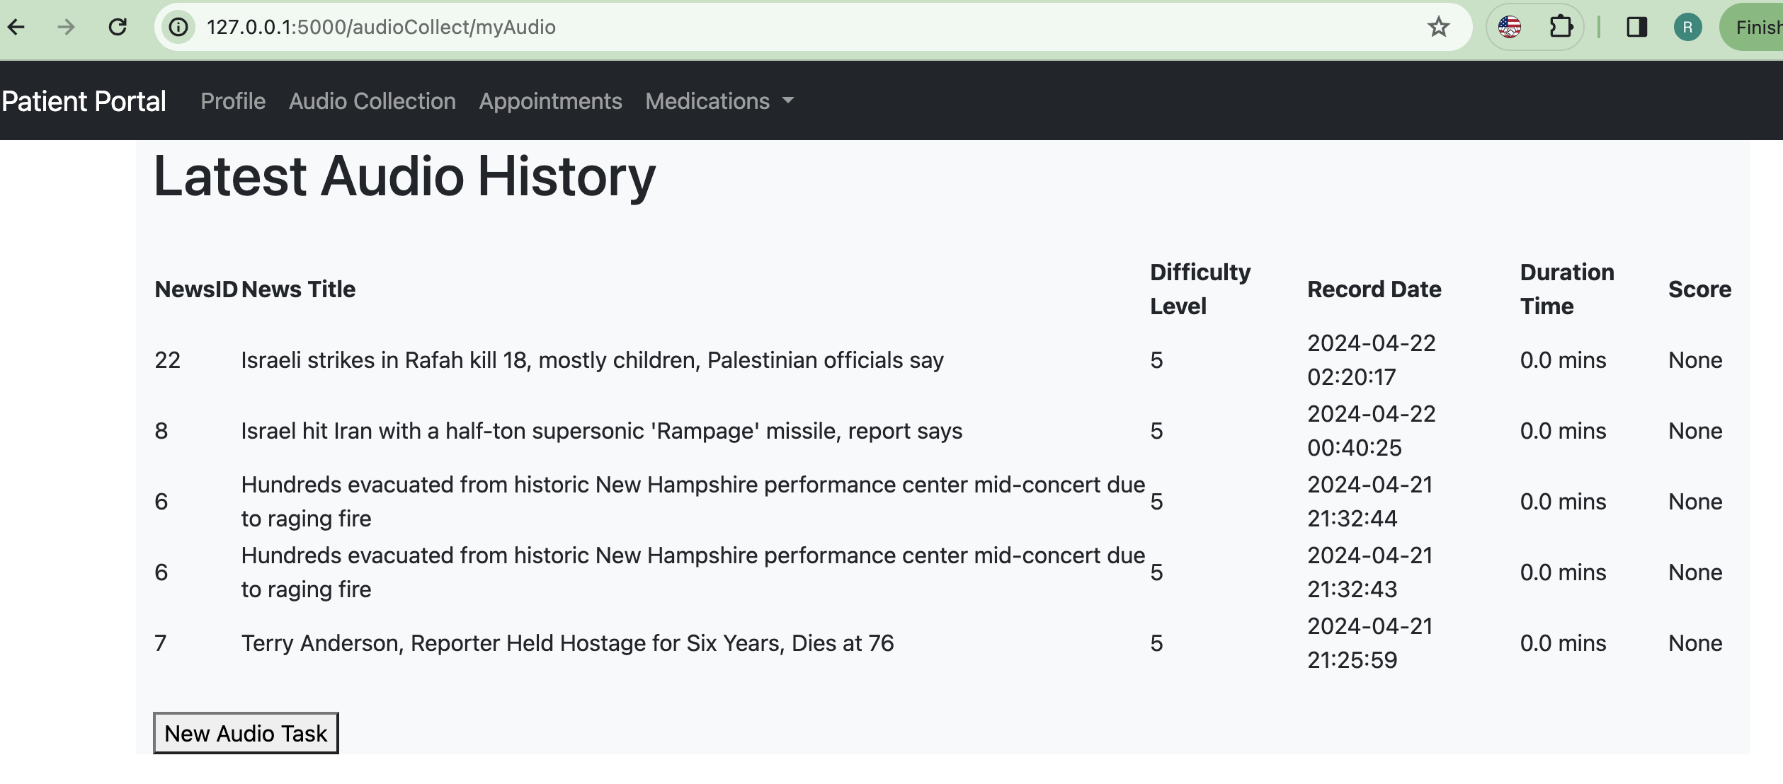
Audio task history for the current patient

Slide 12
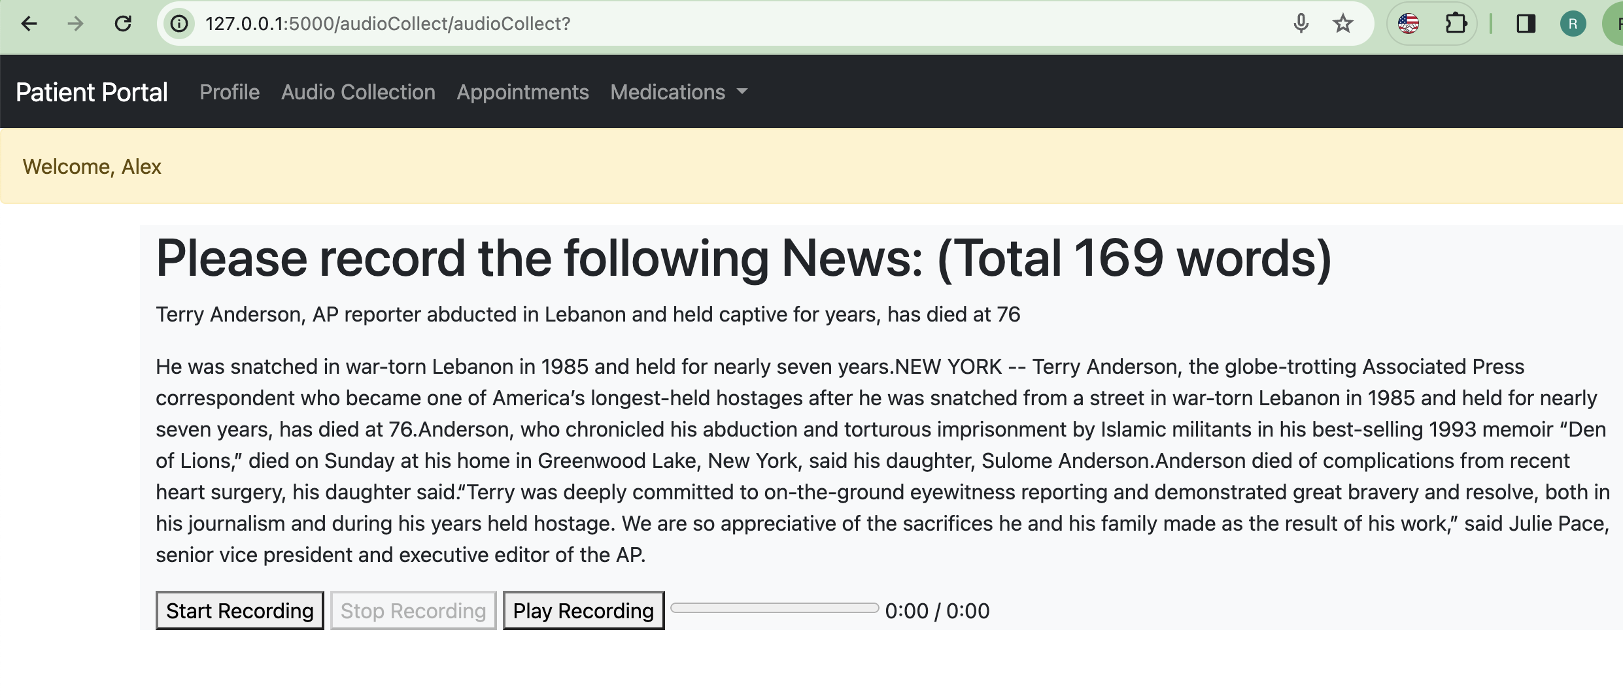
New Audio task for the current patient

Slide 13
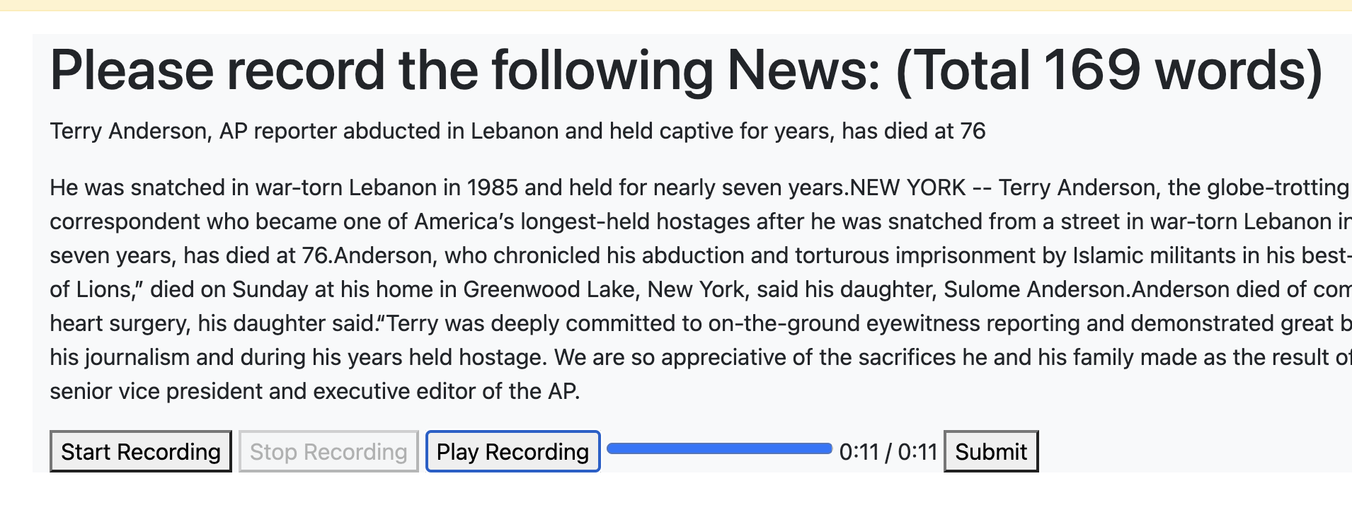
Play recorded audio before submit

Slide 14
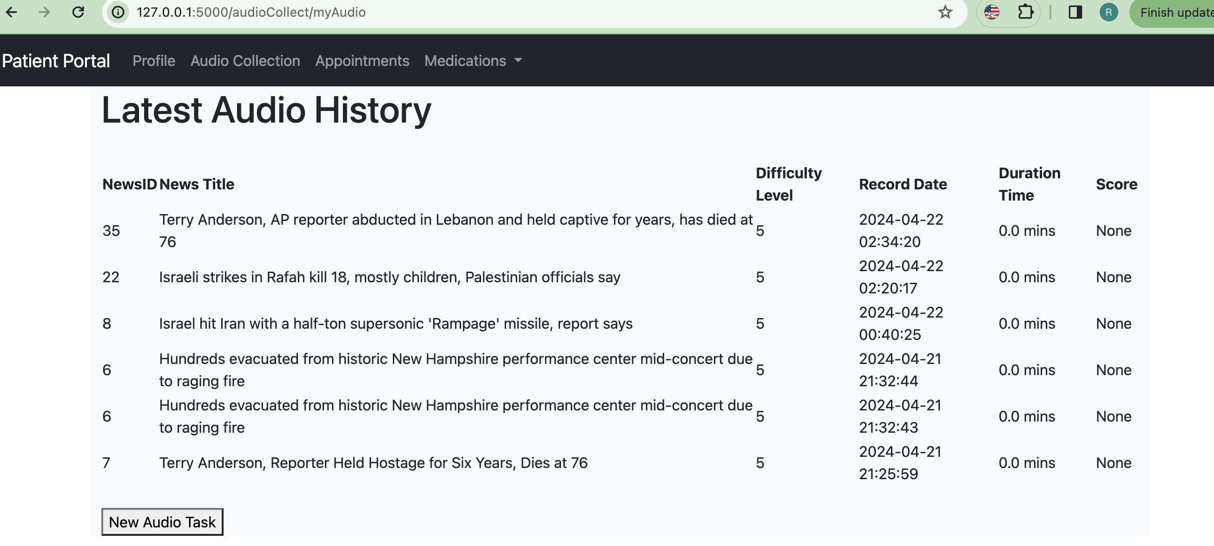
Updated audio history

Slide 15
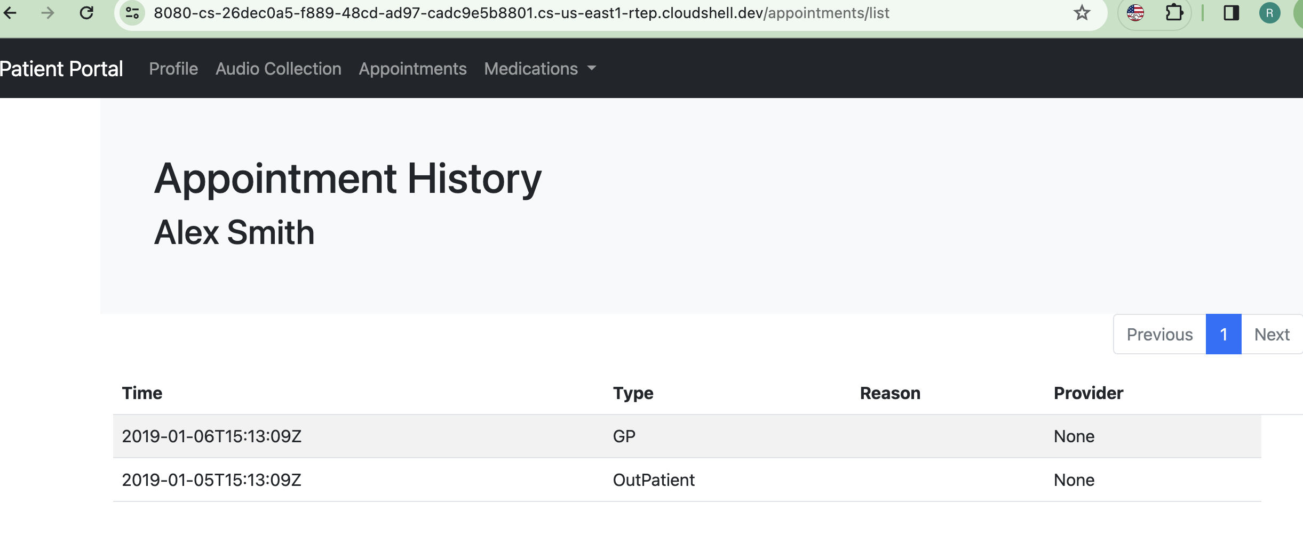
Others: appointments
Local test: Error; Google cloud test: no error

Slide 16
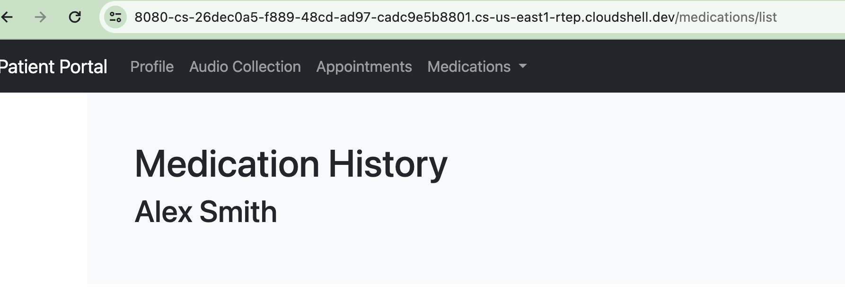
Others: medications

Slide 17
Thanks!

