Slide 1
FPGA Multi Effects Unit
Raymond Fleming
Digital Design
Fall 2018

Slide 2
Guitar Effects
Distortion
Overdrive
Fuzz
Modulation
Filter
Wah
Time
Chorus
Delay/Echo

Slide 3
Using the DE1-SoC
Code was used from Altera/Intel's tutorial lab 12
Written mostly in Verilog
Used to configure the Wolfson WM8731 24-bit CODEC.

Slide 4
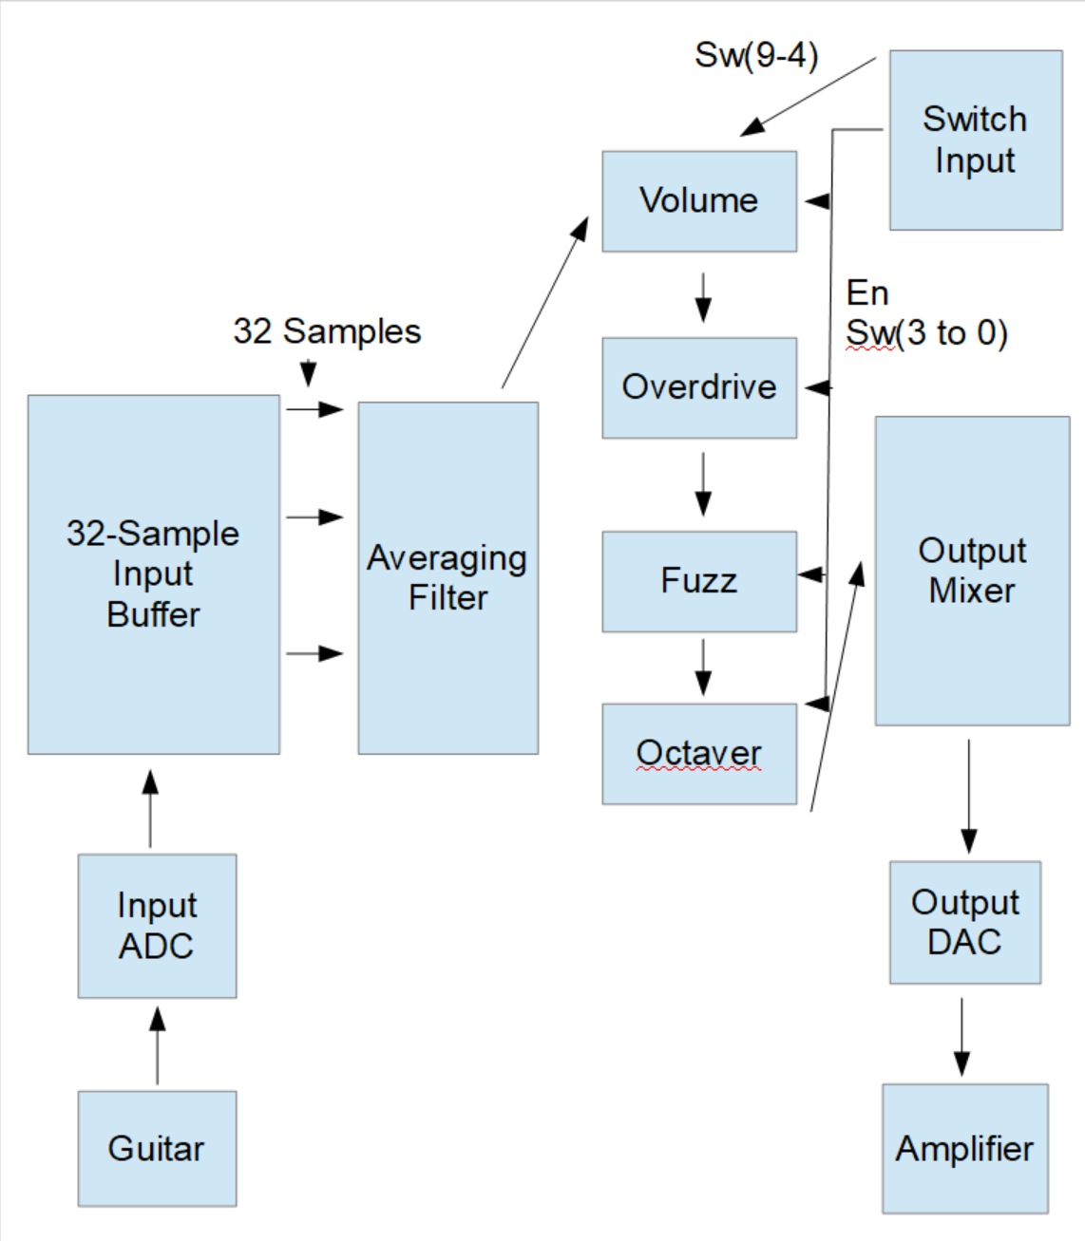
Block Diagram

Slide 5
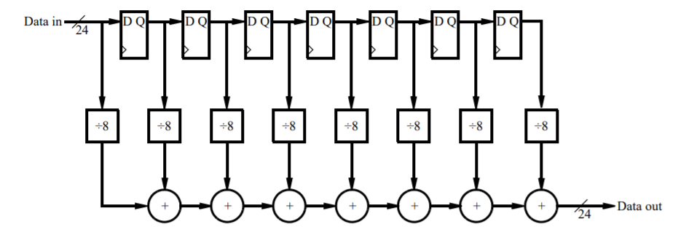
Noise Reduction
The input was found to be noisy. A 32-bit averaging filter was used to reduce noise.

Slide 6

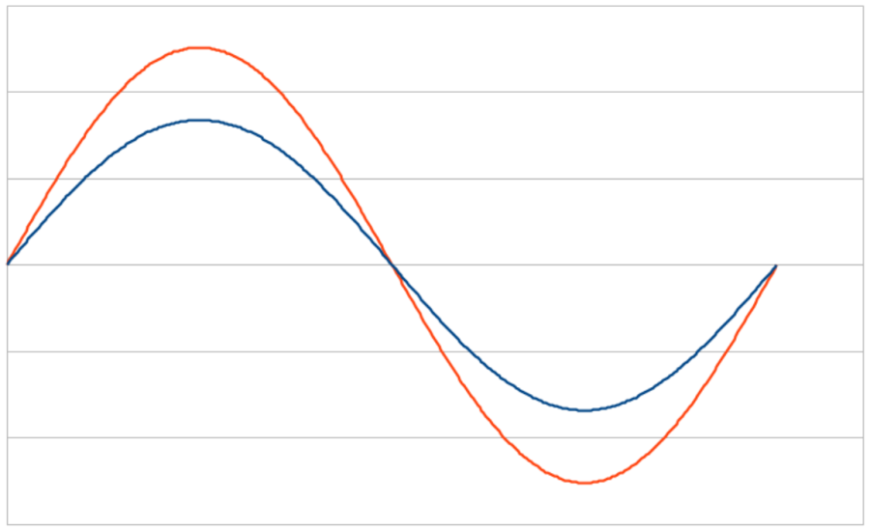
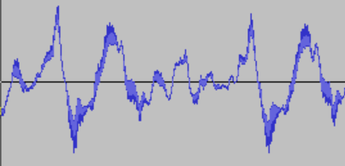
Volume
Volume/Boost effect
Equivalent to a preamplifier.
Output = Input * Multiplier

Slide 7

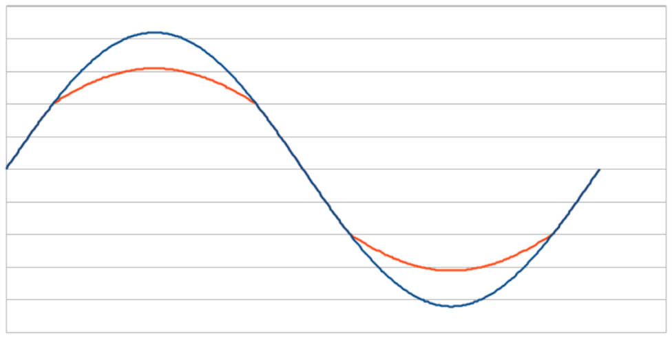
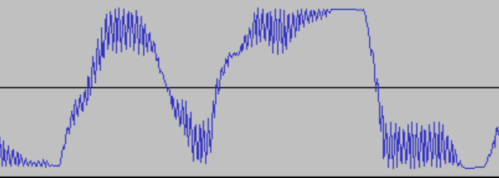
Overdrive
Soft-Clipping Effect
The top of the wave is squashed, rather than clipped.
Output=cutoff-(input-cutoff)/2 for clipped section

Slide 8

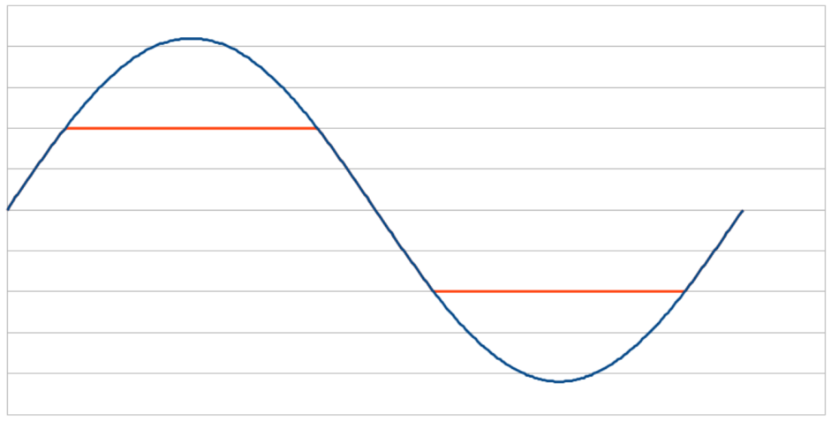
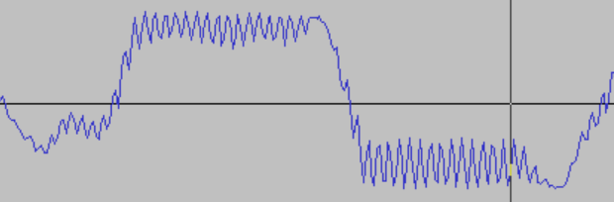
Fuzz
Hard-Clipping Effect
Implemented by clipping the top off the input
Output=4,000,000 if input > 4,000,000

Slide 9

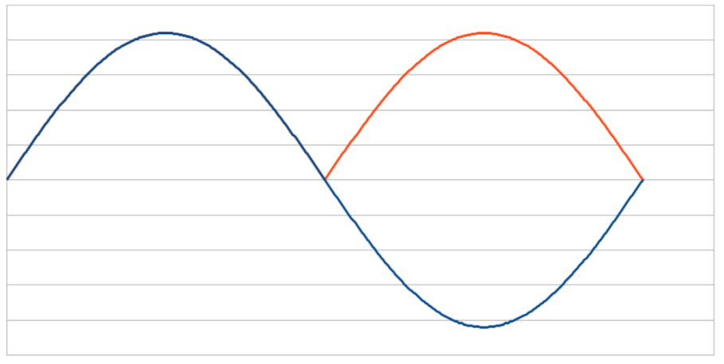
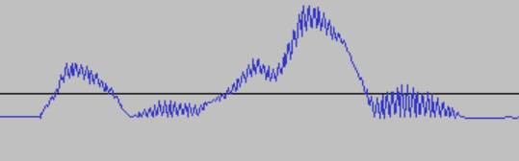
Octaver
Frequency Doubler Effect
Modeled on analog octaver, which is a full wave rectifier.
Output=Input when positive, -Input when negative

Slide 10
Testing
The circuit was designed to use the slide switches for both volume input and to select the effects
The circuit was tested through a PC playing a clean guitar loop

Slide 11
Further Effects
Time based effects could be added to the project with more time.
Reverb can be implemented using a large buffer, playing back signals after a delay with some signals played in reverse.
Chorus can be implemented by playing closely spaced samples mixed together, giving some constructive and destructive interference.

Slide 12
Delay/Echo
Delay is similar to reverb, but with no reversed samples.
With a longer delay, this is also an echo effect.

Slide 13
Chorus
Chorus can be implemented using a smaller buffer, then playing back samples at closely spaced times.
The times are given by a low frequency oscillator, effectively a counter.
These samples provide constructive and destructive interference, giving a chorus sound.

