Slide 1





Front-End
Back-End
AWS EC2
App
Send
Request
Send
Msg
Port:
3306
Display
Data
Return
Response

Slide 2
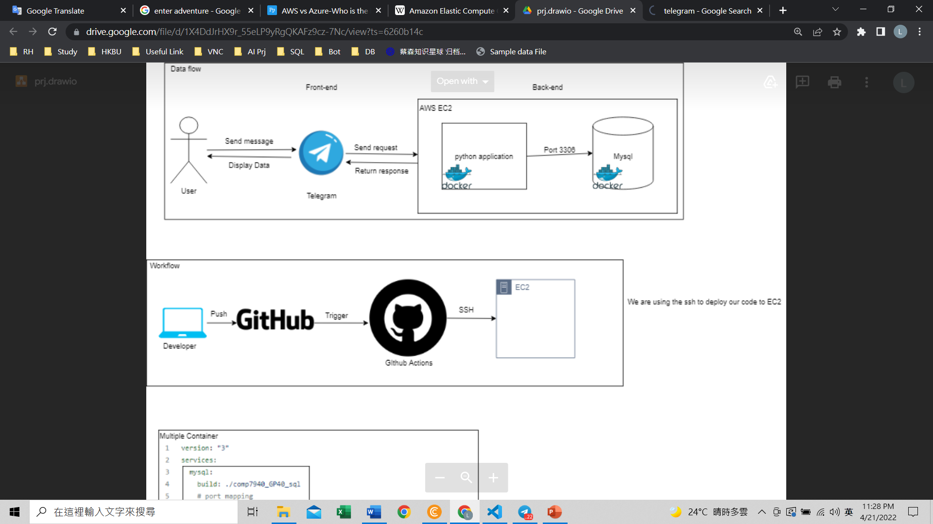

Slide 4

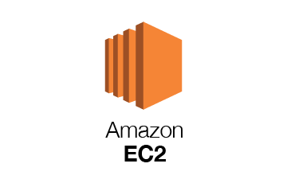



Use SSH to
deploy our
code to EC2
SSH
Trigger
Push

Slide 5
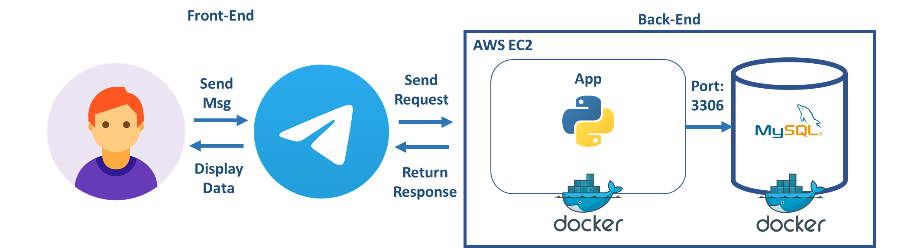

Slide 6




Targets are specified by
instance ID
Protocol: Geneve
Port: 6081
AWS Gateway
Load Balancer

Slide 7
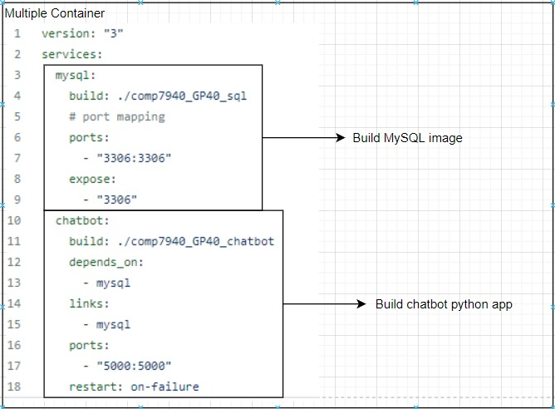

Slide 8
