Slide 1
Optimising Technical Analysis Trading Strategies
Raymond Ward
RW468

Slide 2
How much I achieved
I have completed all tasks, code runs and produces results
I decided to calculate all the technical indicators and signals using Java
All technical analysis and signal calculations in Analysis.java
All trading functions in Trader.java
Writing / Reading files and main function in Base.java
GA simulation in Genetics.java
Helper functions in Helper.java
All calculated indicator and signal values in UnileverStats.txt
Best Individual of each simulation run saved in results.txt

Slide 3
Difficulties and Successes
Difficulties | Successes
Debugging was quite tough and complex | Consistent profit!
Tuning the genetic algorithm (A lot of values to try, kept getting stuck in local maximum) | Overall average of ~40% return over 1320 trading days
Verifying correctness of technical indicators | I think my code is clean and tidy and separated into classes which make sense.
Does not do as well as buy & hold: Buy & hold: £5145.28 My best result: £4436.82

Slide 4
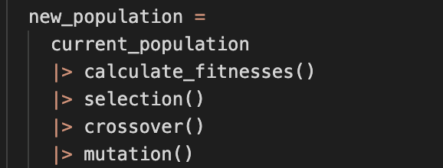
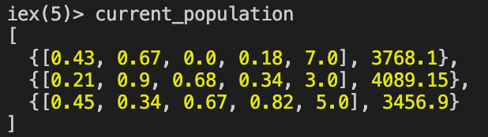
Changes I would make next time
I would use a different programming language such as Elixir as it allows you to create a nice flow to the code, one array can store all the data you need instead of having multiple arrays and the immutability means it is very difficult to fall into the trap of not using the correct population for the evolutionary operators.
Maybe use excel to calculate the technical indicators, a lot more work to calculate these in Java.
Use different crossover / mutation methods (i.e., not just single point crossover and mutation)

Slide 5
Best Results
Wealth (£) | EMA Signal Weight | TBR Signal Weight | VOL Signal Weight | MOM Signal Weight | Trade Amount
4436.82 | 0.0 | 0.83 | 0.0 | 0.83 | 6.0
4377.12 | 0.0 | 0.77 | 0.77 | 0.0 | 6.0
4197.35 | 0.0 | 0.01 | 0.0 | 0.01 | 5.0
I found that the highest wealth above was not reached at the end of a simulation as often as I would have liked / expected.
I attempted to change various parameters such as mutation chance(exploration), elitism proportion (exploitation) but it was still only rarely reached.
I was surprised that this did not perform as well as buy and hold.

Slide 6
GA Parameters
Population size | Mutation chance | Crossover chance | Elite proportion | Tournament K | Generation count | Average wealth £ (50 runs) | Notes
500 | 0.25 | 0.9 | 0.001 | 8 | 350 | 4203
1000 | 0.25 | 0.9 | 0.001 | 8 | 350 | 4243 | This increased the wealth (0.9%) but increase computational time massively.
1500 | 0.25 | 0.9 | 0.001 | 8 | 350 | 4260 | From this point I used population size 750 as this row proves population size relates to wealth generated but I had to balance this with computational time.
750 | 0.4 | 0.9 | 0.001 | 8 | 350 | 4159
750 | 0.25 | 0.75 | 0.001 | 8 | 350 | 4256 | As this increased the average wealth, I now changed the crossover rate to 0.75.
750 | 0.25 | 0.75 | 0.01 | 8 | 350 | 4207 | My final parameters are the ones in the above row.

Slide 7
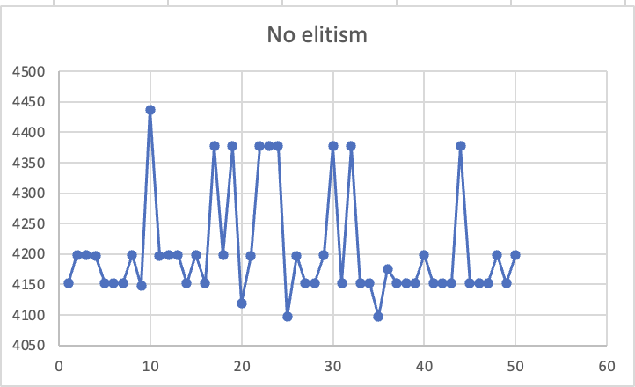
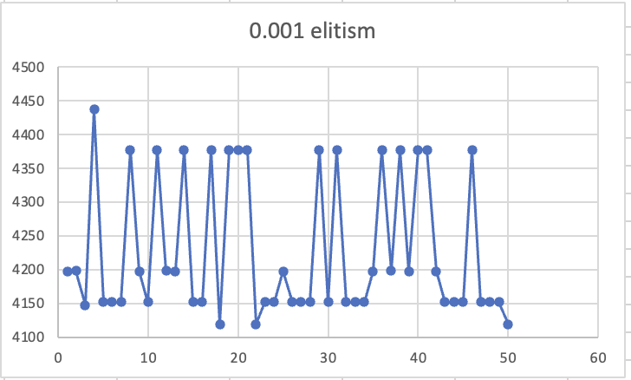
Additional Methods
Elitism – Keeping the fittest x% from the previous generation, this means the fitness never goes down.
I found any elitism proportion above ~0.005% caused too much exploitation and would reduce the average wealth generated. I think this is because the global maximum weights are quite different compared to the local maximum.

