Slide 1

Raymundo Gutierrez, 21
Software Development Student
Emission Monitoring
Integral System
In Spanish:
Sistema Integral de Monitoreo de Emisiones

Slide 2


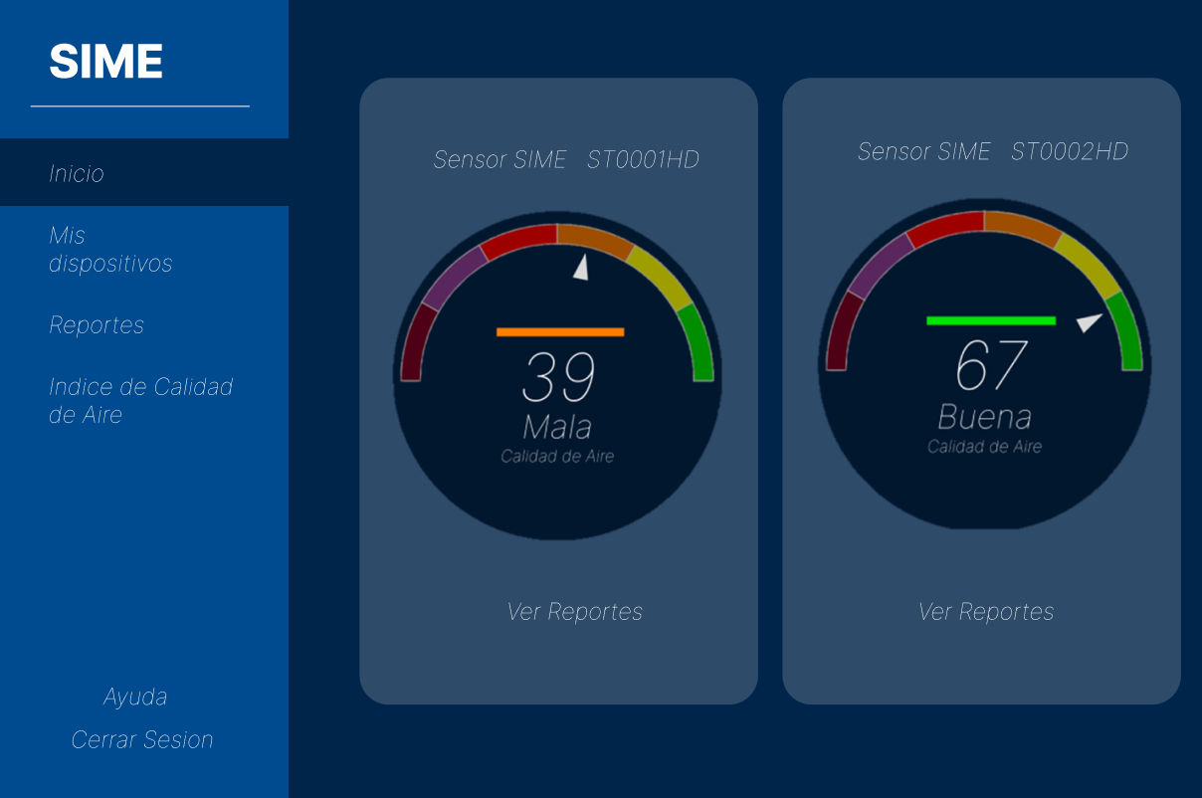

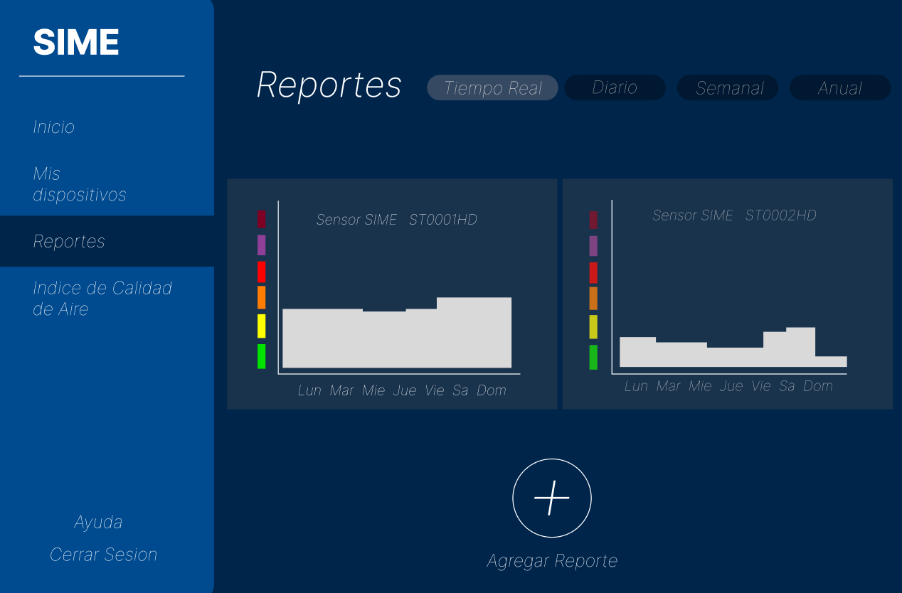
FILTER
TASKS:
- SOFTWARE
- SOURCING SENSORS
- ESTABLISHING CONNECTION

Slide 3
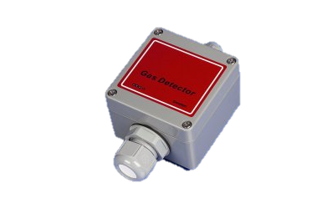
Sensors Needed:
- Air Quality Sensor (VOC)
- Carbon Dioxide Sensor (CO2)
- PM 10, PM 2.5 Sensor
- Nitrogen Dioxide Sensor (NO2)
- Sulfur Dioxide Sensor (SO2)
60-85ºC
(140-185°F)
700 ºC
(1292°F)

