Slide 1


The Portfolio-Driven Disposition Effect LI AN, JOSEPH ENGELBERG, MATTHEW HENRIKSSON, BAOLIAN WANG, and JARED WILLIAMS *
邓湘雯 董默涵 张天柱
2026.4.30

Slide 2
Contents
1
Research Background and Problems
2
Research Design
3
Empirical Evidence
4
Critical Thinking

Slide 3
Disposition Effect
Investors are more likely to sell an asset when it is at a gain than when it is at a loss (Shefrin and Statman (1985))
Standard explanations for the disposition effect—such as tax considerations, portfolio rebalancing, and informed trading—have been proposed and dismissed
Investor Preferences + Narrow framing(Thaler et al. (1997))
Consider an investor with three stocks: X1 , X2 , and X3.
The disposition effect :Pr(Xi is sold|Xi is at a gain) > Pr(Xi is sold|Xi is at a loss) for all i.
Preferences over each individual stock: three independent probabilities statements.
Preferences depend in part on portfolio performance: disposition effect for Stock X1 to depend on the state of the remaining portfolio (X2 and X3).

Slide 4
Core research issue
Does the stock-level disposition effect depend on the portfolios they hold?

Slide 5
Contents
1
Research Background and Problems
2
Research Design
3
Empirical Evidence
4
Critical Thinking

Slide 6
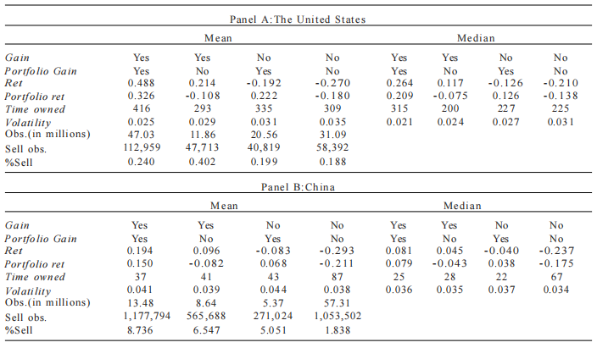
Four independent samples
78,000 households in the Barber and Odean (2000) data set;
97,000 investors in a Chinese brokerage data set;
2,300 U.S. participants in an Amazon Mechanical Turk trading game experiment;
800 experimental participants at a Chinese university.

Slide 7
Empistical Model
Cox (1972) proportional hazard model
Condition | Gain | Portfolio Gain | Probability of selling | Disposition effect
1 | loss（0） | portfolio loss（0） |  | -
2 | profit（1） | portfolio loss（0）
3 | loss（0） | portfolio profit（1） |  | -
4 | profit（1） | portfolio profit（1）
Compared to the linear probability model, Cox proportional hazard model: the ratio of the two should be immune to the change of turnover (Feng and Seasholes (2005));
Fixed effects or stratiﬁcation: the baseline hazard function of is allowed to vary across strata.

Slide 8
Contents
1
Theoretical Background
2
Research Discovery
3
Empirical Evidence
4
Critical Thinking

Slide 9
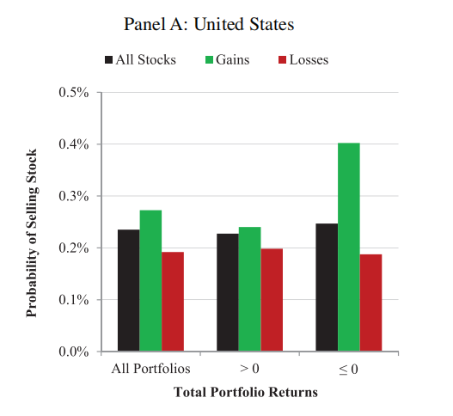
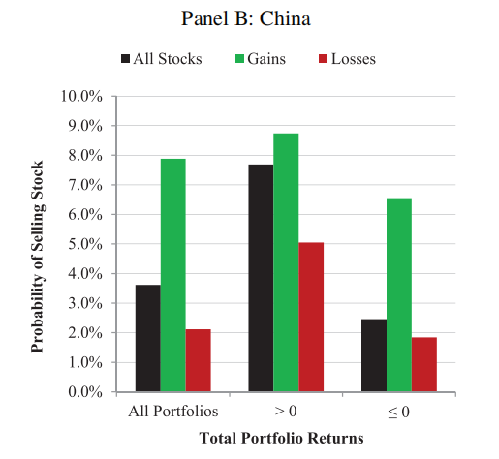
A.Univariate Results

Slide 10
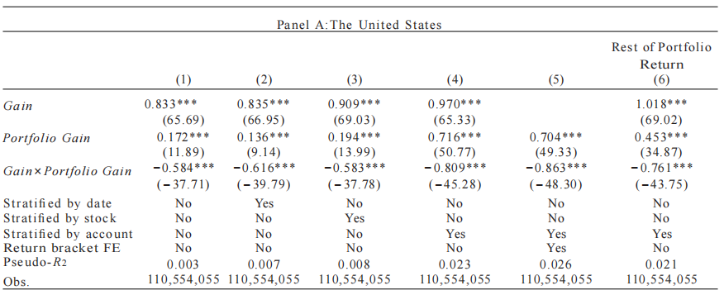
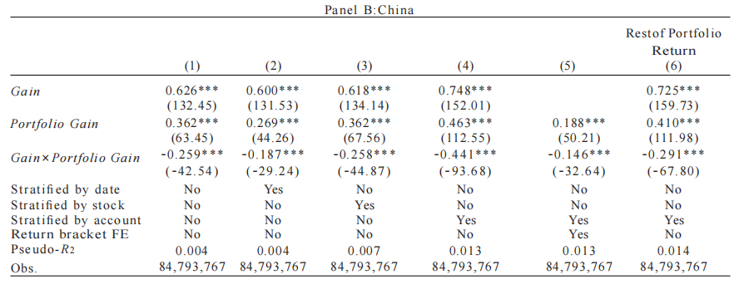
Baseline regressions

Slide 11
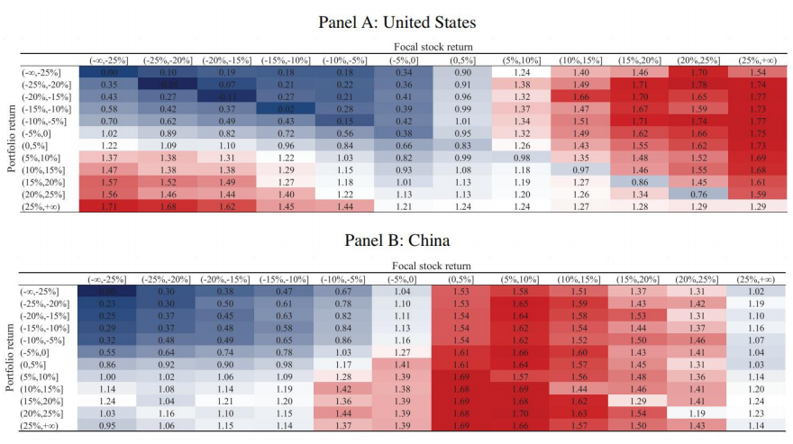
The Magnitude of the Focal Stock and Portfolio Returns

Slide 12
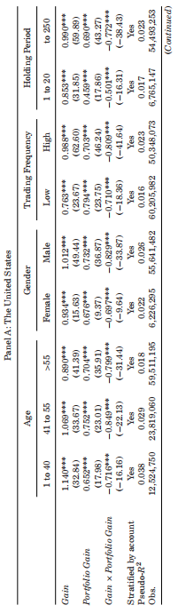
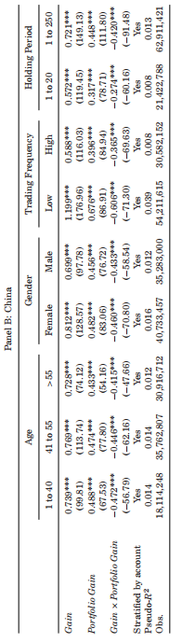
Subsample Analysis

Slide 13
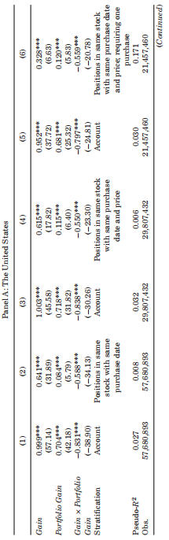
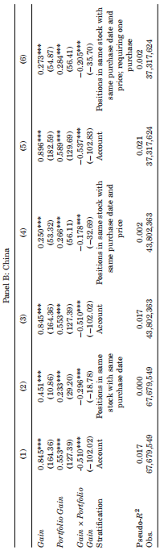
Matching Analysis
Notes:
t-1 空头端

Slide 14
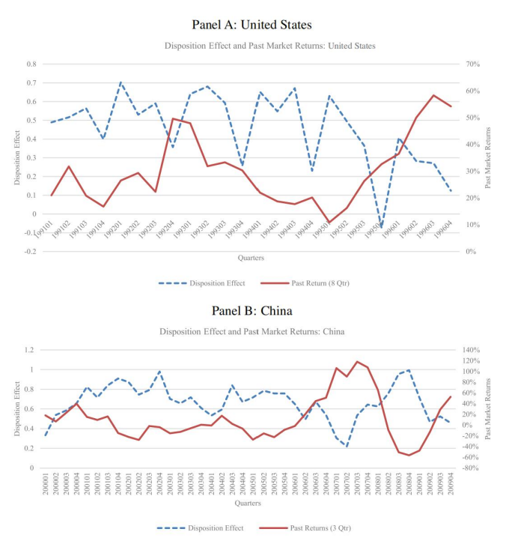
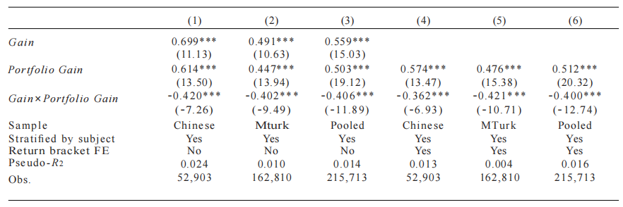
The PDDE in Two Experimental Settings

Slide 15
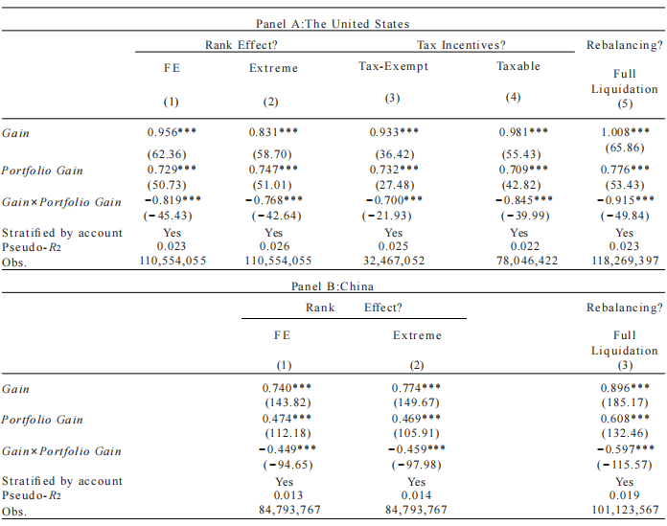
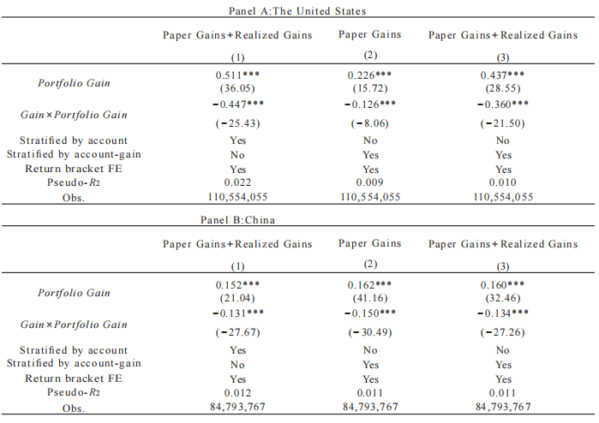
Exclude other explanations
The Rank Effect
Investor Heterogeneity of the Disposition Effect
Tax Incentives
Portfolio Rebalancing

Slide 16
Conclusion
An investor’s disposition effect is large when her portfolio is at a loss and signiﬁcantly smaller when it is at a gain.
The disposition effect exhibits pro-cyclical characteristics:
Bull markets→ weaker disposition effect; Bear markets → stronger disposition effect.
The disposition effect comoves synchronously across investors with different ages, genders, and portfolio sizes, showing a significant common cycle.

Slide 17
Contents
1
Theoretical Background
2
Research Discovery
3
Empirical Evidence
4
Critical Thinking

Slide 18
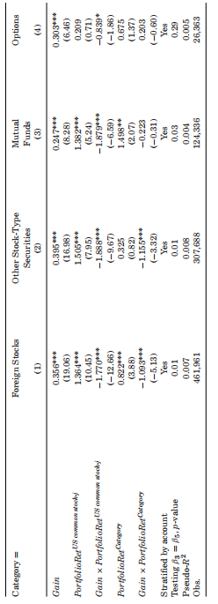
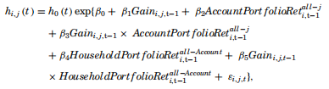

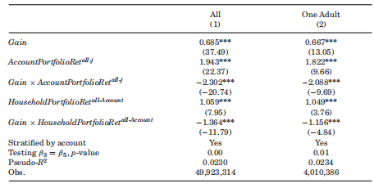
Mechanism analysis:Multiple Frames
Evidence from Account Similarity
Evidence from Asset Similarity

