Slide 1







CA6002 · AI UX & DATA VISUALISATION
Investigating Country
Carbon Emission Patterns
CO₂
- one rising total, two transition pathways
Fossil CO2 of 193 countries rose 63.8%, 1992-2021: does one shared trajectory explain the rise?
Group 30
RAN CHANGMING · REN SIYU · REYIZA RESIBIEKE · SHEN RUITING
Nanyang Technological University · Group Assignment
Notes:
Title slide. Text-only cover by design: no data graphic here, only the framing question and the one number the whole deck investigates. Group 30. Generative AI acknowledgement: ChatGPT (OpenAI) assisted with Python code for figure generation and slide assembly; all data processing, model results, and interpretation are the group's own work.

Slide 2
Contents
Six blocks, one question: covered fossil CO2 kept rising for 30 years - one shared trajectory, or several transition pathways?
1
Introduction
The puzzle: 30 years of growth, one path or many?
Slide 3
2
Exploration of Dataset
Sources, conditioning, and where countries differ
Slides 4-10
3
Design of AI Algorithm
From trajectories to 11 features, PCA and K-means
Slides 11-14
4
Model Evaluation and Performance
Validity, stability and membership uncertainty
Slides 15-17
5
Visual Storytelling
Two pathways, two monitoring priorities
Slides 18-21
6
Conclusions
Contributions, novelty and limitations
Slide 22
Each block below names the stage it reports, and every slide banner repeats that stage name.
Notes:
Contents slide. Section names match the banner on every later slide, so the audience can map any page back to this overview. Generative AI acknowledgement: ChatGPT (OpenAI) assisted with Python code for figure generation and slide assembly; all data processing, model results, and interpretation are the group's own work.

Slide 3
INTRODUCTION · Why we investigate country carbon emission patterns
Emissions kept rising - but not along one shared path
THE PUZZLE
OUR QUESTION CHAIN
+63.8%
Sample-wide fossil CO2, 1992 to 2021
21.97 to 35.98 Gt across the 193 countries covered by our panel
Q1
Is the rise one common trajectory - or different transition pathways?
Q2
Do countries differ only in size, or in speed, timing and fuel mix?
30 years
of sustained global climate attention
yet the covered total kept growing - why, and driven by whom?
Q3
Can AI identify these pathways stably from trajectory features?
Q4
Where should limited climate-monitoring attention go?
Approach
explore differences → engineer trajectory features → K-means (K = 2) → evaluate separation and stability → pathway-specific monitoring priorities
Responsible: SHEN RUITING
3
Notes:
Motivation: despite three decades of climate attention, the sample-wide fossil CO2 total still grew 63.8% between 1992 and 2021 (21.97 to 35.98 Gt). This slide poses the investigative question chain that structures the whole deck; the maroon-framed Q4 is the managerial question the Visual Storytelling section answers. Design rationale: two high-salience stat cards establish the contradiction before any methodology, and the numbered chain previews the four analytical stages. Generative AI acknowledgement: ChatGPT (OpenAI) assisted with Python code for figure generation and slide assembly; all data processing, model results, and interpretation are the group's own work.

Slide 4

EXPLORATION OF DATASET · Where the emission data comes from
Two sources create one traceable emissions panel
1 / 7
1 / 7
SOURCE ROLES
OWID CO2 Data
PRIMARY BACKBONE
Global Carbon Budget 2022 (v27)
SUPPLEMENT
1992–2021 country-year coverage
Fuel-component detail
Population · total CO2 · CO2 per person
Consistent identifiers and broad historical coverage
Coal CO2 · oil CO2 · gas CO2
Used only where the OWID component is missing
Defines which rows remain in the final panel
Adds composition without redefining the backbone
MERGE PRINCIPLE
Retain OWID rows
+
Fill missing fuel fields
=
Never overwrite observed values
Why it matters: every later feature is computed from these same 6,378 country-year rows, so the panel has to be auditable first.
Responsible: SHEN RUITING
Data: [1] [2]
4
Notes:
This slide establishes the provenance of the analytical panel. OWID is the backbone because it provides consistent country-year coverage for population, total CO₂ and per-capita emissions. Global Carbon Budget 2022 (v27) is used only to supplement coal, oil and gas components when those fields are missing in OWID. The visual separates the roles of the two sources and makes the no-overwrite rule explicit. This improves traceability but does not make the sources conceptually identical; definitions and coverage can still vary by entity and year. Generative AI supported slide composition and wording; the source data and calculations were checked against the project README.
[Sources]
- Our World in Data CO₂ Data; Global Carbon Budget 2022 (v27); Final_data/README.md.

Slide 5
EXPLORATION OF DATASET · Building one comparable country-year panel
A controlled left join keeps the OWID backbone intact
2 / 7
2 / 7
CONDITIONING WORKFLOW
1
Scope
2
Harmonise
3
Left join
4
Condition
1992–2021
valid ISO rows
ISO-3 + year
units + names
OWID → GCB
fuel-only fill
core + growth
shares + flags
Final checks: unique country-year keys · consistent units · traceable source fields
6,378
213
30
22
50.8%
country-year rows
ISO entities
years
fields
rows supplemented
STRENGTH
LIMITATION
Traceable row retention and field-level supplementation
Unbalanced country panel; coverage varies across small entities
Why it matters: conditioning is where a study can silently bias itself, so no observed value is overwritten and every filled field stays flagged.
Responsible: SHEN RUITING
Data: [1] [2]
5
Notes:
This process diagram explains how the sources become an analysis-ready panel. We restrict the study to 1992–2021, retain valid ISO rows and harmonise ISO-3 and year keys. A left join keeps the OWID backbone, while GCB values fill only missing fuel components. We then remove records without required core or growth fields, derive fuel shares and quality flags, and verify key uniqueness. The result contains 6,378 country-year rows, 213 entities, 30 years and 22 fields; 50.8% of rows receive at least one supplemented fuel value. The panel is intentionally unbalanced. Generative AI supported composition; the workflow and counts follow the project README.
[Sources]
- Final_data/README.md and the merged country-year panel.

Slide 6
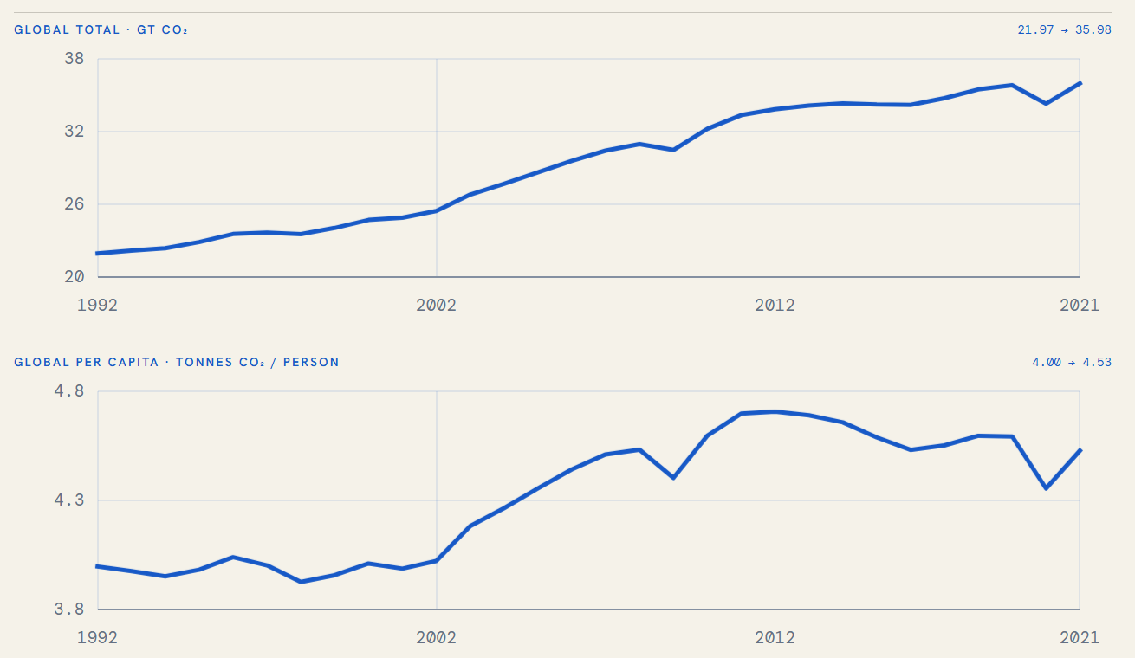
EXPLORATION OF DATASET · How much did the covered emissions rise, 1992-2021?
Total CO2 grew nearly five times faster than per person
3 / 7
3 / 7
1992 → 2021
+63.8%
Global total
21.97 → 35.98 Gt
+13.3%
Per person
4.00 → 4.53 t
INTERPRETATION
Most growth came from scale, not equal growth in emissions intensity.
Why it matters: the aggregate tells us the total grew, not which countries produced the growth or how their paths differ.
Responsible: REYIZA RESIBIEKE
6
Notes:
The paired line charts are appropriate because they compare change through time while preserving the distinct units of total and per-capita emissions. From 1992 to 2021, aggregate CO₂ increased from 21.97 to 35.98 Gt, a 63.8% rise. Per-capita emissions increased from about 4.00 to 4.53 tonnes per person, or 13.3%. The contrast shows that growth in global scale was much stronger than growth in individual intensity. Separate vertical scales prevent the smaller per-capita series from being visually flattened. These are panel aggregates rather than a causal decomposition. Generative AI supported placement and explanatory wording; the temporal chart was supplied by the teammate responsible for temporal analysis.
[Sources]
- Final merged panel, 1992–2021; temporal analysis figure supplied by REYIZA RESIBIEKE.

Slide 7
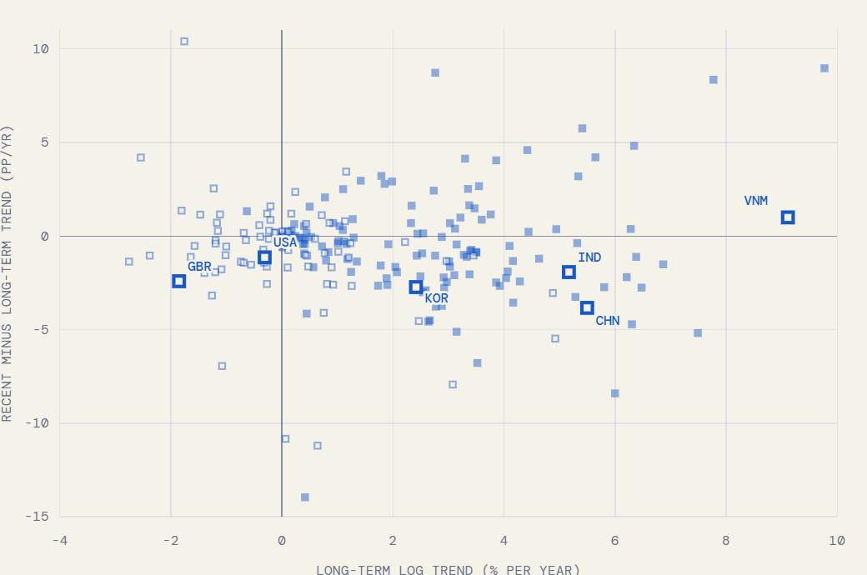
EXPLORATION OF DATASET · Is the rise one shared trajectory or many?
Long-term growth differs from recent momentum
4 / 7
4 / 7
HOW TO READ
X
Long-term log trend
Y
Recent minus long-term
■
Per-capita trend rising
□
Per-capita trend falling
One endpoint change cannot capture both direction and momentum.
Reading the puzzle: long-term growth and recent momentum disagree, so no single growth number can describe a 30-year trajectory.
Responsible: REYIZA RESIBIEKE
7
Notes:
This scatter plot separates two temporal dimensions for each country: the x-axis is the long-term log trend, and the y-axis is the recent trend minus the long-term trend. Countries in the upper-right combine sustained growth with recent acceleration; countries in the lower-right still have positive long-run growth but are slowing relative to that baseline. Filled and outlined squares distinguish the direction of the per-capita trend. The examples illustrate why one start-to-end change cannot represent timing and momentum simultaneously. Extreme values and short or incomplete series require caution. Generative AI supported slide composition; the plotted temporal results were supplied by the teammate responsible for temporal analysis.
[Sources]
- Final merged panel; temporal trend figure supplied by REYIZA RESIBIEKE.

Slide 8
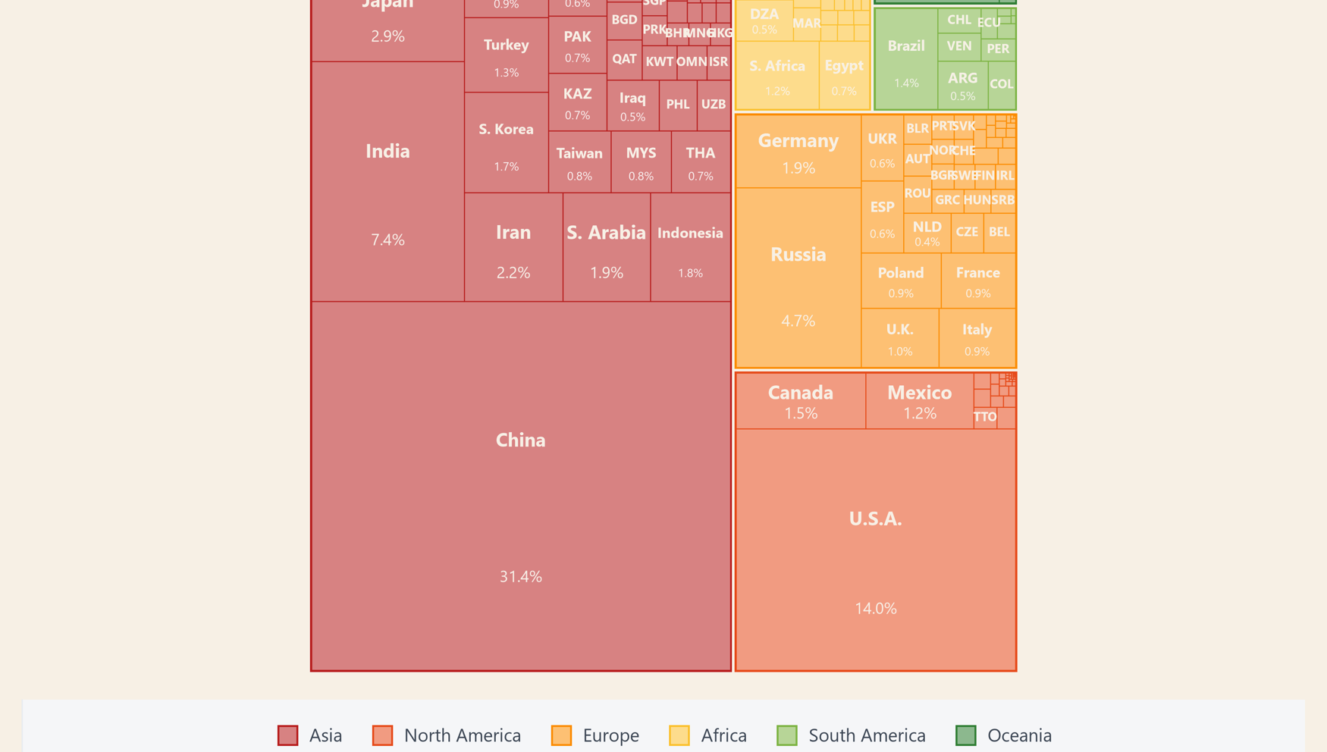
EXPLORATION OF DATASET · Who carries the current emission burden?
A small set of countries drives most 2021 emissions
5 / 7
5 / 7
CONCENTRATION
59.8%
Asia's share of
2021 emissions
31.4%
China's share of
the global total
81.2%
Combined share of
the top 20 emitters
Why it matters: monitoring built around today's biggest emitters alone will overlook the fast-growing rest.
Responsible: SHEN RUITING
8
Notes:
The treemap is suited to a part-to-whole question: rectangle area encodes each country’s share of 2021 total CO₂, while colour groups countries by region. Asia accounts for 59.8% of the total, China alone for 31.4%, and the twenty largest emitters together for 81.2%. This concentration means that global totals are driven by a relatively small set of countries, but area does not express per-capita responsibility or historical contribution. Very small countries are intentionally unlabeled because the available area is insufficient. Generative AI supported slide composition and wording; the underlying visualization was created from the merged project data.
[Sources]
- Final merged panel, 2021; project treemap figure.

Slide 9
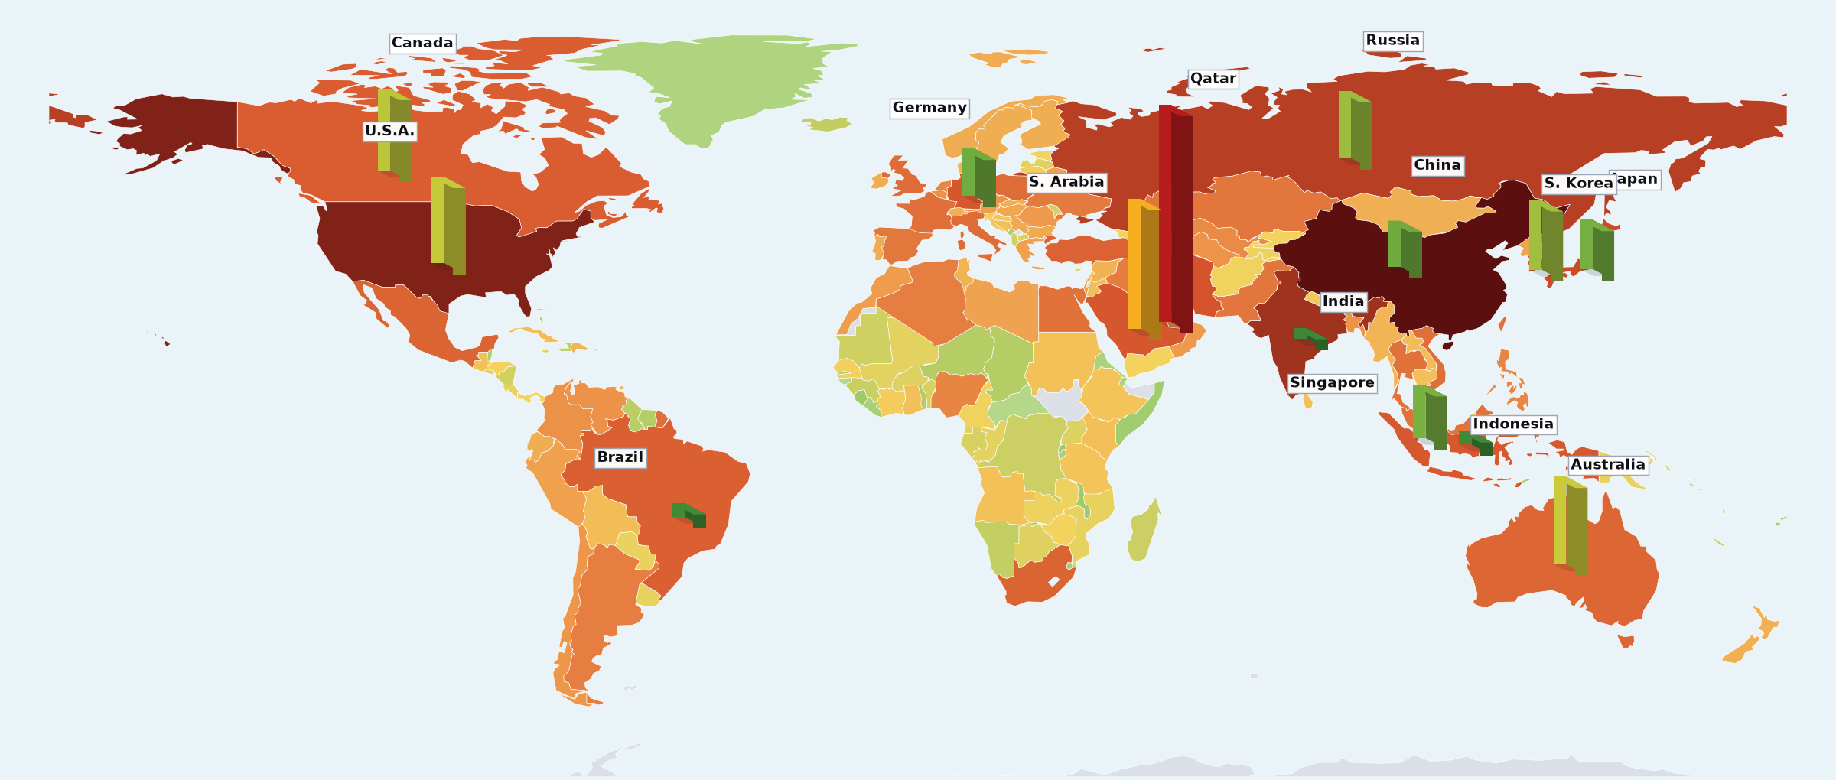
EXPLORATION OF DATASET · Emission scale versus emission intensity
Total burden and per-capita intensity tell different stories
6 / 7
6 / 7
TWO LENSES
TOTAL
China
Largest national burden
PER PERSON
Qatar
High intensity, much smaller total
Scale ≠ intensity
LAND FILL · CO2 PER PERSON
low
high
BAR HEIGHT · TOTAL CO2
short
tall
Why it matters: scale and intensity rank countries differently, which is the first evidence that one ranking cannot serve as one diagnosis.
Responsible: SHEN RUITING
9
Notes:
This map combines two complementary encodings. Land colour represents per-capita CO₂, while vertical bars represent total national emissions; reading both avoids treating national scale and individual intensity as the same concept. China dominates total emissions, whereas Qatar is a high-intensity example despite a much smaller national total. Of 213 entities in the panel, 169 match Natural Earth 110m polygons, covering approximately 99.6% of mapped emissions. Small islands and territories may therefore be absent from land fill. Bar height is comparative rather than a literal geographic measurement. Generative AI supported slide composition; the map was generated from the merged project data.
[Sources]
- Final merged panel, 2021; Natural Earth 110m; project scale-versus-intensity map.

Slide 10
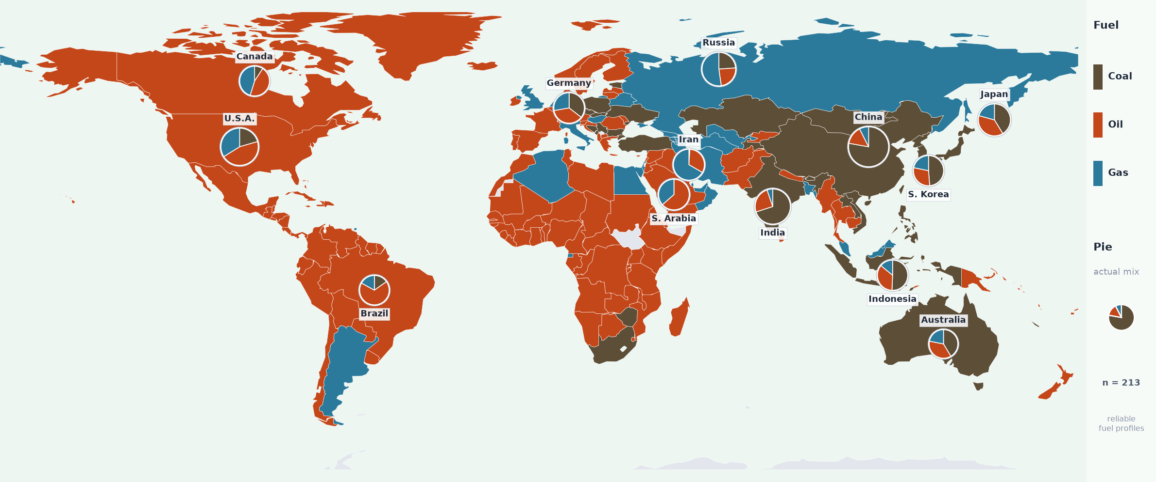
EXPLORATION OF DATASET · What the emissions are actually made of
Fuel dependence is geographically uneven
7 / 7
7 / 7
COAL
Asia
OIL
Africa · Middle East · Americas
GAS
Russia · Central Asia
Dominant fuel shows category; pies retain the actual mix.
Why it matters: fuel composition is what makes a transition easy or locked in, so coal and gas shares enter the model as the fuel-shift block.
Responsible: SHEN RUITING
10
Notes:
This map shows the dominant fossil-fuel component for each country in 2021: coal, oil or gas. The pie charts add the actual three-fuel shares for selected major emitters, preventing a single dominant-fuel label from hiding mixed national structures. Coal dependence is prominent across much of Asia, oil dominates many countries in Africa, the Middle East and the Americas, and gas is prominent in Russia and parts of Central Asia. Fuel shares describe composition, not total magnitude, and coverage varies across small entities. Generative AI supported slide composition and wording; the map was generated from the merged project data.
[Sources]
- Final merged panel, 2021; project dominant-fuel map.

Slide 11
DESIGN OF AI ALGORITHM · Defining the clustering unit and the modelled cohort
From 213 territories to 193 comparable country profiles
1 / 4
COHORT FUNNEL
WHY THIS COHORT
6,378
country-year rows
OWID backbone + GCB fuel fills, 1992-2021
Trajectory features need complete histories. Slopes, peaks and post-peak change are only comparable when every country covers the same 30 years.
Fuel features need reliable shares. Entities with unreliable fuel structure would distort the fuel-shift block.
213
countries & territories
valid ISO codes in the panel
-16
micro states excluded
populations too small for stable trajectories
ONE COUNTRY = ONE PROFILE
Each of the 193 countries becomes a single 11-feature trajectory profile - the clustering unit for everything that follows.
-4
incomplete histories excluded
fewer than 30 consecutive years 1992-2021
193
modelled countries / entities
complete history + reliable fuel structure
AUDITABLE BY DESIGN
Every exclusion is logged with its reason in cohort_audit.csv, so the sample can be reproduced or challenged.
Responsible: RAN CHANGMING
11
Notes:
This funnel defines the modelling sample and makes every exclusion traceable: from 6,378 country-year rows (213 entities) we remove 16 micro states and 4 entities without a complete 1992-2021 history, leaving 193 modelled countries. Design rationale: a narrowing funnel encodes attrition visually; exclusion reasons sit next to the counts so the audience can audit the sample. Source: cohort_audit.csv from our pipeline. Generative AI acknowledgement: ChatGPT (OpenAI) assisted with Python code for figure generation and slide assembly; all data processing, model results, and interpretation are the group's own work.

Slide 12
DESIGN OF AI ALGORITHM · Turning 30-year emission histories into model features
Eleven features describe level, direction, timing and fuel shift
2 / 4
01 · LEVEL
02 · DIRECTION
03 · TIMING
04 · FUEL SHIFT
How intense is the economy now?
Which way is the trajectory moving?
When does change happen?
Is the fuel mix decarbonising?
· Log recent per-capita CO2
· (median 2017-2021)
· Long-term log slope 1992-2021
· Recent log slope 2012-2021
· Acceleration (recent - long-term)
· Growth volatility (MAD)
· Peak timing (relative)
· Post-peak change
· Recent coal & gas shares
· Coal & gas share change
· (early vs recent 5-yr medians)
Log scale stops extreme values from dominating distances.
Separates long-run direction from recent slowdown or renewed growth.
Distinguishes smooth plateauing from unstable or still-rising paths.
Oil share is kept for interpretation but omitted from the model to avoid perfect dependence.
Built only from per-capita CO2, growth rates and fuel shares - total CO2 and population never enter the model; they return later, only to interpret the pathways.
Responsible: RAN CHANGMING
12
Notes:
Feature engineering turns each 30-year history into 11 comparable features in four blocks: level (log recent per-capita CO2), direction (long-term slope, recent slope, acceleration), timing (volatility, peak timing, post-peak change) and fuel shift (coal/gas shares and their change). Deliberate exclusion: total emissions and population are NOT features - size must not decide the grouping; size returns only when we interpret the pathways in Visual Storytelling. Design rationale: four parallel cards mirror the four feature families so the audience learns the feature grammar once. Generative AI acknowledgement: ChatGPT (OpenAI) assisted with Python code for figure generation and slide assembly; all data processing, model results, and interpretation are the group's own work.

Slide 13
DESIGN OF AI ALGORITHM · Scaling, PCA, K-means and how they are validated
A fixed pipeline turns 30-year histories into two pathways
3 / 4
COUNTRY-YEAR PANEL
193 COUNTRY PROFILES
ROBUSTSCALER
PCA → 4 COMPONENTS
K-MEANS · K = 2-8
6,378 rows · 1992-2021
one row per country, 11 features
median / IQR scaling, so outliers cannot dominate distances
87.41% of variance kept, correlated features merged
50 restarts, fixed seed 42: the grouping re-runs identically
VALIDATION RUNS ALONGSIDE - NOT INSIDE - THE CLUSTERING
GMM SOFT MEMBERSHIP
probability of belonging to each cluster
100 x 80% SUBSAMPLING
refit and compare labels (Adjusted Rand Index)
NEITHER CHANGES THE LABELS
both instruments only test the grouping that K-means already produced
WHY K-MEANS
Unsupervised by design: no labels exist for 'transition pathway', so we cluster comparable profiles and validate the structure afterwards.
Simple, explainable, reproducible: a fixed seed and n_init = 50 make the exact grouping re-runnable; PCA removes redundancy among correlated trajectory features before distances are computed.
Responsible: RAN CHANGMING
[4]
13
Notes:
The pipeline is deliberately fixed end-to-end so every later figure traces back to one model run: panel -> 193 eleven-feature profiles -> RobustScaler -> PCA (4 components, 87.41% cumulative variance) -> K-means compared over K = 2-8 (n_init = 50, seed = 42). GMM soft membership and 100 x 80% subsampling are validation instruments drawn outside the main flow. Design rationale: a left-to-right pipeline matches reading order; the amber validation boxes hang below to show they check the model rather than train it. Generative AI acknowledgement: ChatGPT (OpenAI) assisted with Python code for figure generation and slide assembly; all data processing, model results, and interpretation are the group's own work.

Slide 14
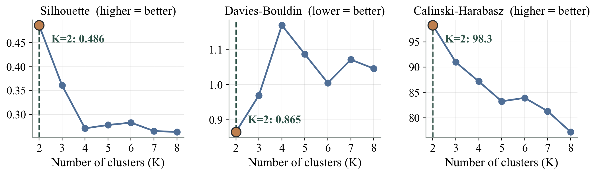
DESIGN OF AI ALGORITHM · Choosing how many emission patterns to keep (K = 2-8)
All three validity metrics rank K = 2 first
4 / 4
0.486 Silhouette
highest - compact, well separated
0.865 Davies-Bouldin
lowest - least overlap
98.3 Calinski-Harabasz
Inertia (within-cluster sum of squares) always falls as K grows - shown for reference only, never used alone to pick K.
highest - strongest split
How the decision was made
· Three internal criteria were computed on the same PCA space for every candidate K from 2 to 8, so the comparison is like-for-like.
· All three agree on K = 2; no criterion prefers a finer split, and K = 3-8 lose separation without adding interpretable structure.
· K = 2 is therefore a screening frame for monitoring attention, not a claim that only two kinds of country exist.
DECISION
K = 2 - the strongest macro segmentation, not the most detailed taxonomy.
Responsible: RAN CHANGMING
[4] [5]
14
Notes:
K was chosen by evidence, not convenience: silhouette (0.486, highest), Davies-Bouldin (0.865, lowest) and Calinski-Harabasz (98.3, highest) all rank K = 2 first across K = 2-8. Inertia is plotted for completeness only because it mechanically decreases with K. Design rationale: three small-multiple panels share one x-axis so the same dashed marker at K = 2 can be compared across criteria at a glance. Source: k_selection_metrics.csv. Generative AI acknowledgement: ChatGPT (OpenAI) assisted with Python code for figure generation and slide assembly; all data processing, model results, and interpretation are the group's own work.

Slide 15
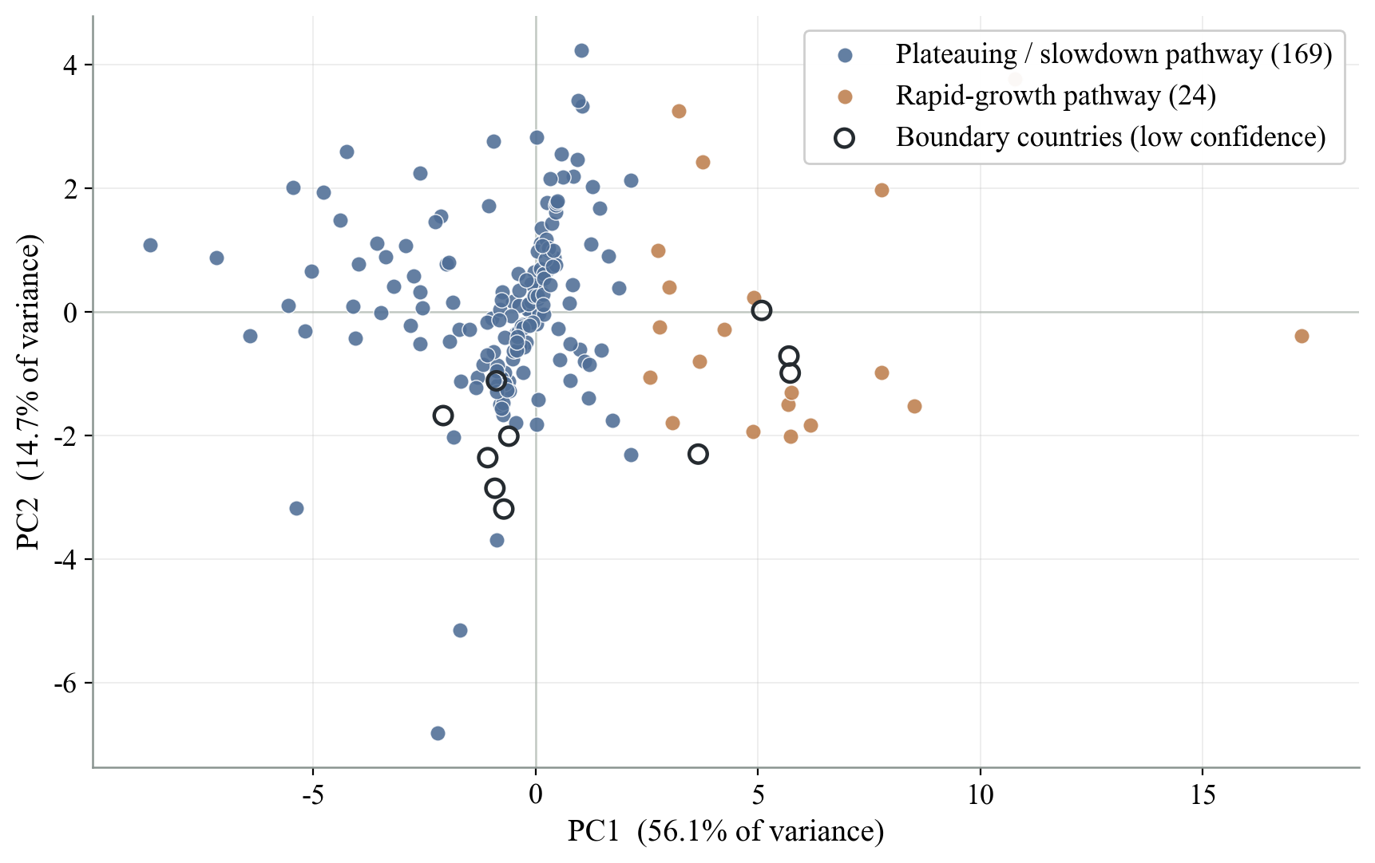
MODEL EVALUATION AND PERFORMANCE · Does the two-pattern structure actually separate?
Two pathways separate cleanly in reduced feature space
1 / 3
HOW TO READ
Each dot is one country's 11-feature profile, projected onto the first two principal components.
Colour shows the K-means label computed in the full 4-component space - not in this 2D view.
Dark rings mark the 10 low-confidence boundary countries.
PC1 + PC2 show 70.8% of variance
Clustering used all four retained components (87.41%). This 2D projection is a display device - the visible separation understates the true separation.
Responsible: REN SIYU
15
Notes:
A PCA projection checks whether the K = 2 structure is real in the feature space rather than an artefact of the algorithm. The amber rapid-growth pathway (24 countries) forms a compact group clearly offset from the broader steel-blue plateauing/slowdown pathway (169). Dark rings flag the 10 boundary countries whose membership is uncertain. Caveat stated on-slide: clustering ran on 4 components (87.41% variance); PC1+PC2 alone show 70.8%, so this view is illustrative. Design rationale: colour encodes only pathway membership; a third visual channel (ring) carries uncertainty instead of a third colour. Generative AI acknowledgement: ChatGPT (OpenAI) assisted with Python code for figure generation and slide assembly; all data processing, model results, and interpretation are the group's own work.

Slide 16
MODEL EVALUATION AND PERFORMANCE · Internal validity metrics, since no ground-truth labels exist
K = 2 wins on every internal validity metric
2 / 3
K | Inertia (lower) | Silhouette (higher) | Davies-Bouldin (lower) | Calinski-Harabasz (higher)
2 | 1675.8 | 0.486 | 0.865 | 98.3
3 | 1296.4 | 0.361 | 0.969 | 91.0
4 | 1064.7 | 0.271 | 1.168 | 87.2
5 | 915.9 | 0.278 | 1.086 | 83.2
6 | 782.4 | 0.283 | 1.004 | 83.9
7 | 700.6 | 0.265 | 1.071 | 81.3
8 | 647.4 | 0.263 | 1.045 | 77.2
SILHOUETTE
Rewards clusters that are internally compact and well separated from neighbours.
DAVIES-BOULDIN
Penalises overlap between cluster pairs; lower means cleaner separation.
CALINSKI-HARABASZ
Compares between-cluster with within-cluster dispersion; higher is better.
NO SUPERVISED ACCURACY
Accuracy, precision, recall, F1, ROC and confusion matrices require ground-truth labels. Pathways have none - evaluation therefore uses internal validity plus stability.
Highlighted row: K = 2 wins Silhouette, Davies-Bouldin and Calinski-Harabasz simultaneously.
Responsible: REN SIYU
[5]
16
Notes:
The full K = 2-8 comparison table lets the audience verify the K choice themselves; each column header states the direction of 'better'. We explicitly state why supervised metrics are not applicable - clustering has no ground-truth labels, so internal validity (this slide) plus stability and membership uncertainty (next slide) carry the evaluation. Design rationale: the selected row uses the deck's maroon accent to pull the eye to the decision before the supporting rows are read. Source: k_selection_metrics.csv. Generative AI acknowledgement: ChatGPT (OpenAI) assisted with Python code for figure generation and slide assembly; all data processing, model results, and interpretation are the group's own work.

Slide 17
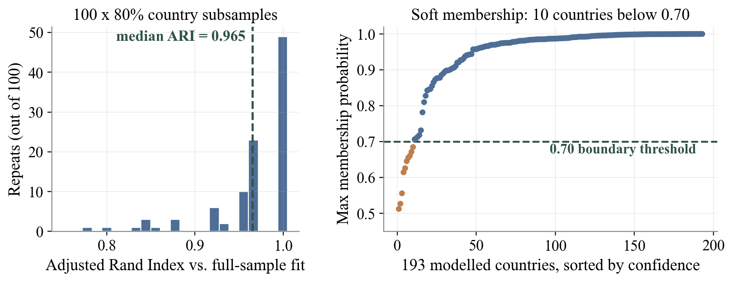
MODEL EVALUATION AND PERFORMANCE · Resampling stability and membership confidence
The split survives resampling; ten stay uncertain
3 / 3
BOUNDARY COUNTRIES
GMM confidence below 0.70:
South Korea 0.51 · Guatemala 0.53 · Trinidad & Tobago 0.56 · Sri Lanka 0.61 · Estonia 0.63 · Venezuela 0.65 · Oman 0.66 · Jordan 0.66 · Madagascar 0.67 · Azerbaijan 0.68
Not a third pathway - membership to be confirmed with more data.
Left: 100 refits on 80% country subsamples - median Adjusted Rand Index 0.965 (minimum 0.778). Right: GMM soft membership on the same feature space.
Verdict: the two-pathway macro structure is stable (ARI close to 1 on most refits), and the only genuine uncertainty is a small, known boundary set - exactly the countries a monitoring programme should track more closely.
Responsible: REN SIYU
[6]
17
Notes:
Stability was tested with 100 refits on 80% country subsamples (scaling, PCA and K-means re-estimated each time): median ARI 0.965 against the full-sample labels, so the macro split is not an initialisation artefact. A GMM fitted on the same PCA space adds soft membership probabilities: median confidence 98.7%, and exactly 10 countries fall below 0.70 - these become the 'boundary countries' carried into Visual Storytelling. Design rationale: histogram plus sorted dot plot show the full distributions rather than a single summary statistic. Sources: stability_results.csv, gmm_membership_probabilities.csv. Generative AI acknowledgement: ChatGPT (OpenAI) assisted with Python code for figure generation and slide assembly; all data processing, model results, and interpretation are the group's own work.

Slide 18
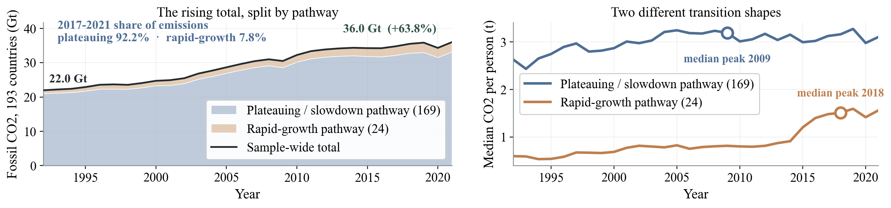
VISUAL STORYTELLING · What kind of emission patterns did the model find?
One rising total conceals two different transition pressures
1 / 4
Shares use 2017-2021 emissions of the 193 modelled countries; the 10 boundary countries stay inside their pathway, not a third group.
Rapid-growth pathway
24 countries
Plateauing / slowdown pathway
169 countries
Lower base, fast recent growth, late peak - potential future additional emissions if recent patterns persist.
Growth has flattened or turned down - yet this pathway still carries almost all of the current emissions burden.
1.49 t
+2.78%
2018
7.8%
3.19 t
-0.26%
2009
92.2%
CO2 per person
recent growth per year
median peak year
share of 2017-21 emissions
CO2 per person
recent growth per year
median peak year
share of 2017-21 emissions
Median country shares coal 38% · gas 2% e.g. Vietnam, Bangladesh
Median country shares coal 1% · gas 11% e.g. China, United States
Responsible: REN SIYU
[1] [2]
18
Notes:
The stacked area on the left decomposes the rising sample total: the plateauing pathway is the thick base that carries 92.2% of 2017-2021 emissions, while the rapid-growth band is thin but grew far faster (+198% versus +58% since 1992). The right panel shows the two transition shapes: the plateauing pathway peaks around 2009 and flattens, the rapid-growth pathway is still climbing with a median peak only in 2018. Pathways are empirical patterns in the sample window - not country rankings, not predictions. Fuel shares are the median country-level CO2-source shares inside each pathway - the typical country, not the pathway aggregate: weighted by emissions the two pathways look similar (coal 48% vs 44% of 2017-2021 fossil CO2), because a few large coal economies sit inside the plateauing pathway. Design rationale: the figure carries the argument and the two strips below only quantify it, so this page is evidence-led rather than text-led. Sources: co2_panel_1992_2021.csv, cluster_profiles.csv. Generative AI acknowledgement: ChatGPT (OpenAI) assisted with Python code for figure generation and slide assembly; all data processing, model results, and interpretation are the group's own work.

Slide 19
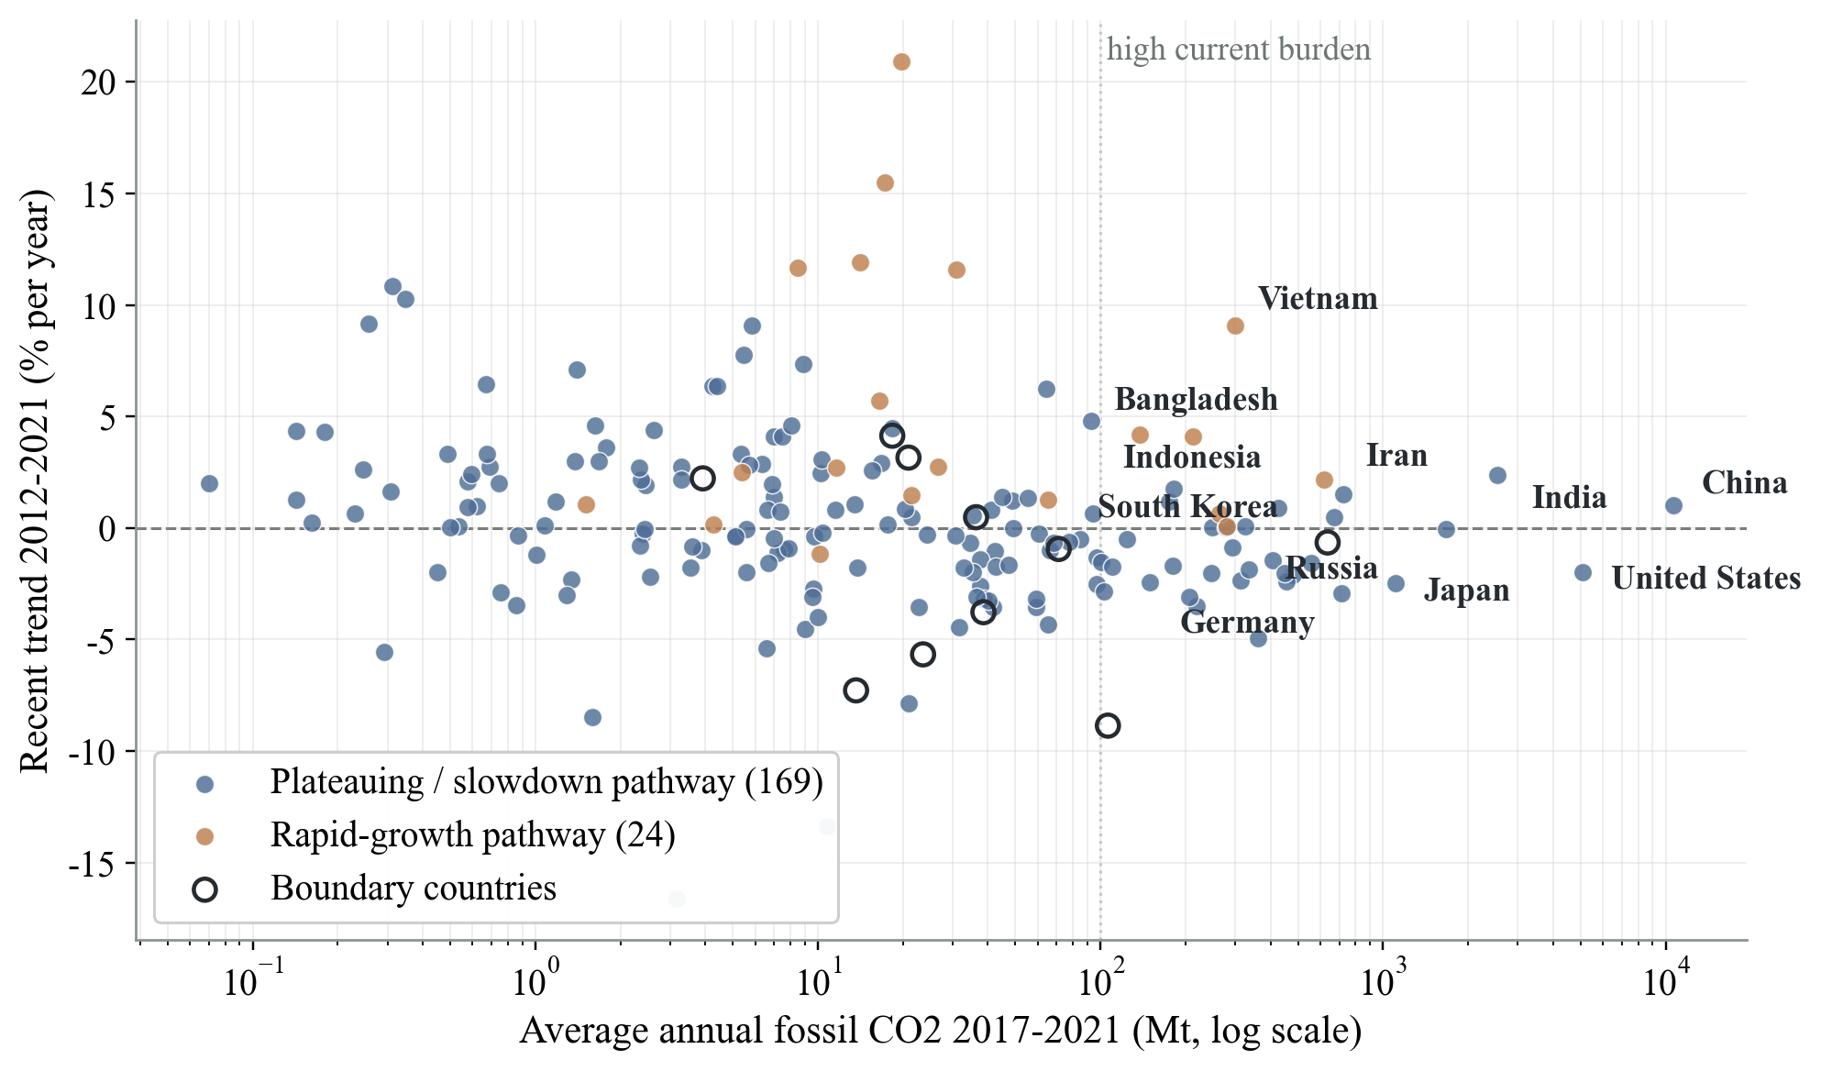
VISUAL STORYTELLING · Why ranking countries by one number misleads
Current burden and future pressure require different lenses
2 / 4
WHY ONE LENS FAILS
Rank by emissions only
and you watch China, the US and India while missing small-base, fast-growing, late-peak countries in the upper left.
Rank by growth only
and you overrate small economies while underrating the plateauing majors that hold 92.2% of 2017-21 emissions.
Responsible: REYIZA RESIBIEKE
19
Notes:
Each country is plotted by current burden (x: average annual fossil CO2 2017-2021, log scale) against recent momentum (y: 2012-2021 log-slope of per-capita CO2, % per year); colour is the validated pathway and dark rings are boundary countries. Reading: upper right = burden AND growth (double attention); upper left = future pressure; lower right = today's mitigation lever. Both single-lens failures are stated on the slide. Bubble area is deliberately NOT reused for emissions because the x-axis already carries it. Generative AI acknowledgement: ChatGPT (OpenAI) assisted with Python code for figure generation and slide assembly; all data processing, model results, and interpretation are the group's own work.

Slide 20
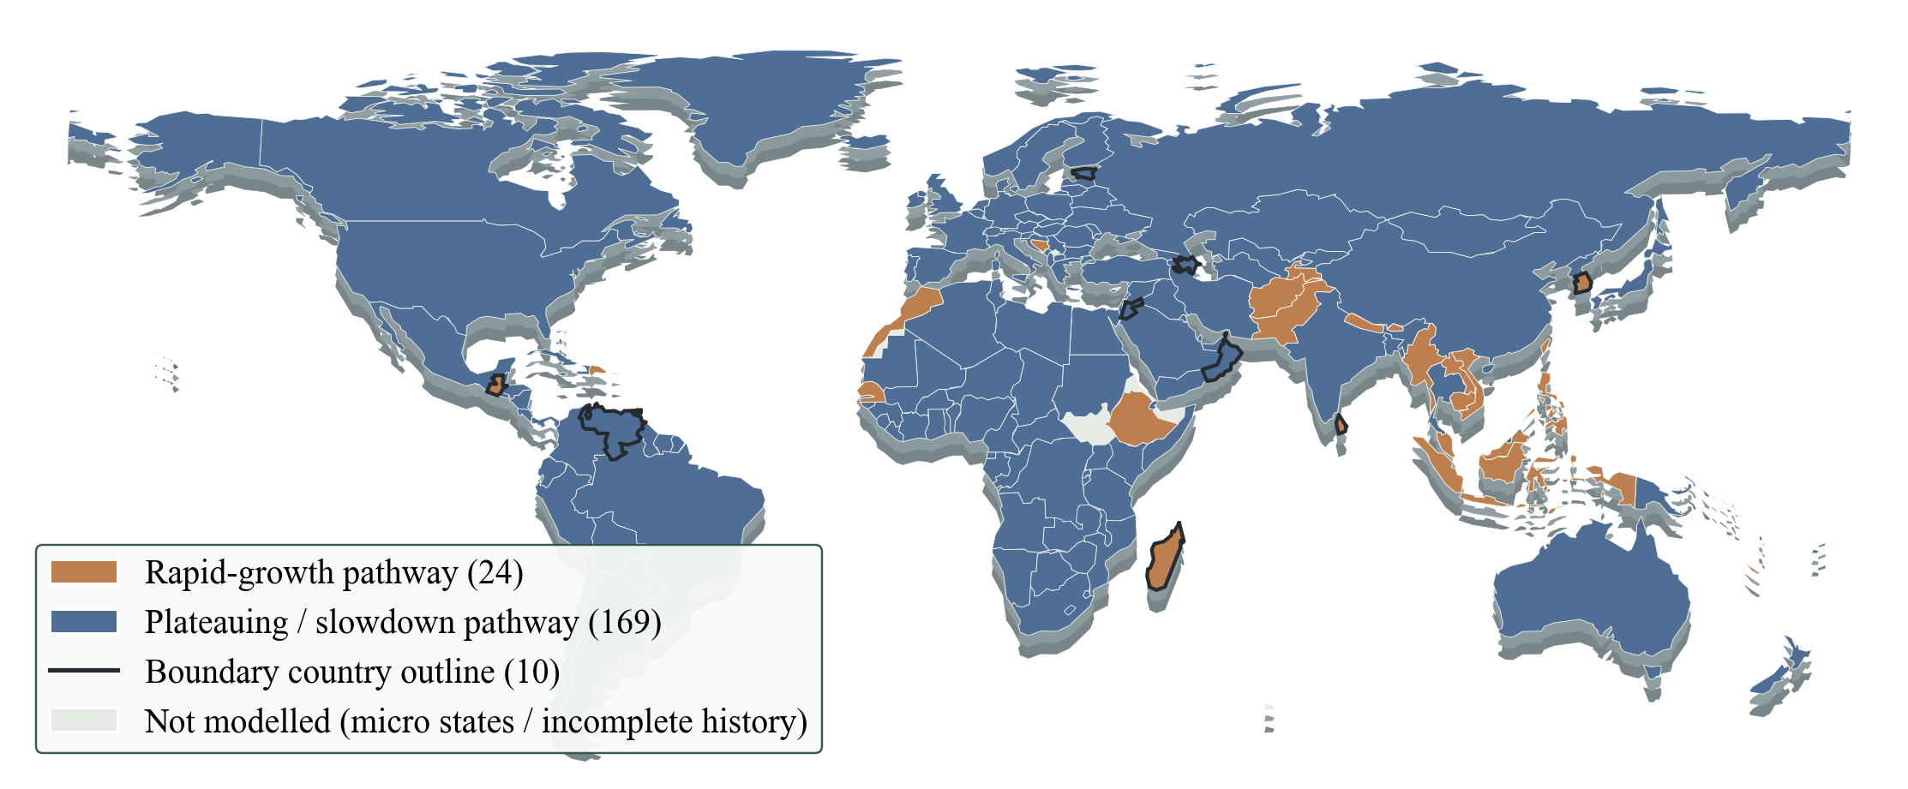
VISUAL STORYTELLING · Where each emission pattern is located
Transition pressures are geographically uneven
3 / 4
The map locates monitoring tasks, not judgement: rapid-growth pressure clusters in South and Southeast Asia; dark outlines flag the 10 boundary countries.
Responsible: SHEN RUITING
[1] [3]
20
Notes:
The frozen K = 2 labels are projected onto the world map using only the two pathway colours; boundary countries get a dark outline instead of a third colour, and grey countries were not modelled (micro states or incomplete histories). Geography was never a model feature - this map shows where the data-driven pathways happen to fall. Twenty-eight small island or city-state members (27 plateauing, 1 rapid-growth) are invisible at this 1:110m base-map scale. Design rationale: the same basemap family and legend style as the exploration maps keeps the spatial language consistent. Source: country_features_with_clusters.csv + Natural Earth 110m. Generative AI acknowledgement: ChatGPT (OpenAI) assisted with Python code for figure generation and slide assembly; all data processing, model results, and interpretation are the group's own work.

Slide 21
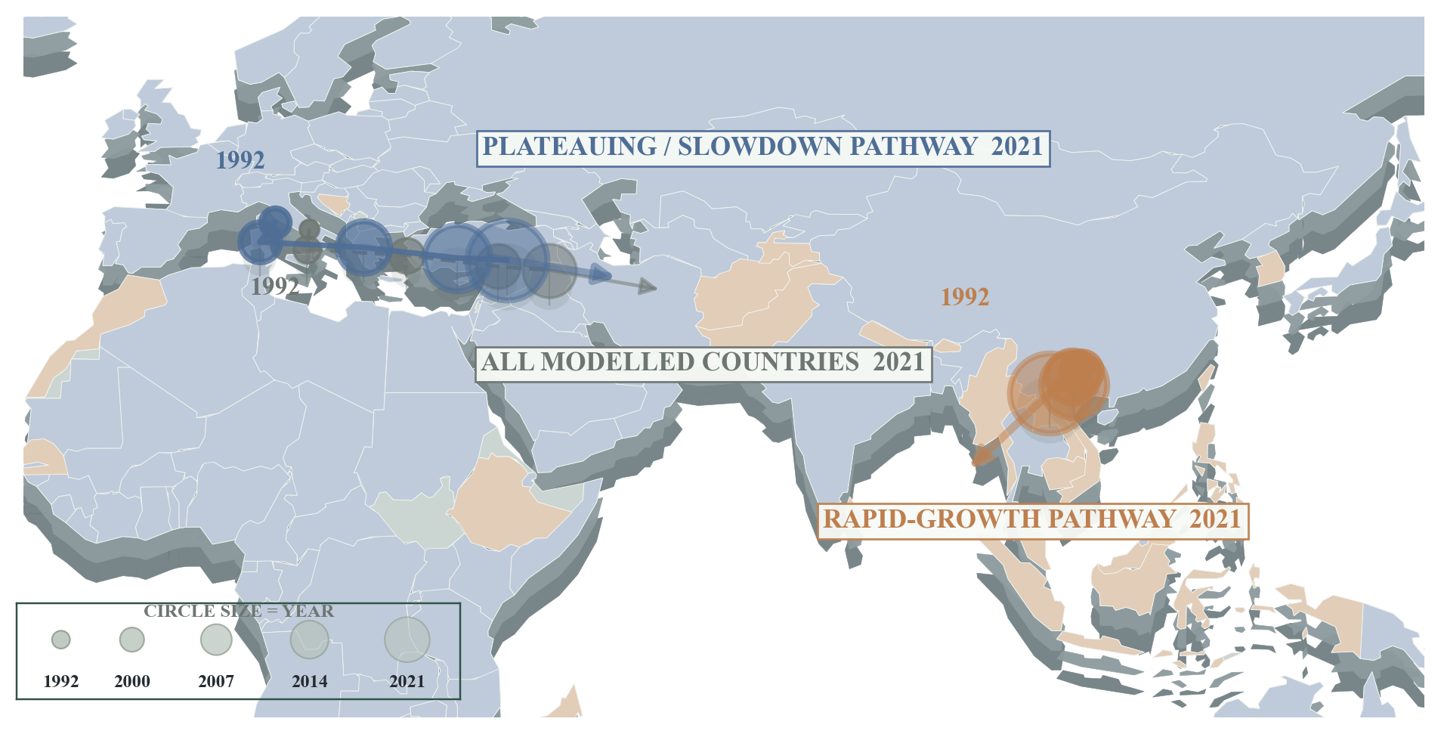
VISUAL STORYTELLING · How limited monitoring attention should be allocated
Where emissions head decides where monitoring goes
4 / 4
MONITORING PRIORITIES
Rapid-growth pathway (24)
Watch: growth rate · fuel shares · peak timing
Progress = growth slows, high-carbon shares fall
Plateauing pathway (169)
Watch: total emissions · pace of decline
Progress = absolute emissions fall structurally
Boundary countries (10)
15E to 44E
+198%
+58%
Watch: data completeness · membership stability
Progress = pathway membership stabilises with better data
Centre of gravity of all 193 countries shifts east.
Rapid-growth emissions since 1992; centre stays in South/Southeast Asia.
Plateauing emissions - 92.2% of 2017-21 emissions.
Same symptom, different causes: flat emissions can mean expansion, slow post-peak decline or a real fuel shift.
Responsible: SHEN RUITING
[3]
21
Notes:
This closing storytelling page joins the spatial and the managerial argument. The map reuses the spatial team's centroid method (CO2-weighted country centroids, code/瑞庭_绘图/scripts/_render_p3_trajectory_revised.py) but replaces continents with the two validated pathways: the overall centre of gravity moves from 15E to 44E, the plateauing centre follows it, and the rapid-growth centre sits in South/Southeast Asia the whole time while its total grows +198%. The table then converts pathways into monitoring instructions: growth, fuel shares, peak timing and lock-in for the rapid-growth pathway; absolute decline for the plateauing pathway; data quality and membership stability for boundary countries. Positions are plotted at true coordinates with no magnification. Generative AI acknowledgement: ChatGPT (OpenAI) assisted with Python code for figure generation and slide assembly; all data processing, model results, and interpretation are the group's own work.

Slide 22
CONCLUSIONS · What this investigation changes for climate monitoring
From one emission total to pathway-specific monitoring
CURRENT BURDEN
FUTURE PRESSURE
BOUNDARY UNCERTAINTY
The 169-country plateauing pathway holds 92.2% of 2017-2021 sample emissions
The 24-country rapid-growth pathway: fast growth, late peaks, +198% since 1992
10 low-confidence countries identified by soft membership
Push the plateau into absolute decline - this is the short-term mitigation lever.
Track growth and lock-in signals now, before today's growth becomes tomorrow's burden.
Observe them more frequently instead of forcing a fixed classification.
What is novel here: an 11-feature trajectory profile (level · direction · timing · fuel shift) that makes 30 years of history comparable per country, and a stability-checked K = 2 screen used as a monitoring tool - not as another league table.
Honest limits: pathways are empirical patterns in 1992-2021, not causes, forecasts or policy verdicts; with no policy or economic variables in the panel, the model prioritises deeper investigation - it does not replace it.
The purpose is not to rank countries, but to identify where different transition pressures require different monitoring priorities.
Responsible: GROUP 30 - ALL MEMBERS
22
Notes:
Conclusions avoid repeating earlier slides and instead summarise the contribution: one rising sample total was decomposed into two validated transition pressures plus an explicitly uncertain boundary set, each with its own monitoring implication. Novelty: the trajectory-profile feature design and the stability-checked use of K-means as a screening device for management attention. Limits are stated plainly: exploratory, non-causal, non-predictive. Generative AI acknowledgement: ChatGPT (OpenAI) assisted with Python code for figure generation and slide assembly; all data processing, model results, and interpretation are the group's own work.

Slide 23
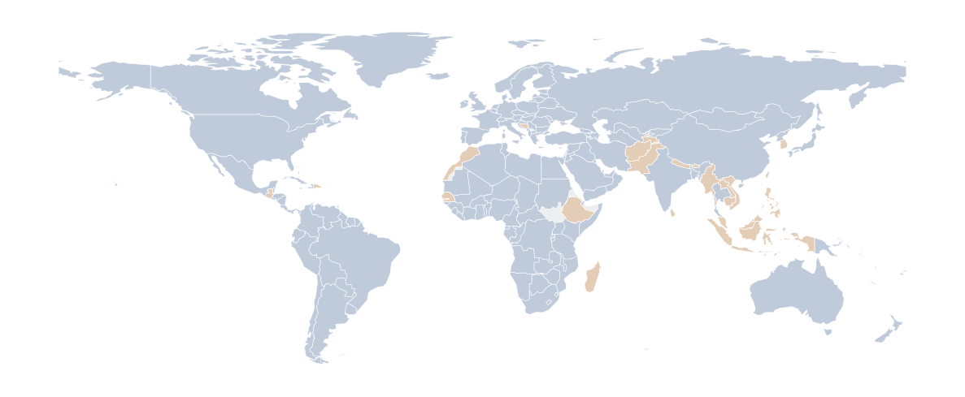
Acknowledgements
Thank you
for your attention and questions.
Course
CA6002 AI UX & Data Visualisation Design Principles, NTU.
Open-source tools
Python, pandas, scikit-learn, matplotlib, GeoPandas, python-pptx.
Group 30
RAN CHANGMING · REN SIYU
REYIZA RESIBIEKE · SHEN RUITING
Generative AI
ChatGPT (OpenAI) assisted with Python plotting code; all data processing, results and interpretation are the group's own work.
REFERENCES
[1]
Ritchie, H., Rosado, P. & Roser, M. (2023). CO₂ and Greenhouse Gas Emissions. Our World in Data.
[4]
Pedregosa, F. et al. (2011). Scikit-learn: Machine Learning in Python. JMLR, 12, 2825-2830.
[2]
Friedlingstein, P. et al. (2022). Global Carbon Budget 2022. Earth Syst. Sci. Data, 14(11), 4811-4900.
[5]
Rousseeuw, P. J. (1987). Silhouettes: a graphical aid to cluster analysis. J. Comput. Appl. Math., 20, 53-65.
[3]
Natural Earth. Admin 0 - Countries, 1:110m Cultural Vectors (public domain).
[6]
Hubert, L. & Arabie, P. (1985). Comparing partitions. J. Classification, 2, 193-218.
Notes:
Acknowledgements slide. It credits the course, the open-source toolchain and the generative-AI assistance, and lists the six references cited on the slides: the two data sources, the basemap, the clustering library and the two cluster-validity papers behind the silhouette and ARI diagnostics. Generative AI acknowledgement: ChatGPT (OpenAI) assisted with Python code for figure generation and slide assembly; all data processing, model results, and interpretation are the group's own work.

