Slide 1

EXPLORATION OF DATASET: Two sources create one traceable emissions panel
1 / 7
SOURCE ROLES
OWID CO2 Data
PRIMARY BACKBONE
Global Carbon Budget 2022 (v27)
SUPPLEMENT
1992–2021 country-year coverage
Fuel-component detail
Population · total CO2 · CO2 per person
Consistent identifiers and broad historical coverage
Coal CO2 · oil CO2 · gas CO2
Used only where the OWID component is missing
Defines which rows remain in the final panel
Adds composition without redefining the backbone
MERGE PRINCIPLE
Retain OWID rows
+
Fill missing fuel fields
=
Never overwrite observed values
Responsible: Shen Ruiting
Notes:
This slide establishes the provenance of the analytical panel. OWID is the backbone because it provides consistent country-year coverage for population, total CO₂ and per-capita emissions. Global Carbon Budget 2022 (v27) is used only to supplement coal, oil and gas components when those fields are missing in OWID. The visual separates the roles of the two sources and makes the no-overwrite rule explicit. This improves traceability but does not make the sources conceptually identical; definitions and coverage can still vary by entity and year. Generative AI supported slide composition and wording; the source data and calculations were checked against the project README.
[Sources]
- Our World in Data CO₂ Data; Global Carbon Budget 2022 (v27); Final_data/README.md.

Slide 2
EXPLORATION OF DATASET: A controlled left join keeps the OWID backbone intact
2 / 7
CONDITIONING WORKFLOW
1
Scope
2
Harmonise
3
Left join
4
Condition
1992–2021
valid ISO rows
ISO-3 + year
units + names
OWID → GCB
fuel-only fill
core + growth
shares + flags
Final checks: unique country-year keys · consistent units · traceable source fields
6,378
213
30
22
50.8%
country-year rows
ISO entities
years
fields
rows supplemented
STRENGTH
LIMITATION
Traceable row retention and field-level supplementation
Unbalanced country panel; coverage varies across small entities
Responsible: Shen Ruiting
Notes:
This process diagram explains how the sources become an analysis-ready panel. We restrict the study to 1992–2021, retain valid ISO rows and harmonise ISO-3 and year keys. A left join keeps the OWID backbone, while GCB values fill only missing fuel components. We then remove records without required core or growth fields, derive fuel shares and quality flags, and verify key uniqueness. The result contains 6,378 country-year rows, 213 entities, 30 years and 22 fields; 50.8% of rows receive at least one supplemented fuel value. The panel is intentionally unbalanced. Generative AI supported composition; the workflow and counts follow the project README.
[Sources]
- Final_data/README.md and the merged country-year panel.

Slide 3
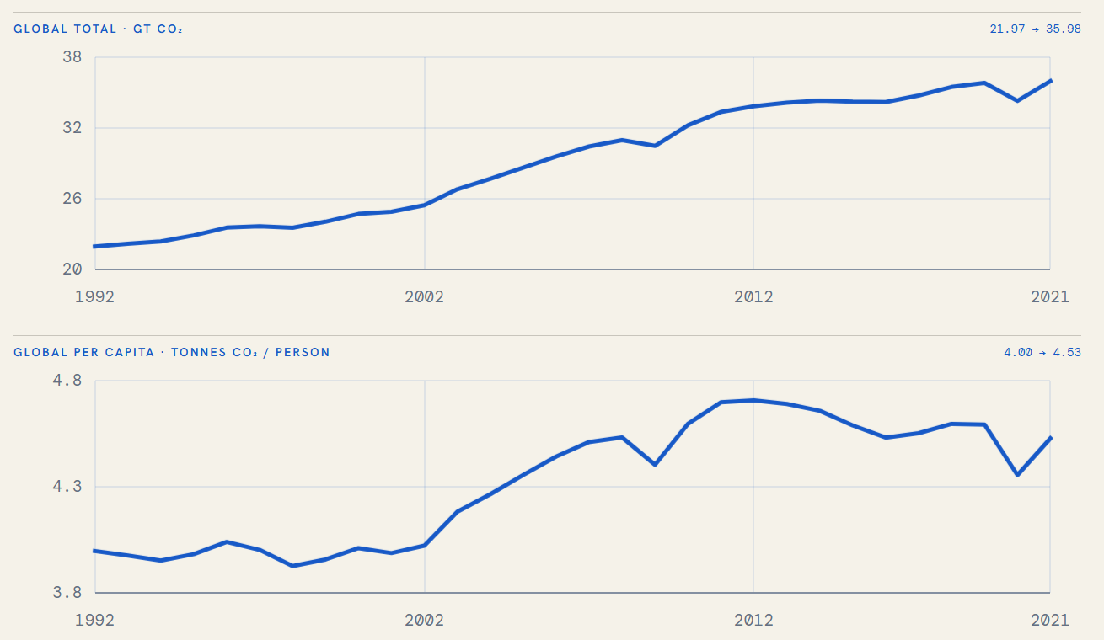
EXPLORATION OF DATASET: Total CO2 grew nearly five times faster than per person
3 / 7
1992 → 2021
+63.8%
Global total
21.97 → 35.98 Gt
+13.3%
Per person
4.00 → 4.53 t
INTERPRETATION
Most growth came from scale, not equal growth in emissions intensity.
Responsible: REYIZA RESIBIEKE
Notes:
The paired line charts are appropriate because they compare change through time while preserving the distinct units of total and per-capita emissions. From 1992 to 2021, aggregate CO₂ increased from 21.97 to 35.98 Gt, a 63.8% rise. Per-capita emissions increased from about 4.00 to 4.53 tonnes per person, or 13.3%. The contrast shows that growth in global scale was much stronger than growth in individual intensity. Separate vertical scales prevent the smaller per-capita series from being visually flattened. These are panel aggregates rather than a causal decomposition. Generative AI supported placement and explanatory wording; the temporal chart was supplied by the teammate responsible for temporal analysis.
[Sources]
- Final merged panel, 1992–2021; temporal analysis figure supplied by REYIZA RESIBIEKE.

Slide 4
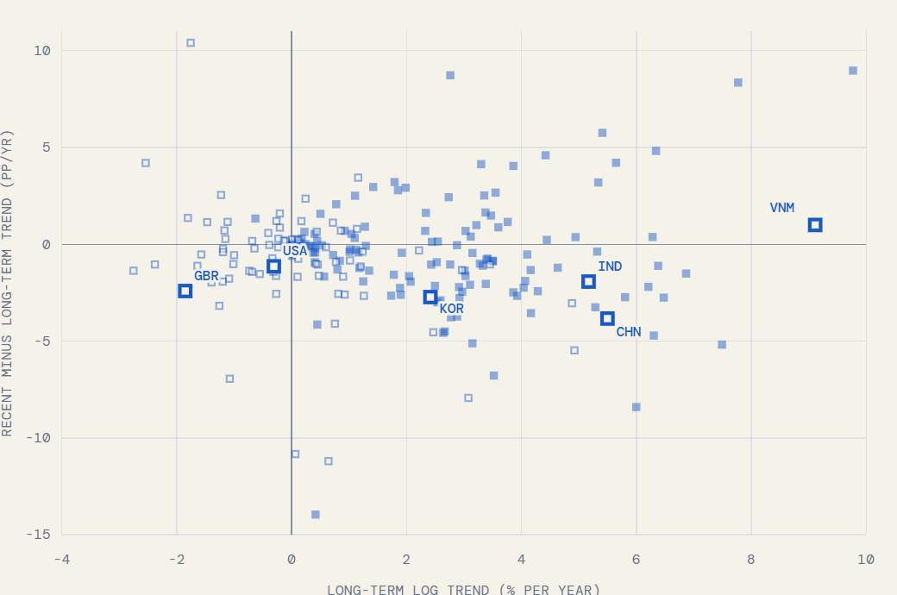
EXPLORATION OF DATASET: Long-term growth differs from recent momentum
4 / 7
HOW TO READ
X
Long-term log trend
Y
Recent minus long-term
■
Per-capita trend rising
□
Per-capita trend falling
One endpoint change cannot capture both direction and momentum.
Responsible: REYIZA RESIBIEKE
Notes:
This scatter plot separates two temporal dimensions for each country: the x-axis is the long-term log trend, and the y-axis is the recent trend minus the long-term trend. Countries in the upper-right combine sustained growth with recent acceleration; countries in the lower-right still have positive long-run growth but are slowing relative to that baseline. Filled and outlined squares distinguish the direction of the per-capita trend. The examples illustrate why one start-to-end change cannot represent timing and momentum simultaneously. Extreme values and short or incomplete series require caution. Generative AI supported slide composition; the plotted temporal results were supplied by the teammate responsible for temporal analysis.
[Sources]
- Final merged panel; temporal trend figure supplied by REYIZA RESIBIEKE.

Slide 5
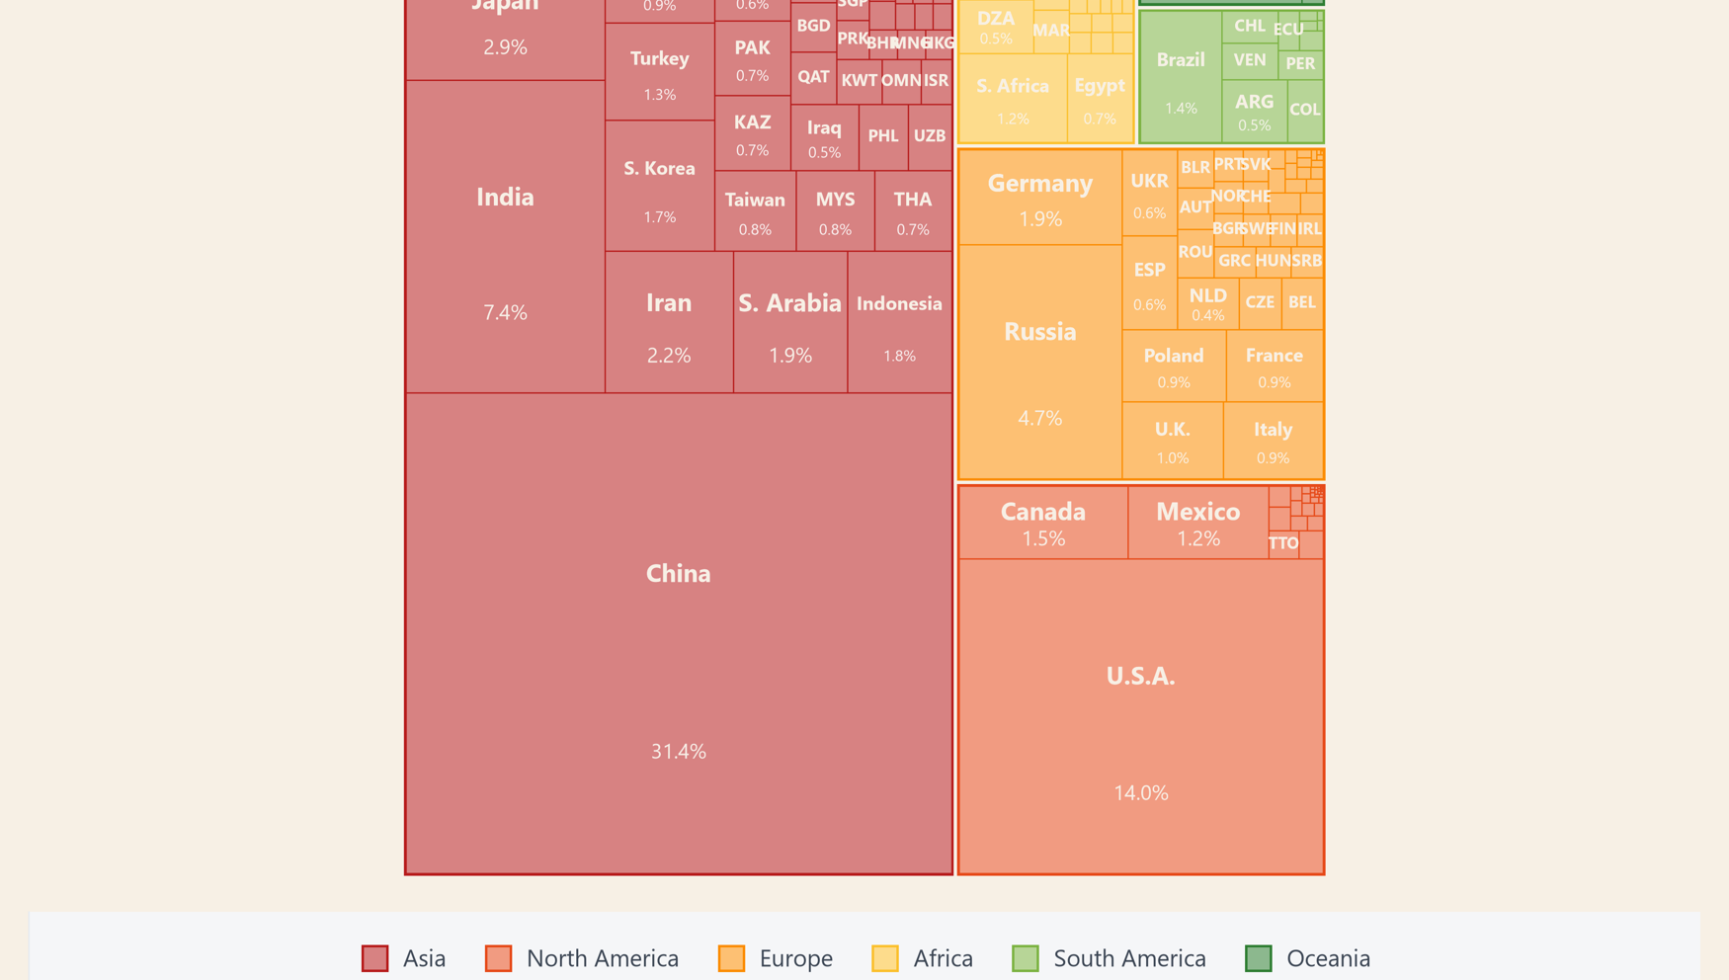
EXPLORATION OF DATASET: A small set of countries drives most 2021 emissions
5 / 7
CONCENTRATION
59.8%
Asia's share of
2021 emissions
31.4%
China's share of
the global total
81.2%
Combined share of
the top 20 emitters
Responsible: Shen Ruiting
Notes:
The treemap is suited to a part-to-whole question: rectangle area encodes each country’s share of 2021 total CO₂, while colour groups countries by region. Asia accounts for 59.8% of the total, China alone for 31.4%, and the twenty largest emitters together for 81.2%. This concentration means that global totals are driven by a relatively small set of countries, but area does not express per-capita responsibility or historical contribution. Very small countries are intentionally unlabeled because the available area is insufficient. Generative AI supported slide composition and wording; the underlying visualization was created from the merged project data.
[Sources]
- Final merged panel, 2021; project treemap figure.

Slide 6
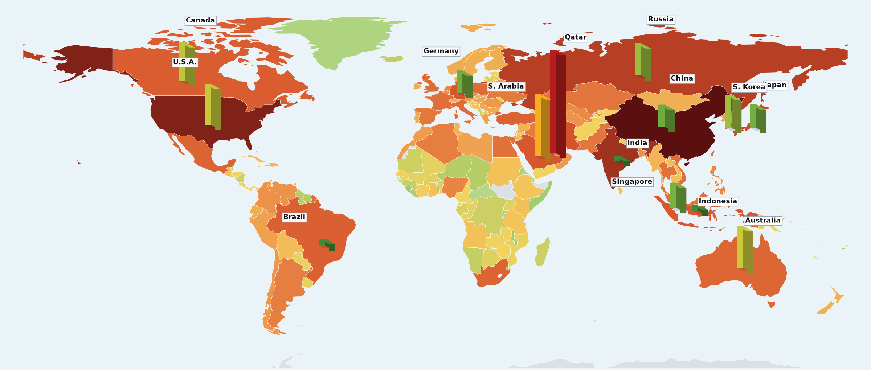
EXPLORATION OF DATASET: Total burden and per-capita intensity tell different stories
6 / 7
TWO LENSES
TOTAL
China
Largest national burden
PER PERSON
Qatar
High intensity, much smaller total
LAND FILL · CO2 PER PERSON
low
high
Scale ≠ intensity
BAR HEIGHT · TOTAL CO2
short
tall
Responsible: Shen Ruiting
Notes:
This map combines two complementary encodings. Land colour represents per-capita CO₂, while vertical bars represent total national emissions; reading both avoids treating national scale and individual intensity as the same concept. China dominates total emissions, whereas Qatar is a high-intensity example despite a much smaller national total. Of 213 entities in the panel, 169 match Natural Earth 110m polygons, covering approximately 99.6% of mapped emissions. Small islands and territories may therefore be absent from land fill. Bar height is comparative rather than a literal geographic measurement. Generative AI supported slide composition; the map was generated from the merged project data.
[Sources]
- Final merged panel, 2021; Natural Earth 110m; project scale-versus-intensity map.

Slide 7
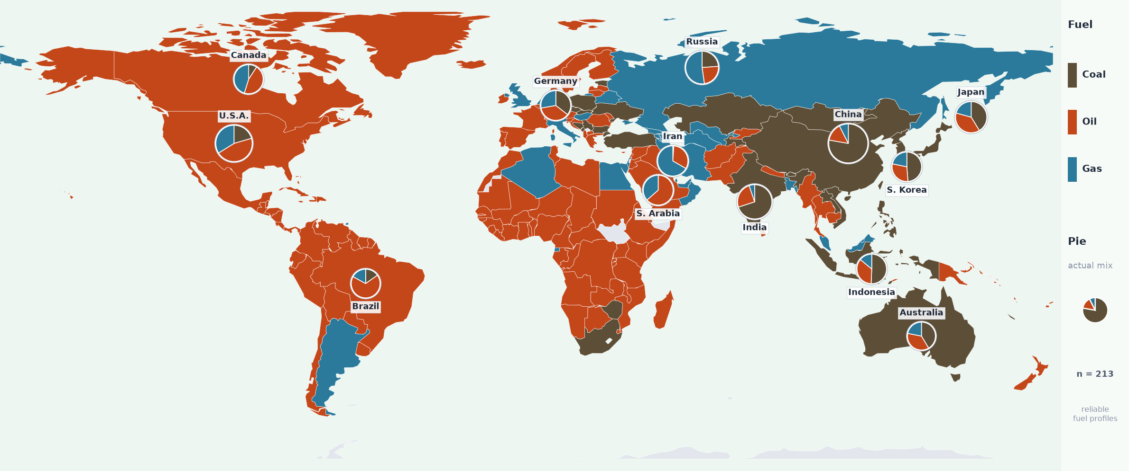
EXPLORATION OF DATASET: Fuel dependence is geographically uneven
7 / 7
COAL
Asia
OIL
Africa · Middle East · Americas
GAS
Russia · Central Asia
Dominant fuel shows category; pies retain the actual mix.
Responsible: Shen Ruiting
Notes:
This map shows the dominant fossil-fuel component for each country in 2021: coal, oil or gas. The pie charts add the actual three-fuel shares for selected major emitters, preventing a single dominant-fuel label from hiding mixed national structures. Coal dependence is prominent across much of Asia, oil dominates many countries in Africa, the Middle East and the Americas, and gas is prominent in Russia and parts of Central Asia. Fuel shares describe composition, not total magnitude, and coverage varies across small entities. Generative AI supported slide composition and wording; the map was generated from the merged project data.
[Sources]
- Final merged panel, 2021; project dominant-fuel map.

