Slide 1

Determining the best neighbourhood to expand business operations
2
+
2
+
By Raynell Foo

Slide 2


Introduction
2
+
2
+

Slide 3
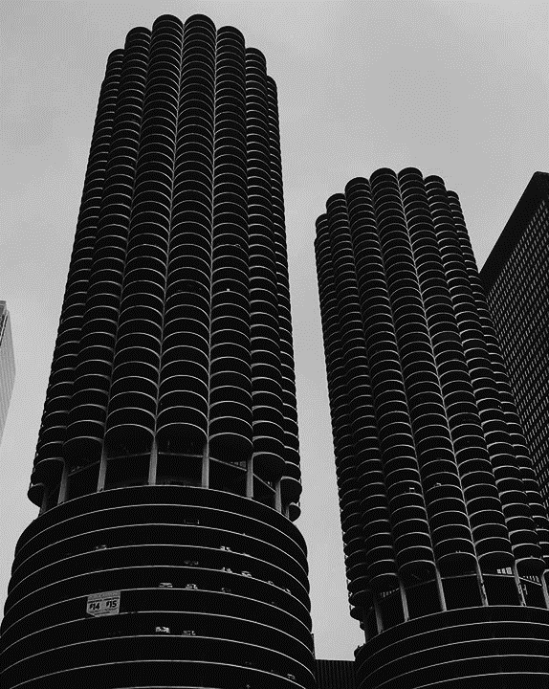
The problem
2
+
A business wants to expand business operations in Toronto.
To find out which neighbourhood to open in, the business needs to find out which neighbourhood has the most food venues.

Slide 4
The task
2
+
To determine which neighbourhood is most ideal, Foursquare’s API is utilised.
Manual webscrapping is also conducted.

Slide 5

Data acquisition and cleaning
2
+
2
+
2
+

Slide 6

Data sources
2
+
Wikipedia page of all neighbourhoods in Toronto.
Longitude and Latitude from an online downloadable.
Foursquare’s API.
Manual webscrapping.

Slide 7
Data cleaning
2
+
Bulk of work is done with multiple Pandas DataFrames.
Cleaning of html scraped through manual webscrapping is done through Beautifulsoup4.

Slide 8

Data exploratory
Statistics of Data Utilised
Python Libraries Used
4 DataFrames utilised
4 Data sources utilised
2289 rows of data generated and cleaned
1125 venues scraped and appended.
Pandas
Numpy
Lxml
Requests
Json
Beautifulsoup4

Slide 9

CONCLUSION
2
+
Central Street Bay has the highest number of food venues amongst all of Toronto’s neighbourhood.
The business should expand its operations there.

Slide 10
THANK YOU
2
+
2
+
Data Science Capstone Project

