Slide 1
Multi-Task Learning on SAR Images
A frozen DINOv3 backbone + LoRA, with a detector rebuilt for sub-patch objects
Validation Δm +38.23 · macro-F1 95.06 · mAP 45.62
CS701 · Team NN · Member A, Member B, Member C, Member D
11 Nov 2026
Notes:
One line intro: one frozen backbone, two heads; the score is driven by detection of objects smaller than a ViT patch.

Slide 2
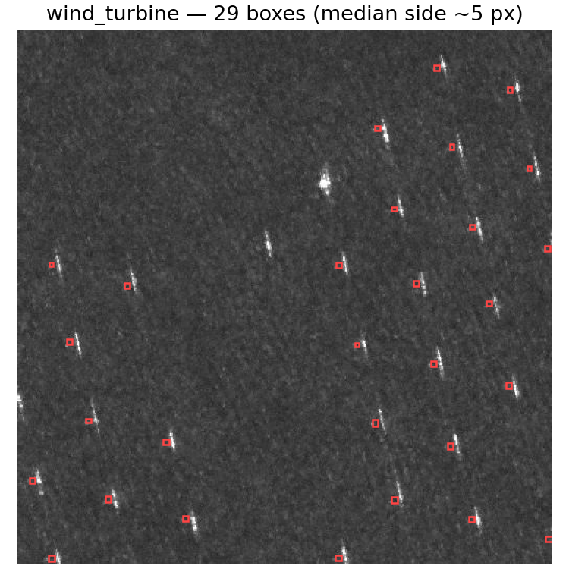
THE TASK
One model, two outputs — on radar images
Input: one 8-bit gray SAR image (75% 512×512, 25% 256×256)
Output 1: image class — 9 classes (aircraft … wind_turbine), macro-F1
Output 2: a box + class + score per object (all share the image class), COCO mAP
Ranking: Δm = mean relative gain over ViT-B/16 + LoRA reference
Budget: ≤130 M total / ≤40 M trainable params · one model · no TTA · ≤512 px in
The catch: 52.6% of boxes < 16 px — smaller than one ViT patch (median 15 px)
Notes:
SAR = microwave echo strength, not a photo: speckle, bright metal, dark water. Δm=0 means "as good as the reference". Right: a wind_turbine image — 29 objects at ~5 px each.

Slide 3
MOTIVATION
Where the score lives
Run (val reference) | macro-F1 | mAP | Δm
ViT + LoRA (reference) | 93.3 | 26.1 | 0
ViT from scratch (over budget) | 83.5 | 18.2 | −20.3
ViT full FT (over budget) | 94.4 | 32.0 | +11.8
Pretraining is everything: scratch ≈ −20 Δm
F1 saturates ≈ 94–96 → headroom is in mAP
8 px box + 2 px offset ⇒ IoU ≈ 0 → IoU matching starves tiny objects
SAR ≠ RGB: 1 channel, speckle, own mean/std
Notes:
Even the over-budget full fine-tune only reaches +11.8: the ceiling is not capacity, it is the detector design for tiny objects.

Slide 4
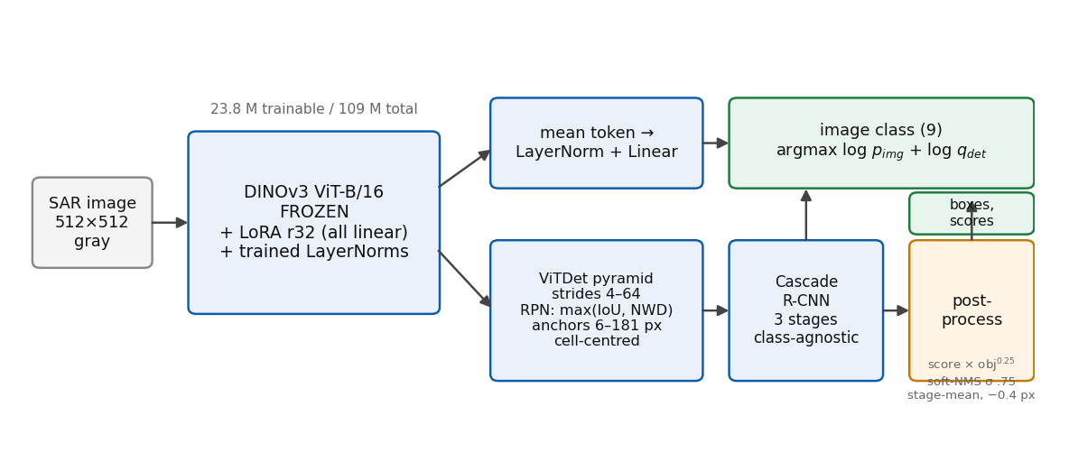
METHOD
The model: frozen DINOv3 + LoRA, two heads
post: score = p_det · obj^0.25 · soft-NMS σ.75 · stage-mean boxes · −0.4 px shift · ≥30 ≤100 boxes
image class = argmax_c log p_img(c) + log q_det(c)
23.8 M trainable / 109 M total · one forward pass
Notes:
One forward pass per image produces both outputs. Frozen backbone → we only train LoRA + heads, 23.8M of the 40M budget.

Slide 5
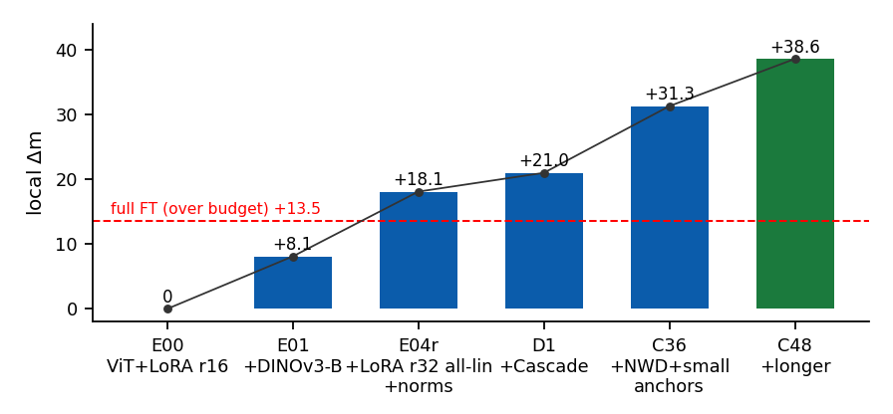
RESULTS
Ablation ladder → +38.23 on the leaderboard
macro-F1 95.06
mAP 45.62
AP50 70.38
Δm +38.23
Biggest wins: DINOv3 (+8), wide LoRA (+10), tiny-object detector (+13)
mAP drives Δm: +19.5 over ref; F1 +1.75
Beats the over-budget full-FT upper bound (+13.5)
Notes:
Screening rule: only differences > ~1.5 Δm trusted (seed noise ±1). Local holdout over-estimates the leaderboard by ~3 mAP.

Slide 6
POST-PROCESSING
Free mAP on frozen outputs (one forward pass)
Step | Δ mAP
score = p_det × RPN objectness^0.25, per-class soft-NMS σ .75 | +1.3–1.8
box = mean of the 3 cascade stages | +0.3–0.5
−0.4 px shift (measured annotation bias) | +0.4–0.7
threshold 1e−5, keep ≥30 ≤100 boxes | +0.1–0.2
image class = argmax log p_img + log q_det | ±0.2 F1
All steps reuse the same single forward pass — no ensemble, no TTA
Raw outputs dumped once → whole study re-scored in seconds (pp_study.py)
≈ +2–3 mAP total on the same model
Notes:
COCO mAP rewards keeping low-scored boxes: every image has ≥1 object so a 30-box floor only adds recall.

Slide 7
NEGATIVE RESULTS
What did not work (and what we kept)
token-stride 8 (overlapping patches): +bridge/playground/turbine, −0.4 mAP overall (oil tank) · 2.6× cost
LoRA rank 64 · Mona adapters · multi-level ViT neck · ConvNeXt backbones
D4 rotations + same-class copy-paste augmentation
DINO-YOLO cls-head: +3–4 F1 but −1.5 mAP → kept detector-vote class
Selection discipline: screen on the stratified local split (80/10/10),
submit to the leaderboard at most what the holdout justifies
Notes:
Every dropped option has a local-split measurement behind it — this is the "interesting extensions" bonus evidence.

Slide 8
EFFICIENCY
Budget & a lighter single-shot family
Model | total | trainable | local Δm | note
Ours (V2) | 109.0 M | 23.8 M | +38.2 (LB) | 15 ms/img, 3.5 h on 2×RTX 6000
DINO-YOLO26-s | 31.9 M | 31.9 M | +21.3 | single-shot; class from detections
improved YOLO11-s | ~9.5 M | ~9.5 M | +20.5 (LB) | 48 epochs
Reference LoRA | 107 M | 21.0 M | 0 | ViT-B/16 + Faster R-CNN
DINO features fused into YOLO via zero-init 1×1 convs: +3–4 mAP over plain YOLO26-s
Two-stage wins on mAP (+8–9) at 3× the parameters — accuracy vs footprint trade-off
Where the 40 M budget went: ~20 M heads, ~3.5 M LoRA + norms
Notes:
DINO-YOLO: DINOv3 ViT-S features resized + zero-init 1×1 conv added to P3/P4/P5 — training starts from COCO-pretrained YOLO.

Slide 9
WRAP-UP
Phase 2 plan & take-away
Phase 2 (test, 2 submissions only):
  F1_full — V2 recipe retrained on all 9,392 labelled images, 100 epochs
  Second slot: best-screened variant (EMA / second seed) — raw outputs saved
  for post-hoc re-scoring without re-running the model
Take-away:
  Freeze a strong self-supervised backbone; spend the budget on wide LoRA
  and a detector rebuilt for sub-patch objects — detection is where Δm lives
Notes:
Close on the single sentence. Q&A backup slides follow.

Slide 10
Q&A
Backup: per-class & size analysis
Weak classes: bridge, playground, wind_turbine (confuse with each other & oil_tank)
[per-class AP table from tools/size_ap.py — insert]
[AP by box size — insert]
Local holdout over-estimates Codabench val by ~3 mAP (48.9 vs 45.6)
Notes:
Fill with tools/size_ap.py output on V2 raw dumps.

Slide 11
Q&A
Backup: submission format & reproducibility
submission.zip
├── classification.csv image_id,label (one row per image, label 0–8)
└── detection.json [{"image_id","category_id" 1–9,"bbox" [x,y,w,h] orig px,"score"}]
check_submission.py → format rules + box/class agreement
predict.py --raw-out → raw outputs kept for re-scoring
train.py prints total & trainable parameters (109,014,752 / 23,805,152)
Notes:
Mention seed policy: gains < ~2 reported as mean±std in the report.

