Slide 1
Visual Analytics: Introduction to Statistical Pattern Analysis
Ian Nabney
ian.nabney@bristol.ac.uk

Slide 2
Overview
Contextual reading: selections from chapter 1 of Bishop (free pdf available from https://www.microsoft.com/en-us/research/uploads/prod/2006/01/Bishop-Pattern-Recognition-and-Machine-Learning-2006.pdf )
Understand key concepts of fitting models to data
Able to use simple methods for model selection
Understand the relevance of the ‘curse of dimensionality’ to model fitting and overfitting
Understand the basic principles of information theory as they apply to pattern analysis

Slide 3
Overview of pattern analysis part of unit
We will cover principles, algorithms, and application of linear and non-linear methods for statistical pattern recognition.
The primary focus will be on dimensionality reduction, but this will allow us to cover a range of other models in passing (e.g. Gaussian mixture models, Gaussian Processes, kernel methods, etc.).
It is aimed to complement Introduction to AI. Some of material may overlap, but the principles are so fundamental, this is not a bad thing
It cannot be comprehensive: the Wikipedia page on non-linear dimensionality reduction methods lists 12 ‘Important Concepts’ and 14 ‘Other Algorithms’ and that does not include some of the methods that will be discussed in this unit!
Theory in lectures will be followed by practical exercises in the labs.

Slide 4
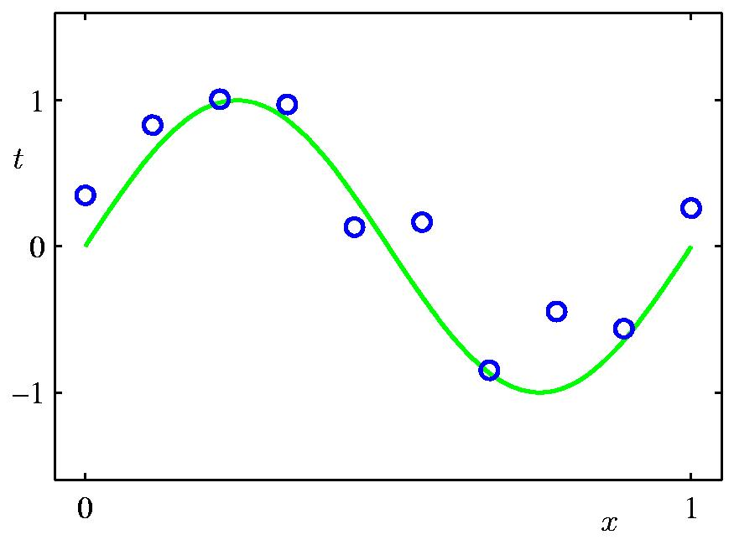
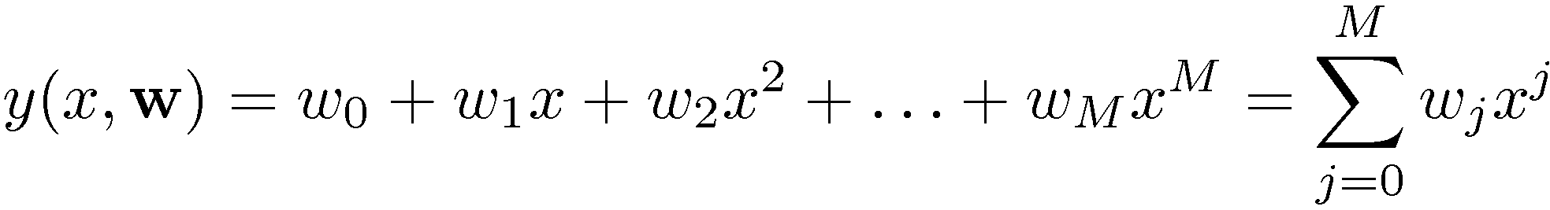
Polynomial Curve Fitting

Slide 5
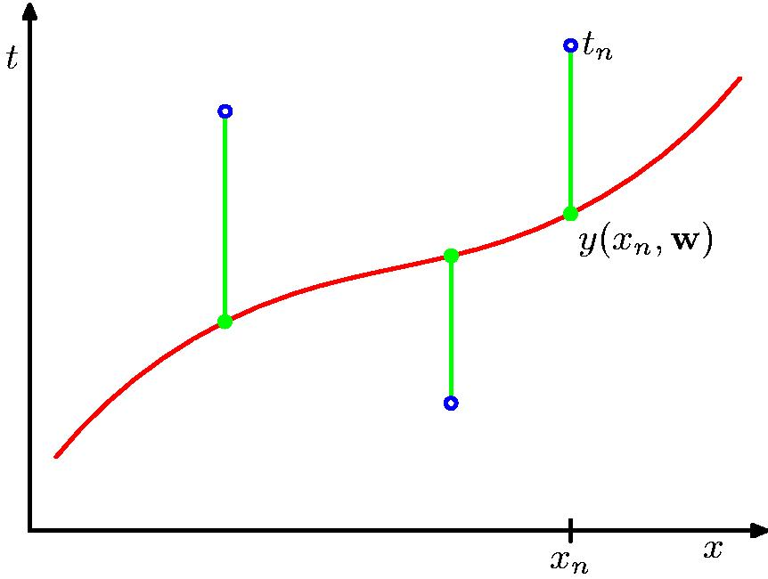
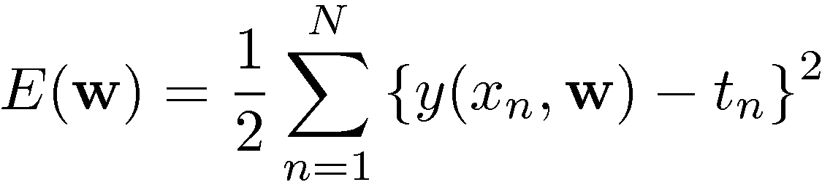
Sum-of-Squares Error Function

Slide 6
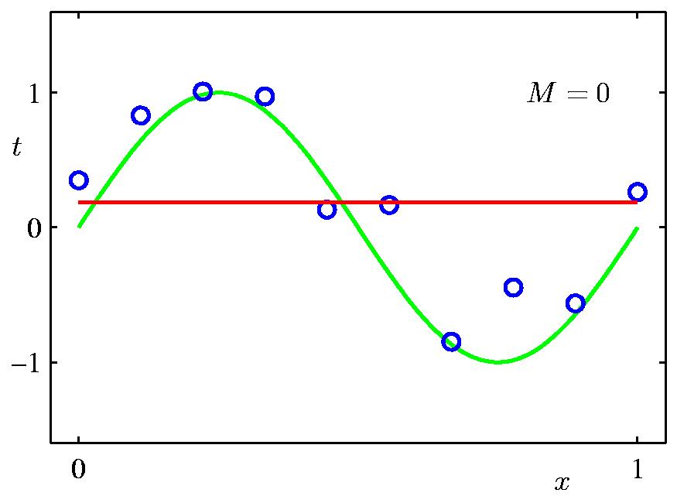
0th Order Polynomial

Slide 7
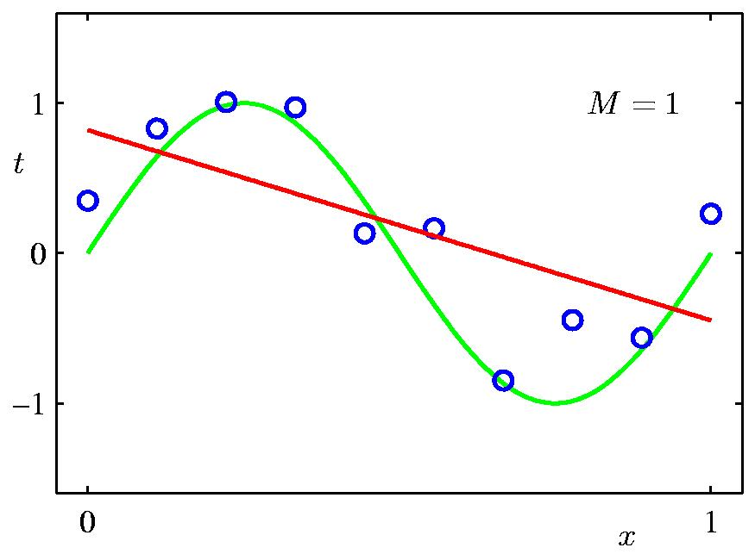
1st Order Polynomial

Slide 8
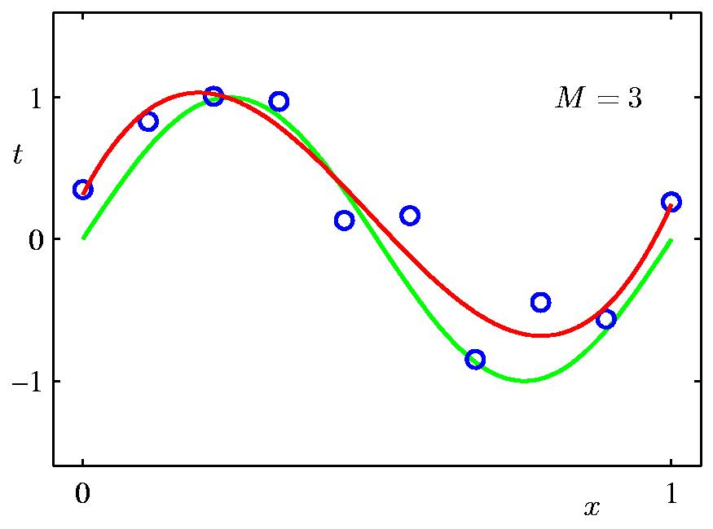
3rd Order Polynomial

Slide 9
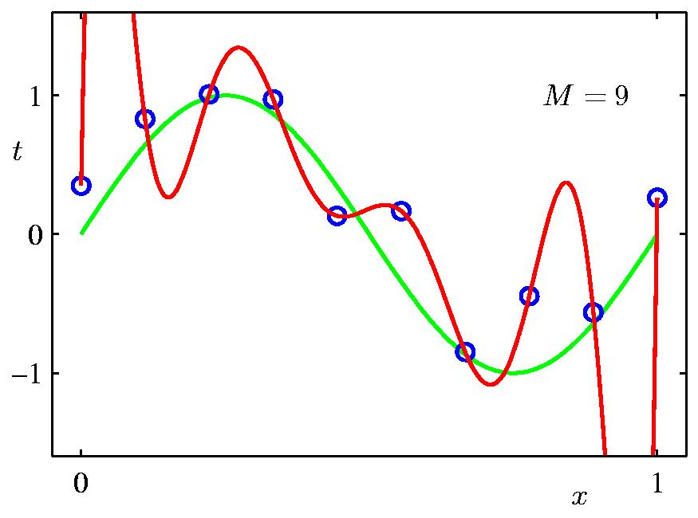
9th Order Polynomial

Slide 10
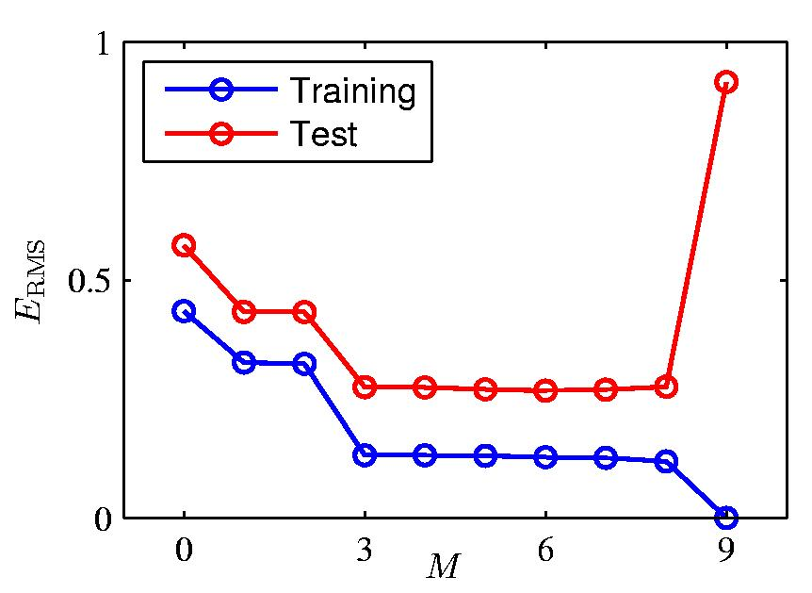
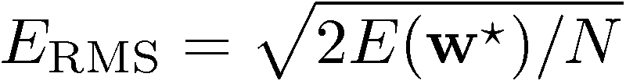
Over-fitting
Root-Mean-Square (RMS) Error:

Slide 11
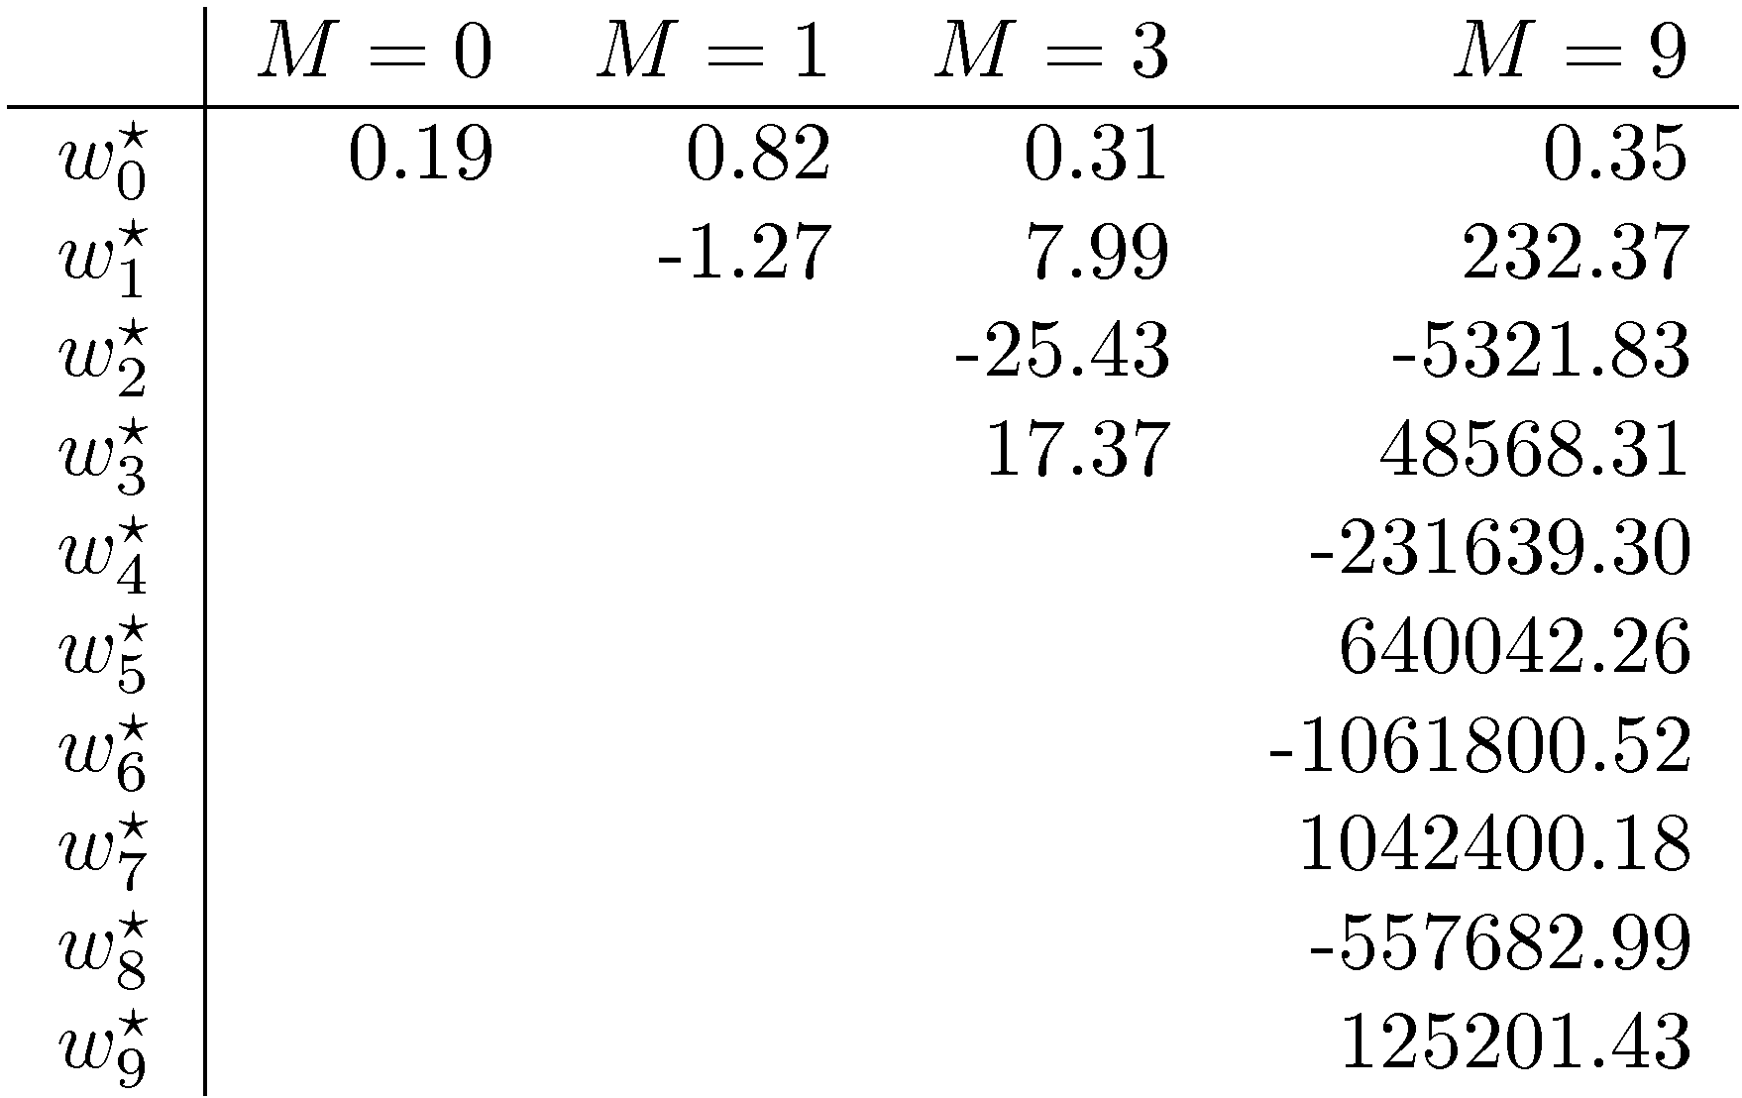
Polynomial Coefficients

Slide 12

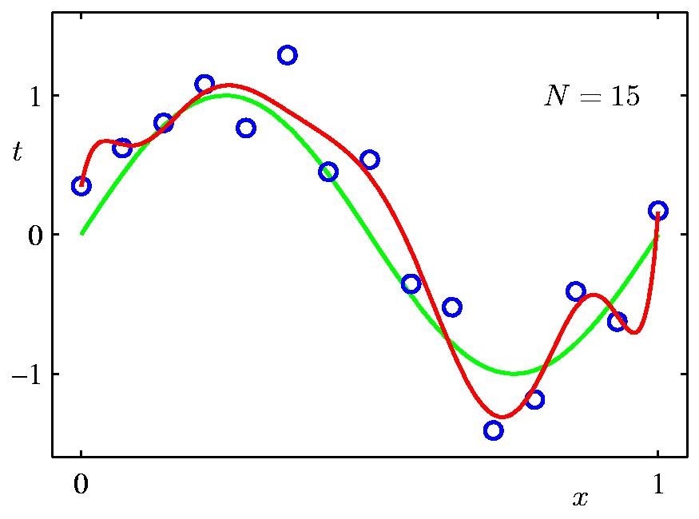
Data Set Size:
9th Order Polynomial

Slide 13

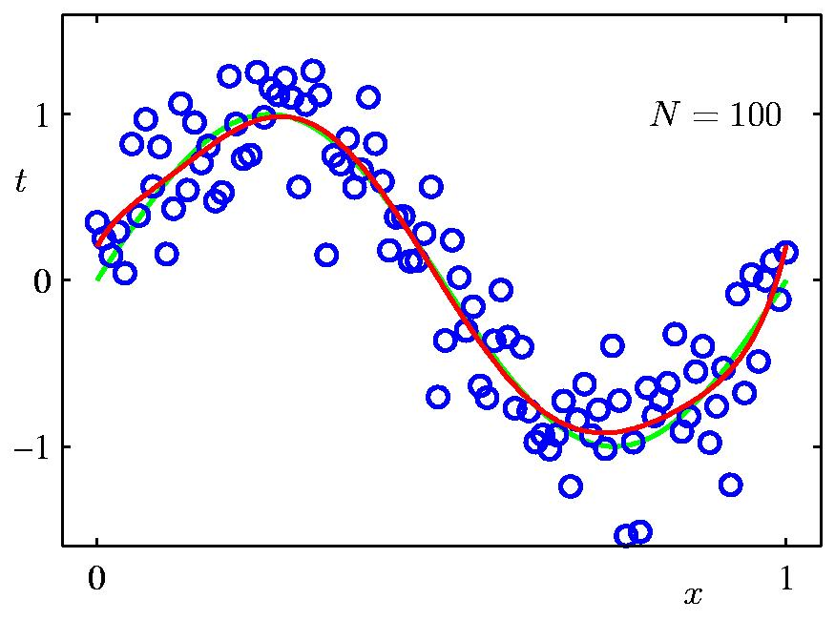
Data Set Size:
9th Order Polynomial

Slide 14
Managing model complexity
One rough heuristic that is sometimes advocated is that the number of data points should be at least 5 or 10 times the number of adaptive parameters in the model.
But the number of parameters is not necessarily the best measure of model complexity.
There is something unsatisfying about having to limit the number of parameters in this way. It would be better to choose the complexity of the model according to the complexity of the problem.
This approach is an example of maximum likelihood, and over-fitting is a general property of this approach.
By adopting a Bayesian approach, this problem can be avoided, at the cost of additional mathematical complexity.
Indeed, from the Bayesian perspective, there is no difficulty in employing models for which the number of parameters greatly exceeds the number of data points. The effective number of parameters adapts automatically to the size of the dataset.

Slide 15
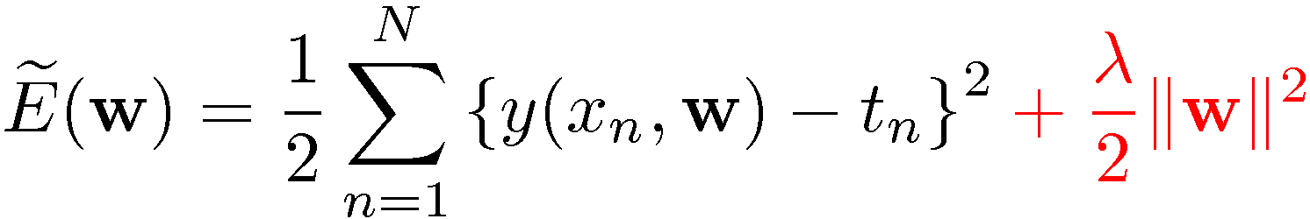
Regularization
Penalize large coefficient values

Slide 16

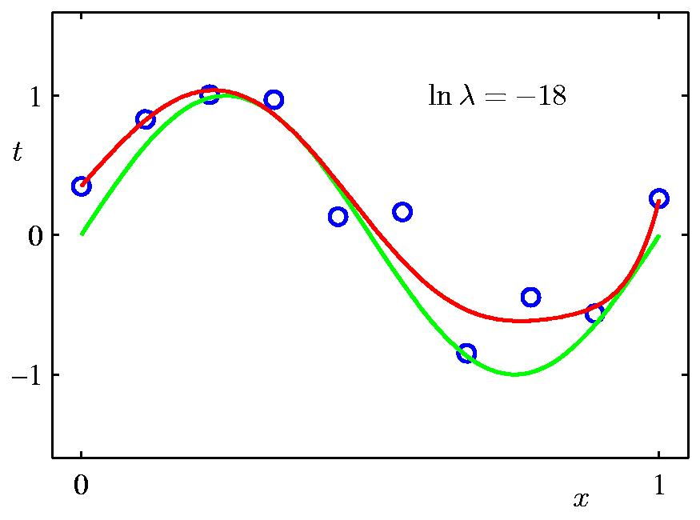
Regularization:

Slide 17

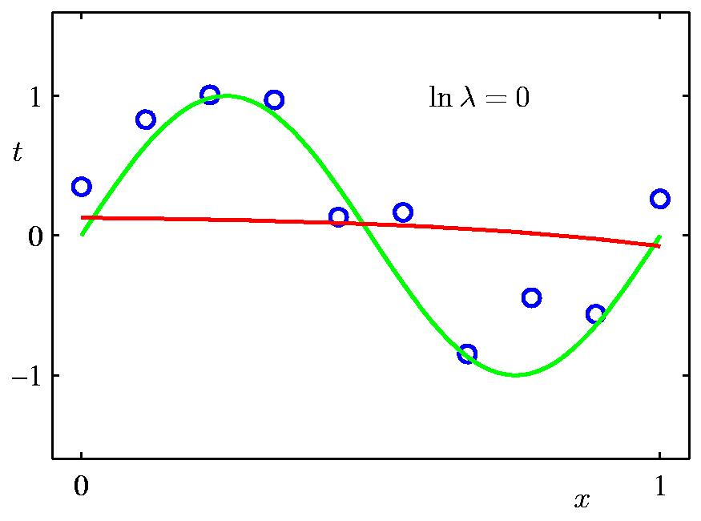
Regularization:

Slide 18


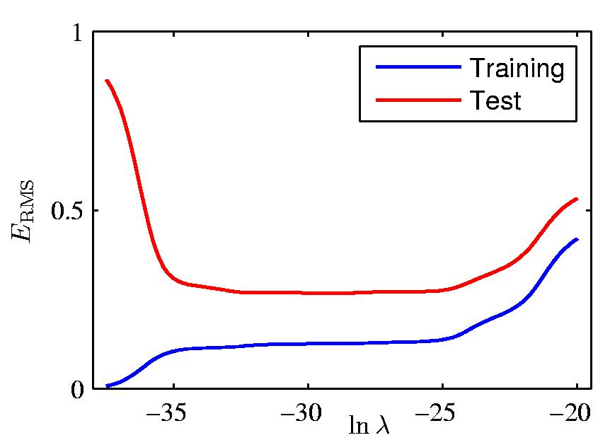
Regularization: vs.

Slide 19
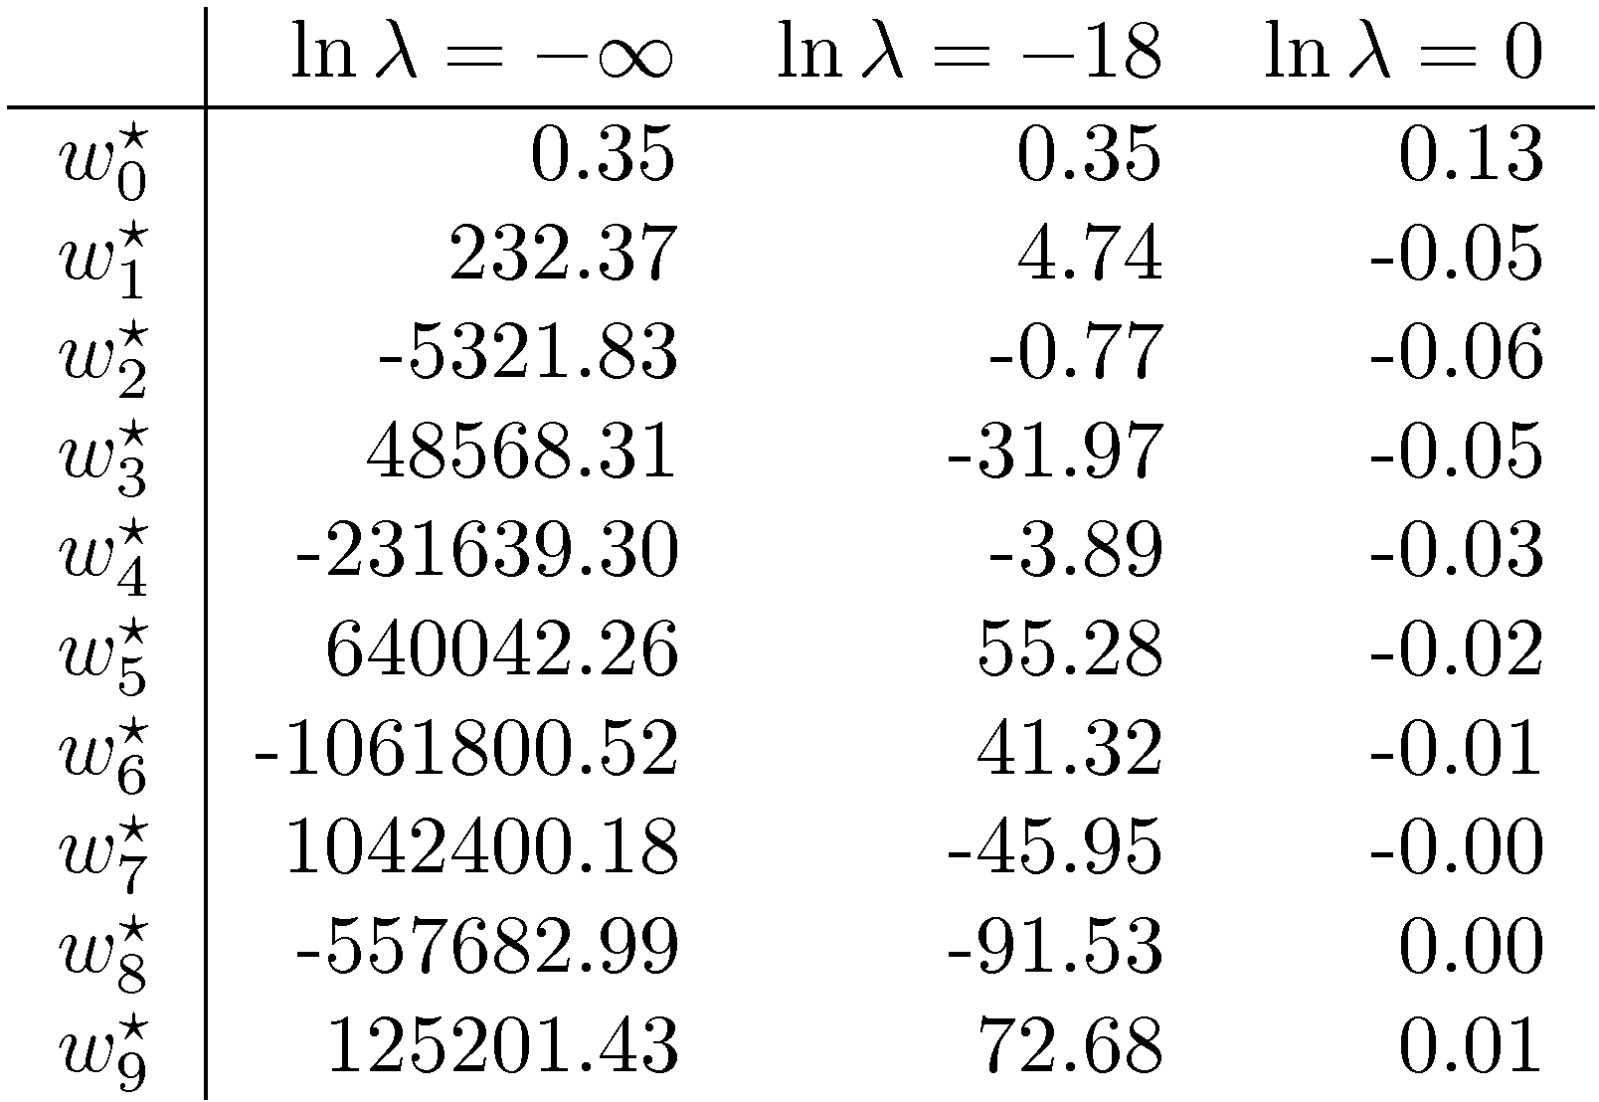
Polynomial Coefficients

Slide 20
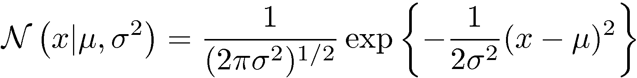
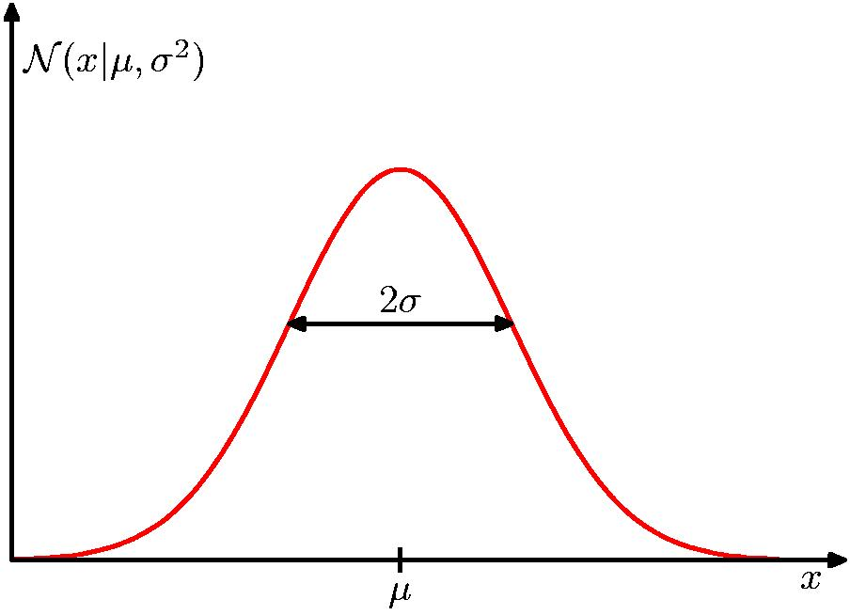
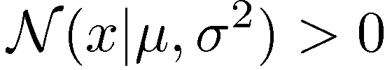
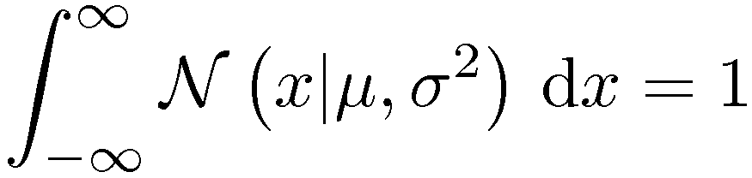
The Gaussian Distribution

Slide 21
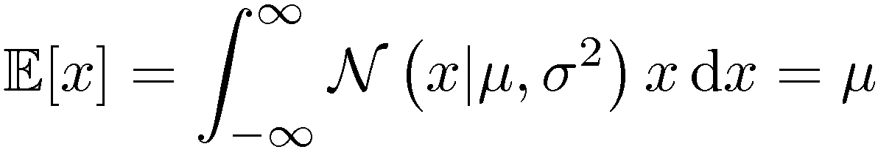
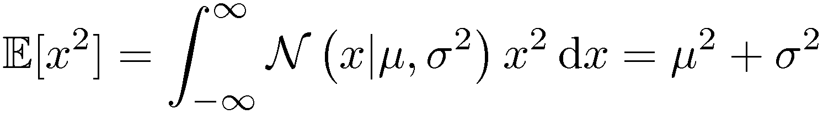
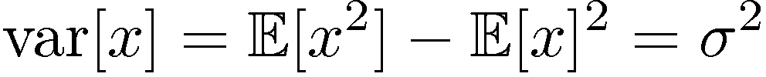
Gaussian Mean and Variance

Slide 22
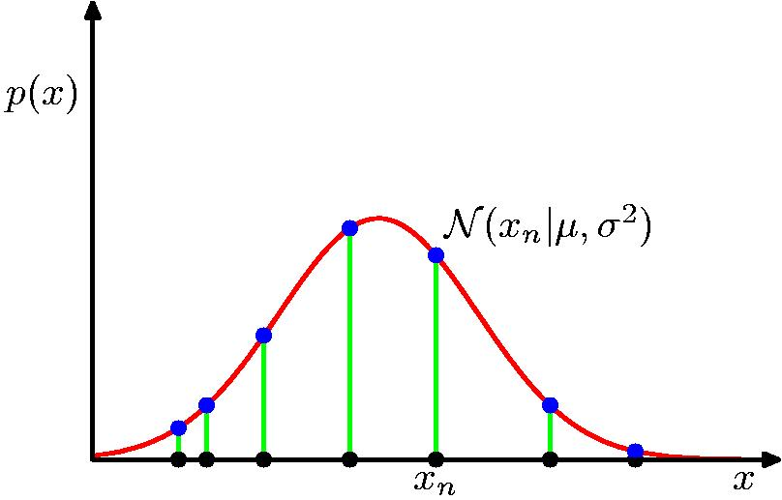
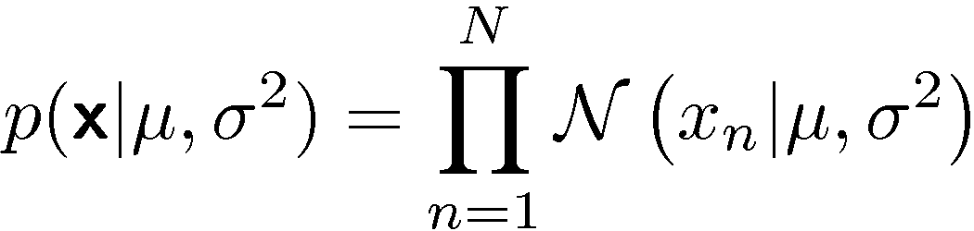
Gaussian Parameter Estimation
Likelihood function

Slide 23
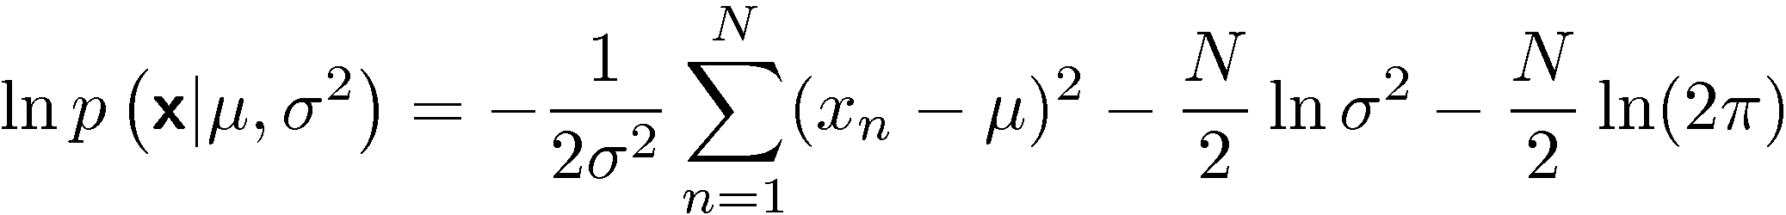
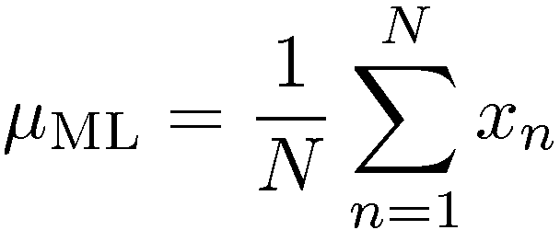
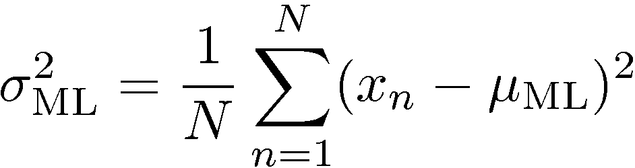
Maximum (Log) Likelihood

Slide 24
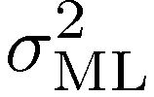


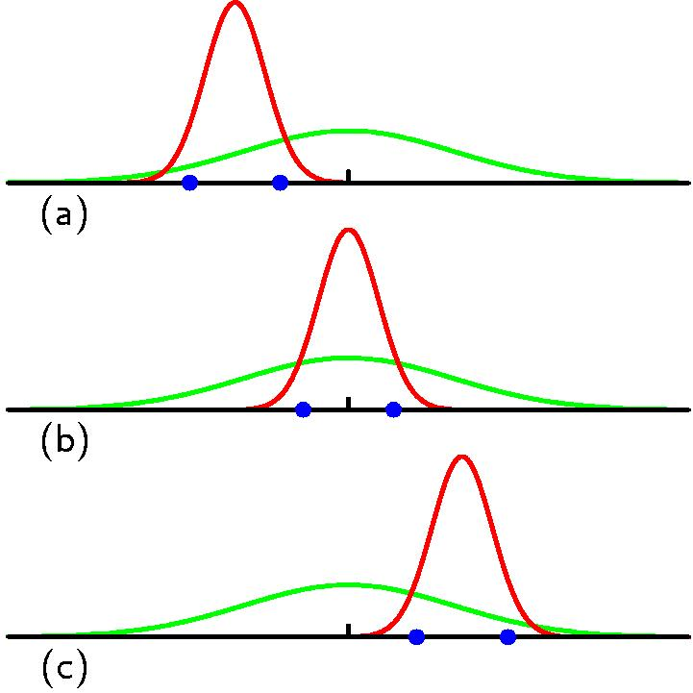
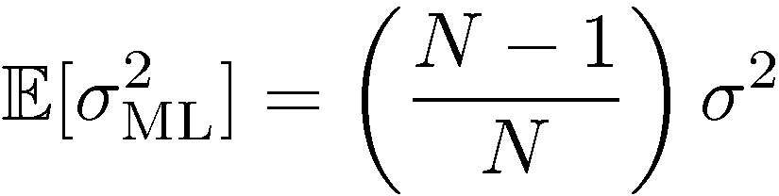
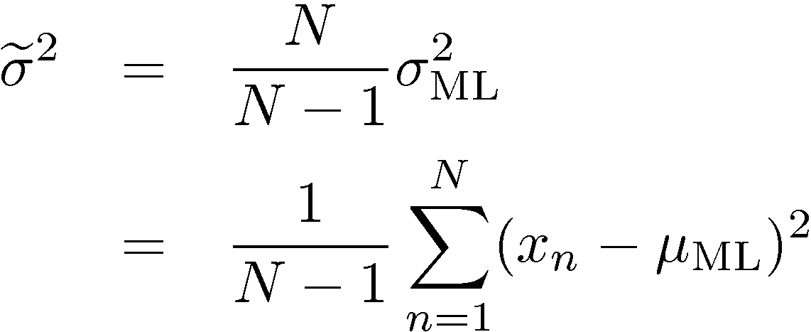
Properties of and

Slide 25
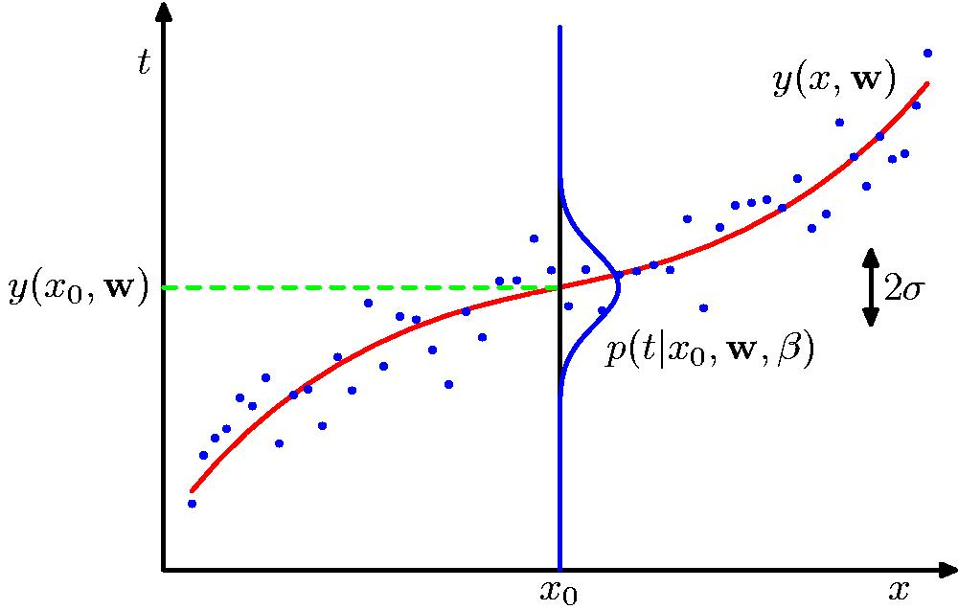
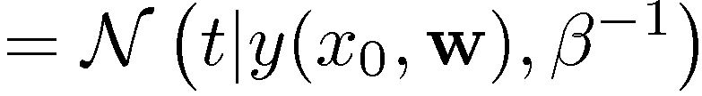
Curve Fitting Re-visited

Slide 26
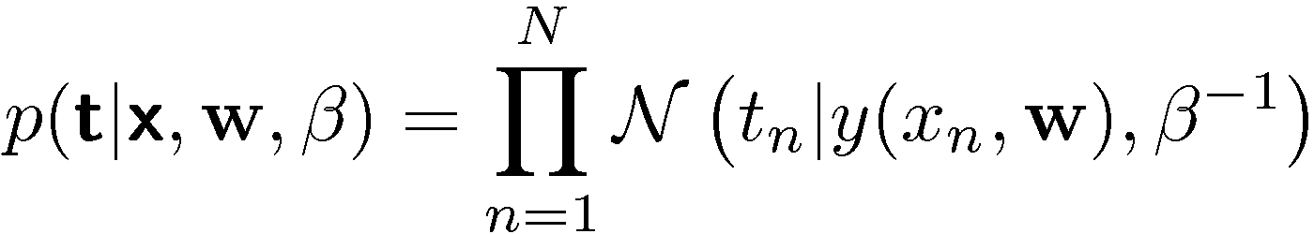
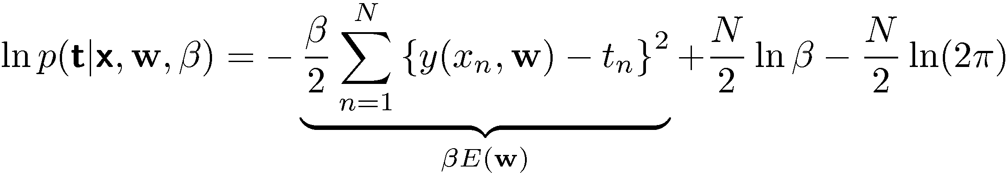


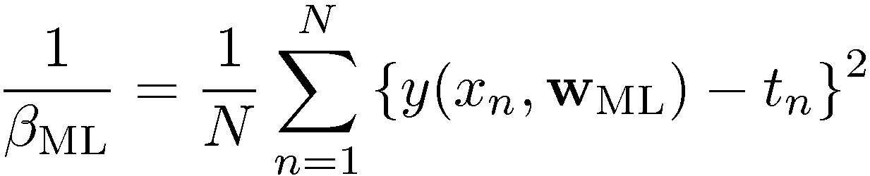
Maximum Likelihood
Determine by minimizing sum-of-squares error, .

Slide 27
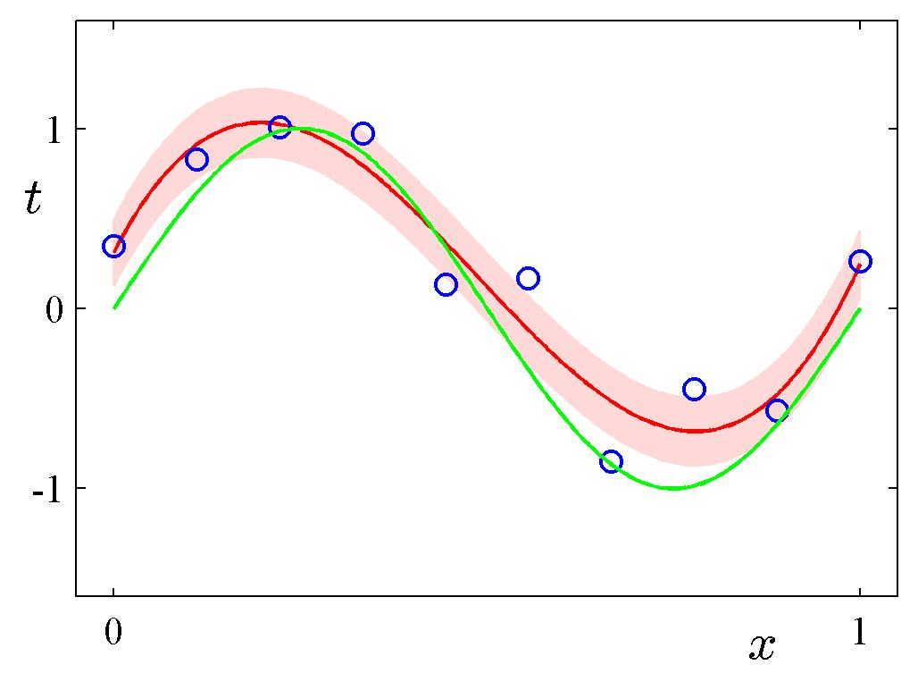
Predictive Distribution

Slide 28
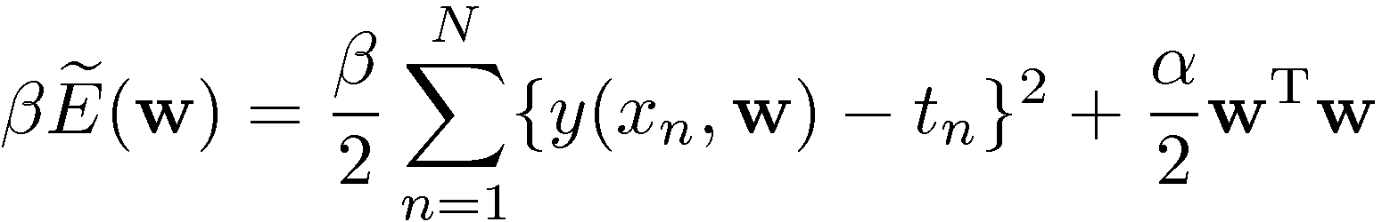

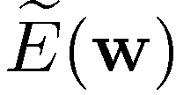
MAP: A Step towards Bayes
Determine by minimizing regularized sum-of-squares error, .

Slide 29
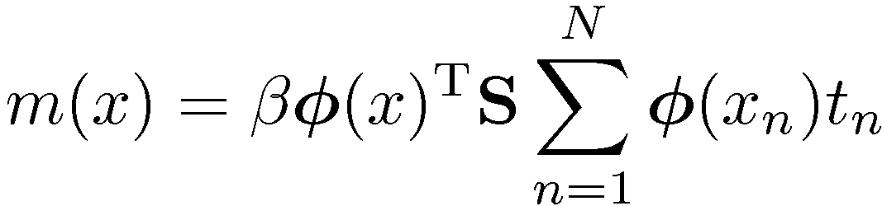
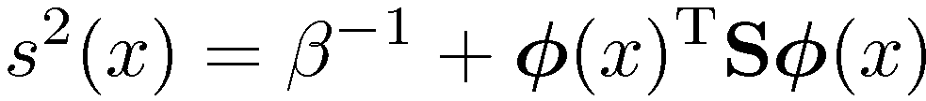
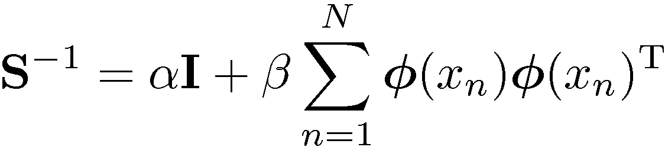
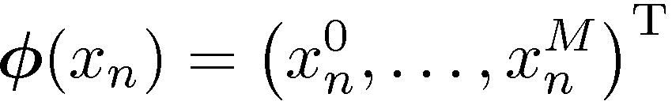
Bayesian Curve Fitting

Slide 30
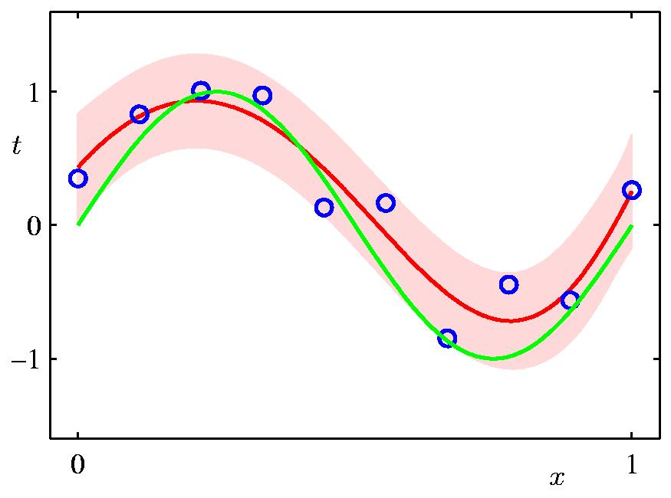
Bayesian Predictive Distribution

Slide 31
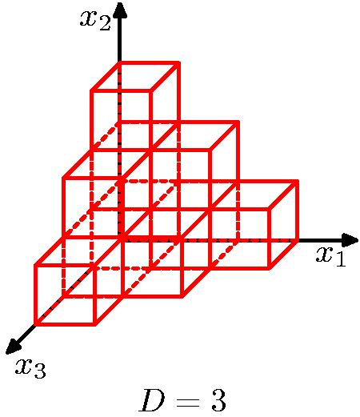
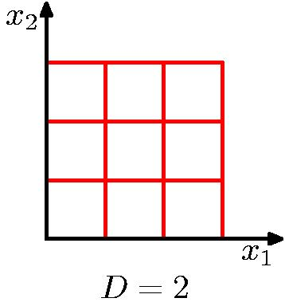
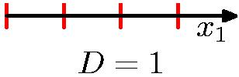
Curse of Dimensionality

Slide 32


Curse of Dimensionality
Polynomial curve fitting, M = 3
Gaussian Densities in higher dimensions

Slide 33
Pattern analysis in high dimensions
We can still find effective techniques in high dimensions for two reasons:
Real data is often confined to a region of the space having lower effective dimensionality. In particular, the directions over which important variations in the target variables occur may be so confined.
Real data typically exhibits some smoothness properties (at least locally) so that for the most part small changes in input variables produce small changes in the target variables. We can exploit local interpolation-like techniques to allow us to make predictions of the target variables.

