Slide 1
Visual Analytics: Data Abstraction
Ian Nabney
ian.nabney@bristol.ac.uk

Slide 2
Overview
Reading: Chapter 2 of Munzner (e-book that can be downloaded from UoB library website)
Understand what we are presenting: the categorisation of data
Able to describe the type and semantics of variables and datasets

Slide 3
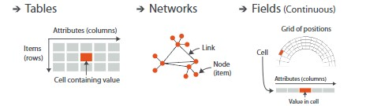
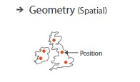
The Big Picture
Three primary dataset types: tables, networks, spatial
Four data types: items, attributes, links, positions
Datasets may be available all at once as a static file or dynamically processed in the form of a stream
Attributes (also known as variables or dimensions) may be nominal, ordinal, or continuous

Slide 4
Data semantics and types
Measurement theory states that you should treat variables/attributes in a way that respects the meaning of the measurement (‘semantics’)
Nominal attributes are distinct symbols (reasonably small number). The value serve as labels. The only comparison that makes sense is equality (two values are the same or different): e.g. colour
Ordinal attributes are symbols with a meaningful order but no distance measure: e.g. ‘hot’, ‘mild’, ‘cold’. Ordered comparison makes sense ‘temperature > mild’
Interval attributes are numeric and the size of the difference in values is meaningful: e.g. temperature on Celsius scale
Ratio attributes are numeric and there is a well-defined zero point (so comparisons involving ratios make sense): e.g. weight

Slide 5
Dataset types
For a simple flat table, each row represents an item of data, and each column is an attribute of the dataset.
Networks are well suited for modelling relationships between two or more items. An item in a network is often called a node. A link is a relation between two items. Nodes may also have associated attributes. A tree has no cycles/loops.
Spatial datasets store attribute values together with a location where they were measured. In regular grids, this location may be implicit.
More complex datasets may well combine these types with other measurements (such as geometry, time series, etc.).

Slide 6
Dataset availability
The default approach to vis assumes that the entire dataset is available all at once, as a static file.
However, some datasets are instead dynamic streams, where the dataset information trickles in over the course of the vis session.
One kind of dynamic change is to add new items or delete previous items.
Another is to change the values of existing items.
A dataset may be static in principle, but so large that it has to be accessed in a streamed form.

Slide 7
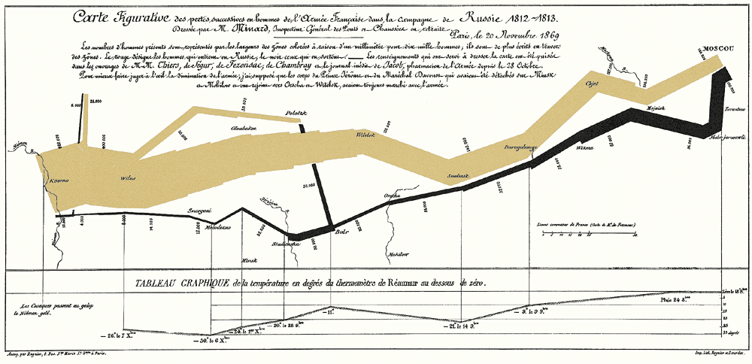
Minard the map maker

Slide 8
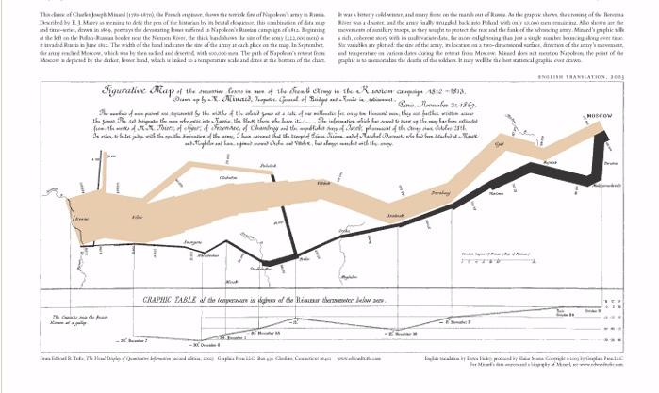

Map in English
Minard was a French civil engineer
Map drawn in 1861
Six types of variables shown in a single plot

Slide 9
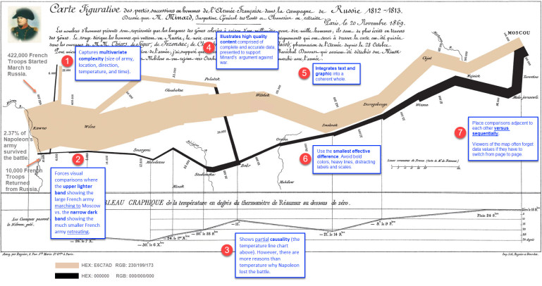
Annotated map
https://datavizblog.com/2017/07/11/dataviz-as-history-annotating-minards-napoleon-map/

