Slide 1
Visual Analytics: Marks and Channels
Ian Nabney
ian.nabney@bristol.ac.uk

Slide 2
Overview
Reading: Chapter 5 of Munzner (e-book that can be downloaded from UoB library website)
Explain why we consider marks and channels
Able to use appropriate marks and channels with justification

Slide 3
What are marks and channels?
Reasoning about marks and channels enables you to analyse visual encodings
The core of the design space of visual encodings combinestwo aspects: graphical elements called marks, and visual channels to control their appearance
The effectiveness of a channel for encoding data depends on its type: the channels that perceptually convey magnitude information are a good match for ordered data, and those that convey identity information with categorical data.

Slide 4

Marks
Marks are geometric primitive objects classified according to the number of spatial dimensions they require.
a zero-dimensional (0D) mark is a point
a one-dimensional (1D) mark is a line
a two-dimensional (2D) mark is an area.
A three-dimensional (3D) volume mark is possible, but they are not frequently used

Slide 5
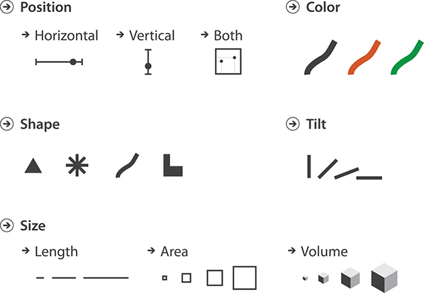
Channels
In addition, there are motion channels

Slide 6
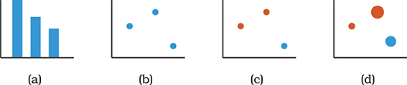
Combining marks and channels
Can show multiple independent dimensions
Height of the bar conveys a quantitative value for that attribute. Bar charts show two attributes, but only one is quantitative: the other is the categorical attribute used to spread out the bars along the axis.
A second, independent quantitative attribute can be encoded by using the visual channel of horizontal spatial position. The mark type needs to be a point: a scatterplot.
You cannot continue to add more spatial position channels when creating drawings in two-dimensional space, but many visual channels are nonspatial. An additional categorical data attribute can be encoded in a scatterplot format using the visual channel of hue.
The addition of a fourth quantitative attribute encoded with the visual channel of size.

Slide 7
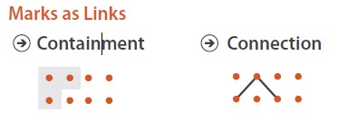
Channel and mark types
The human perceptual system has two fundamentally different kinds of sensory modalities:
identity channels tell us information about what something is or where it is
magnitude channels tell us how much of something there is
For table datasets, a mark always represents an item.
For network datasets, a mark might represent either an item (node) or a link representing a relationship between items
A connection mark shows a pairwise relationship between two items, using a line
A containment mark shows hierarchical relationships using areas: can be nested within each other at multiple levels

Slide 8
Expressiveness and effectiveness
Visual encoding should express all of, and only, the information in the dataset attributes
ordered data should be shown in a way that our perceptual system intrinsically senses as ordered
unordered data should not be shown in a way that perceptually implies an ordering that does not exist
recall the characterisation of attribute types
effectiveness principle dictates that the importance of the attribute should match the salience of the channel; that is, its noticeability.
The most important attributes should be encoded with the most effective channels in order to be most noticeable, and then decreasingly important attributes can be matched with less effective channels

Slide 9
Channel effectiveness
Five criteria:
accuracy,
discriminability,
separability,
ability to provide visual popout,
ability to provide perceptual groupings
Answers come to us from psychophysics, the subfield of psychology devoted to the systematic measurement of general human perception

Slide 10
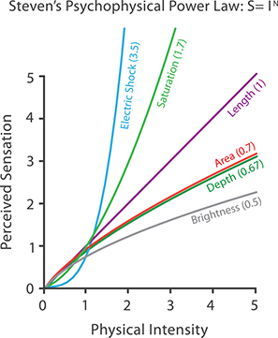
Accuracy
Power law of perception $S=I^{n}$
S is the perceived sensation and I is the physical intensity
Want phenomena with n close to 1
Experiments on magnitude channels:
aligned position against a common scale
unaligned position against an identical scale
length
angle
area judgements are notably less accurate than all of these.

Slide 11
Discriminability
Are differences between items perceptible as intended?
Quantify the number of bins that are available for use within a visual channel, where each bin is a distinguishable step or level from the other
The number of different values that need to be shown for the attribute being encoded must not be greater than the number of bins available for the visual channel used to encode it.
If not, aggregate value or choose a different channel
Linewidth can only discriminate 3 or 4 levels

Slide 12
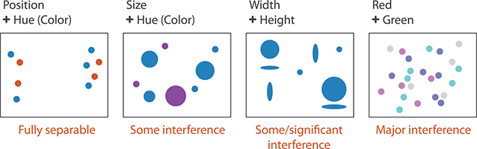
Separability
There may be interactions between channels that affect their interpretation
Visual encoding is straightforward with separable channels, but attempts to encode different information in integral channels will fail
Integrality versus separability is not good or bad; you must match the characteristics of the channels to the information that is encoded.

Slide 13
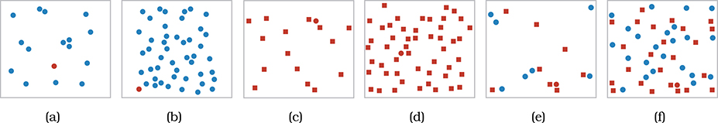
Popout
Many visual channels provide visual popout, where a distinct item stands out from many others immediately
Our low-level visual system does massively parallel processing on these visual channels, without the need for the viewer to consciously directly attention to items one by one
The time it takes for the red circle to pop out of the sea of blue ones is roughly equal when there are 15 blue ones as in (a) or 50 as in (b)
The difference between red and blue on the colour hue channel is larger than the difference in shape between filled-in circles and filled-in squares

Slide 14
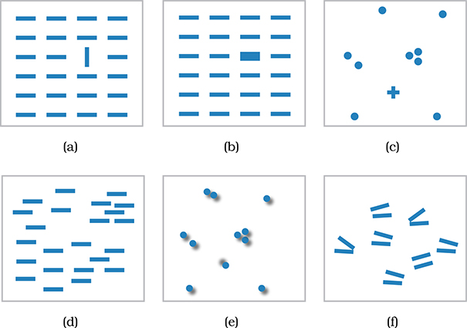
Popout on other channels
Other channels that support popout include: tilt, size, shape, proximity, and even shadow direction but not parallelism

Slide 15
Grouping
Grouping can be conveyed either by link marks or identity channels
For link marks, containment is a stronger cue for grouping than connection
All of the items that share the same level of the categorical attribute can be perceived as a group: this is not as strong as the use of connection or containment marks, but it does not add clutter in the form of extra link marks
The third strongest grouping approach is proximity; i.e., placing items within the same spatial region
The final grouping channel is similarity with the other categorical channels of hue and motion, and also shape if chosen carefully

Slide 16
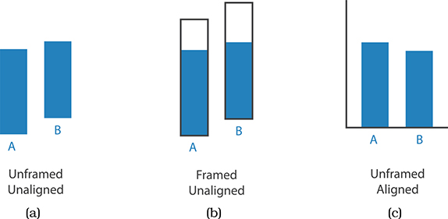
Relative and absolute judgement
The human perceptual system is fundamentally based on relative judgements, not absolute ones; Weber’s Law
For instance, the amount of length difference we can detect is a percentage of the object’s length
This principle holds true for all sensory modalities: our senses work through relative rather than absolute judgements

Slide 17
Conclusions
Explain why we consider marks and channels
Able to use appropriate marks and channels with justification
Next step will be to delve into psychophysics in greater depth to understand some of the underlying science of visual perception

