Slide 1

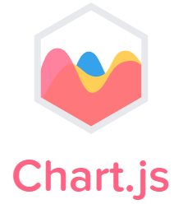








Having Fun with JavaScript
Introduction to Two JavaScript Visualization Libraries
......

Slide 2
Low learning cost
Echarts is a visualization Library Based on canvas. Its biggest feature is intuitive syntax. You need to use JSON format to configure charts. It encapsulates most of the graphics you can think of and you can‘t think of. If you want to use it, you just need to call it directly. At the same time, it also has plenty of interaction and animation effects. Just like this, https://echarts.apache.org/en/feature.html#fancy-effects
Customization and flexibility
If we see the codes about D3 as a refresher, we may not understand what those mean quickly. Cause, D3 is the library drawing charts through SVG, based on XML. D3 doesn't encapsulate charts, so we need to add canvases and draw graphics on our own. Each drawn chart is an object and customized events can be added to objects, which cannot be done in Echarts.

Slide 3
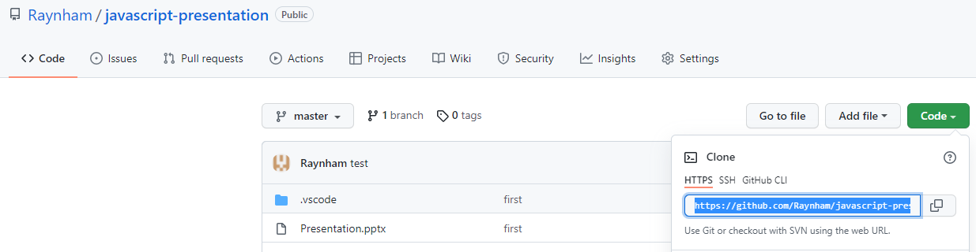
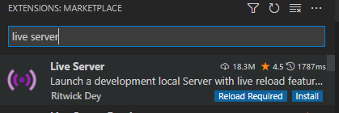
Before Introducing Further…
(1)
git clone https://github.com/Raynham/javascript-presentation.git to get some examples
(2)
Install an extension named “live server” in VS Code, which can launch a local development server for static and dynamic pages. Some examples will appear errors if open as a local file (Maybe due to the strict same-origin policy of Chrome and Edge).
If you finish, please click: https://www.menti.com/3yfjgzaw7d

Slide 4
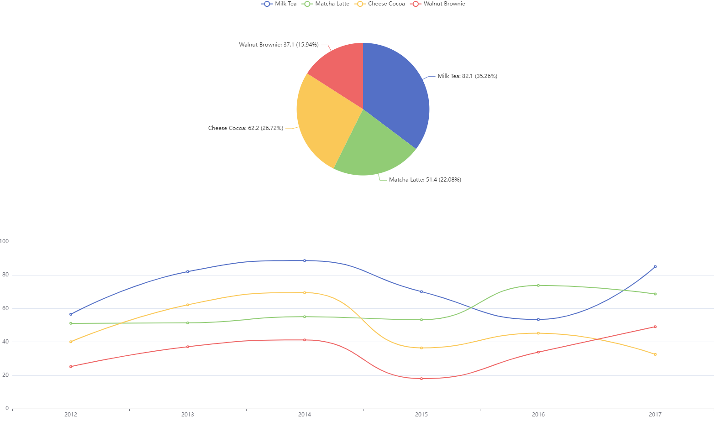
Dessert Sales by Echarts.js

Slide 5
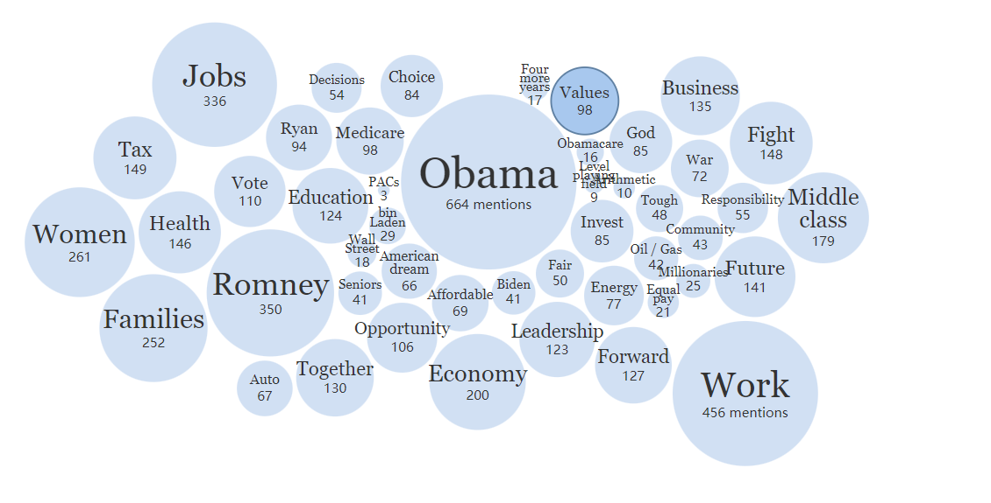
Visualizing Words Used at the US Democratic Convention By D3.js
URL: https://archive.nytimes.com/www.nytimes.com/interactive/2012/09/04/us/politics/democratic-convention-words.html#Values

Slide 6
Compared with Tableau, what are the advantages of using JavaScript for data visualization?

Slide 7
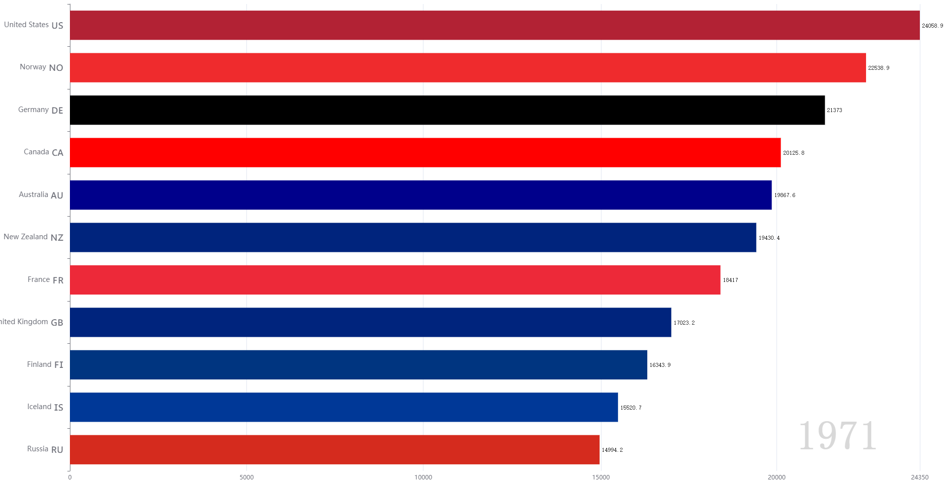
(1) Dynamic Visualization
The Dynamic Change of The Average Income of Countries by Echart.js

Slide 8
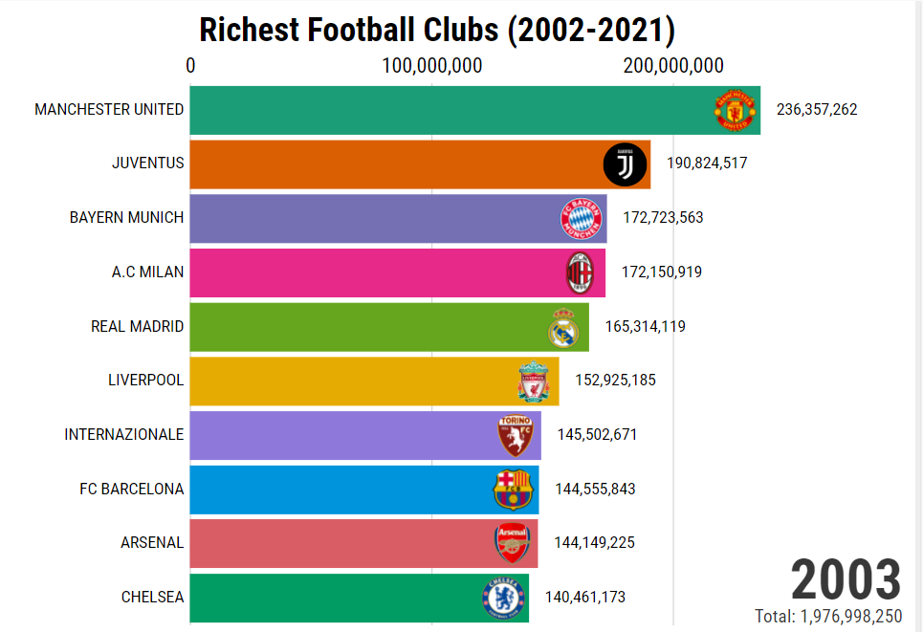
(2) Reuse (Componentization)
The Dynamic Change of Top 10 Richest Football Club in the World
https://app.flourish.studio/visualisation/8576423/

Slide 9
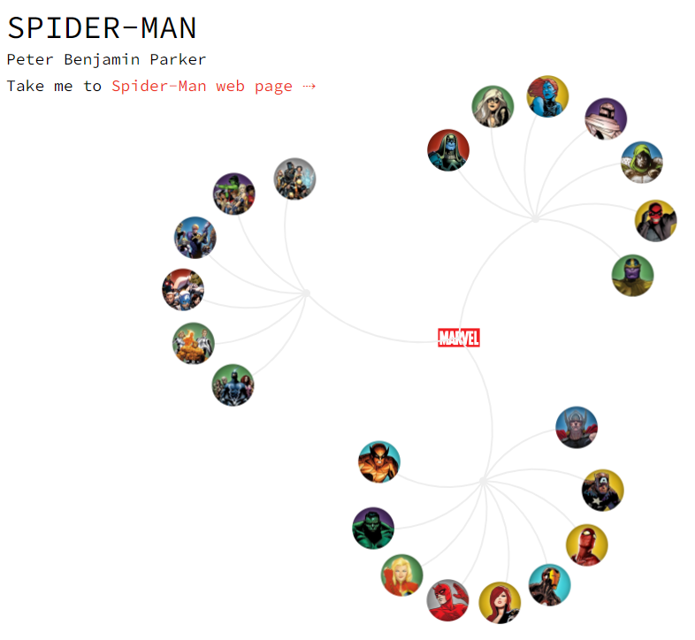
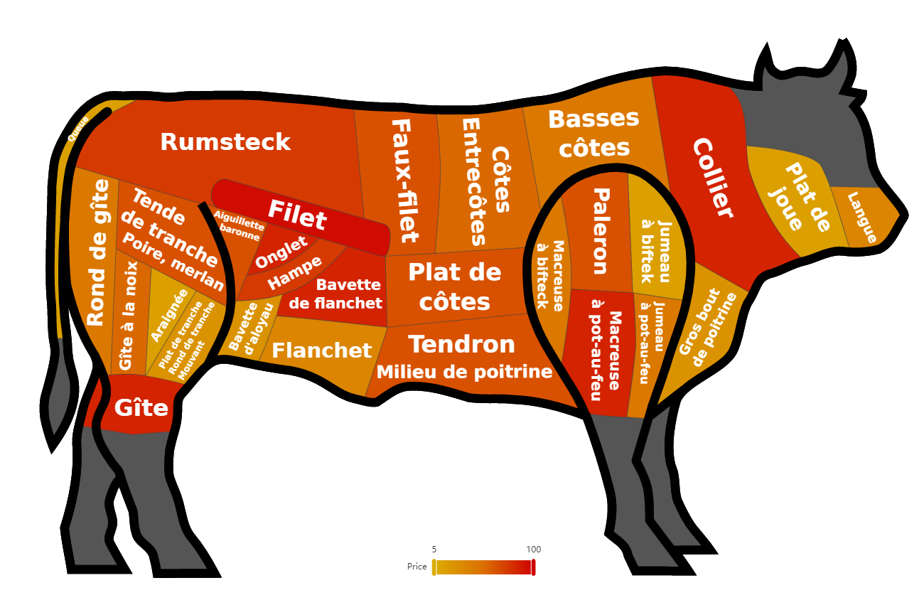
(3) Customization
The Geo Map about the Price of different beef parts
The Network of Marvel Universe Heroes

Slide 10
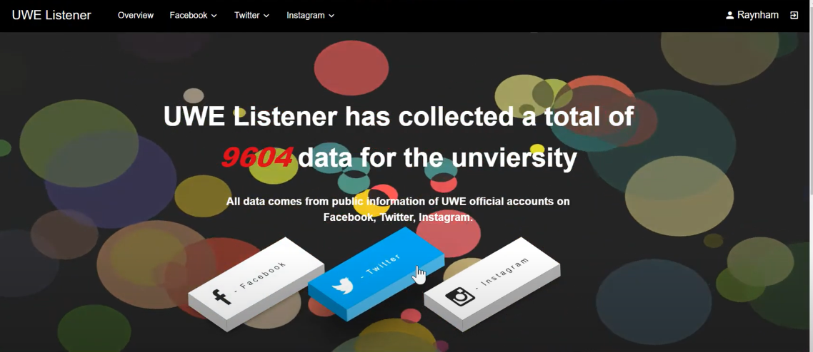
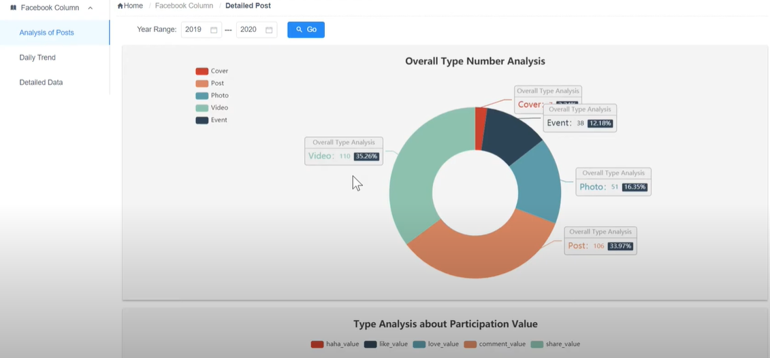
(4) Visualizing Real-Time Data
UWE Listener (A Monitoring System, My Undergraduate Graduation Project )

Slide 11
Three Ways to Install Echarts.js and D3.js
(1) Download echarts.min.js or d3.min.js and include them in html files.
(2) Use CDN (Content Delivery Network)
(3) npm install echarts --save / npm install d3 --save
And then require() to use them

Slide 12
In the End…
JavaScript is the closest programming language to users, as long as you use a browser to do something, you must deal with JavaScript. Therefore, its visualization libraries focus more on interaction and animation so as to make a better user experience (UX). Meanwhile, it may be an alternative visualization solution for Data Science Mini-Project except for Tableau.
D3.js and Echarts.js have detailed documentation on the official website if you have an interest in them.
https://d3js.org/
https://echarts.apache.org/en/index.html

