Slide 1










Having Fun with JavaScript
Introduction to Two JavaScript Visualization Libraries
......

Slide 2
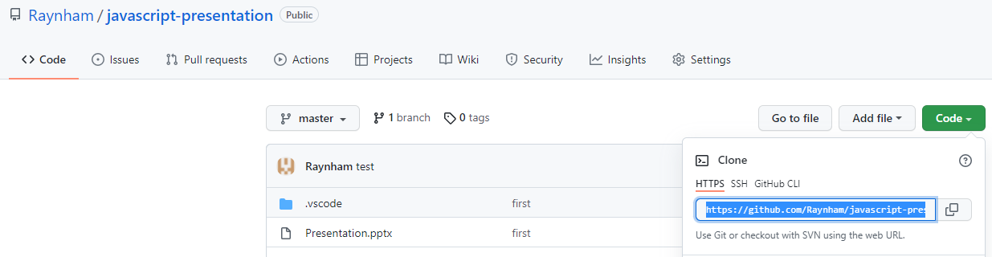
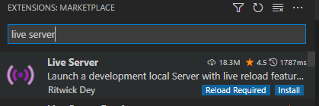
Before the Introduction…
(1)
git clone https://github.com/Raynham/javascript-presentation.git to get some examples
(2)
Install an extension named “live server” in VS Code, which can launch a local development server for static and dynamic pages. Some examples will appear errors if open as a local file (Maybe due to the strict same-origin policy of Chrome and Edge).

Slide 3
Three Ways to Install Echarts.js and D3.js
(1) Download echarts.min.js or d3.min.js and include them in html files.
(2) Use CDN (Content Delivery Network)
(3) npm install echarts --save / npm install d3 --save
And then require() to use them

Slide 4
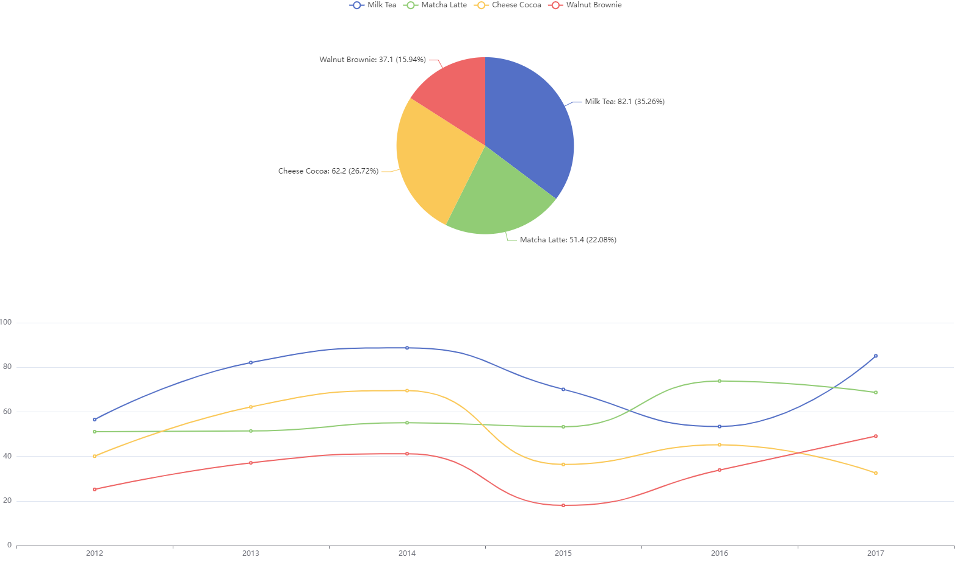
Dessert Sales by Echarts.js

Slide 5
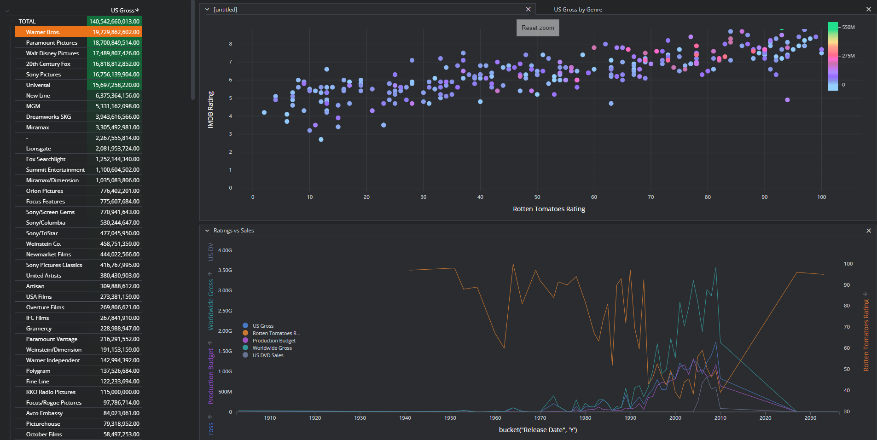
American film companies dashboard by D3.js

Slide 6
Compared with Tableau, what are the advantages of using JavaScript for data visualization?

Slide 7
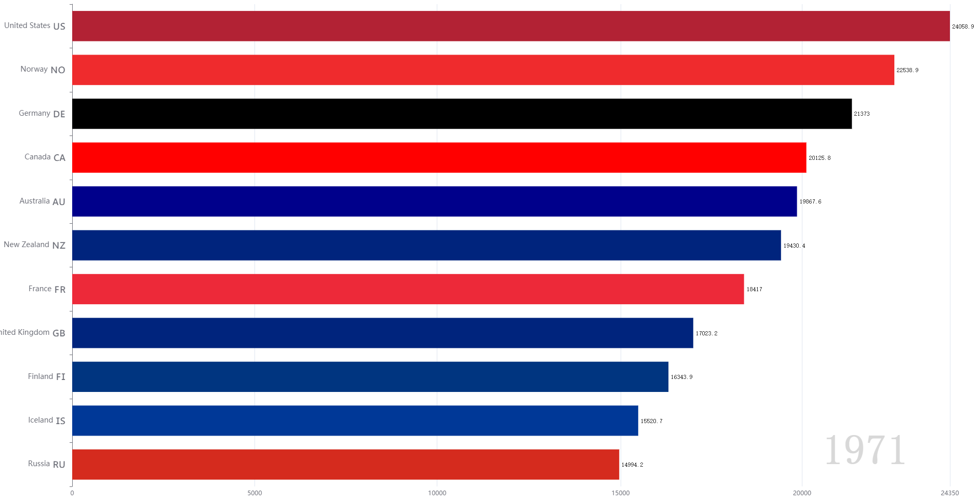
(1) Dynamic Visualization
The Dynamic Change of The Average Income of Countries by Echart.js

Slide 8
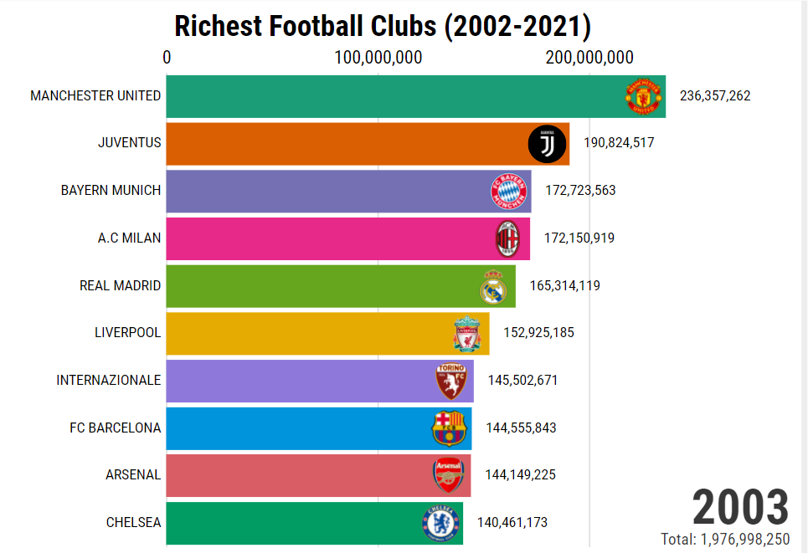
(2) Reuse (Componentization)
The Dynamic Change of Top 10 Richest Football Club in the World
https://app.flourish.studio/visualisation/8576423/

Slide 9
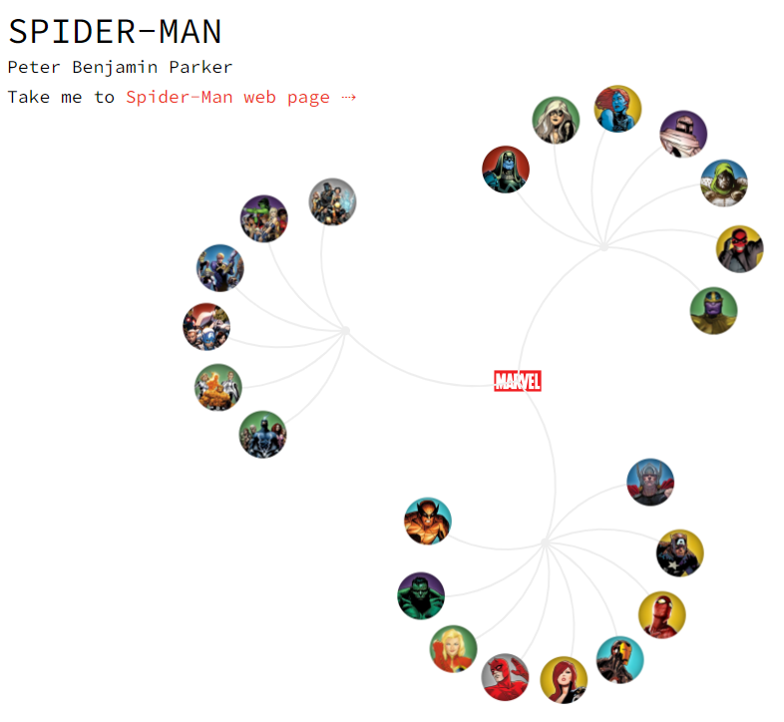
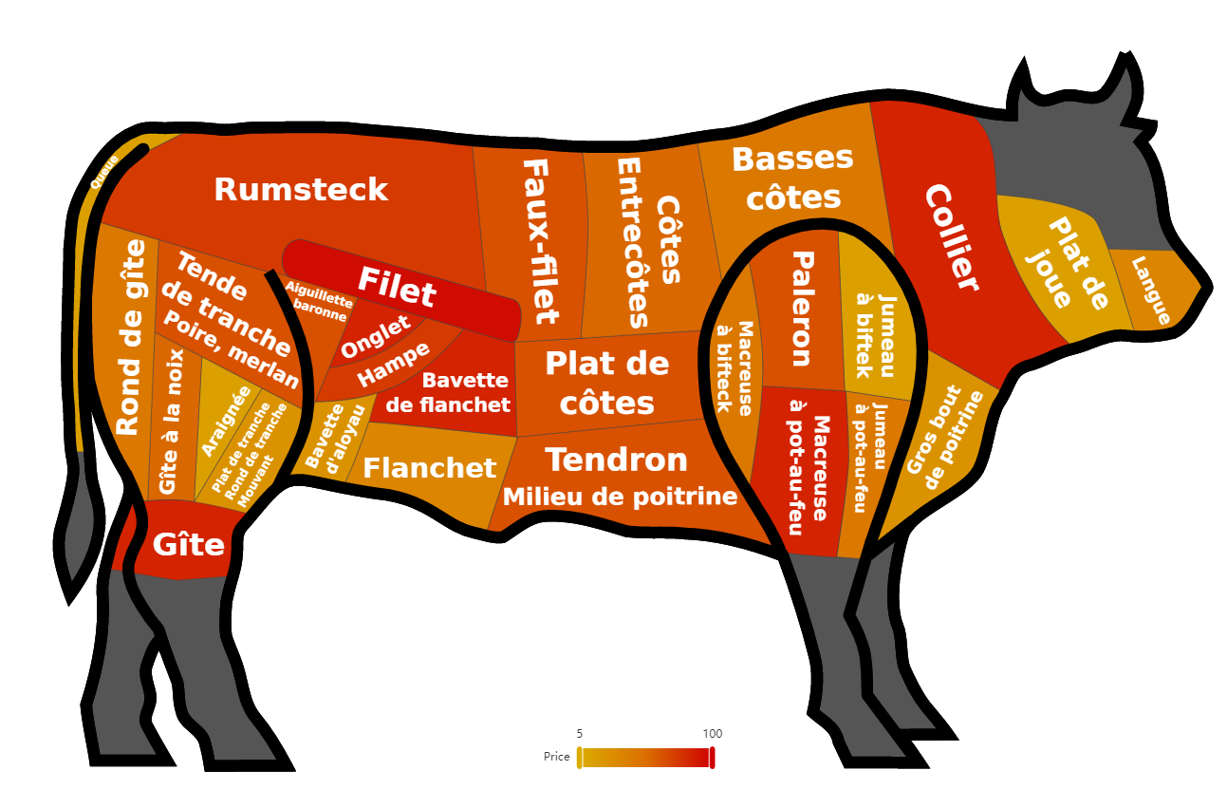
(3) Customization
The Geo Map about the Price of different beef parts
The Network of Marvel Universe Heroes

Slide 10

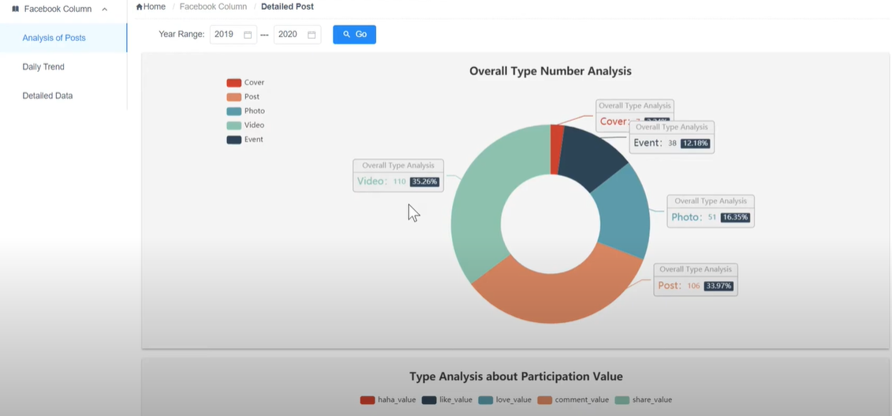
(4) Visualizing Real-Time Data
UWE Listener (A Monitoring System, My Undergraduate Graduation Project )

Slide 11
In the End…
JavaScript should be the closest programming language to users, so its visualization libraries focus more on interaction and animation so as to make a better user experience (UX). Meanwhile, it may be an alternative visualization solution for Data Science Mini-Project except for Tableau.
D3.js and Echarts.js have detailed documentation on the official website if you have an interest in them.
https://d3js.org/
https://echarts.apache.org/en/index.html

