Slide 1


SentinelSOL
Zero-footprint, predictive observability
for Solana validators.
Colosseum Frontier • Validator and Staking Infra

Slide 2


Validators Bleed MEV Revenue Silently
PROBLEM 01
PROBLEM 02
THE BLIND WINDOW
JITO-NATIVE BLINDNESS
Hardware exhaustion precedes delinquency. Currently, operators have a 4–12 minute window where their node is dying, but their alerts are silent.
Standard stacks (Node Exporter) don't track ShredStream latency or Block Engine acceptance rates. If MEV tips drop, you don't know until the epoch ends.
4-12m
ZERO
$$$
INVISIBLE FAILURE WINDOW
JITO-NATIVE TOOLING
CUMULATIVE TIP LOSS

Slide 3
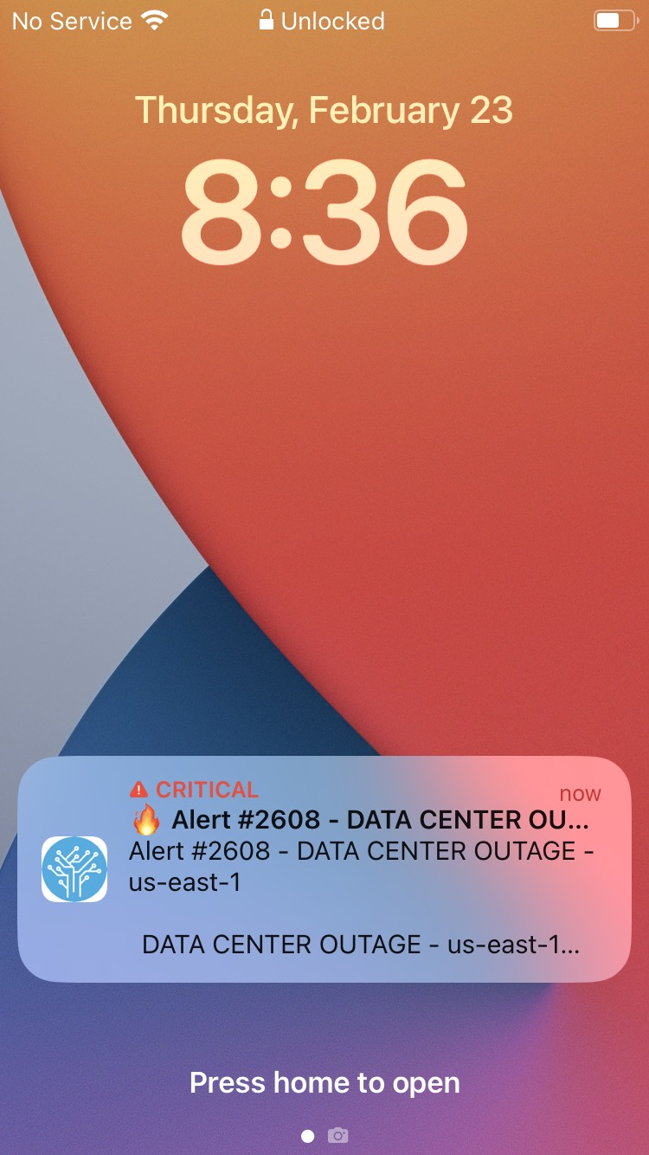

Reactive Alerts: A Post-Mortem Strategy
Industry Default: Too Little, Too Late
Every existing monitor is reactive by construction. By the time a "Validator Delinquent" alert fires:
30+ Slots have already been missed
Jito Tip revenue is already forfeited
SFDP Pruning risk has spiked
Standard dashboards track uptime. SentinelSOL tracks revenue.

Slide 4
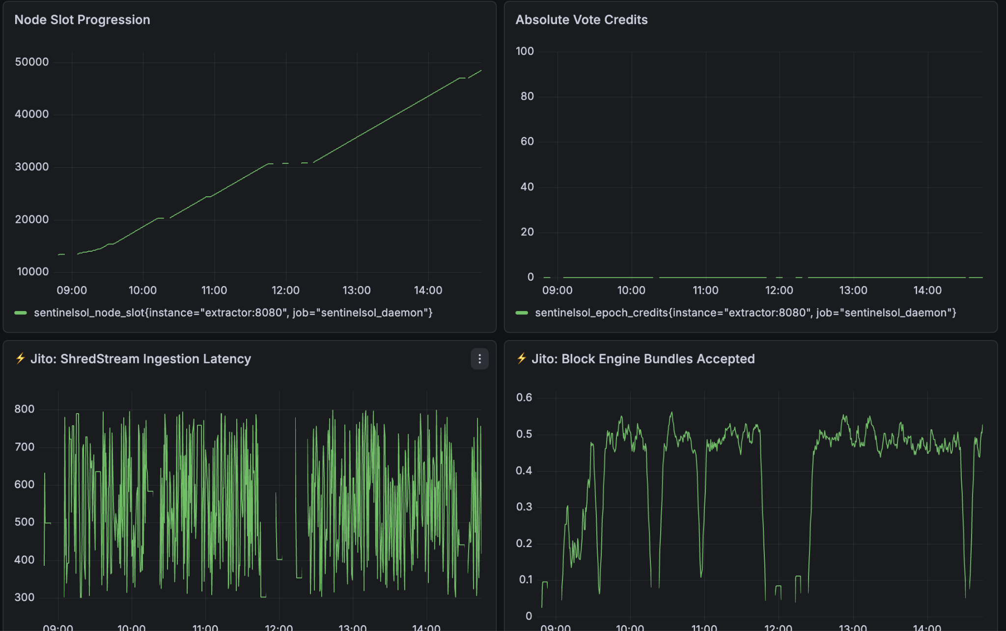
X FOR Y ANALOGY
Datadog for Jito Revenue
SentinelSOL is a proactive, Out-of-Band (OOB) telemetry sidecar that monitors the leading indicators of failure.
Go Daemon: Polls Jito-Solana RPC independently
Predictive: Tracks ShredStream latency trends
OOB: Zero impact on validator hot-path
Live at sentinelsol-sre.vercel.app/

Slide 5

Concentrated Market. High-Impact Revenue.
I am not targeting a billion-dollar generic market. I am targeting the top-tier operators who keep Solana running.
SEGMENT | COUNT | PAIN POINT
Total Solana Validators | ~1,400 | General Network Health
Jito-Solana Nodes | 600–900 | MEV / Tip Revenue Sensitivity
Institutional (Target) | Top 200 | SLA Enforcement & SFDP Protection
100% Open-Source Primitive. No vendor lock-in. No SaaS fees. Deployable to any bare-metal validator instantly via “make up”.

Slide 6
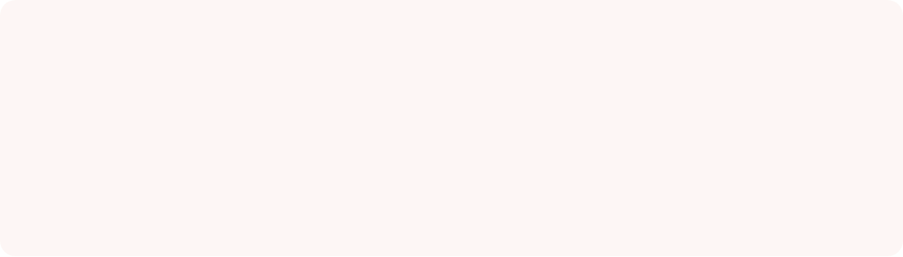


Built Solo. Engineered to Scale.
Hamza Shaikh
M.Sc. Computer Science • Solo SRE Architect
SRE henchman responsible for cloud migrations and 25% OpEx reduction at B2C Shark Tank India startup. I built SentinelSOL because in a high-stakes network like Solana, reactive observability is negligence.
Raynzler @shamza31 sentinelsol-sre.vercel.app/

