Slide 1
Exploratory Data Analysis
Rayon MORRIS
DDS ANALYTICS

Slide 2
Contents
Overview
Methodology
Attrition Facts
Attrition
Data Trends
Software

Slide 3
Overview
Frito-Lay wants to prevent voluntary employee turnover by identifying the factors that leads to Attrition. They’ve provided their current employee data (sans PII) for us to perform our analysis.
In this presentation, I’ll provide the top 3 factors that leads to Attrition; Trends I observed in the data; and a regression model on the Monthly Income.
Notes:
What if I told you that we could predict Attrition by performing Data Analysis on your companies data?

Slide 4
METHODOLOGY
1. Loaded the data set provided (CaseStudy2-data.csv)
2. Performed Exploratory Data Analysis to identify key factors that leads to Attrition and find explanatory variables for the Linear Regression Model.
3. Used the Naive Bayes to achieve Classification
4. Used Linear Regression to predict the Monthly Income.

Slide 5
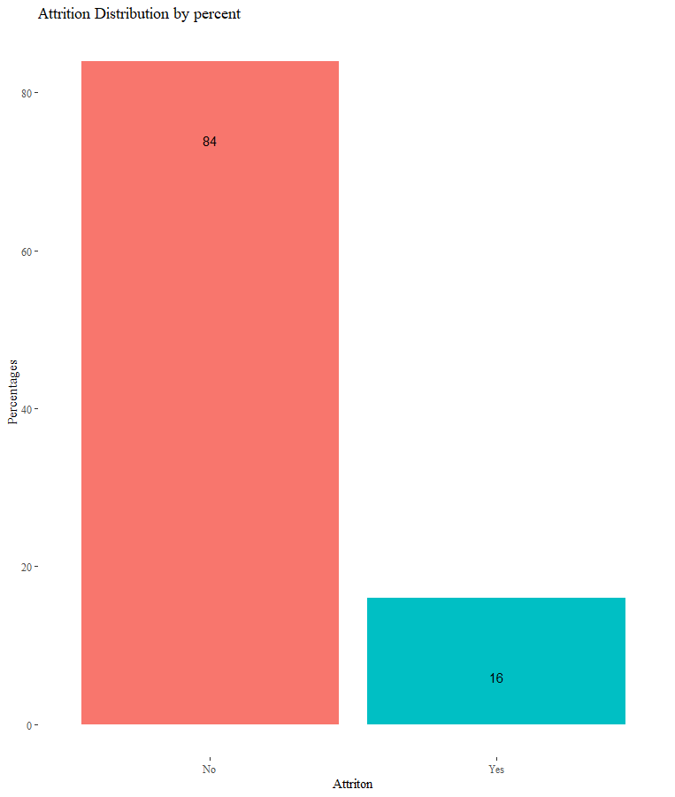
Attrition FACTS
Attrition accounted for16% of the observations within the dataset.
Attrition | Count | Percent
No | 730 | 84%
Yes | 140 | 16%

Slide 6
Attrition
Top 3 Factors that leads to Attrition:
Overtime
Job Level
Monthly Income

Slide 7
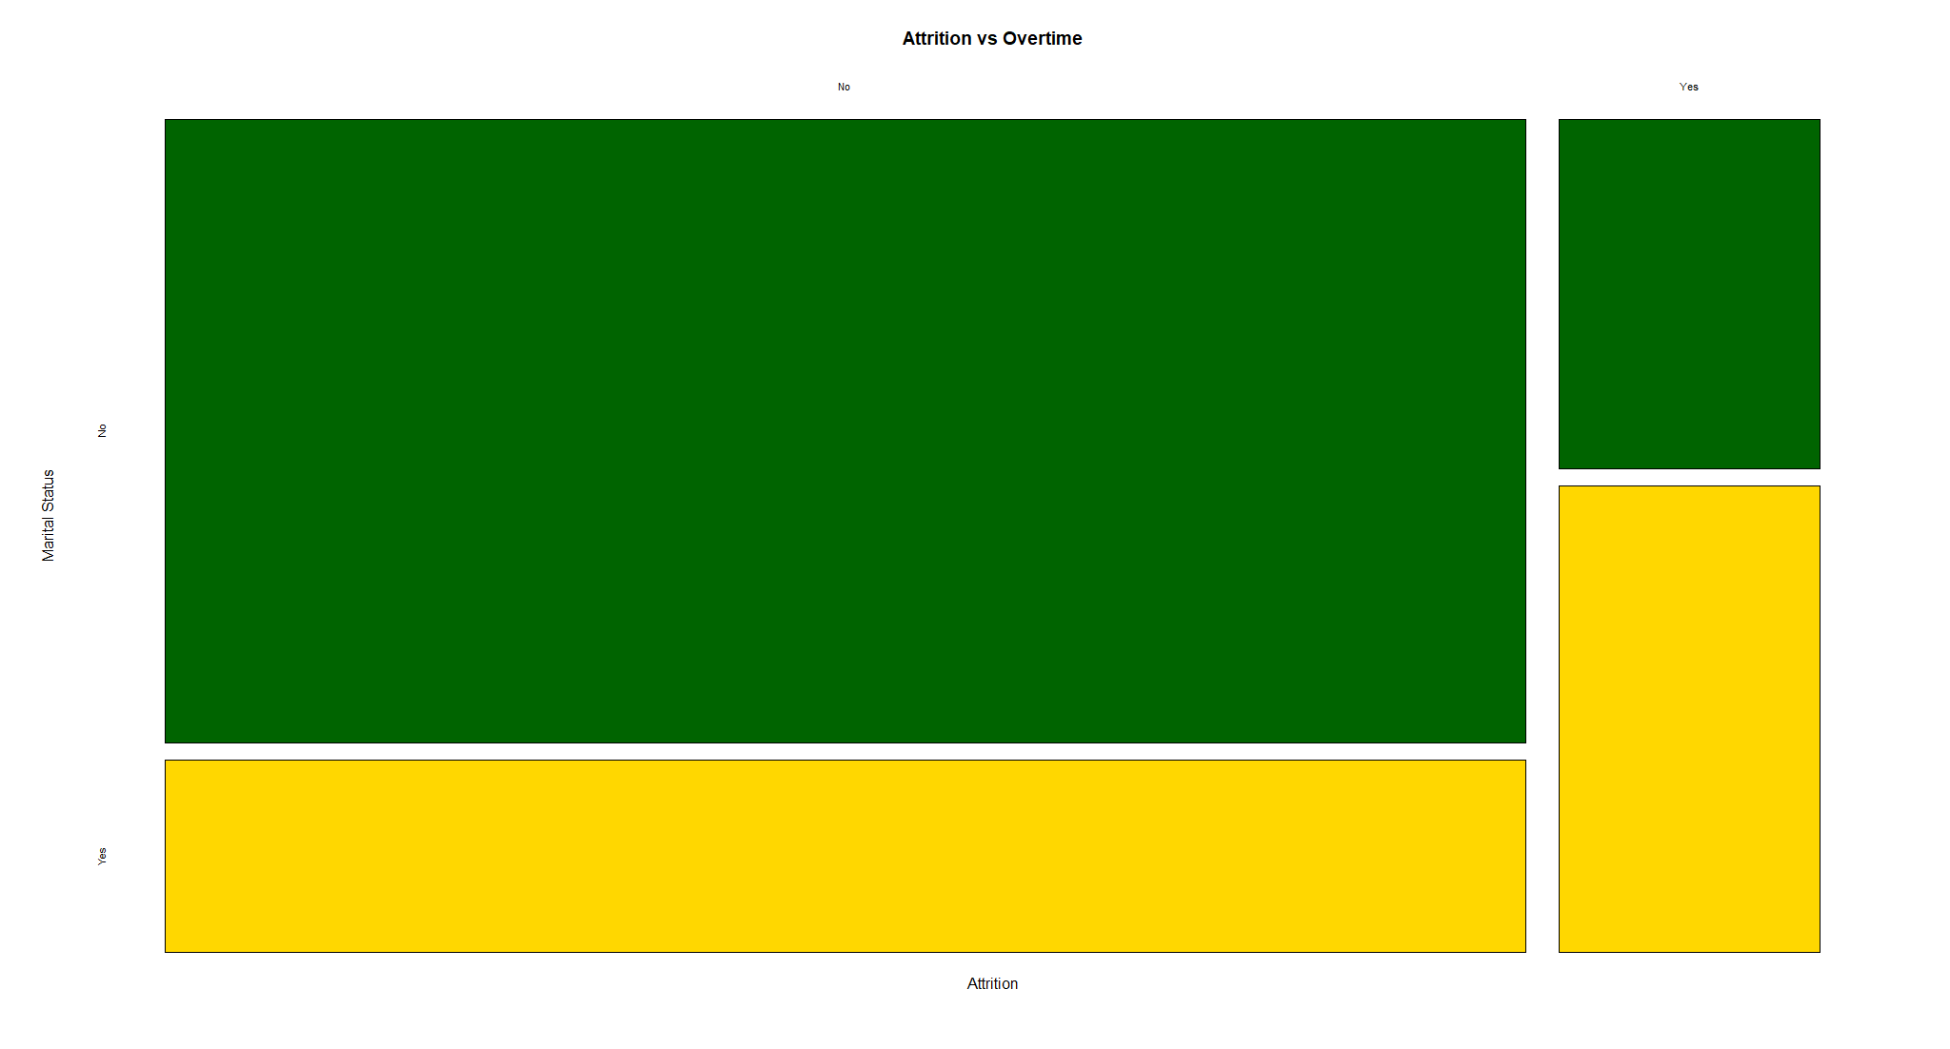
Overtime
57% of persons who voluntary left the company were working overtime.

Slide 8
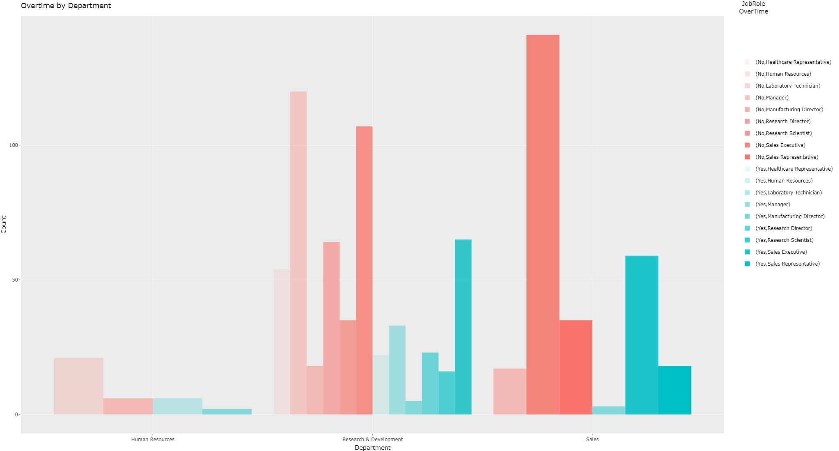
Data Trends
Overtime is high within the following departments: Research and Development, and Sales. Research Scientist and Sales Executives were the Job Roles that had the highest Overtime.

Slide 9
Data TRENDS
People who are in their role for a long period of time tend to stay with the company – why do they stay? Who are these people?

Slide 10
Works cited

Slide 11
Works cited

Slide 12
Works cited

