Slide 1
Category review: Chips
November 2023
Retail Analytics
Brand note: If client logo is not required, use alternate title page layout right click slide thumbnail > Layout > Title

Slide 2
Notes:
To view Privacy video explaining how important data privacy is to Quantium, please click here: https://www.youtube.com/watch?v=Zq1QDAkoRzU
or here Q:\Company Reference\Brand & Design\Brand videos\Q Privacy.mp4
At Quantium, we believe that data is the behavioural footprint of humanity and that it has to be treated with the utmost care and responsibility.
Histories, attitudes, indeed lives are stored within it in ways that aren’t always apparent – and that’s what makes its potential so powerful.
To work with it responsibly, sensitively, we set ourselves the highest data privacy protection and governance standards.
We have spent 17 years perfecting privacy-by-design and secure-by-design principles. Central to this is not holding any personally identifiable information about people –
we neither receive it, and put the necessary protections in place to be unable to decipher it.
Every aspect of handling data is safeguarded: from its de-identification, to its encryption – data security is paramount and of the highest grade.
We pride ourselves on gaining the trust of iconic organisations around the world through years of securely working with their data,
and in turn the trust that builds with their stakeholders.

Slide 3
Executive summary
01
Task 1
Examine transaction data
Examine Customer data
Data Analysis and customer segments
Deep dive into customer segments
02
Task 2
Uplifting testing, comparing trial and control stores
Control store selection based on defined metrics
Insightful data visualizations
Examine statistical analysis to assess sales differences and formulate recommendations

Slide 4
01
Category

Slide 5
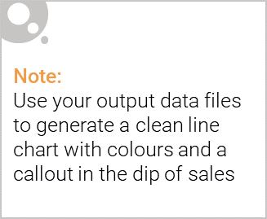
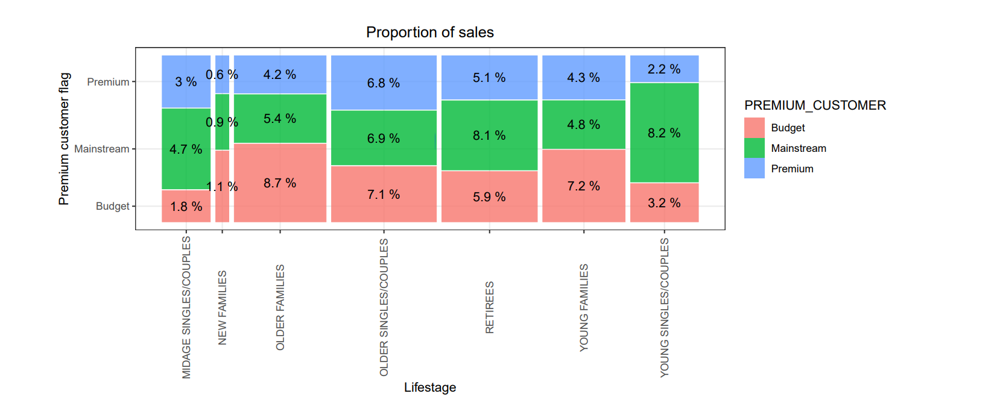
Overview: your key callout for the category should be included here

Slide 6
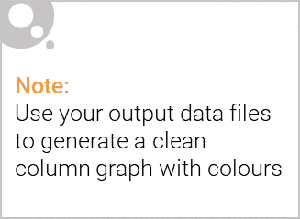
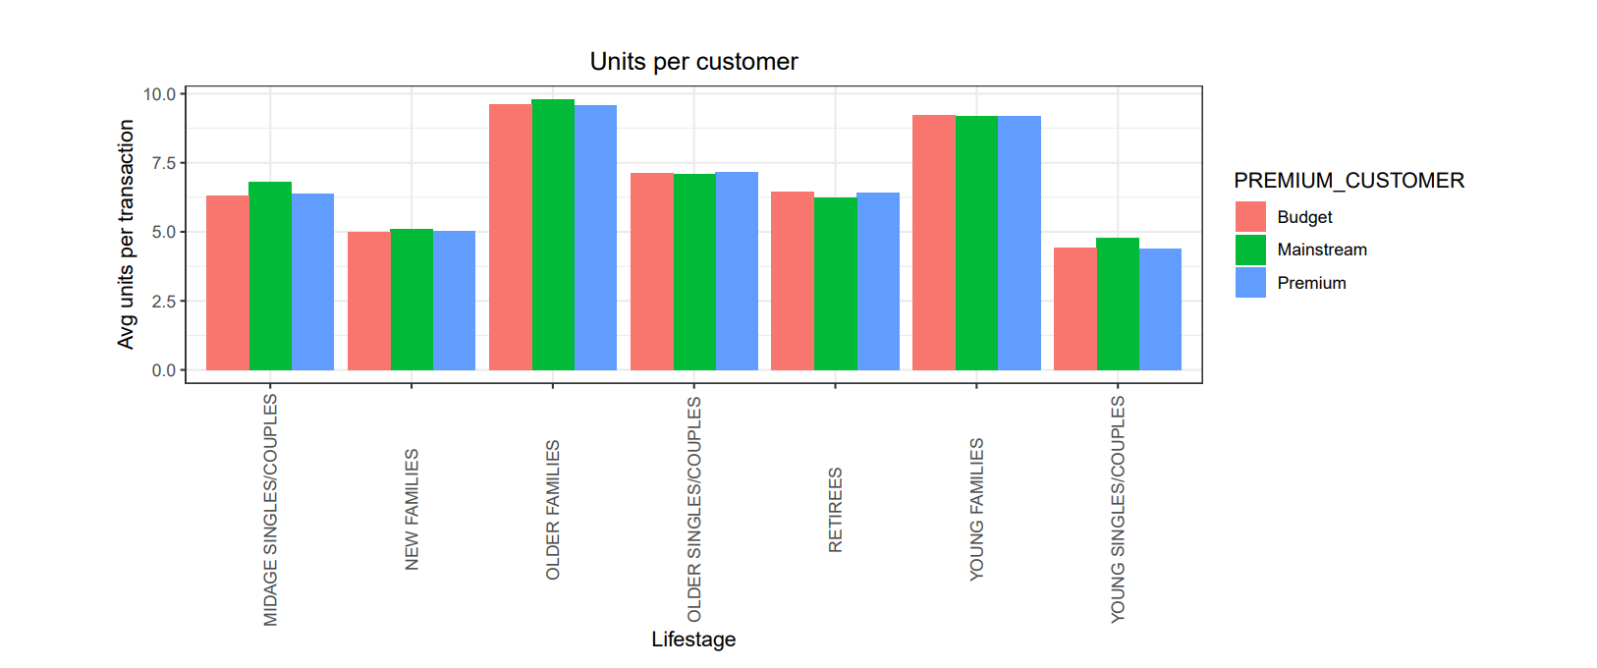
This slide will be commentary on affluence and its effect on consumer buying for the category of chips
We also found that high spend in chips for young ingles and retirees ids due to there being more of them than other byers. This is an indicative of impulsive buying behaviour.
23% Main Stream young singles and couples are 23% more likely to purchase Tyrells chips compared to the rest of the population.
Category Manager may want to increase category’s performance by off-locating some Tyrells and smaller packs of chips with discretions

Slide 7
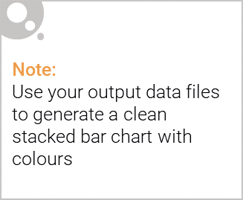
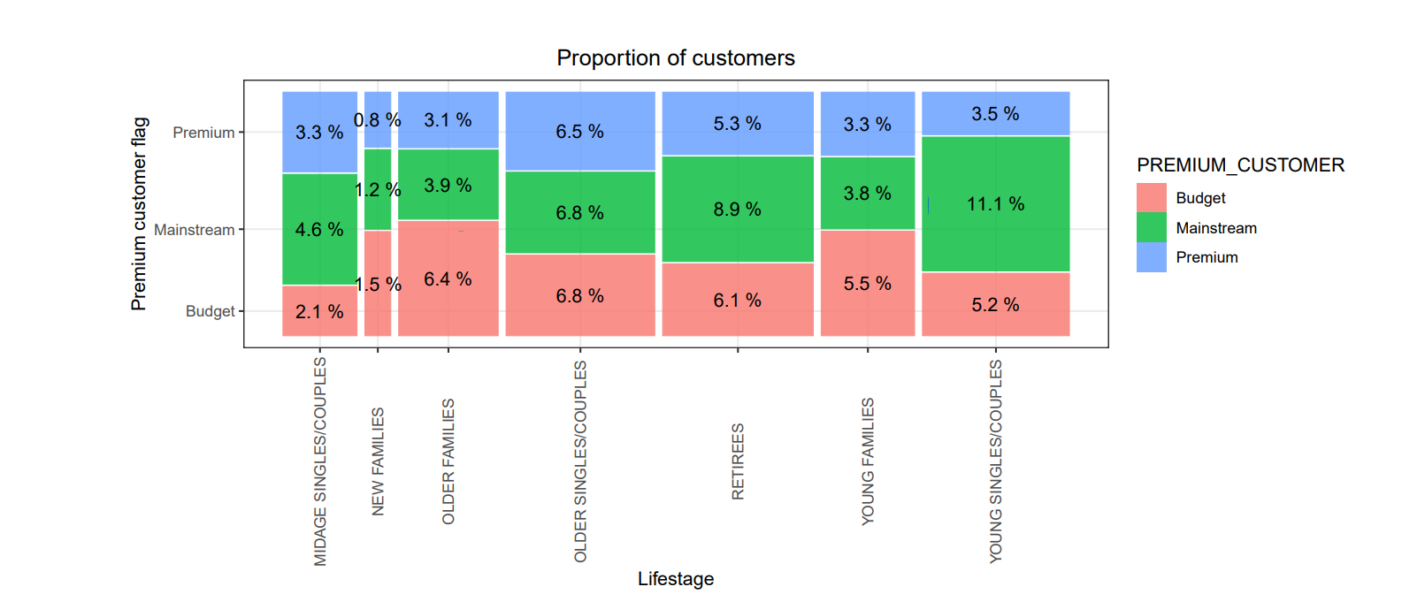
Editable (delete this)
Stretch: Try visualising the proportion of customers by affluence and life stage on this slide

Slide 8
02
Trial store performance

Slide 9
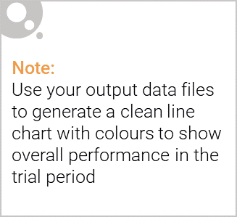
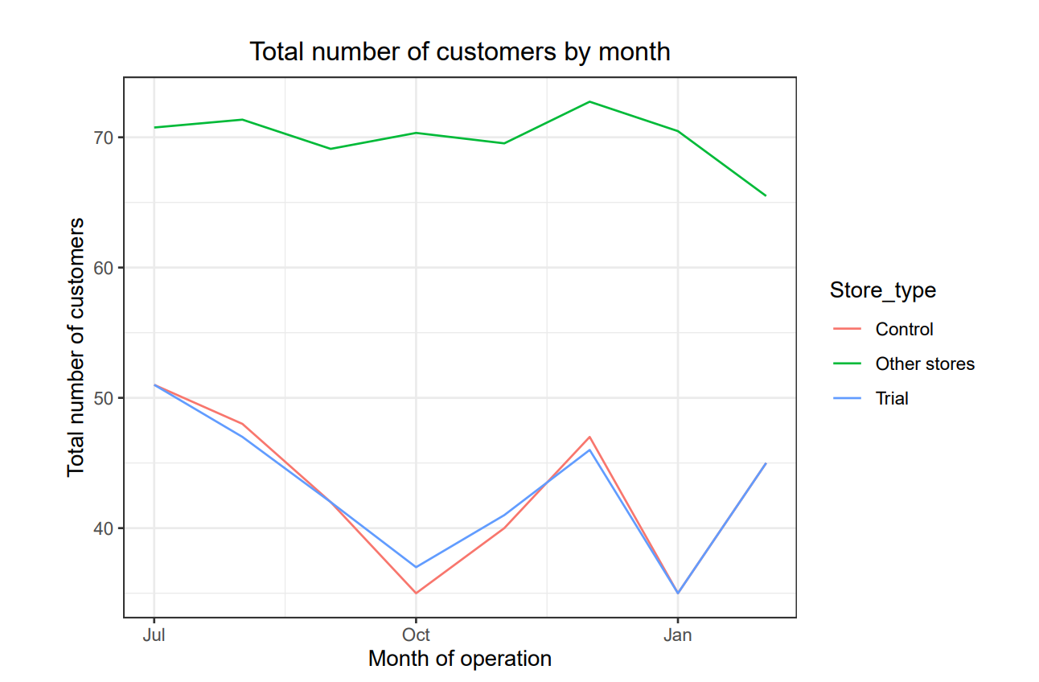
Explanation of the control store vs other stores
Here we are using data of those control stores which are exhibiting similar behaviour as that of the trial store.
Other store is nothing but other store data and the number of customers based on month in those stores.
We see that the number of other stores is higher as compared to trial and control as we have narrowed down are search to just similar pattern based control and trial and comparing their performance.

Slide 10
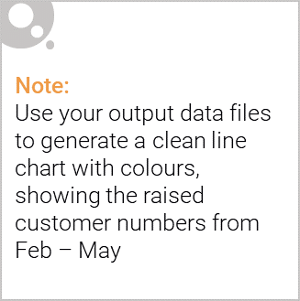
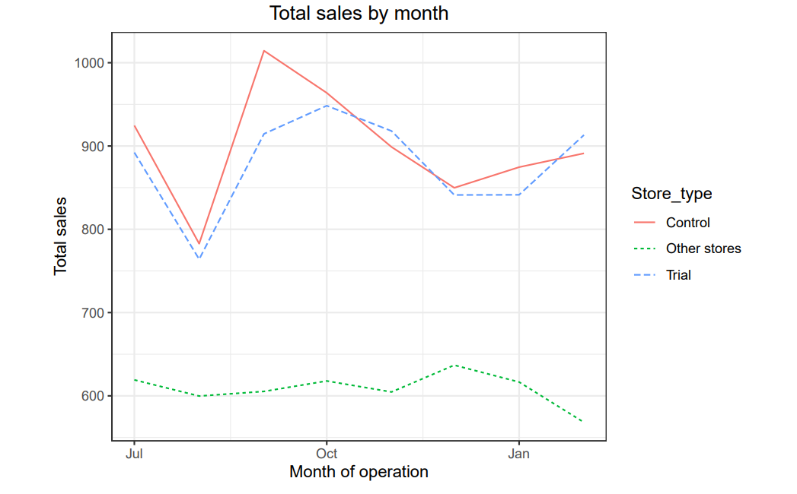
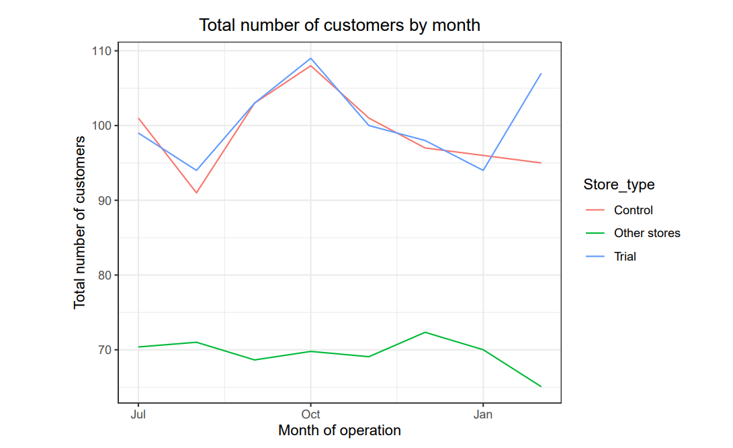
Call out of the performance in the trial store, determining if it was successful
Trial store 86 was overall successful as it shows significant increase in sales..
The number of customers is higher in all three months.
This indicates that the trial store had significant impact on increasing the number of customers at the trial store.

Slide 11
Thank You !

