Slide 1



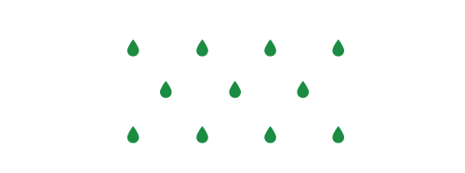






OlymPIC Torch Relay
He is OlymPIC torch relay runner.
He has to carry the torch.
But, during his journey, there are some obstacles.
Choose pictogram,
ward off danger and
run toward finish line.
2. Action character
1. Tap here

