Slide 1


Slide 2









4 Skills x 2 Modes
Program Overview
G
SL
C
/ F
R
EE
TOEFL iBT Skills Drills @ LABS (730/731)
SALLC (Kijang), LKC (Anggrek) & HW (Home)
F
2
F
READING
Homework (HW) :
3 – 5 Passages
@650 – 700 words
LISTENING
Practice / HW:
2 Conversations
4 Lectures
SPEAKING
Practice / Test:
Telephoning, Negotiation, Presentation
WRITING
Practice / Test:
Paragraph Writing

Slide 3








UTS (UAS) + TM 1 (or 2) = 100%
Assessment
READING
Computer-based activities
UTS/UAS @Labs:
50%
LISTENING
SPEAKING
Communicative-based activities
TM 1 or 2 @Class: 50%
WRITING

Slide 4







UTS & TM 1 + UAS & TM 2 = 100%
Assessment
Reading & Listening
UTS + TM 1:
50%
Speaking & Writing
TOTAL SCORE:
100%
Reading & Listening
UAS + TM 2:
50%
Speaking & Writing
Bina Nusantara

Slide 5
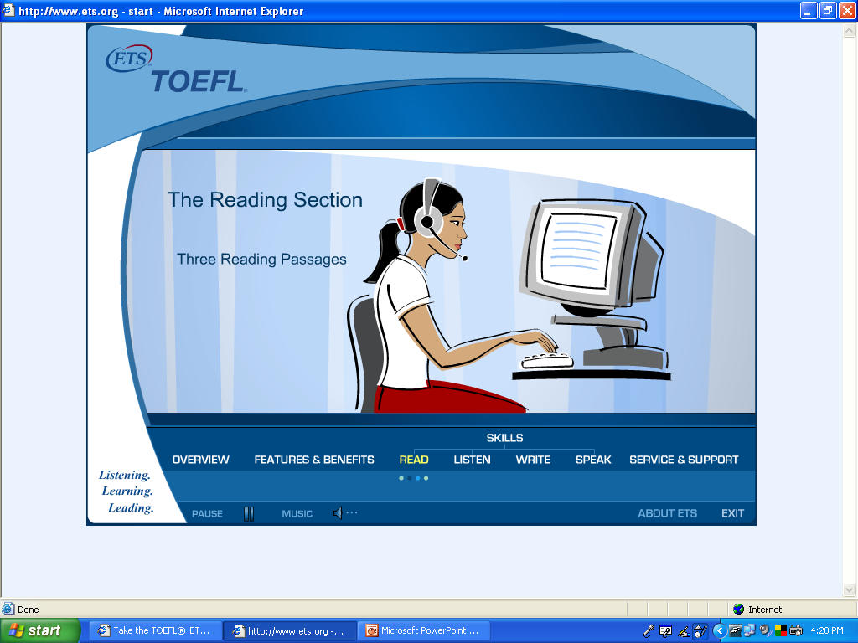
Skimming, Scanning, Summarizing, Paraphrasing
Reading Overview
Bina Nusantara

Slide 6
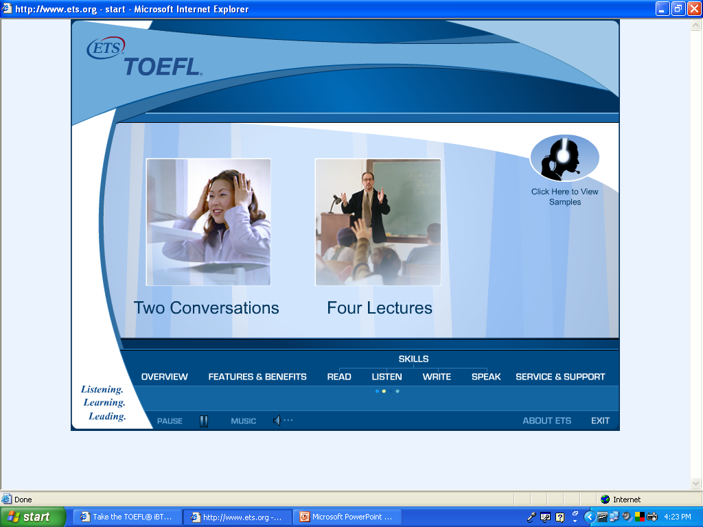
Note for Main Ideas & Supporting Details
Listening Overview
Bina Nusantara

Slide 7
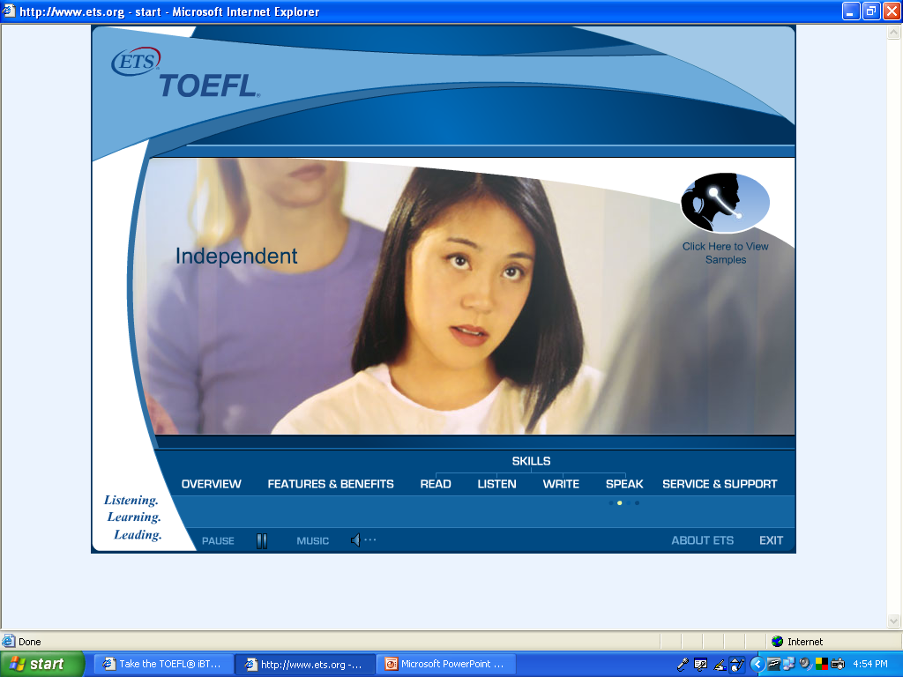
Speak Clearly, Fluently & Appropriately
Speaking Overview
Bina Nusantara

Slide 8
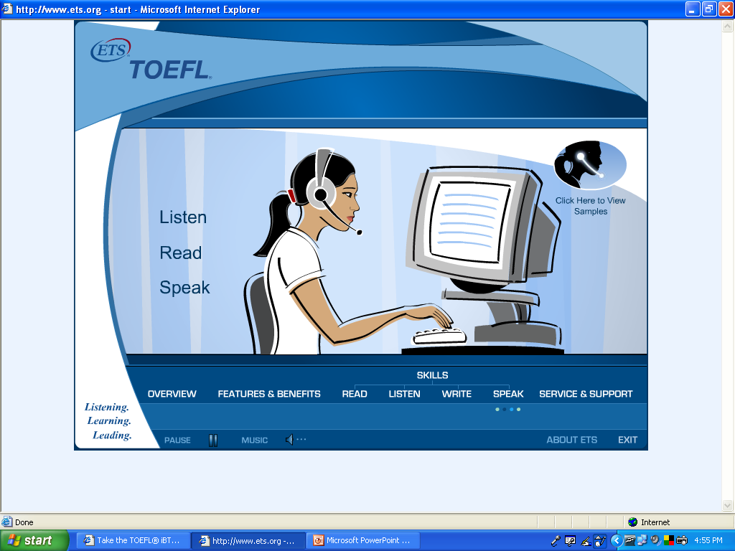
Communicate & Demonstrate Understanding
Speaking Overview
Bina Nusantara

Slide 9
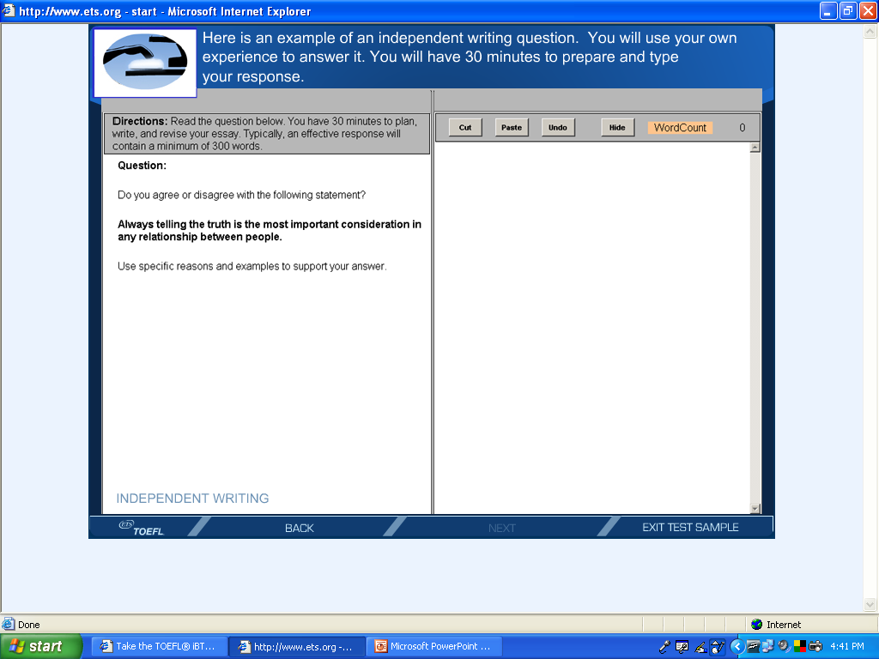
Write a 300-word-long essay based on own experiences
Writing Overview
Bina Nusantara

Slide 10
Verb Forms After Have
 | Active |  | Passive
I | have come had come | have been living had been living | have been invited had been invited
You
We
They
He | has arrived had arrived | has been working had been working | has been called had been called
She
It
Bina Nusantara

Slide 11
Verb Forms After Be
 | To be | been | be
I | am/was teaching am/was taught | have/had been sending have/had been sent | will/would be paying will/would be paid
You | are/were calling are/were called
We
They
He | is/was monitoring is/was monitored | has/had been giving has/had been given
She
It
Bina Nusantara

