Slide 1
Instability as Signal:
Diagnosing Latent Heterogeneity in
Multimodal Survival Models
Rishika Ray · Dr. Sayar Singh Shekhawat
Department of Computer Science & Engineering
Manipal University Jaipur, India
Multimodal Learning
Survival Analysis
Transformers
Cancer Prognostication
TCGA-BRCA Cohort | 2026

Slide 2
The Problem: Instability in Multimodal Survival Models
Multimodal deep learning promises better cancer prognosis by integrating RNA-seq and histopathology data. Yet a persistent, under-discussed problem remains — models trained on the same cohort produce wildly different results depending on the data split.
Performance Variance
C-index Masks Reality
Treated as Noise
Concordance index swings dramatically across random train/validation splits — sometimes as wide as 0.30 to 0.62 on the same cohort.
A single mean C-index hides subgroup-specific failures. High average performance can coexist with near-random behaviour in specific validation sets.
Most studies attribute this to architecture limits or hyperparameters — and simply regularise it away. The deeper cause remains unexplored.
Central Question: Is instability a technical nuisance — or a diagnostic signal of latent patient heterogeneity?
2 / 15

Slide 3
Hypothesis & Diagnostic Framework
This study does not propose a new architecture. Instead, it treats a standard multimodal transformer as a diagnostic probe to understand when and why models fail.
Hypothesis: Performance instability in multimodal survival models is not noise — it is a structured signal arising from unmodelled latent patient heterogeneity.
3-Stage Sequential Investigation
Stage 1
Stage 2
Stage 3
Global Survival Modelling
Unsupervised Structure Discovery
Conditional Survival Modelling
Train a transformer-based fusion model and quantify instability across repeated stratified splits.
Extract multimodal embeddings; cluster patients without survival labels to find latent subgroups.
Retrain on the discovered homogeneous subgroup; measure stability and performance gain.
3 / 15

Slide 4
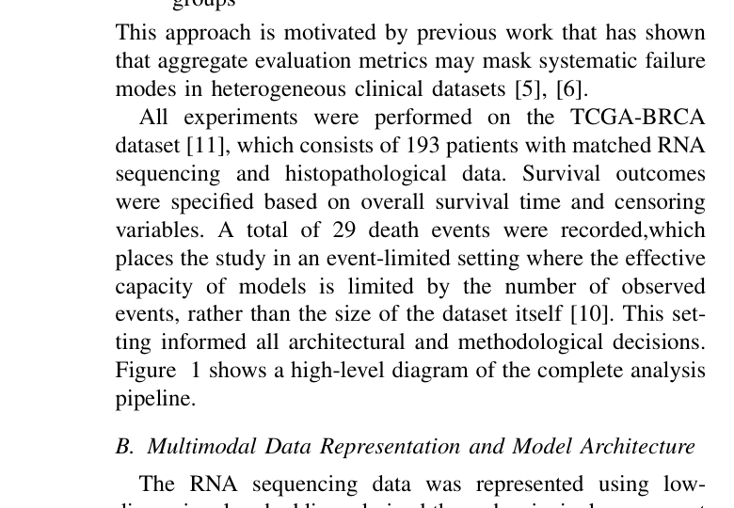
Dataset & Study Design
TCGA-BRCA Cohort — Breast Invasive Carcinoma
193
20K+
8
Patients
(matched RNA + WSI)
Gene Features
(reduced via PCA → 128)
WSI Patches
per Patient (K)
Event-Limited Setting
Only 29 events in 193 patients. Model capacity constrained accordingly to prevent overfitting.
Evaluation Strategy
Stratified shuffle-split cross-validation (10 splits). Focus on distribution of C-index, not just the mean.
No Label Leakage
Unsupervised clustering performed without survival outcomes, receptor status, or clinical labels.
Fig. 1 — Diagnostic pipeline: Global modelling → Latent structure discovery → Conditional evaluation
4 / 15

Slide 5
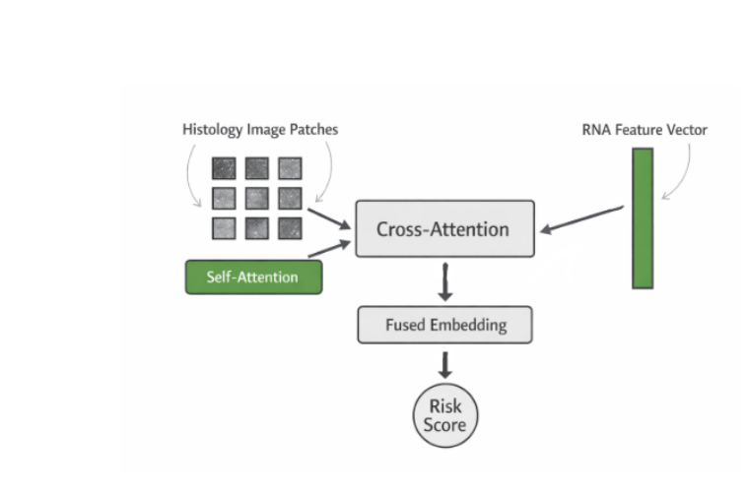
Model Architecture
Transformer-Based Cross-Modal Fusion (~120K parameters)
RNA Embedding
PCA → 128-dim vector per patient. Projected to common latent space (dim=64) via linear layer.
WSI Encoding
K=8 patches → CNN 2048-dim each. Self-attention over patch tokens to aggregate spatial features.
Cross-Attention
Image embedding = Query. RNA features = Keys & Values. Models conditional molecular-morphological interaction.
Risk Output
Aggregated fused embedding → risk score. Trained via Cox partial likelihood. Single head, dropout + weight decay for regularisation.
Fig. 2 — Self-attention over image patches → cross-attention with RNA → fused risk score.
Design Choice
Intentionally compact (64-dim latent, 1 attention head) to avoid overfitting in event-limited regime.
5 / 15

Slide 6
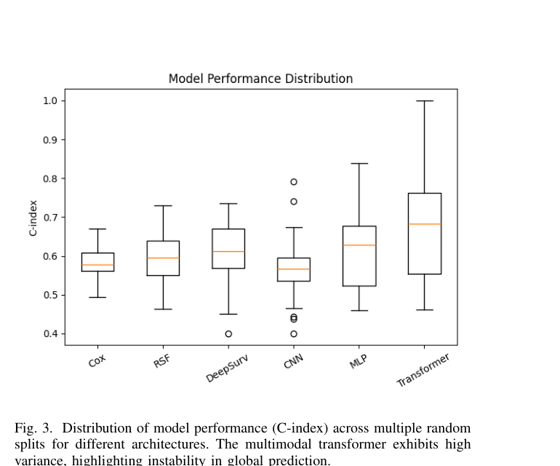
Result 1 — Global Prediction Exhibits Stochastic Instability
0.518
0.131
Mean C-index
Transformer (global)
Std. Deviation
Across 10 splits
0.619
0.295
Best Split
C-index (same model)
Worst Split
Near anti-correlation
A 0.131 standard deviation is clinically unacceptable. The same model can achieve 0.619 or drop to 0.295 simply by changing the random split. This is not training noise — it is a structural signal.
Fig. 3 — C-index distribution across architectures. Transformer shows highest variance.
6 / 15

Slide 7
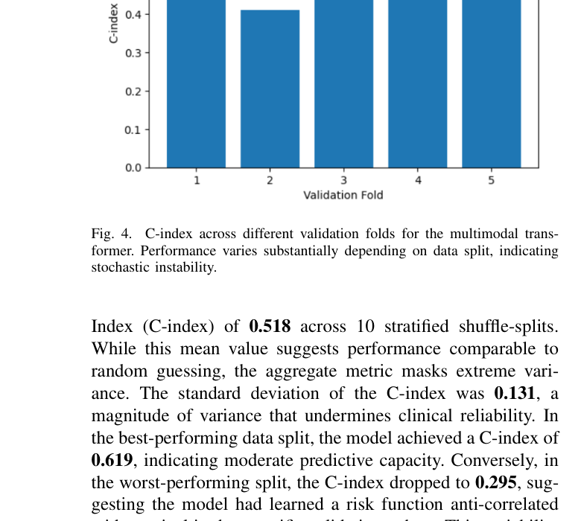
Result 1 (cont.) — Instability Is Not Architecture-Specific
Model Performance Comparison (TCGA-BRCA)
Model | Modality | Mean C | Std Dev
Cox PH | RNA | 0.59 | 0.05
DeepSurv | RNA | 0.61 | 0.08
CNN-only | Image | 0.57 | 0.09
Concat MLP | Multi | 0.62 | 0.10
Transformer ✱ | Multi | 0.64 | 0.15 ⚠
✱ Despite highest mean, transformer shows greatest instability — inconsistent with clinical deployment requirements.
Fig. 4 — C-index across validation folds. Performance varies substantially across splits.
The Naive Concatenation baseline shows even higher variance (σ = 0.149), confirming instability is not due to attention mechanism — it is intrinsic to the heterogeneous cohort.
7 / 15

Slide 8
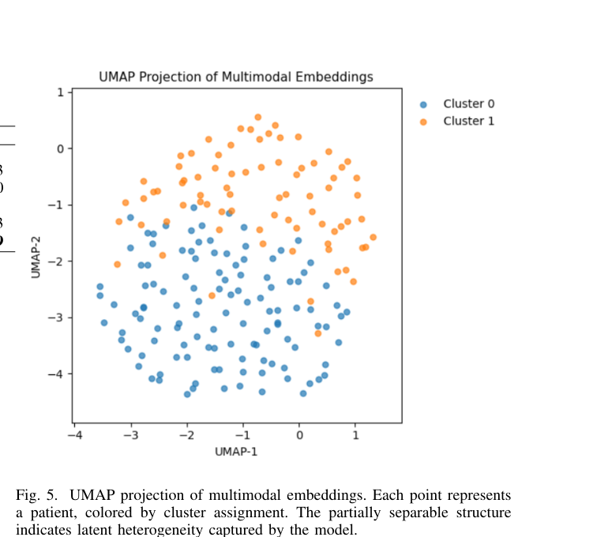
Result 2 — Unsupervised Discovery of Latent Subgroups
Rather than suppressing instability, we repurposed the trained model as a representation learning tool. Multimodal embeddings were extracted from the cross-attention layer and clustered without any survival labels.
Cluster 0 — High-Risk
157 patients (81.3%)
Higher event rate: 11.5%
Median survival: 811 days
Dominant subgroup
Cluster 1 — Low-Risk
36 patients (18.7%)
Higher event rate: 31%
Median survival: 548 days
Distinct prognosis
Fig. 5 — UMAP of multimodal embeddings. Partially separable structure reveals latent heterogeneity (K-Means, K=2).
Clustering performed without survival labels, receptor status, or clinical subtypes
8 / 15

Slide 9
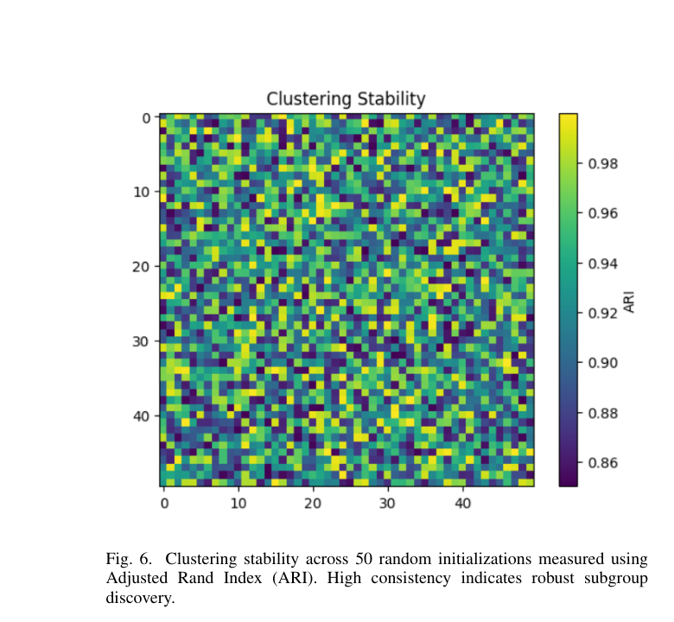
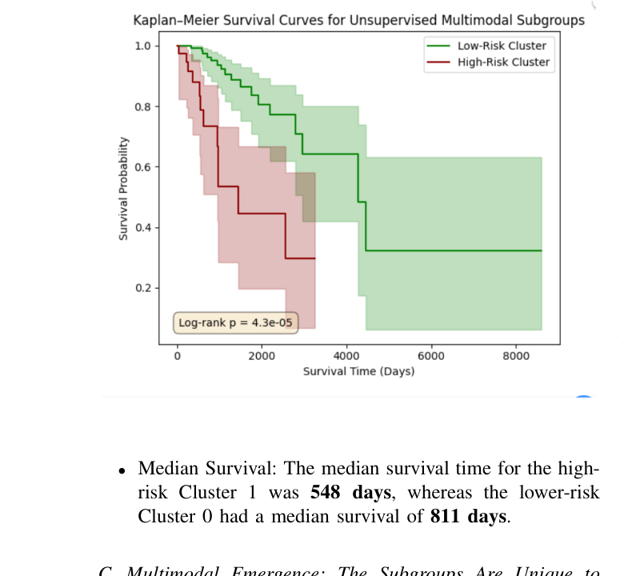
Result 2 (cont.) — Stable Clusters & Divergent Survival
Cluster Stability
▸ Mean ARI = 0.890
Over 50 random K-Means initialisations. The same two groups are recovered regardless of the starting seed — confirming this is not an artefact.
▸ Log-rank p = 4.33×10⁻⁵
The survival difference between Cluster 0 and Cluster 1 is statistically significant across thousands of days of follow-up.
Fig. 6 — ARI across 50 random K-Means initialisations. Mean ARI = 0.890 → highly robust subgroups.
▸ Median Survival Gap
Cluster 1 (high-risk): 548 days.
Cluster 0 (low-risk): 811 days.
A 263-day median gap from purely unsupervised structure.
▸ Event Rate Difference
Cluster 1: 31% events vs Cluster 0: 11.5% events — 2.7× more events in the high-risk cluster.
Fig. 7 — Kaplan-Meier curves. Log-rank p = 4.33×10⁻⁵. Clusters show significantly different survival.
9 / 15

Slide 10
Result 3 — Subgroups Are Unique to Multimodal Fusion
A critical question: do the discovered clusters simply recapitulate what either modality already knew? An ablation study compared cluster partitions across embedding types.
Adjusted Rand Index — Overlap Between Clustering Partitions
Comparison | ARI Value | Interpretation
Multimodal vs. RNA-Only | 0.0008 | No correlation
Multimodal vs. Image-Only | -0.0210 | No correlation
RNA-Only vs. Image-Only | 0.0114 | No correlation
Emergent Property
Not a Rediscovery
Cross-Modal Interaction
The latent subgroups cannot be recovered from RNA-seq alone, image features alone, or their naive concatenation. They emerge only from cross-attention — the interaction space.
Clusters show no enrichment for ER, PR, or HER2 receptor subtypes. The model is not simply rediscovering known clinical categories.
The value of multimodal learning lies in how modalities condition each other — not just in aggregating two information sources. Deep fusion creates new patient taxonomy.
10 / 15

Slide 11
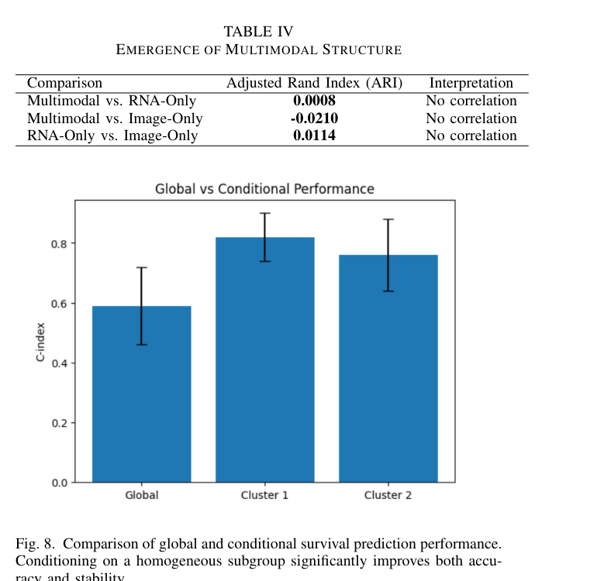
Result 4 — Conditional Modelling Restores Stability
After discovering a homogeneous subgroup (Cluster 0, N=157), the multimodal transformer was retrained exclusively on that subgroup — without changing the architecture.
Performance Gains
+0.294
[0.159, 0.453]
Mean C-index Improvement
vs. RNA-only baseline
95% CI for improvement
Global model (all patients)
C-index range: 0.295 – 0.619, mean 0.518, σ = 0.131
Conditional model (Cluster 0 only)
Bootstrap C-index: 0.60 – 0.70 range, low variance
Multimodal vs. Unimodal
Conditional setting: multimodal substantially outperforms RNA-only baseline
Implication
Survival predictability is conditional on population homogeneity
Fig. 8 — Global vs. Conditional C-index. Conditioning on Cluster 0 significantly improves accuracy and stability.
11 / 15

Slide 12
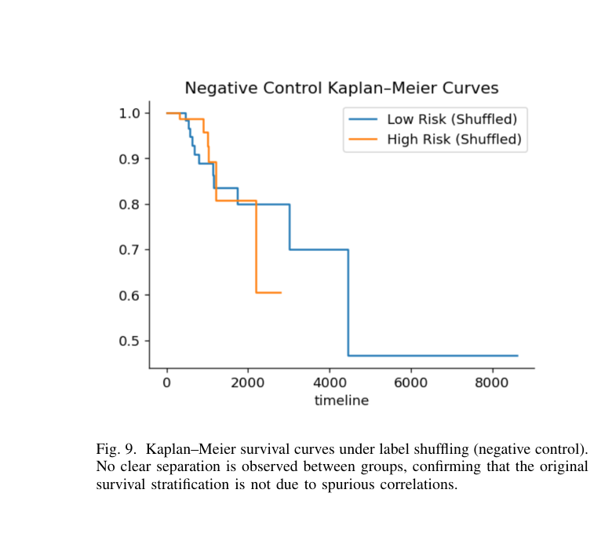
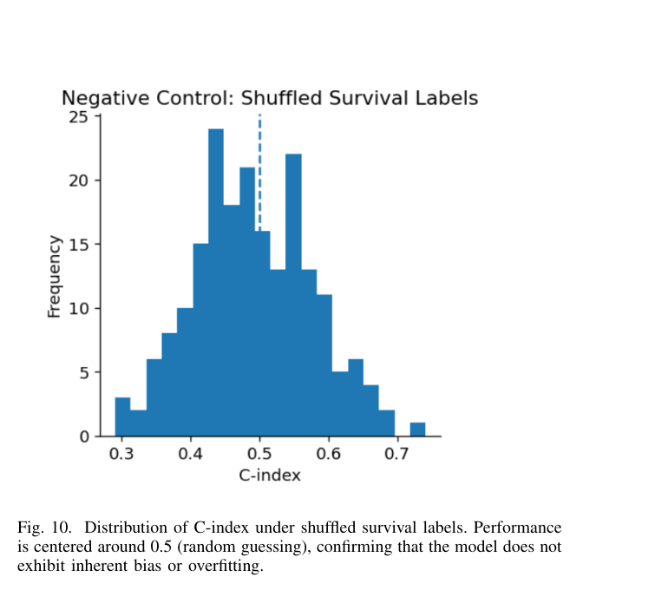
Negative Control — Ruling Out Overfitting & Artefact
To confirm the discovered subgroups and performance gains reflect genuine biological signal — and not statistical artefact — survival labels were randomly permuted while keeping all features intact.
Fig. 9 — KM curves under label shuffling. No meaningful separation → original result is not spurious.
Fig. 10 — C-index distribution under shuffled labels. Centred near 0.5 → no inherent model bias.
Result: Mean C-index under shuffled labels = 0.490 (95% CI: 0.338–0.665), centred at random (0.50). The KM curves show no separation. This confirms that every result in this study is driven by true biological structure, not model artefact.
12 / 15

Slide 13
Biological Interpretation — What the Clusters Actually Represent
What is the biological meaning of the discovered latent subgroups? RNA expression profiles of both clusters were analysed post-hoc.
Proliferative Activity (MKI67)
Not Receptor Status
Not Immune Infiltration
Cluster 1 (high-risk) shows consistently elevated expression of MKI67 — a canonical marker of cellular proliferation. Increased proliferation is a well-established driver of aggressive tumour behaviour and poor survival.
No significant enrichment for ER, PR, or HER2 receptor subtypes was found in either cluster. The model is not rediscovering known clinical categories — it has found something new.
Immune-related gene expression differences between clusters were modest. Immune infiltration is not the primary driver of the discovered heterogeneity — it is tumour-intrinsic aggressiveness.
Clinical & Methodological Significance
• The multimodal model recovered tumour-intrinsic proliferative heterogeneity without any supervision — validating its biological grounding.
• This aligns with established oncology: high proliferative activity (MKI67+) is a known poor-prognosis driver in breast cancer (Hoadley et al., 2014).
• Deep cross-attention reveals interaction-level signals inaccessible to unimodal analysis — supporting the hypothesis that fusion captures new biology.
13 / 15

Slide 14
Key Findings & Methodological Implications
F1
Global Instability is Real
The multimodal transformer achieves σ=0.131 across splits — not attributable to architecture or training. It is data-structural.
F2
Instability = Heterogeneity Signal
Rather than noise, variance indicates that the cohort contains multiple competing survival mechanisms. A single global model cannot fit them all.
F3
Deep Fusion Reveals Hidden Structure
Cross-attention embeddings expose stable latent subgroups (ARI=0.890) with significantly different survival (p=4.33×10⁻⁵) — invisible to unimodal approaches.
F4
Survival Predictability is Conditional
Within a homogeneous subgroup, performance jumps to 0.60–0.70 C-index range with +0.294 improvement. Homogeneity is the key, not the model.
F5
Towards Heterogeneity-Aware Pipelines
Future multimodal survival research should report variance alongside means, treat representations as discovery tools, and adopt two-stage (cluster-then-predict) strategies.
14 / 15

Slide 15
Conclusion & Future Work
Conclusion
Limitations
This study demonstrates that global multimodal survival modelling on TCGA-BRCA is fundamentally unstable — not due to architectural limitations, but due to unmodelled latent patient heterogeneity.
Deep cross-attention embeddings reveal biologically grounded subgroups that are invisible to unimodal analysis. Conditioning survival modelling on these subgroups recovers strong, stable performance — proving that instability is a signal, not noise.
• Single cohort (TCGA-BRCA only)
• RNA + histopathology — no mutations, CNVs, or epigenetics
• Coarse subgroup resolution (K=2)
• No external validation dataset
Future Directions
External Cohort Validation
Adaptive Subgroup Discovery
Test heterogeneity patterns on independent multimodal breast cancer datasets
Hierarchical or adaptive clustering for fine-grained biological resolution
Richer Modality Integration
Heterogeneity-Aware Pipelines
Incorporate somatic mutations, CNVs, epigenetic profiles, and treatment histories
Formally develop two-stage (cluster → predict) frameworks for robust clinical survival modelling
15 / 15

