Slide 1
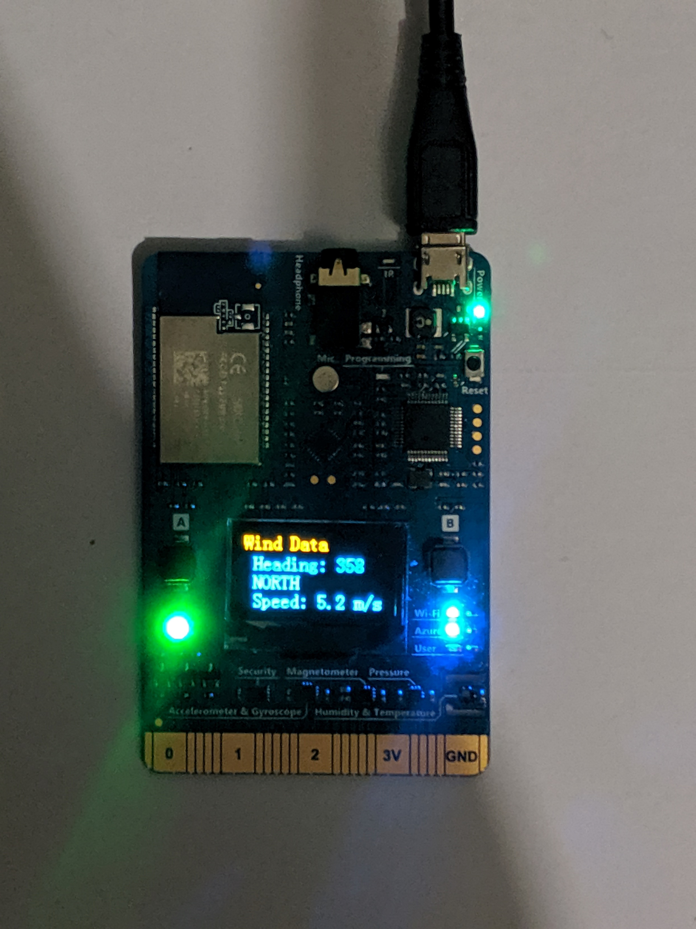













Weather Station POV
IOT Device MXCHIP:
( iot-hub-4C2C5A3B)
IoTCapstoneRG
Warm Path: Real time
Func App*
(iot-func2-4C2C5A3B)
IOT Hub:
(iot-hub-4C2C5A3B)
CosmosDB
Device App built with Azure IOT SDK is used to communicate with Azure IOT hub to send and receive messages
(iot-cosmos-4c2c5a3b)
Stream Analytics
(iot-asa-4C2C5A3B)
Sensors
Temperature
Pressure Sensor
Magnetometer
Humidity
Wind Speed
Telemetry
{
"temperature" "pressure" "humidity" "windSpeed", "windDirection
}
D
Desired Properties
Device Twin
Real Time
Cold-path
Device twin update
Func-App
Date Lake Storage Cold Storage
Data Lake Storage
(iot-func-4C2C5A3B)
(Iotdls4c2c5a3b)
Date Lake Analytics
(Iotdla4c2c5a3b )
Wind Alert RGB lights
Desired
Changed Event Handler
Device Management
Azure Web Portal
Identity Registry
Automatic firmware update configured on IOT Hub Device Managment
Evaluate windspeed and update device twin desired properties.
Output data: avg, 1 hour
Device Life cycle
DPS Resource
(iot-dps-4C2C5A3B)
iot-dps-4C2C5A3B
IOT hub Device Enrolment: Secured auto Provision using Azure Device provision service Client SDK
Authentication: X.509 certificate
Things
Insights
Actions

