Slide 1

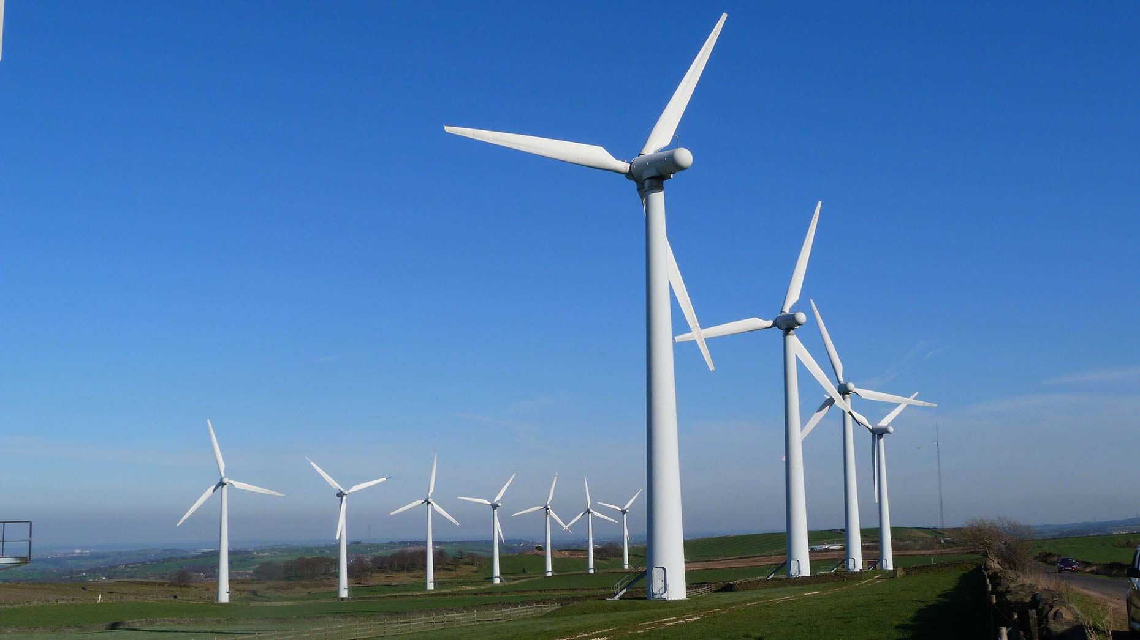








Wind Farm POV
IoTCapstoneRG
Simulated Wind Turbines
Time Series Insights
( iot-tsi-4C2C5A3B)
Time Series Insights Explorer
Query API
Sensors
Cloud Gateway (IOT Hub)
telemetry: {
windSpeed
lowSpeedShaftRpm
highSpeedShaftRpm externalTemperatureCelsius generatorTemperatureCelsius rotorTemperatureCelsius
power
isTurbineBrakeOn
name }
Real time
Data Access Policies: Add permission to users
( iot-hub-4C2C5A3B)
Web
Authentication: Symmetric Key
consumer
Group
Stream Analytics Job
Stream analytics job
( iot-asa-4C2C5A3B )
Power BI
Historical analysis
CosmosDB
(iot-cosmos-4c2c5a3b)
IOT Devices
Things
Insights
Actions

