Slide 1
IBM University Engagement Project Submission
“Exploring the Power of AI with IBM Watson ML, XGBoost Classifier”

Slide 2

Project Tile – PMGSY Project Classifier
Intelligent Classification of Rural Infrastructure Projects
Domain of Project – Rural Infrastructure and Development
Student Name | Recent Passport Photo | Email ID | Mobile number [WhatsApp]
Rayudu Somi Setty |  | srayudu3@gitam.in | 9494588144

Slide 3
Problem Statement -
Problem Statement : PMGSY scheme classifier
Problem Statement: Intelligent Classification of Rural Infrastructure Projects
The Challenge
The Pradhan Mantri Gram Sadak Yojana (PMGSY) is one of India's largest rural infrastructure development programs, aimed at providing reliable road connectivity to rural habitations. Over time, multiple schemes such as PMGSY-I, PMGSY-II, RCPLWEA, PMGSY-III, and others have been introduced, each with unique objectives, funding models, and project specifications.
Government agencies and infrastructure planners manage thousands of road and bridge construction projects across the country. Manually classifying these projects into the correct PMGSY scheme is labor-intensive, error-prone, and inefficient. Misclassification can impact project monitoring, budget allocation, policy evaluation, and decision-making.
Without an intelligent automated system, stakeholders face challenges in analyzing project data, tracking scheme performance, and ensuring transparency in rural infrastructure development.
The Objective
Build an AI-powered PMGSY Project Classification System that automatically identifies and classifies rural road and bridge construction projects into their appropriate PMGSY Scheme based on physical, financial, and administrative project characteristics.
The solution should:
Intelligent Project Classification
Predict the correct PMGSY scheme (PMGSY-I, PMGSY-II, RCPLWEA, PMGSY-III, etc.) using project attributes.
Support classification of both completed and ongoing projects using an XGBoost Classifier.
Provide fast and accurate predictions through a deployed machine learning model.
Project Data Processing
Accept project details through a user-friendly web interface.
Validate infrastructure-related input parameters before prediction.
Process physical, financial, and work-progress metrics for classification.
Real-Time Prediction Service
Securely connect to the machine learning model deployed on IBM Watson Machine Learning.
Generate real-time prediction results through API-based model scoring.
Display prediction outcomes instantly to users.

Slide 4
Infrastructure Analytics
Analyze project characteristics and classification patterns across different PMGSY schemes.
Support monitoring and evaluation of rural infrastructure projects.
Provide insights that help improve project categorization and reporting.
Decision Support
Assist government agencies, infrastructure planners, and policy analysts in efficiently categorizing projects.
Reduce manual effort, classification errors, and processing time.
Improve transparency and consistency in project monitoring and management.
System Components
Project Data Processor
Collects, validates, and prepares project information for classification.
Classification Engine
Uses the trained XGBoost model to predict the appropriate PMGSY scheme.
Analytics Module
Tracks prediction requests, execution times, and system performance metrics.
Monitoring Module
Provides system health checks and operational status for reliable deployment.
Technology Used
Tech Stack (Mandatory)
Use any one of the following approaches:
LangFlow + IBM watsonx.ai + Granite Models
IBM Cloud Agentic Lab with IBM Granite Models
Replicate with LangChain + RAG + IBM Granite Models
I used LangFlow + IBM watsonx.ai + Granite Models

Slide 5
Proposed Solution -
The proposed solution is an AI-powered PMGSY Project Classification System that automatically categorizes rural road and bridge infrastructure projects into the correct PMGSY scheme, such as PMGSY-I, PMGSY-II, and RCPLWEA.
The system leverages an XGBoost machine learning model trained on PMGSY project data and deployed on IBM Watson Machine Learning for real-time predictions.
The solution follows a three-layer architecture consisting of a responsive frontend, a secure Node.js and Express.js backend, and a cloud-hosted machine learning model.
The model analyzes 14 project attributes, including administrative, financial, and progress-related parameters, to accurately determine the appropriate scheme category.
Users can enter project details through a web dashboard and instantly receive classification results along with execution metrics. The backend securely manages authentication, API communication, and system monitoring, while the deployed model delivers fast and reliable predictions.
The system includes four key modules:
Project Data Processing Module – Collects and validates project inputs.
Classification Module – Predicts the appropriate PMGSY scheme using XGBoost.
Analytics Module – Tracks prediction performance and execution statistics.
System Monitoring Module – Provides health checks and service diagnostics.
Overall, the solution improves classification accuracy, reduces manual effort, enhances transparency, and supports efficient monitoring of rural infrastructure projects under the PMGSY program.

Slide 6
Working component Used -
Chat Input Component Accepts project parameters entered by users.
API Request Component Sends project data to the backend prediction service.
IBM Watson Machine Learning Component Connects to the deployed XGBoost model endpoint.
Data Processing Component Validates and formats the 14 project attributes.
Output Component Displays the predicted PMGSY scheme and execution metrics.
Health Monitoring Component Checks API and model availability.

Slide 7
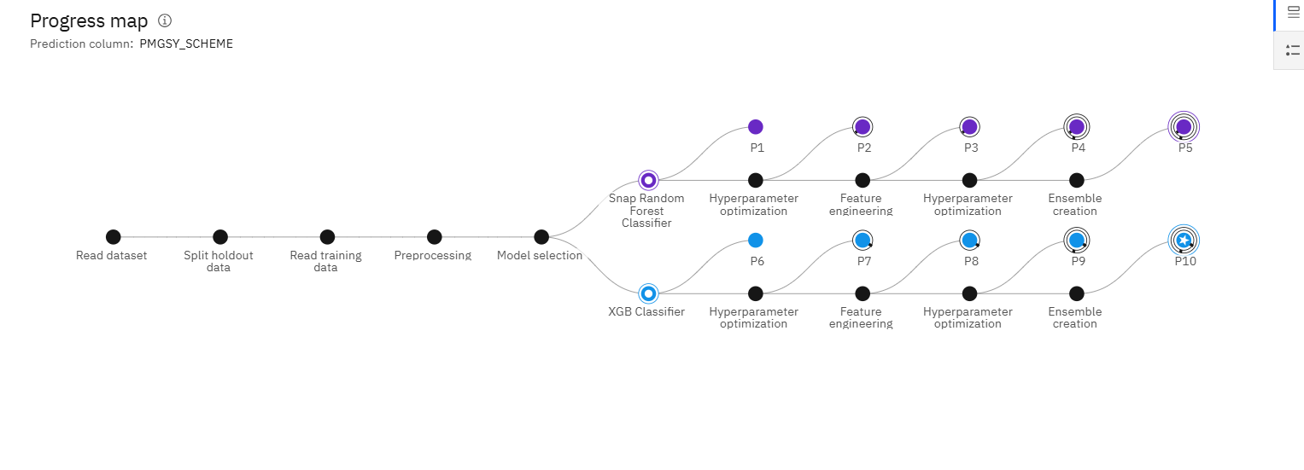
Model Development Workflow-

Slide 8
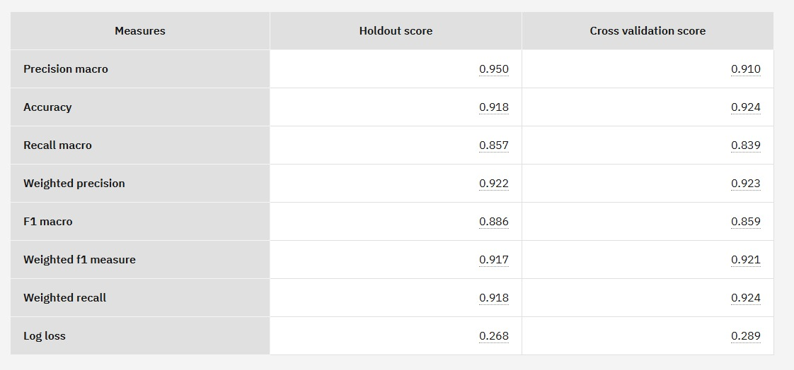
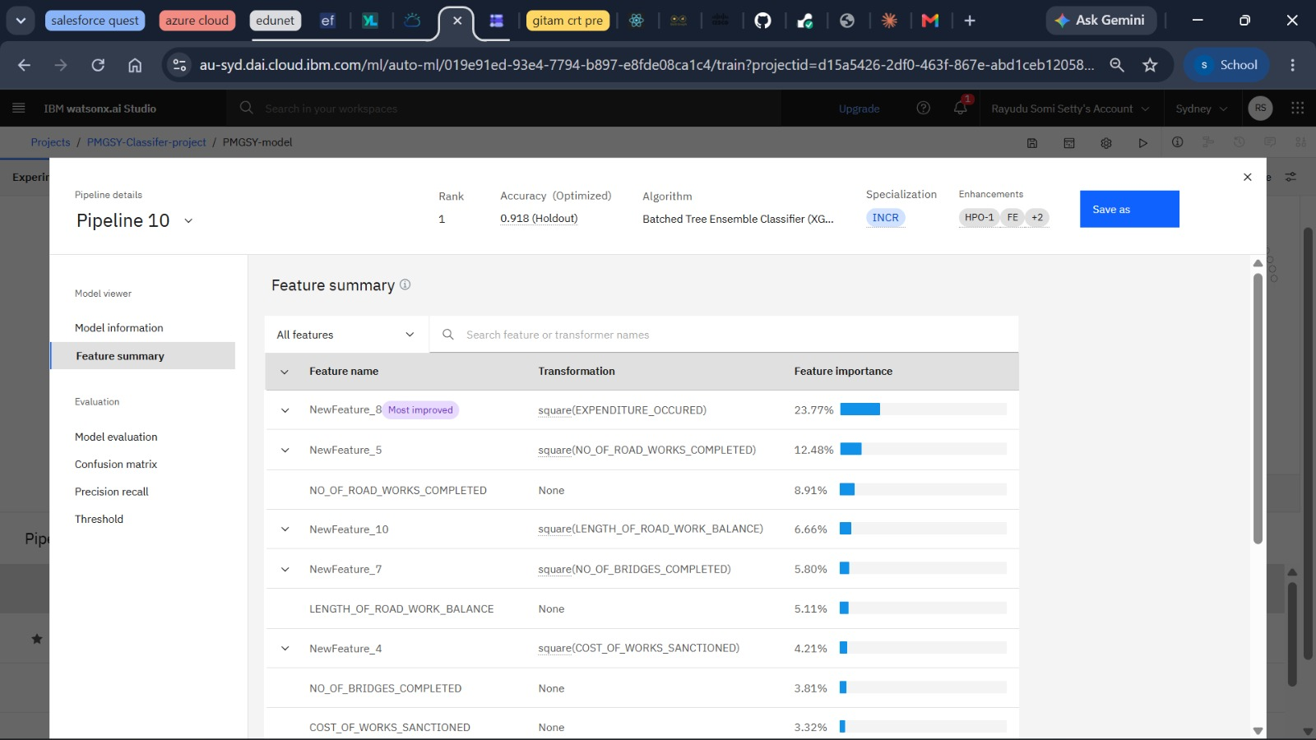
Model Testing and Evaluation
Model evaluation scores
Feature Map summary

Slide 9
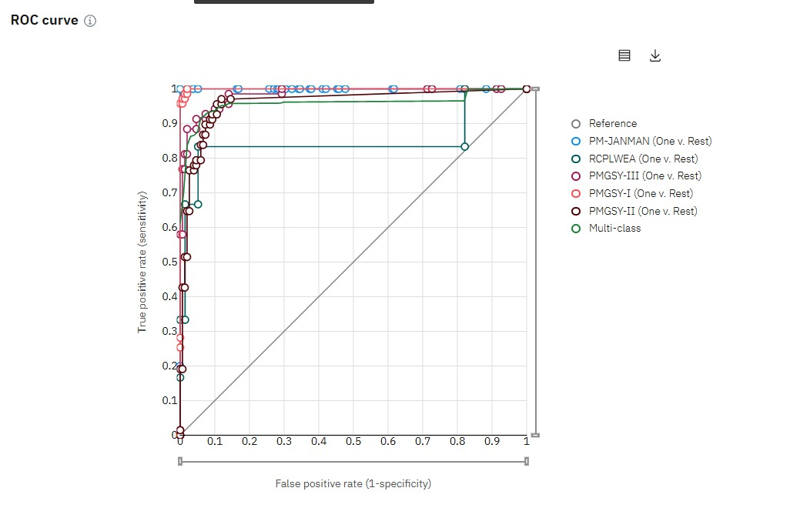
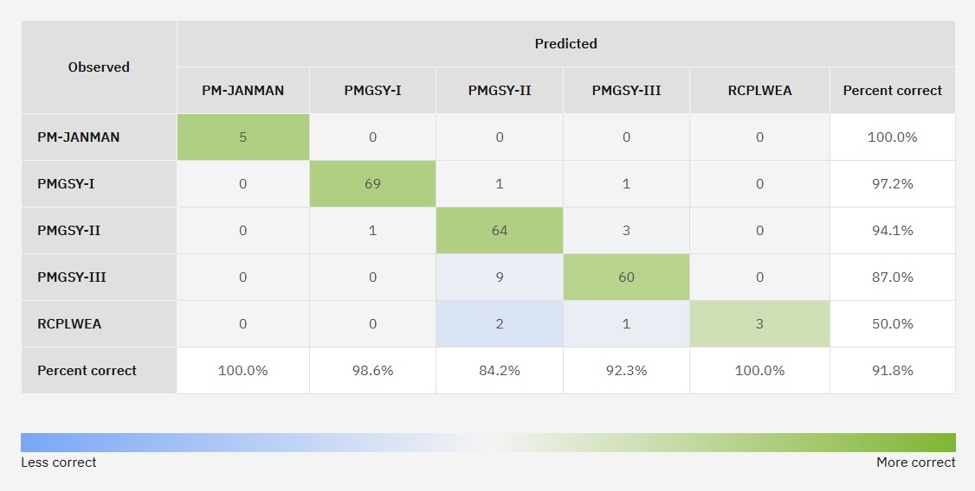
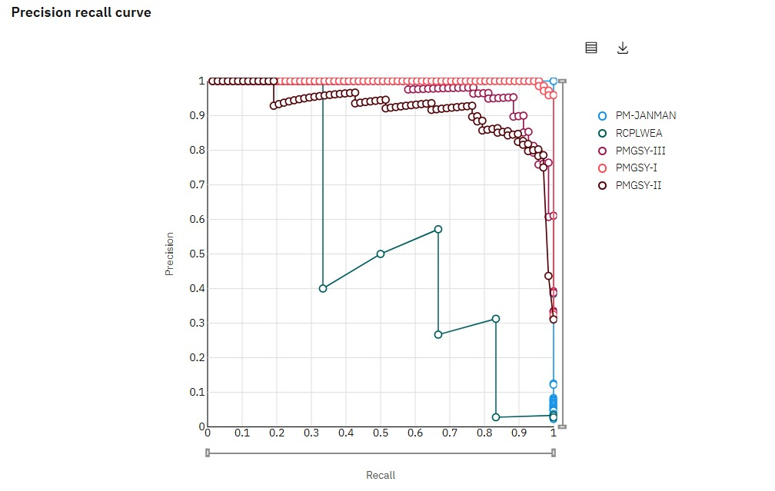
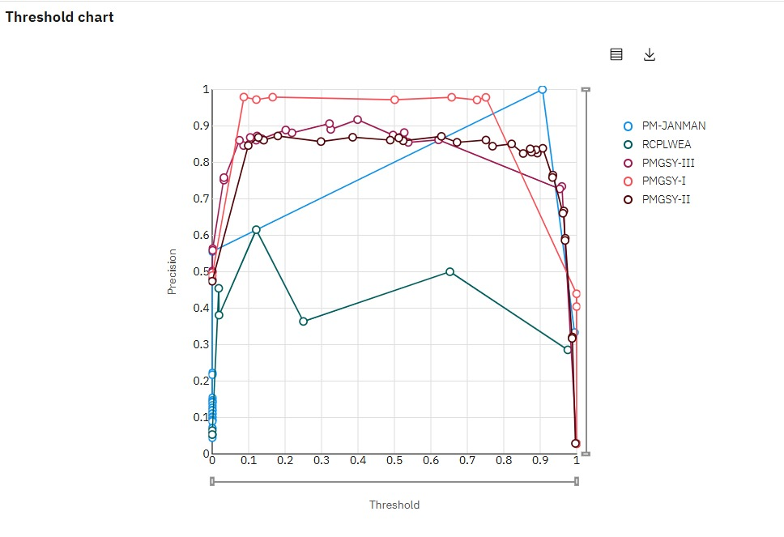
Roc curve, confusion matrix, precision recall curve , threshold chart

Slide 10
Architecture blueprint
┌──────────────────────┐
│ User Dashboard │
│ (HTML/CSS/JS Frontend)
└──────────┬───────────┘
│ HTTPS
▼
┌──────────────────────┐
│ Node.js + Express API│
│ Input Validation │
│ Authentication │
└──────────┬───────────┘
│
▼
┌──────────────────────┐
│ IBM Cloud IAM │
│ OAuth Token Service │
└──────────┬───────────┘
│
▼
┌──────────────────────┐
│ IBM Watson ML │
│ XGBoost Classifier │
└──────────┬───────────┘
│
▼
┌──────────────────────┐
│ Prediction Results │
│ PMGSY Scheme Output │
└──────────────────────┘
Project workflow
PMGSY Dataset
↓
Data Preprocessing
↓
Feature Selection
↓
XGBoost Model Training
↓
IBM Watson Machine Learning Deployment
↓
Node.js / Express Backend
↓
Prediction API
↓
Web Dashboard
↓
PMGSY Scheme Prediction

Slide 11
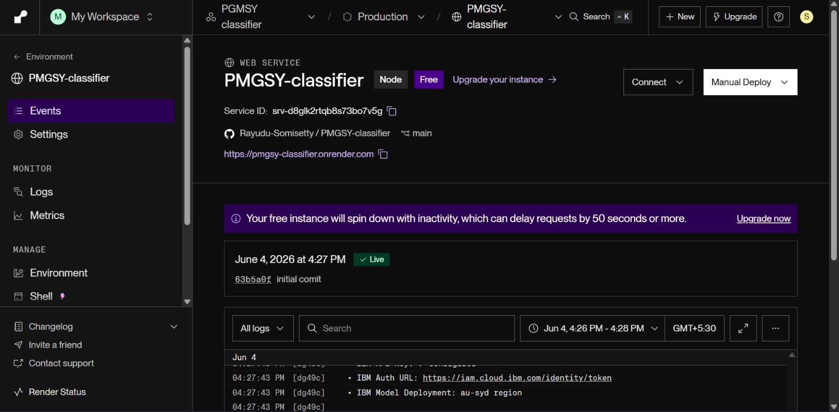
Deployment (deployed on render)
Deployment link:-
https://pmgsy-classifier.onrender.com

Slide 12
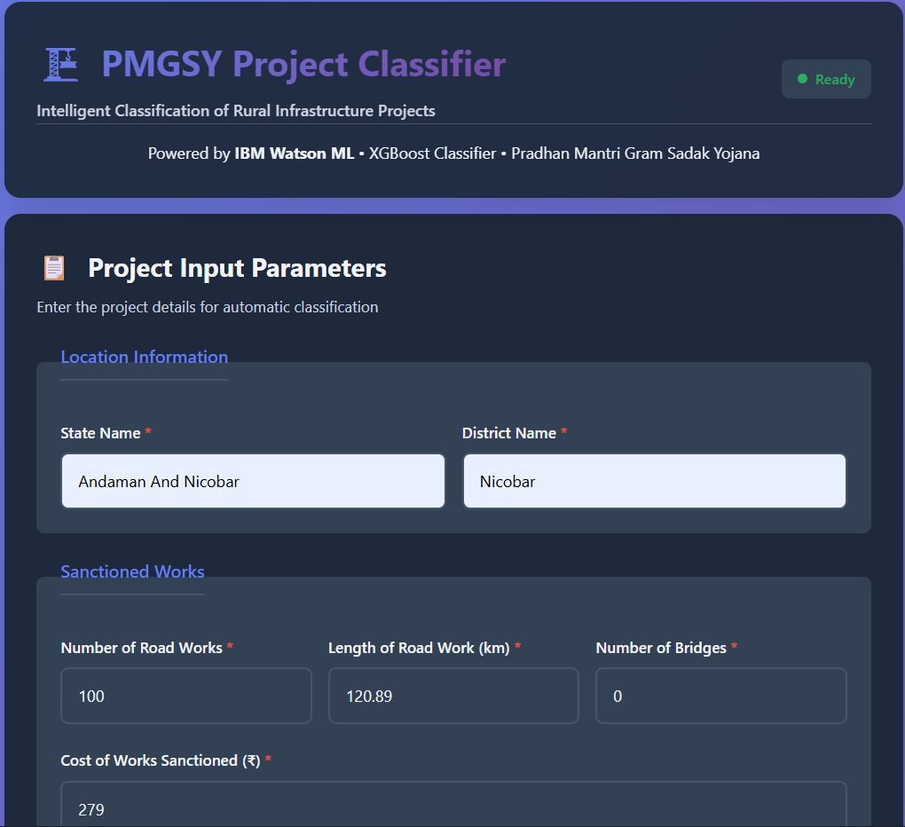
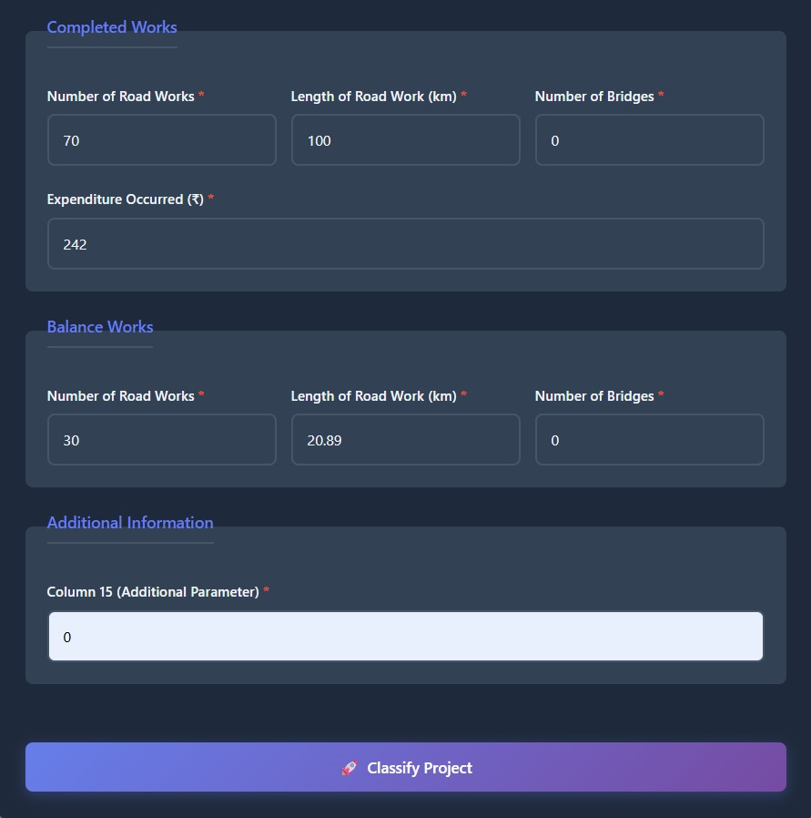
Web interface and working

Slide 13
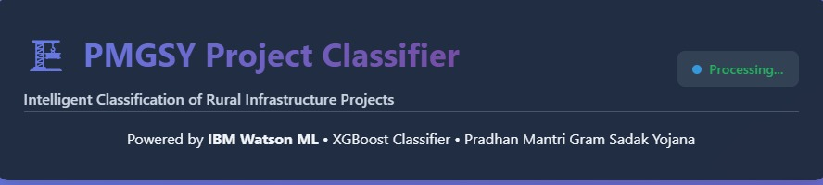
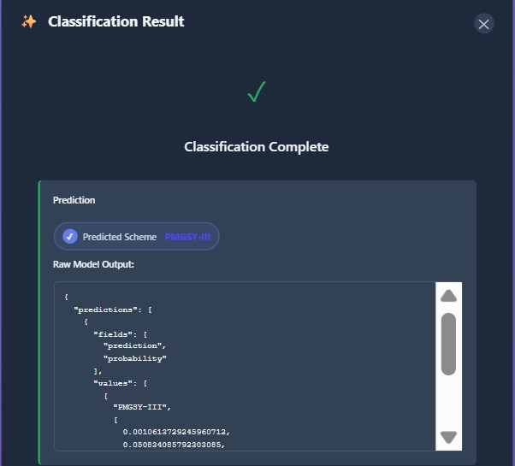
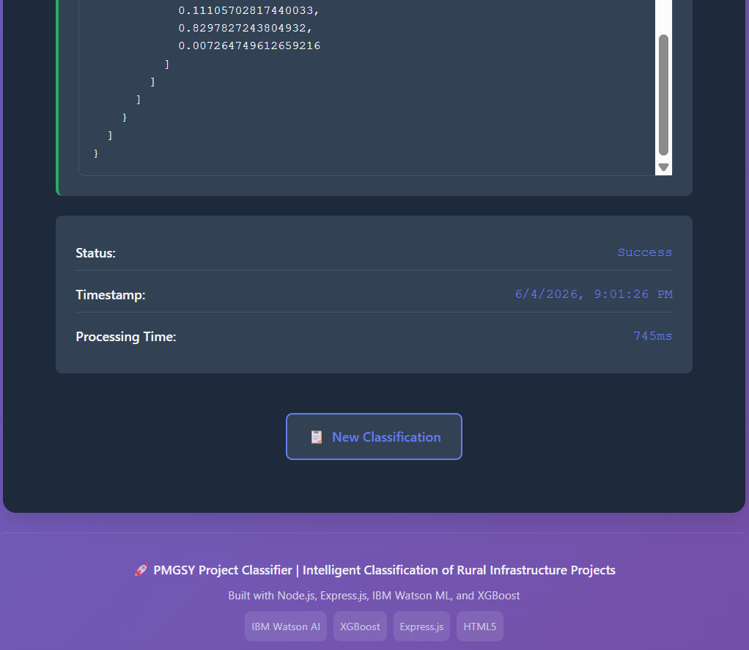

Slide 14

Role of AI in the solution
Role of AI in the Solution
Artificial Intelligence serves as the core decision-making component of the PMGSY Project Classification System. The solution utilizes a trained XGBoost machine learning model to analyze project-specific characteristics and automatically classify infrastructure projects into their appropriate PMGSY schemes.
The AI model learns patterns from historical PMGSY project data, including administrative information, sanctioned work metrics, financial expenditures, completed assets, and remaining project backlogs. By identifying complex relationships among these parameters, the system can accurately predict the most suitable scheme category for new projects.
Unlike manual classification methods, the AI-driven approach provides faster, more consistent, and scalable decision-making. The model processes project data in real time and generates instant predictions through IBM Watson Machine Learning, reducing administrative effort and minimizing classification errors.
The integration of AI enables:
Automated PMGSY scheme classification.
Faster processing of large volumes of project records.
Improved accuracy and consistency in project categorization.
Data-driven decision support for government agencies and infrastructure planners.
Real-time predictions through cloud-based deployment.
Overall, AI transforms the classification process from a manual and time-consuming task into an intelligent, efficient, and scalable solution for managing rural infrastructure projects.

Slide 15
Technology Used
IBM Watson Studio AutoAI
Automates data preparation, model selection, and optimization to build the best classification model.
XGBoost Classifier
The machine learning algorithm used to predict the correct PMGSY scheme based on project data.
IBM Watson Machine Learning
Deploys the trained model and provides real-time predictions through cloud APIs.
IBM Cloud
Provides secure and scalable infrastructure for hosting and managing AI services.
IBM Cloud IAM (OAuth 2.0)
Ensures secure access to the deployed machine learning model using authentication tokens.
REST APIs
Enable communication between the application and the deployed AI model for real-time predictions.

Slide 16
Novelty and Uniqueness
Automated PMGSY Scheme Classification
Automatically classifies rural infrastructure projects into the correct PMGSY scheme, reducing manual effort and classification errors.
AI-Driven Decision Making
Uses an XGBoost machine learning model to identify complex patterns in project data and provide accurate scheme predictions.
Real-Time Cloud Predictions
Delivers instant classification results through IBM Watson Machine Learning, enabling faster project assessment and monitoring.
Data-Driven Infrastructure Analysis
Analyzes administrative, financial, and progress-related project parameters to support informed decision-making.
Secure Cloud Integration
Implements IBM Cloud authentication and secure API communication, ensuring reliable and protected access to prediction services.
Scalable and Practical Solution
Can efficiently process large volumes of infrastructure projects, making it suitable for government agencies and policy analysts.
Improved Transparency and Efficiency
Provides consistent project categorization, helping improve monitoring, reporting, and resource allocation within PMGSY programs.

Slide 17
Git Hub Link:- https://github.com/Rayudu-Somisetty/PMGSY-classifier
Github repo files tree:-
PMGSY Classifier Project/
├── server.js # Express server & IBM integration
├── package.json # Dependencies configuration
├── .env # Environment variables (gitignored)
├── .env.example # Environment template
├── .gitignore # Git ignore rules
├── README.md # This file
└── PMGSY_DATASET.csv # Sample dataset
└── Project.pptx # project presentation
├── Problem statement 35.pdf # PDF
│
└── public/ # Frontend assets
├── index.html # Main HTML form
├── style.css # Styling (CSS Grid, Flexbox, responsive)
├── app.js # Frontend JavaScript logic
·
·
·

Slide 18
Future Scope
Geographic Information System (GIS) Integration:- Integrate GIS and map-based visualization to analyze project locations, connectivity, and regional infrastructure development patterns.
Advanced Predictive Analytics:- Extend the system to predict project completion status, cost overruns, budget requirements, and construction delays.
Explainable AI (XAI):- Provide explanations for predictions, helping policymakers understand the factors influencing scheme classification.
Real-Time Government Data Integration:- Connect with PMGSY and other government databases to automatically retrieve and classify newly added projects.
Mobile Application Support:- Develop a mobile application to enable field officers and administrators to access predictions and analytics on the go.
Multi-Scheme Infrastructure Classification:- Expand the system to classify projects from other rural development and infrastructure programs beyond PMGSY.
Interactive Analytics Dashboard:- Incorporate advanced visualizations, trend analysis, and performance reports to support strategic planning and policy decisions.
·
·
·

Slide 19


