Slide 1

Agentic AI enabled secure Electronic Health Record using permissioned blockchain
Team Members
R.Chinna rayudu(22CSB0A45)
P.Krishnamohan(22CSB0A04)
N.Shiva kumar(22CSB0C26)
Guide
Dr. E.Suresh Babu Department
Computer Science & Engineering Date: 13/04/2026

Slide 2
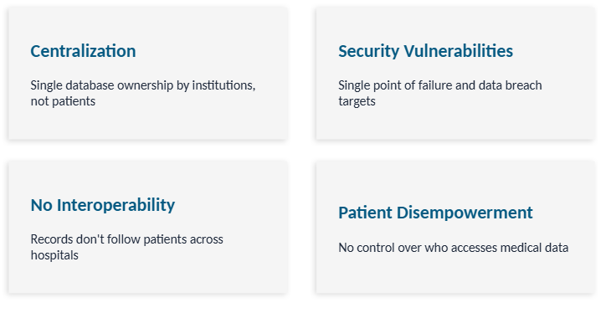
Problem Definition
Healthcare systems face challenges due to fragmented patient records, lack of secure identity, and absence of consent‑based data sharing. Doctors often cannot access complete medical history, leading to delayed diagnosis and repeated tests. Additionally, existing systems lack AI‑based decision support and secure, tamper‑proof storage.
Motivation
To address these challenges, there is a need for a secure, intelligent, and decentralized Electronic Health Record system that integrates:
Agentic AI for diagnosis
DID for patient identity
CID for record referencing
Hyperledger Fabric for secure storage
Consent‑based access control
Key Problems

Slide 3
Existing Solutions & Limitations
Existing Approaches
Centralized EHR systems
Single-model AI diagnosis tools
Manual medical coding
Limitations
No multi-modal intelligence
Patient records scattered across hospitals
No unified patient identity
No patient‑controlled consent
Manual data sharing
Weak data integrity & auditability
Poor interoperability across hospitals

Slide 4
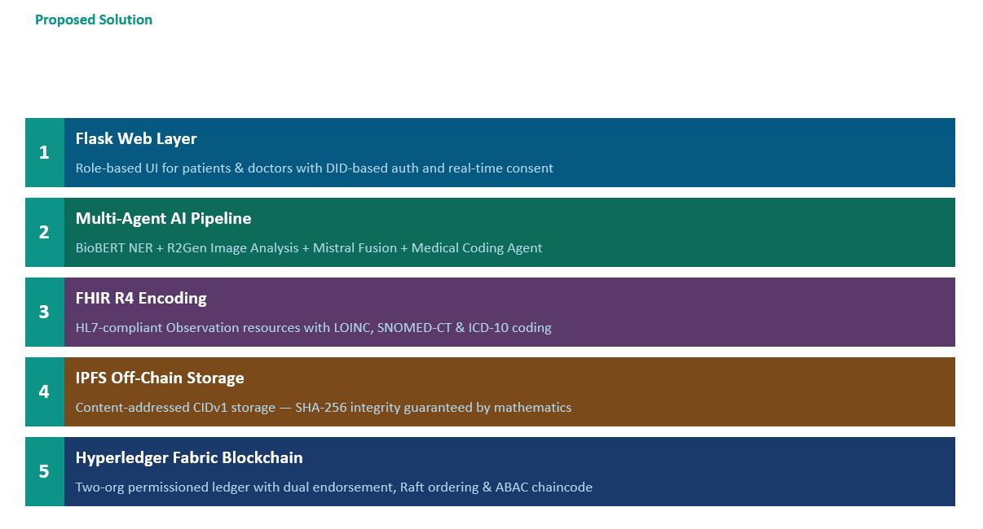
Project Overview
What is Our System?
A Secure Multi‑Agent AI Healthcare Framework that:
Accepts Text, Image, and Video through the web UI and uses collaborative AI agents
Performs:
Clinical extraction
Disease identification
Medical coding
AI‑based medical assessment
Generates:
FHIR Standard Healthcare Data
Structured Electronic Health Records (EHR)
Storage Platforms:
Off‑chain (IPFS) — Stores EHR data
On‑chain (Hyperledger Fabric) — Stores CID + Patient DID

Slide 5
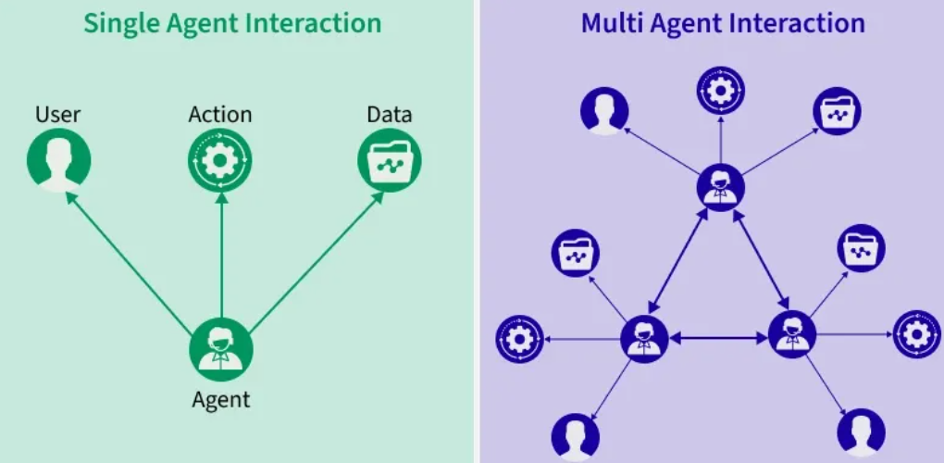
Key innovations
1. Flask‑Based Web Interface
Built using Flask framework
Accepts Text, Image, and Video inputs from patients
Handles authentication using DID‑based identity
Connects AI agents with storage and blockchain layers
2. Multi-Agent AI Collaboration
Separate agents for:
Text analysis
Image/X-ray analysis
Medical coding
Decision fusion
3. Automated Medical Coding
SNOMED CT
ICD-10
4. Decentralized & Secure Storage
IPFS (Off‑chain) for storing medical records
Hyperledger Fabric (Blockchain) for storing CID + Patient DID
Tamper‑proof and decentralized access
Protocol used for agent communication:-
LangChain ReAct–based Message Passing Protocol

Slide 6
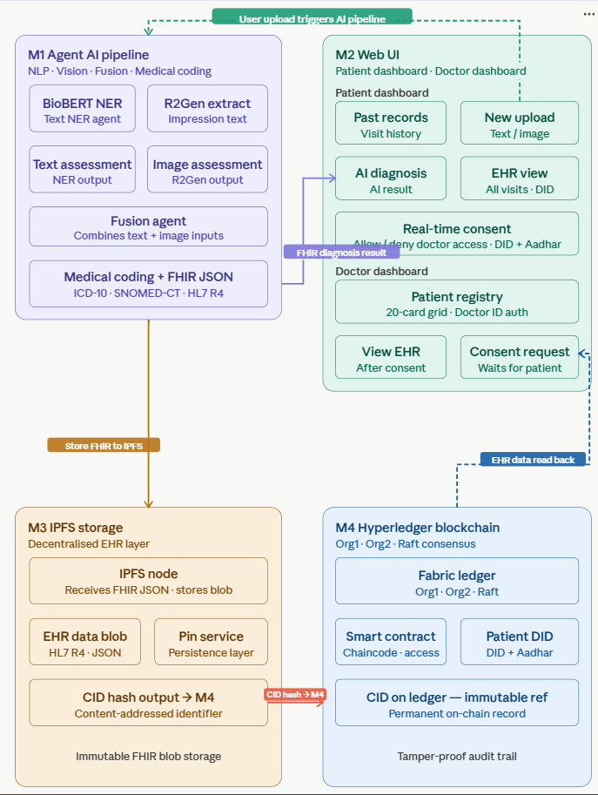
System Architecture(High level)

Slide 7
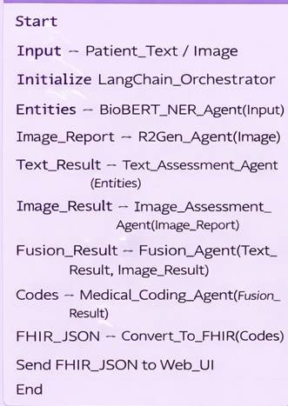
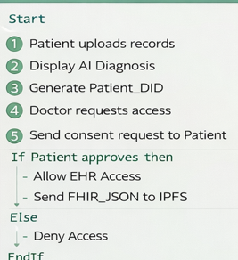
Module 1:- Agent AI pipleine
Description:
Extracts medical insights from text and medical images
Uses BioBERT NER for entity extraction
Uses R2Gen for image report generation
Fusion agent combines text + image
Converts output to FHIR JSON + Medical coding (ICD-10, SNOMED-CT)
Output: Structured medical diagnosis in FHIR format.
Module 2 – Web UI
Description:
Patient dashboard (upload records, view diagnosis)
Doctor dashboard (view EHR, request consent)
Real-time Consent management
Patient identity using DID + Aadhaar
Output: User interaction + Consent approval
Algorithm
Algorithm

Slide 8
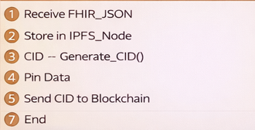
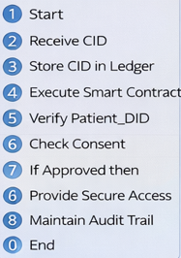
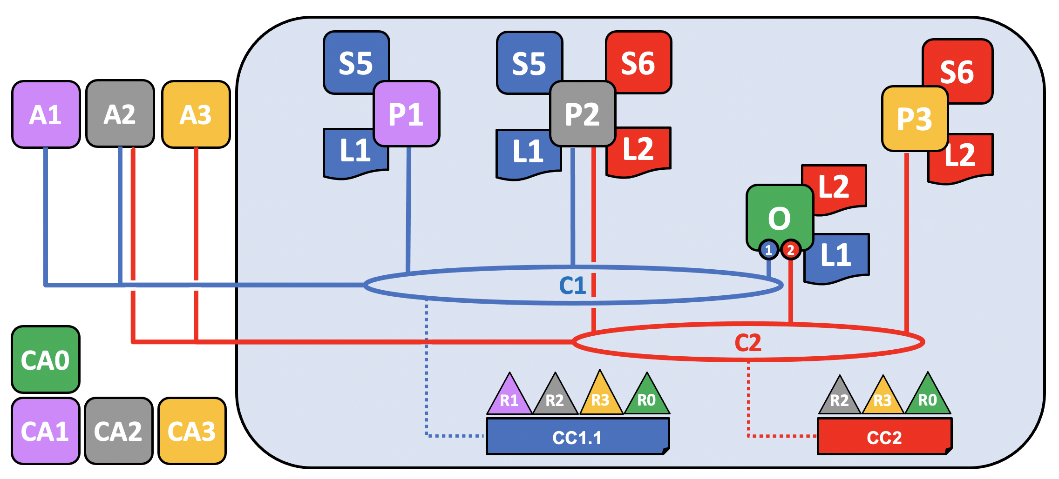
Module 3:– IPFS Storage
Description:
Stores FHIR JSON data in decentralized storage
Generates CID hash
Immutable EHR storage
Uses Pin service for persistence
Output: CID hash
Module 4 – Hyperledger Blockchain
Description:
Stores CID hash on blockchain
Smart contract for access control
Patient DID based identity
Immutable audit trail
Output: Secure & tamper-proof EHR access
Algorithm
A1–A3 → Applications CA0–CA3 → Certificate Authorities
P1–P3 → Peer Nodes L1–L2 → Ledger
S5–S6 → Smart Contracts O → Ordering Service
C1–C2 → Channels CC1.1–CC2 → Consortiums
Algorithm

Slide 9
End-to-End Transaction Flow
1.
Patient submits clinical text + X-ray image
2.
BioBERT extracts entities (fever, cough, headache)
3.
R2Gen generates radiology report from X-ray
4.
Mistral LLM fuses assessments → clinical conclusion
5.
Medical Coding Agent maps to ICD-10 + SNOMED-CT
6.
FHIR R4 Observation resource generated
7.
FHIR uploaded to IPFS → CID returned
8.
CID committed to blockchain (Org endorsement)
9.
EHR record written to CSV with DID, timestamp, CID
10.
Patient sees completion page with their DID

Slide 10
EXPERIMENTS & RESULTS
System Interface — Patient & Doctor Workflows
Screen 01
Screen 02
Screen 03
Home Page
Patient Registration
Patient Dashboard
Four pillars: Agentic AI Diagnosis, Secure EHR, Blockchain, IPFS Storage
Aadhar de-duplication, DID generation, AI pipeline launch on submit
Past Records · New Upload · AI Diagnosis — three panels, three routes
Screen 04
Screen 05
Screen 06
Clinical Upload Form
Doctor Dashboard
AI Processing Complete
Text Only (Mode 1) or Text + Image (Mode 2) — activates BioBERT + R2Gen
20-patient grid — every View triggers consent flow; cannot be bypassed
Page only renders when returncode=0 — proof of full end-to-end execution

Slide 11
Multi-Layer Security Architecture
CID Integrity Verification
Multi-Organization Endorsement
Decentralized Storage
Any byte modification changes the IPFS content hash, making tampering cryptographically detectable
No single server holds all records - eliminates single point of failure and breach risk
Patient-Controlled Consent
TLS 1.3 Encryption
Zero-persistence authorization - every doctor access requires real-time patient approval
All Hyperledger Fabric inter-component communication uses mutual TLS authentication
ABAC Chaincode
Attribute-Based Access Control restricts CreateAsset to identities with abac.creator=true

Slide 12
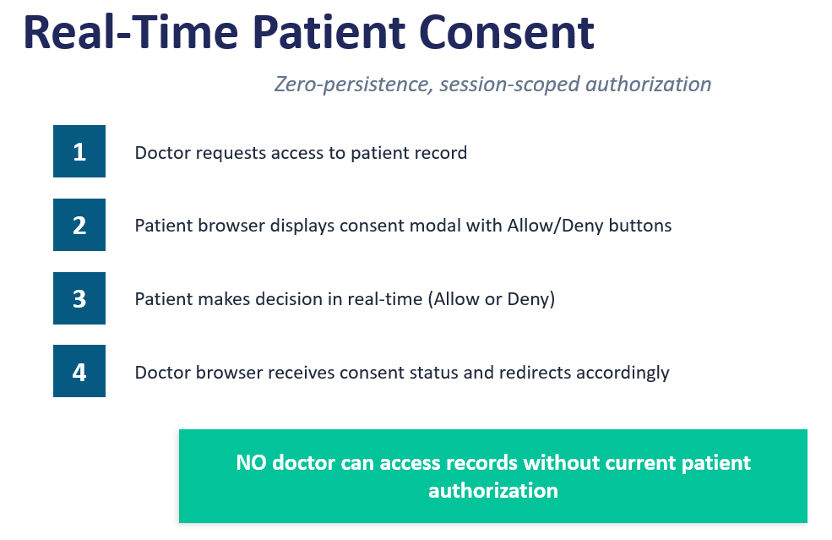
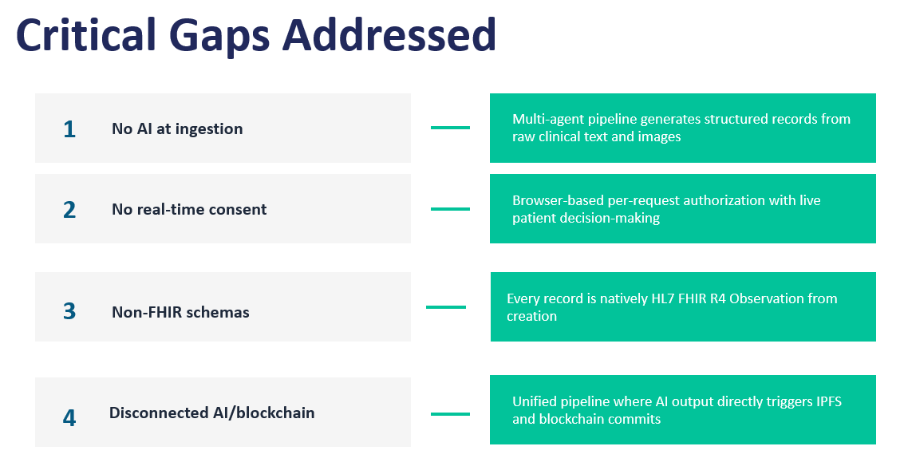
1
2
3
4

Slide 13
System Performance Analysis
BioBERT NER
1–2 seconds
R2Gen Image Analysis
3–8 seconds
Mistral Fusion Agent
5–10 seconds
Medical Coding Agent
3–6 seconds
IPFS Upload
<1 second
Blockchain Commit
2–4 seconds
Total (Text Only)
8–15 seconds
Total (Text + Image)
15–25 seconds

Slide 14
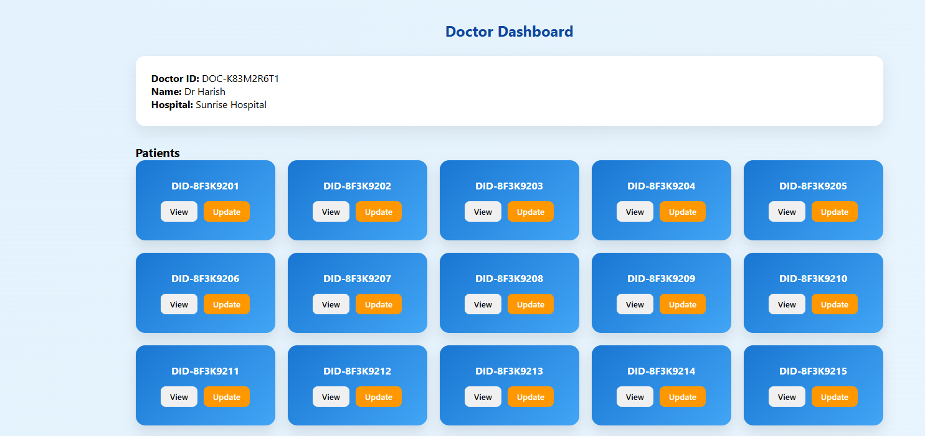
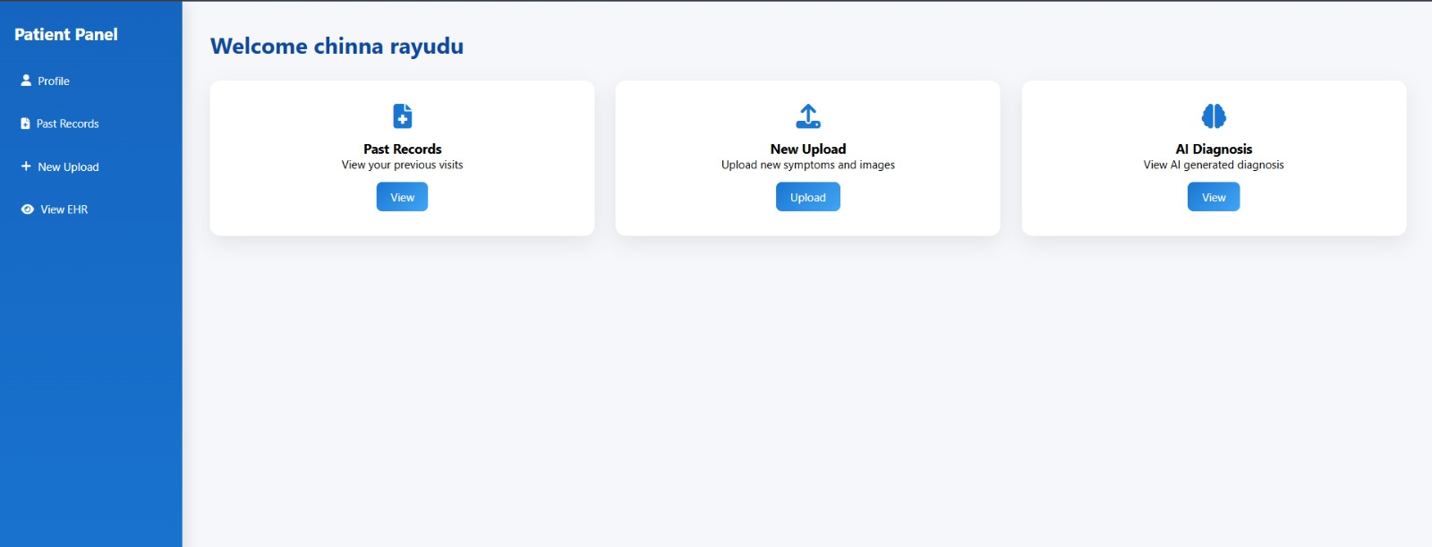
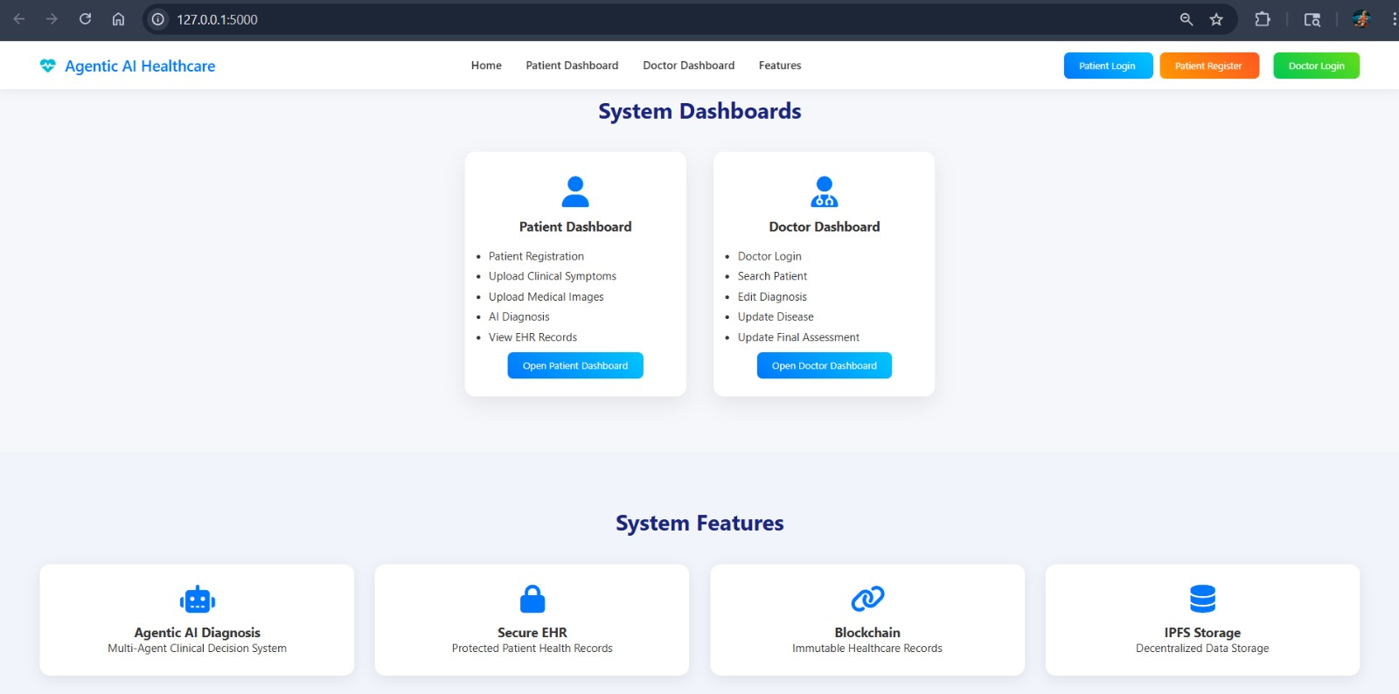
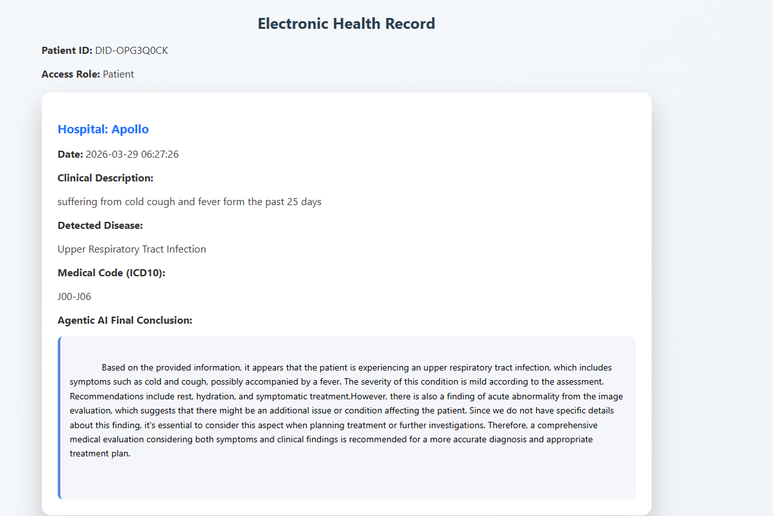
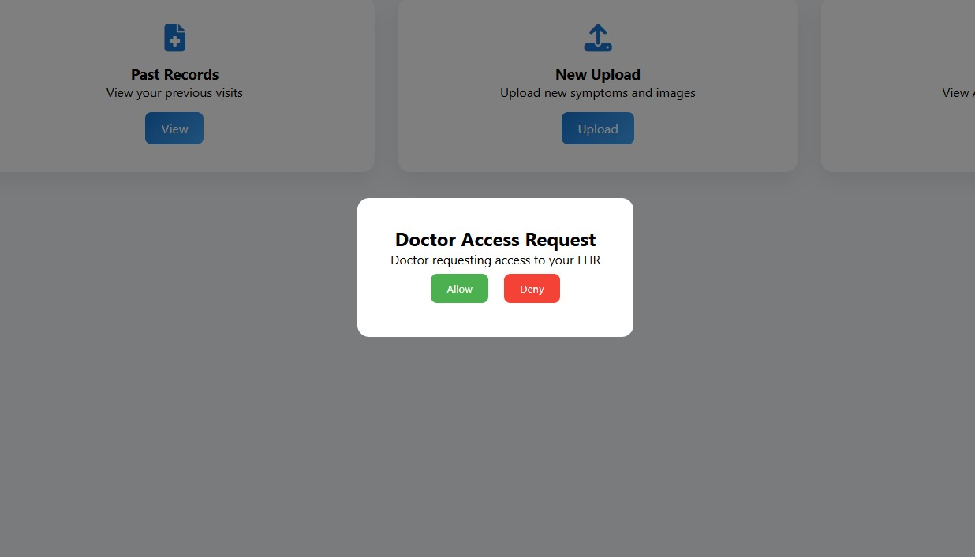
Results(Frontend part)
Home website
Patient Dashboard
Real time patient consent

Slide 15
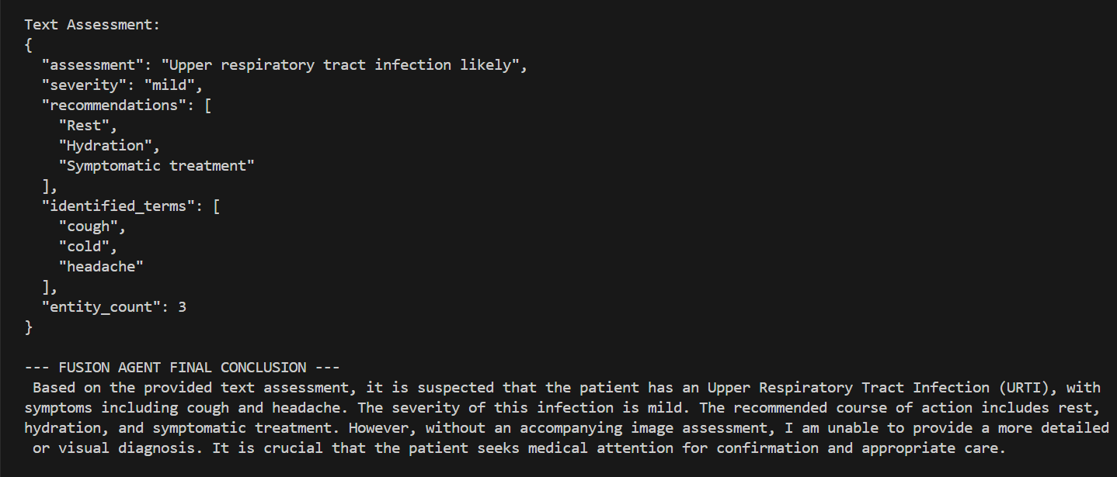
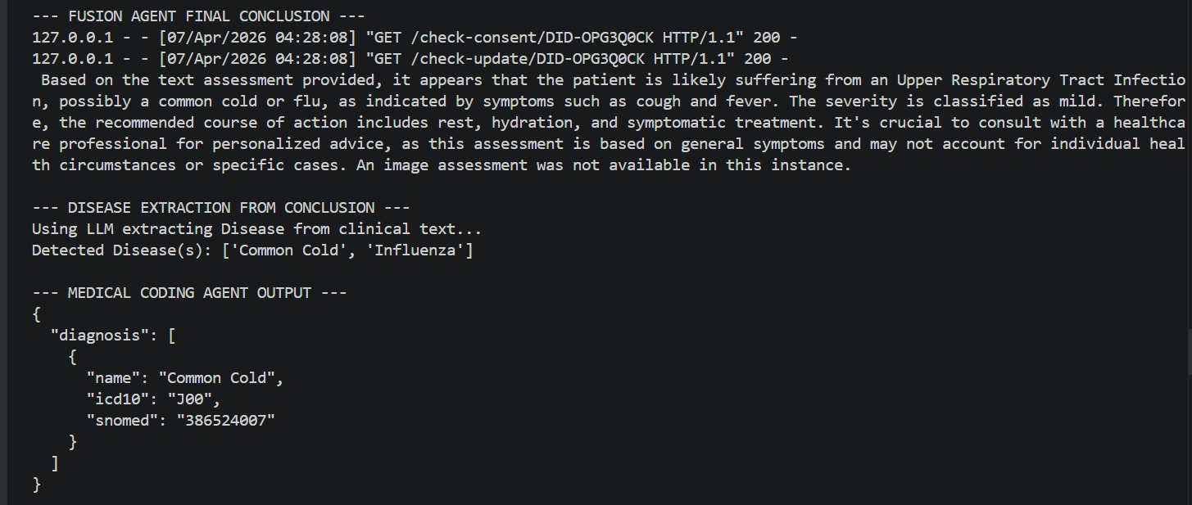
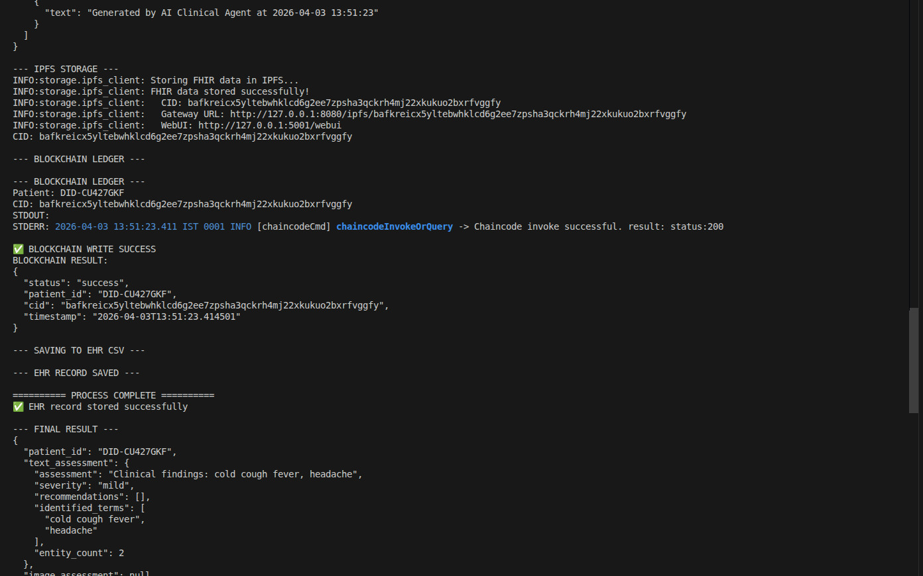
Results (Backend part)
Agent AI Conclusion
Medical coding
Transaction in blockchain ledger
IPFS & CSV and Blockchain status
Real time patient consent

Slide 16
Future Enhancements
A complete, multi-role, working prototype was deployed on a real two-device Hyperledger Fabric network — not just a de
Smart Consent Management
Role‑based access control
Time‑limited consent
A
Mobile Application
Patient & Doctor mobile apps
Real‑time notifications and access
I + Blockchain + IPFS + FHIR can be tightly integrated in a single pipeline where AI output is the direct input to decentralized storage
Enhanced Security
Zero‑knowledge proofs
Advanced DID authentication
or (Org1MSP:true, Org2MSP:true, status:200) was demonstrated, not just claimed
Cloud + Edge Deployment
Scalable healthcare infrastructure
t consent, cross-institution longitudinal records, and DID-based identity were all implemented end-to-end
Hyperledger Fabric · IPFS · BioBERT · R2Gen · Mistral LLM · HL7 FHIR R4 · LangChain · Decentralized Identifier · ICD-10 · SNOMED-CT

Slide 17
Thank you

