Slide 1

Title: Machine Learning Prediction of Potential
Energy of CuZr
Ramavath Chinna Rayudu 22CSB0A45(CSE)
Sabavath Kumar 22EEB0A65 (EEE)
Machine Learning for materials informatics (MLMI)

Slide 2
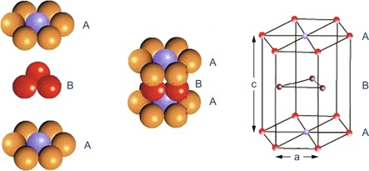
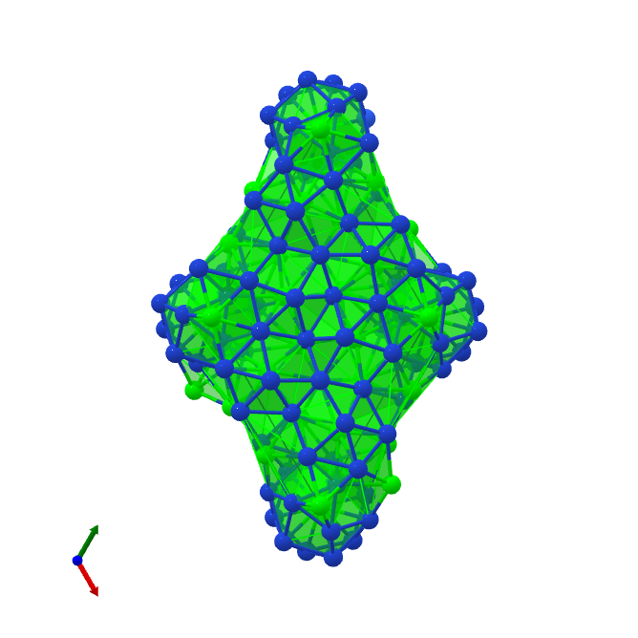
CuZr
CuZr (Copper-Zirconium Alloy) is an intermetallic compound or metallic glass-forming alloy composed primarily of copper (Cu) and zirconium (Zr). It is widely studied for its excellent mechanical strength, high glass-forming ability, and good corrosion resistance.
Properties:
Mechanical Strength (Tensile Strength: 480–560 Mpa)
Elasticity (136 Gpa)
Thermal Stability (1081°C)
Corrosion Resistance(Good corrosion and wear resistance)
Electrical Conductivity (50–86% IACS)

Slide 3
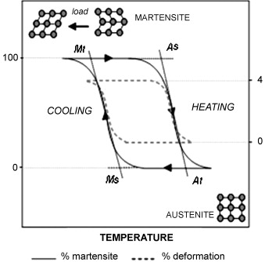

Applications of Copper Zirconium(CuZr):-
Contacts and connectors
Shape Memory Alloys

Slide 4
Why study CuZr PE?
To understand and design superior metallic glasses (Bulk Metallic Glasses).
To predict key material properties like stability and mechanical behavior.
To develop and validate accurate interatomic potentials for simulations.
To guide the design of new alloys with tailored compositions and properties.
To explain unusual properties like high strength and superplastic forming.

Slide 5
Motivation
Computational Expense:
MD simulations demand huge computational resources, often taking thousands of CPU hours to model complex alloy systems.
Why ML?
ML can learn from past simulation data and quickly capture non-linear relationships between composition, process conditions, and material properties — enabling faster predictions and accelerating the materials discovery process.
5
Notes:
Why you studying this materials

Slide 6
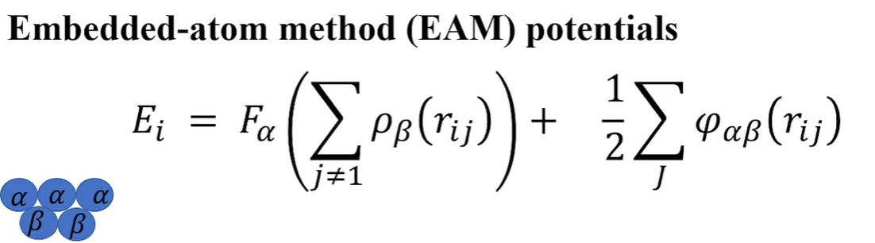
Embedded Atom Potential
Why EAM Potentials Are Used
Overcome Limitations of Simple Models: They address the limitation of bond strength independence found in simpler pair potentials.
Predict Material Properties: They allow for high-fidelity atomistic simulations to study properties like defects, mechanical behavior, melting, and thermal expansion.
Electron Embedding energy
Pair-wise
Potential

Slide 7
MD Simulation
Molecular Dynamics (MD) simulation is a computational technique that models the motion of atoms and molecules over time by solving Newton’s equations of motion. It helps in understanding the microscopic behavior and predicting thermodynamic, structural, and mechanical properties of materials at the atomic level.
System Setup
  Material: Cu–Zr.
  Structure: FCC lattice.
  Atoms: 5k–50k.
Interatomic Potential
  EAM/alloy potential (CuZr.eam.alloy)
Simulation Procedure
  Initialization: Assign velocities at 300 K, zero net momentum
  Equilibration:
    Short NVE relaxation :- stabilize system
    NPT at 300 K & 0 bar :- equilibrate temperature, pressure, volume
Outputs
  Thermodynamic data :- PE, KE, Temp, Vol, Press, E
  Used for machine learning prediction of potential energy and thermal properties

Slide 8
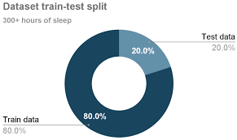

Train-Test Split
We partition the dataset into two distinct subsets using random sampling without replacement. This ensures the model is evaluated on data it has never seen during training.
Training Set (80%): Used to learn model weights through
gradient descent
Test Set (20%): Final evaluation on completely unseen data

Slide 9
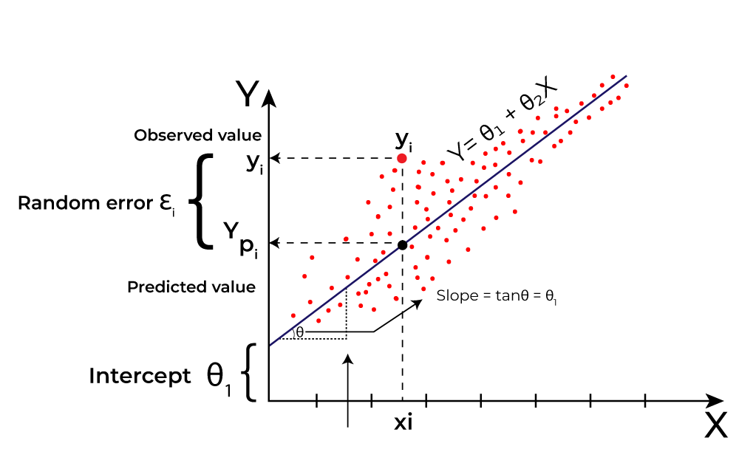


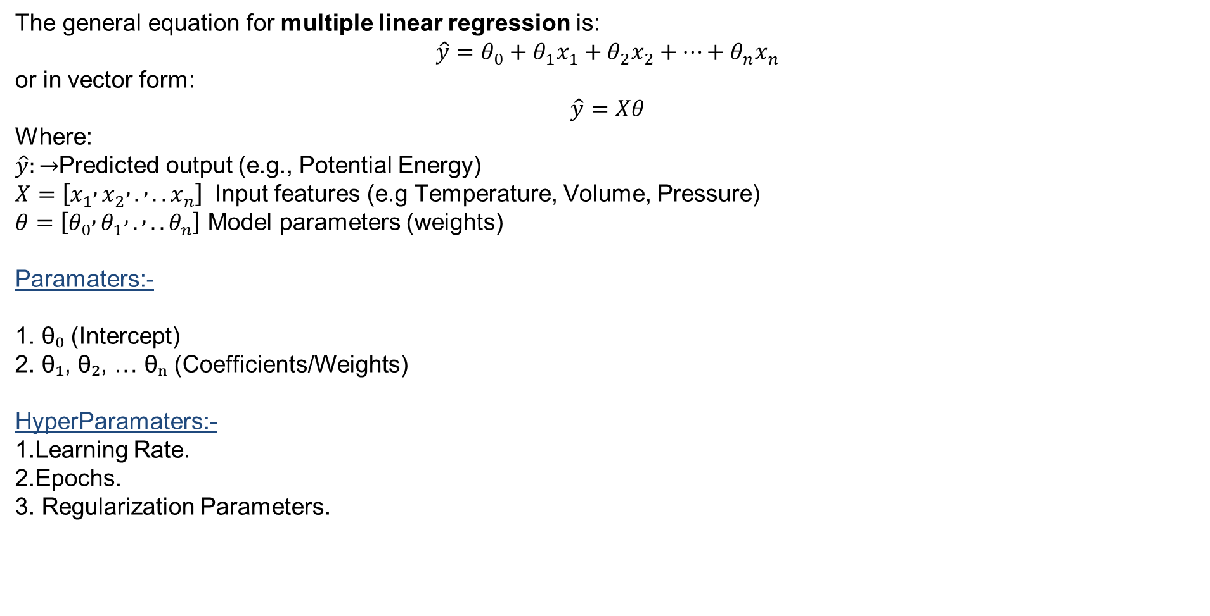
Linear Regression
The general equation for multiple linear regression is:
$$\hat{y}=θ_{0}+θ_{1}x_{1}+θ_{2}x_{2}+⋯+θ_{n}x_{n}$$
or in vector form:
$$\hat{y}=Xθ$$
Where:
$\hat{y}:→$Predicted output (e.g., Potential Energy)
$X=\left[x_{1} , x_{2} , . , ..x_{n}\right]$ Input features (e.g Temperature, Volume, Pressure)
$θ=\left[θ_{0} , θ_{1} , . , ..θ_{n}\right]$ Model parameters (weights)
Paramaters:-
1. θ₀ (Intercept)
2. θ₁, θ₂, … θₙ (Coefficients/Weights)
HyperParamaters:-
1.Learning Rate.
2.Epochs.
3. Regularization Parameters.

Slide 10
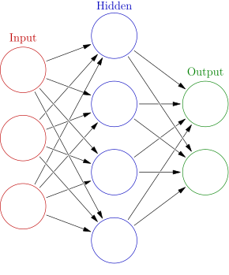
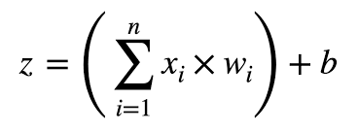
Neural Network
A neural network is composed of layers of interconnected units called neurons. Each neuron receives input, processes it using a mathematical function, and passes the result to the next layer. The network learns by adjusting weights and biases during training to minimize prediction errors.
Input Layer: Receives raw data (e.g., images, text, sensor readings).
Hidden Layers: Perform transformations and extract features.
Output Layer: Produces predictions or classifications.
Each connection between neurons has a weight, and each neuron has an activation function (like ReLU, sigmoid, or tanh) that determines its output.

Slide 11
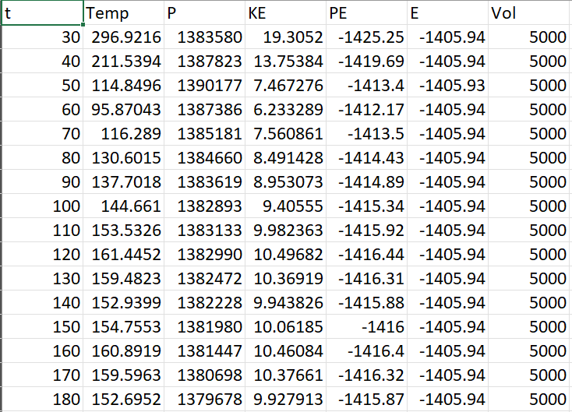
MD Simulation Results:-

Slide 12
ML model Results:-
Model​ | RMSE​ | R-square​
Linear Regression​ | 9.9946 | 0.9977
Neural Network | 2.1917 | 0.9999
Best model​ | Neural Network | Neural Network

Slide 13
ML pipeline
Develop EAM potential
MD Simulation
Simulated Data
Data Normalisation
Spilt Data
Test Data
Linear Regression
Neural Network
Models Evaluation & Comparison

Slide 14
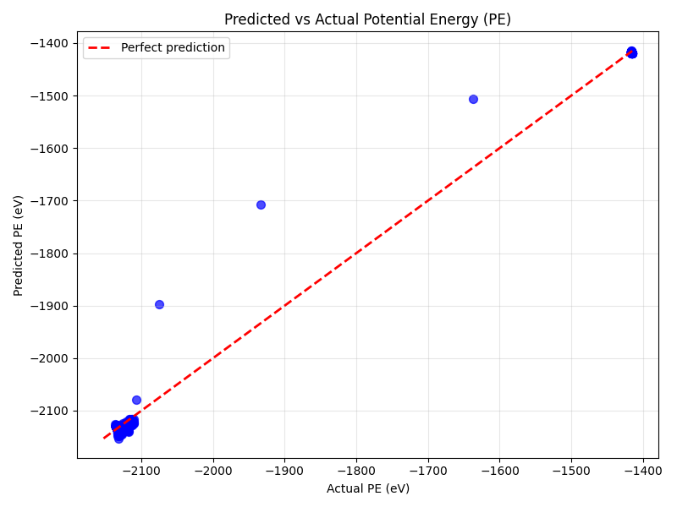
Linear Regression Model

Slide 15
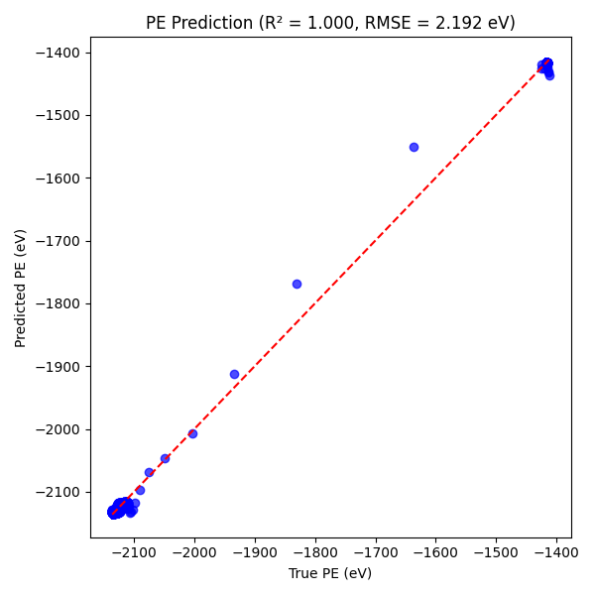
Neural Network Model

Slide 16
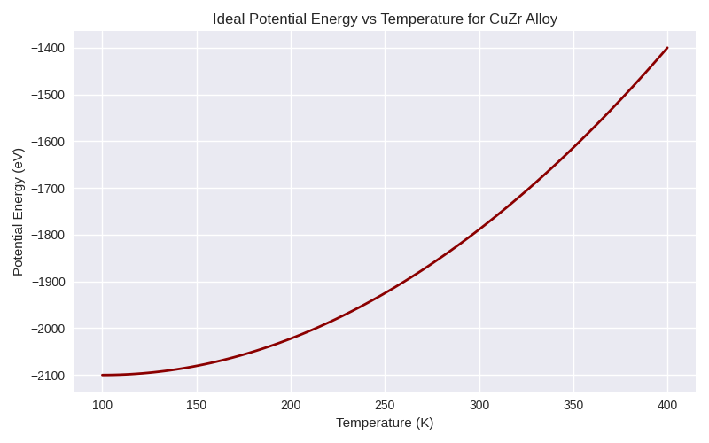
Results Visualization

Slide 17
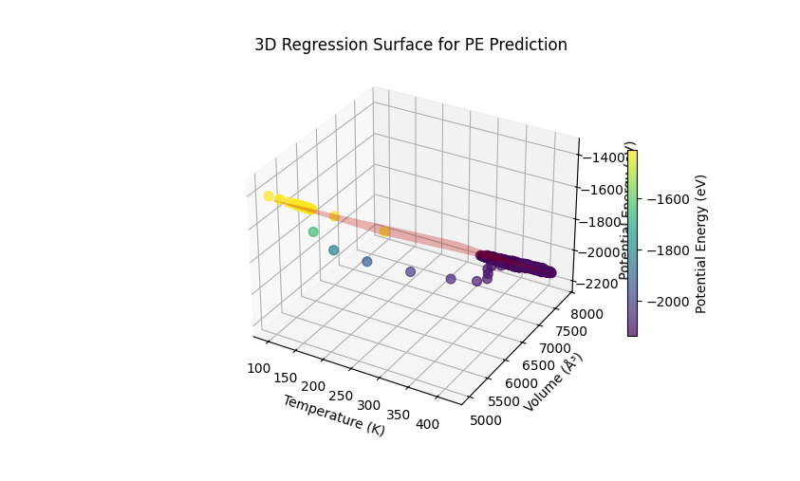
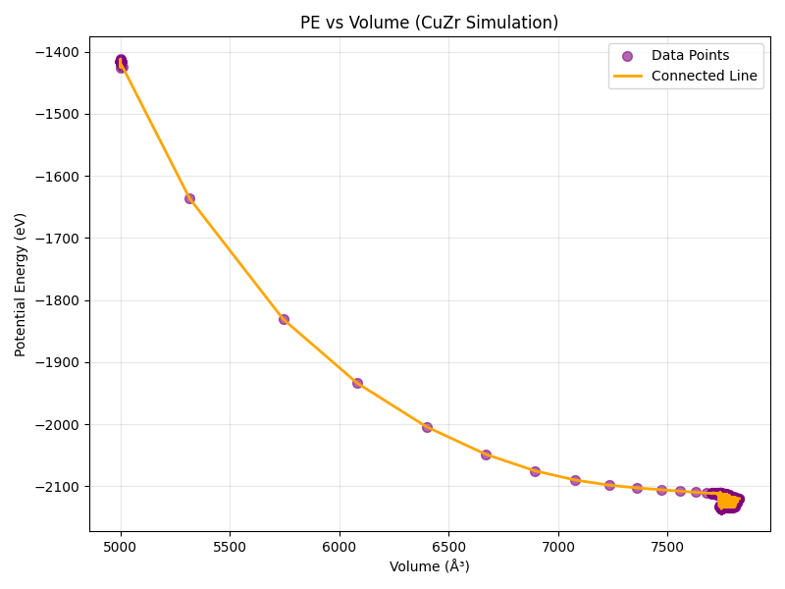

Slide 18
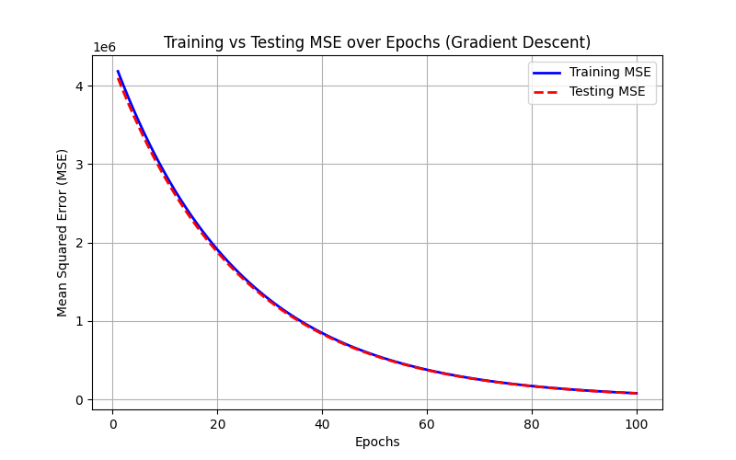
Training vs Testing Error

Slide 19
Conclusions
Developed a linear regression model and neural network model to predict the potential energies of CuZr using temperature ,pressure and volume as inputs from MD simulation data.
The model effectively reflects the relationship between potential energy and changes in temperature, pressure, and volume, aligning well with the results obtained from molecular dynamics simulations.
The Linear Regression model effectively predicts the thermal response of CuZr, showing strong agreement with molecular dynamics data and laying the foundation for advanced machine learning approaches in materials property prediction.
17

Slide 20
Thank you

