Slide 1
SQL
Autonomous SQL Agent
Data Warehouse
Verified baseline
20 tests passed
SQLite demo
Groq planner
0 retries smoke run
Natural language analytics with schema-aware planning, guarded SQL generation, safe execution, repair, and traceable run evidence.
Frontend: http://localhost:5173
API: FastAPI on port 8000
Database: data/demo.sqlite
Evidence: reports/iteration and experiments/runs
user_question -> structured_plan -> allowlisted_sql -> execution -> evaluation -> trace

Slide 2
Introduction
What the project does
The project is a working natural-language-to-SQL analytics prototype for a warehouse-style dataset.
It uses an LLM for planning and SQL generation, but wraps it with metadata, validation, execution guardrails, and run tracing.
The demo focuses on sales analytics such as top customers, country revenue, product revenue, monthly trends, and segmentation-oriented questions.
Question: "Show top 10 customers by total revenue"
Intent: top_customers
SQL: SELECT/CTE only
Output: table rows + debug trace
The contribution is architectural: a traceable pipeline around the LLM, not a new model.
Claims are limited to repository evidence and local smoke-test results.

Slide 3
Literature Review
Context without unsupported SOTA claims
Rule-based NLIDB
Early systems mapped controlled language to SQL using handcrafted grammars and templates. They were interpretable but brittle.
Neural semantic parsing
Seq2seq and transformer systems improved flexibility but still struggled with schema linking and execution validity.
LLM-based NL2SQL
Modern LLMs can draft SQL from natural language, but may hallucinate tables, columns, and unsupported assumptions.
Metadata-aware agents
Recent systems improve reliability by grounding generation in schema metadata, examples, and execution feedback.
This project position
A baseline pipeline that combines planning, schema context, allowlist checks, execution repair, and trace logging.
Note: the report avoids invented citation numbers and presents literature as technology categories unless formal references are added later.

Slide 4
Problem Statement
Why this is needed
Business users need quick answers from warehouse data, but writing SQL requires schema knowledge.
Direct LLM-to-SQL can produce invalid or unsafe SQL if it is not grounded in the real schema.
Analytics systems need reproducibility: what prompt, plan, SQL, dataset, result, timing, and error were produced?
Core problem:
How can a user ask natural-language warehouse questions while preserving schema grounding, execution safety, and traceability?
The system must reject unsafe query forms.
The system must run against actual registered metadata.
The system must record evidence for later review.

Slide 5
Objectives
Project goals
Build a data warehouse analytics pipeline that accepts natural-language questions.
Use a planner to convert questions into structured intent before SQL generation.
Generate SQL using schema metadata rather than model memory alone.
Validate and execute only safe SELECT/CTE queries with row limits and timeouts.
Support dataset onboarding, metadata persistence, frontend interaction, and debug traces.
Verify the baseline through automated tests and a documented local smoke run.

Slide 6
Data Description
Current demo dataset
data/demo.sqlite
dim_customer: 50 rows
dim_product: 20 rows
dim_date: 366 rows
fact_sales: 4,494 rows
Schema follows a compact star-schema pattern.
Fact table stores invoice lines, quantity, unit price, and total amount.
Dimensions cover customers, products, and calendar dates.
Demo seed uses deterministic sales-line generation with a fixed random seed for invoices.
source: scripts/seed_sqlite_demo.py + sqlite count check

Slide 7
Proposed Methodology
Pipeline architecture
User Prompt
->
Planner
->
SQL Generator
->
Safe Executor
->
Evaluator
->
Trace + UI
Planner returns JSON fields such as intent, task type, entity scope, metric, n, time grain, and comparison mode.
SQL generator receives the structured plan plus dataset metadata and must return SELECT/CTE SQL.
Validator blocks non-SELECT operations and checks table/column allowlists when metadata is available.
Failures can be fed back to the SQL generator for repair.

Slide 8
Implementation
Main modules
frontend/
Static HTML/CSS/JS UI for prompt input, results, SQL, metrics, and debug trace.
api/routes.py
FastAPI endpoints for health, dataset onboarding, analyze, reports, mining, and evaluation.
agent/planner.py
Groq-backed planner that normalizes LLM JSON into a typed plan contract.
agent/sql_llm_generator.py
Schema-aware SQL generator with allowlisted table and column validation.
agent/executor.py
Safe SELECT/CTE validation, row limits, timeout checks, and DB adapter execution.
metadata/
Dataset registry, schema cache, semantic maps, SQL cache, and query traces.

Slide 9
Result Analysis
Evidence from current repository
The local demo executed a live /analyze/debug request.
The generated SQL joined fact_sales and dim_customer, grouped by customer, ordered by total revenue, and limited to 10 rows.
Evidence is stored in experiments/runs/local_demo_smoke_20260426T092105Z.json and reports/iteration/iter_001.md.
This is a functional smoke result, not a model-quality benchmark.
Automated tests: 20 passed
API health: ok
Dataset: demo_sales ready
Smoke query: top_customers
Rows returned: 10
Retries used: 0
Evaluator: ok
No SOTA claim
Baseline verified

Slide 10
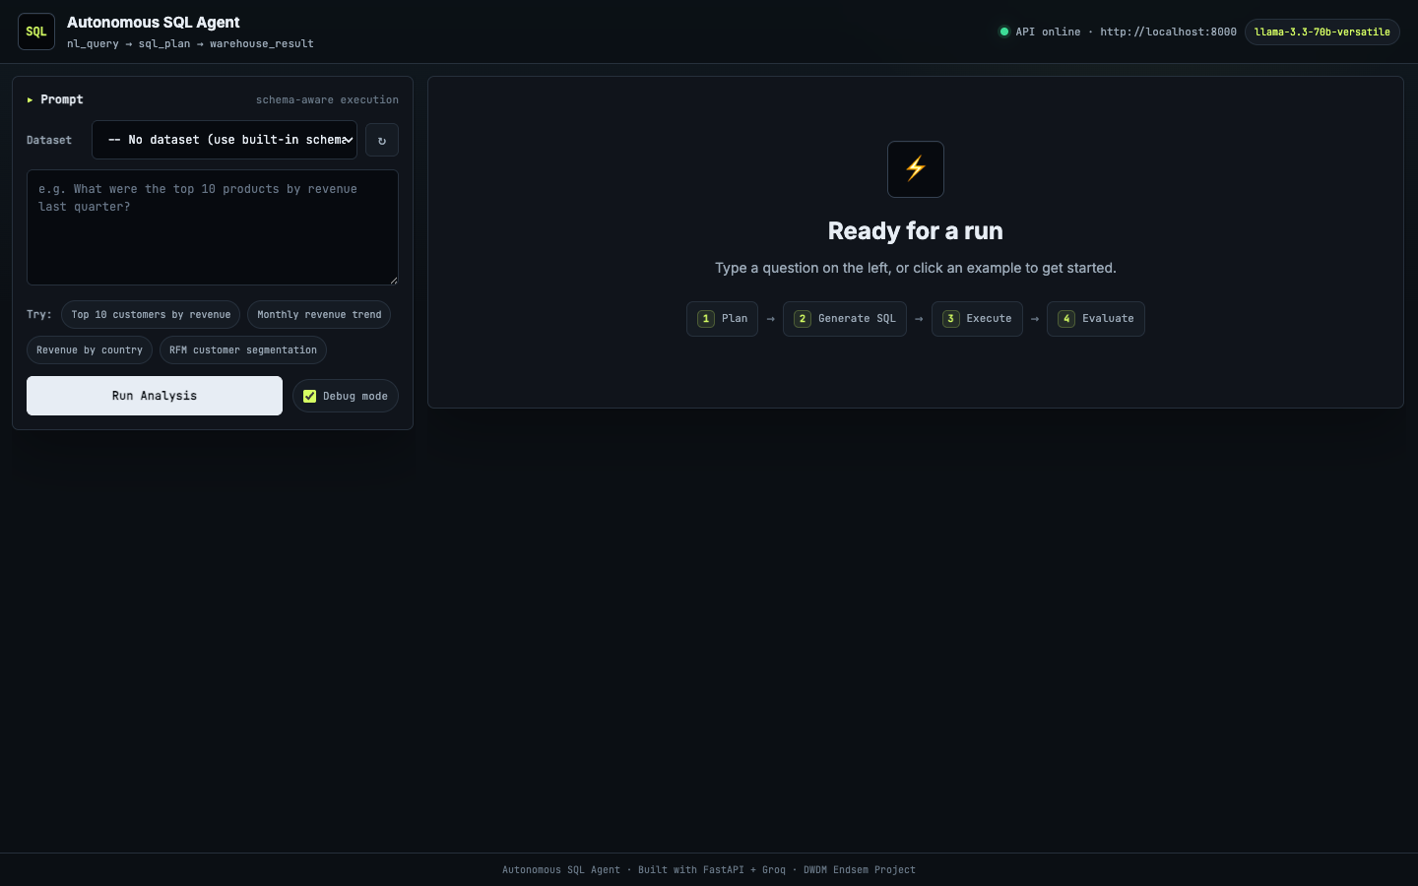
Frontend Demo
Developer-oriented interface

Slide 11
Advantages and Disadvantages
Balanced assessment
Advantages
Disadvantages
Schema-aware planning reduces unsupported assumptions.
Guardrails block unsafe SQL operations.
Trace IDs, prompt versions, SQL, timings, and errors improve reproducibility.
SQLite demo makes local evaluation easier.
Frontend exposes SQL, rows, metrics, and debug state clearly.
Live analysis depends on Groq API availability and quota.
No broad benchmark suite is included yet.
No ablation results are available yet for each component.
LLM output can still fail and needs repair/validation.
Demo dataset is synthetic and limited in domain coverage.

Slide 12
Conclusion
What is proven now
The project implements a working baseline for natural-language warehouse analytics.
The design separates planning, SQL generation, execution safety, result evaluation, and trace logging.
The demo has been verified through tests, API health checks, dataset availability, frontend serving, and one live analysis run.
Current evidence supports a functional prototype claim, not SOTA or publication-ready claims.
Honest claim: traceable, schema-aware autonomous SQL analytics baseline.

Slide 13
Future Work
Next steps
Add a benchmark suite comparing baseline templates, direct LLM-to-SQL, and planner-first generation.
Run ablations for metadata grounding, allowlist checks, repair loop, SQL cache, and semantic maps.
Evaluate on multiple datasets and database engines.
Add CI smoke tests that avoid external LLM calls, plus optional live LLM checks.
Improve report generation with citations, charts, failure categories, and limitations derived from run artifacts.
Add authentication and deployment hardening before real production use.

