Slide 1

Homework Lecture No 1
Calculate the mark to market values of few transactions, and answer the question on PDE

Slide 2
As of 12/31/2019, the forward prices / rates, and discount factors where:
Assume all payments to be made on the last day of the month.
Calculate the Mark to Market value of the transactions listed on the next slide
Delivery Month | Natural Gas | Crude Oil | EUR per 1 USD | Discount Factors
Jan-20 | 2.17 | 60.998 | 1.1207 | 0.99873
Feb-20 | 2.18 | 61.327 | 1.1214 | 0.99754
Mar-20 | 2.08 | 61.135 | 1.1221 | 0.99627
Apr-20 | 2.13 | 60.147 | 1.1228 | 0.99504
May-20 | 2.21 | 59.261 | 1.1235 | 0.99377
Jun-20 | 2.31 | 59.609 | 1.1242 | 0.99255
Jul-20 | 2.43 | 59.022 | 1.1249 | 0.99128
Aug-20 | 2.36 | 57.973 | 1.1256 | 0.99002
Sep-20 | 2.32 | 57.584 | 1.1263 | 0.9888
Oct-20 | 2.39 | 56.921 | 1.127 | 0.98754
Nov-20 | 2.43 | 56.643 | 1.1277 | 0.98633
Dec-20 | 2.62 | 56.802 | 1.1285 | 0.98507
Jan-21 | 2.67 | 55.968 | 1.1292 | 0.98382
Feb-21 | 2.70 | 55.79 | 1.1298 | 0.98269
Mar-21 | 2.54 | 55.626 | 1.1305 | 0.98143
Apr-21 | 2.28 | 55.409 | 1.1312 | 0.98023
May-21 | 2.18 | 54.88 | 1.132 | 0.97898
Jun-21 | 2.32 | 55.056 | 1.1327 | 0.97777
Jul-21 | 2.35 | 54.477 | 1.1334 | 0.97653
Aug-21 | 2.31 | 54.556 | 1.1341 | 0.97528
Sep-21 | 2.36 | 54.37 | 1.1348 | 0.97408
Oct-21 | 2.42 | 54.139 | 1.1355 | 0.97284
Nov-21 | 2.35 | 53.11 | 1.1362 | 0.97164
Dec-21 | 2.54 | 54.681 | 1.1369 | 0.97041

Slide 3
Transactions
Natural gas, purchase 10,000 units / day, for delivery Jan’20-Mar’20 at a fixed price of $2.20 / unit
Crude oil, purchase 1,000 barrels / day for delivery throughout Calendar 2020 at a fixed price of $57 / barrel
Crude oil, sell 20,000 barrels / month for delivery throughout Calendar 2021 at a fixed price of $54.50 / barrel
Natural gas, purchase 330,000 units / month for delivery throughout Calendar 2021 at a fixed price of $2.45 / unit
Sell 10,000,000 EUR / Buy 11,250,000 USD for the payment on 4/30/2021

Slide 4
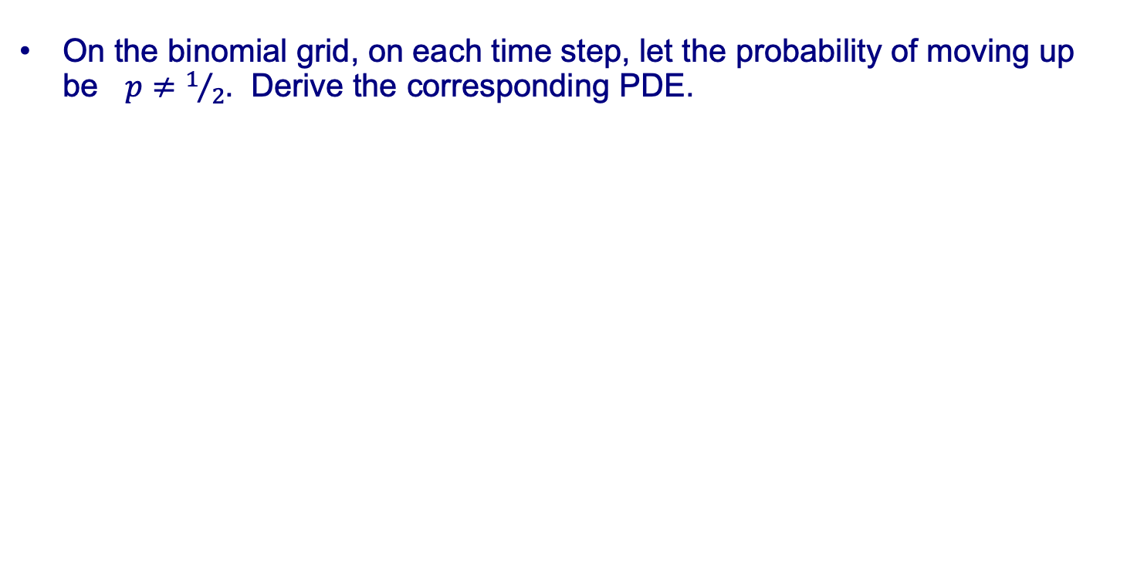
Question
On the binomial grid, on each time step, let the probability of moving up be $p≠1/2$. Derive the corresponding PDE.

