Slide 1

Introduction to Financial Mathematics

Slide 2
Overview
What are the derivatives?
Random behavior of the markets
Simplified view: sequence of up and down movements: Prices and Probabilities
Generalization to multiple paths, multiple time steps: Binomial Tree
Initial distribution of prices – portfolio of similar stocks
Partial Differential Equation

Slide 3
Derivatives
What are derivatives?
We will see few examples and few meanings of the term derivative
They are often used together

Slide 4
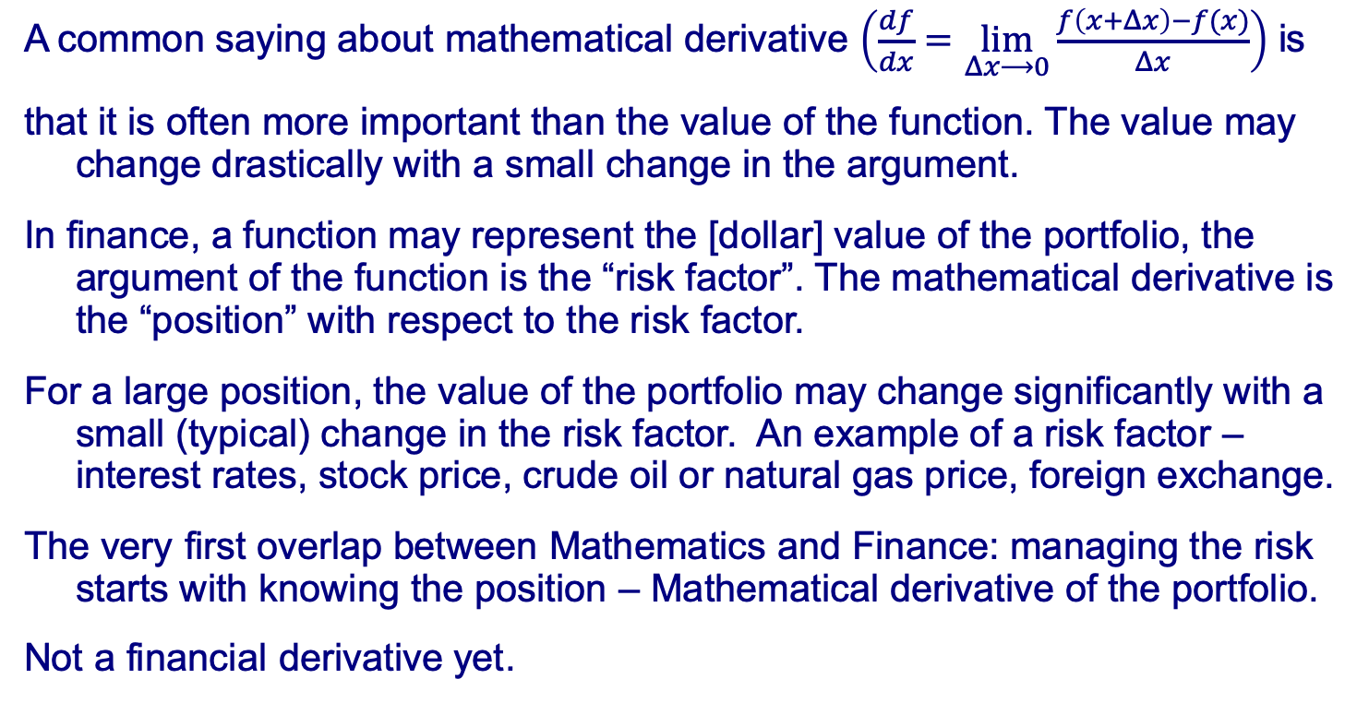
Derivatives
A common saying about mathematical derivative $\left(\frac{df}{dx}=\lim_{Δx⟶0}{\frac{f\left(x+Δx\right)−f(x)}{Δx}}\right)$ is
that it is often more important than the value of the function. The value may change drastically with a small change in the argument.
In finance, a function may represent the [dollar] value of the portfolio, the argument of the function is the “risk factor”. The mathematical derivative is the “position” with respect to the risk factor.
For a large position, the value of the portfolio may change significantly with a small (typical) change in the risk factor. An example of a risk factor – interest rates, stock price, crude oil or natural gas price, foreign exchange.
The very first overlap between Mathematics and Finance: managing the risk starts with knowing the position – Mathematical derivative of the portfolio.
Not a financial derivative yet.

Slide 5
Derivatives
In Commodities:
Crude oil is refined into… Gasoline, Diesel Fuel & Heating Oil, Jet Fuel, Heavy Fuel Oil … Asphalt, etc.
These are oil derivatives – not financial derivatives.
Purchasing gasoline at gas [petroleum] station is a financial transaction. We purchase oil derivative. Not a financial derivative.
However, an agreement today to purchase in the future certain amount of an asset at a price agreed upon today is an example of a financial derivative.
Purchasing a single stock, similar to gasoline, is not a financial derivative. Single stock futures contract (the buyers agrees to pay a specified price for a stock at a certain time in the future). The stock price changes every day.

Slide 6
Derivatives
Contractual agreement signed on 3/1/2019 to purchase (or sell) 10,000 units of natural gas for $3.25/unit, delivered during the month of April 2021 is an example of a Financial Derivative
(Note: 3/1/2019 in US is 1st March 2019, mm/dd/yyyy convention)
On 3/1/2019, at certain time during the day both parties agreed that the delivery price for April 2021 was $3.25/unit. There was a market for this “forward price”
Markets move. Forward prices change all the time. On 3/15/2019 the price for delivery in April 2021 was different - $3.10/unit, or $3.45/unit. However, the agreement between two parties was to purchase / sell at $3.25.
We don’t know how the markets will change by 3/31/2021, but we know – the price of natural gas to be purchased under this contract is $3.25

Slide 7
Derivatives
The contractual agreement signed in the past (today, or before), and maturing, expiring, in the future has a certain value today. An expectation of the payoff (amount to be paid or received) at the maturity.
The general approach in valuation is to calculate the mark-to-market value:
V=Qty∙(Fwd-K)∙Df,
where Qty is the quantity of the transaction (10,000 units),
Fwd - the forward price today $3.10 or $3.45, or some other?
K - the contractual fixed price, $3.25 per unit of natural gas.
Df - the discount factor; at the current interest rates, how much should be invested today to have $1 at maturity. It adjusts the future expected payment to the current time: “present value”

Slide 8
Derivatives
V=Qty∙(Fwd-K)∙Df
Interpretation:
the mark to market value shows the profit or loss that the trader would have should they terminate the existing position at the current market level.
Or, it could also be thought of as:
the relative value of the transaction with respect to the current forward price Fwd. If the market (forward price) is at the level of the fixed price, the value is V=0 – it did not change since inception. If the market moved up, and the quantity is positive, the trader made a purchase, not a sale, then V>0, trader has a profit. The next moment, if the market moves down, the transaction will suffer a loss.

Slide 9
Derivatives
Financial Instrument
A derivative is a financial instrument with a value that is derived from an underlying asset or group of assets at a later point in time (maturity or expiration).
The derivative is defined in a contract between two or more parties. The value of the derivative before its maturity is estimated from forward / futures markets.
The most common underlying assets include stocks, bonds, commodities, currencies, interest rates and market indexes.
Different meanings of word “derivative” could be used within the same paragraph or sentence…
For quants, any function (linear or non-linear) of time and underlying market variable (risk factor) is a financial derivative.

Slide 10
Examples
Valuation principle – mark to market value – examples and explanation:
On 9/30/2019 Trader A enters into a forward transaction on foreign exchange. In two years, on 9/30/2021, A should pay USD 1,125,000 and receive EUR 1,000,000. What is the value of this transaction on 12/31/2019?
On 8/15/2018, Trader B entered into a forward purchase of 10,000 units of natural gas for $3.25/unit, delivered during the month of April 2020. What is the value of this transaction on 12/31/2019?
On 6/15/2018, Trader C entered into interest rate swap (IRS) transaction, where, for every month of the period of 12/1/2018-1/31/2038, C should pay 2.0% interest accrued on 10mln notional, and receive the interest accrued on the same notional at then current (floating) rate. What is the value of this transaction on 12/31/2019?
Once we know the underlying we can project the future cash flows
And we need the discount factors.

Slide 11
Underlying Instruments
Financial instruments used as the inputs in mark to market calculations are called underlying instruments.
Forward prices, interest rates, foreign exchange rates, and, sometimes, stock prices are underlying instruments.
Their values (market levels) change between the transaction date and the maturity. They are often assumed to follow certain stochastic processes.
We call them underlying processes.

Slide 12
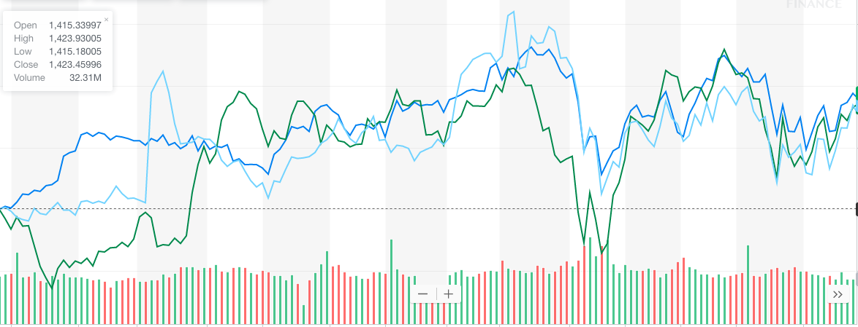
Markets Move Up & Down
Look up at Yahoo! finance. Any stock, any time period.
Random moves up and down.

Slide 13
Simplified View
Consider a random path: up, down, up, up
t₀
t₁
t₂
t₃
t₄
Assume prices are adjusted for up and down moves:
The last price:

Slide 14
Simplified View
The order of up and down moves does not matter
t₀
t₁
t₂
t₃
t₄

Slide 15
Adding Probability
Suppose the probability of moving up is p
Then the probability of moving down is (1-p)
t₀
t₁
t₂
t₃
t₄
At any time step, the probability of moving up or down is independent of the prior moves. Probability of reaching S4 along any path is

Slide 16
Consider all possible paths
From the origin O, at time t0,
Only one path leads to “node” J:
O-A-C-F-J:
Price:
Probability:
Four paths lead to “node” K:
O-A-C-F-K; O-A-C-G-K; O-A-D-G-K;
O-B-D-G-K. Same price:
Probability along each path:
Overall probability of reaching “node” K:
J
F
C
K
A
G
O
D
L
B
H
E
M
I
N
t₀
t₁
t₂
t₃
t₄

Slide 17
Consider all possible paths
The number of paths leading to each node is
t1(A,B) : 1 1
t2(C,D,E) : 1 2 1
t3(F,G,H,I) : 1 3 3 1
t4(J,K,L,M,N) : 1 4 6 4 1
Pascale's triangle / binomial coefficients
J
F
C
K
A
G
O
D
L
B
H
E
M
I
N
t₀
t₁
t₂
t₃
t₄

Slide 18
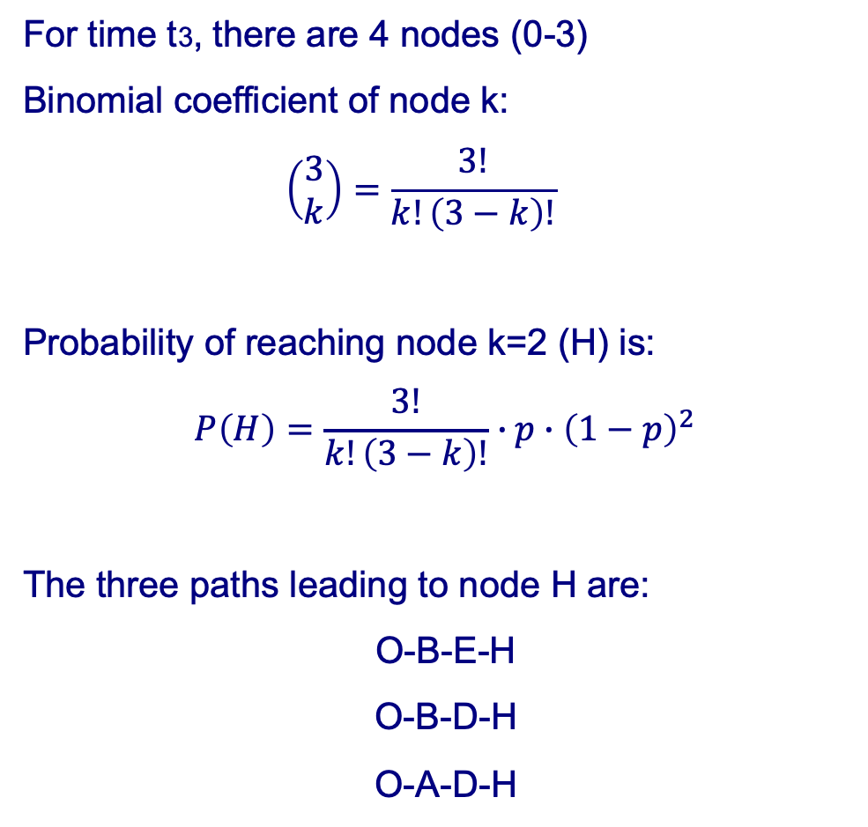
Consider all possible paths
J
F
C
K
A
G
O
D
L
B
H
E
M
I
N
t₀
t₁
t₂
t₃
t₄

Slide 19
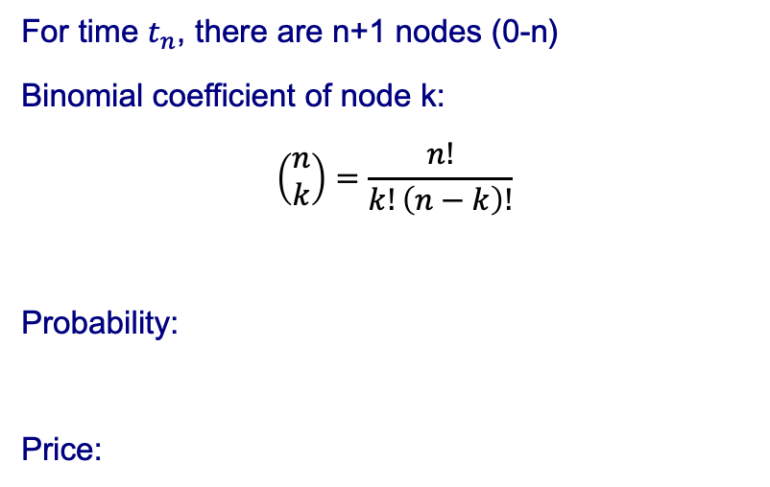
Multistep Binomial Tree
t₀
t₁
t_{i}
t_{j}
t_{n}
Note that total probability at (any) time tn is:
Recall Binomial Theorem:

Slide 20
Portfolio of Stocks. Initial Distribution of Prices
Imagine a large number of similar stocks. Same u and d, same probabilities of moving up, p
For sake of simplicity assume d=1/u, p=1/2
Possible prices at time t0 are:
Let N(t0,k) denote number of stocks at time t0 with price Sk (k indicates any of n+1 prices from 0 to n):
At different k, N(t0,k) represents a portfolio composition or - initial distribution of the stock prices within the portfolio

Slide 21
Portfolio of Stocks. Initial Distribution of Prices
Half of the stocks at Sk move to Sk-1 half to Sk+1 (blue arrows); this is because p=1/2
On the other hand, half of the stocks at Sk-1 move to Sk; and half of the stocks at Sk+1 move to Sk (green arrows)
t₀
t₁
t₂
t_{n}

Slide 22
Portfolio of Stocks. Initial Distribution of Prices
Half of the stocks at Sk move to Sk-1, the other half to Sk+1 (equal amounts are due to p=1/2)
On the other hand, half of the stocks at Sk-1 move to Sk; and half of the stocks at Sk+1 move to Sk
Change at Sk from t0 to t1 is then:
or

Slide 23
Evolution of the Initial Distribution
Half of the stocks at Sk move to Sk-1, the other half to Sk+1 (equal amounts are due to p=1/2)
On the other hand, half of the stocks at Sk-1 move to Sk; and half of the stocks at Sk+1 move to Sk

Slide 24
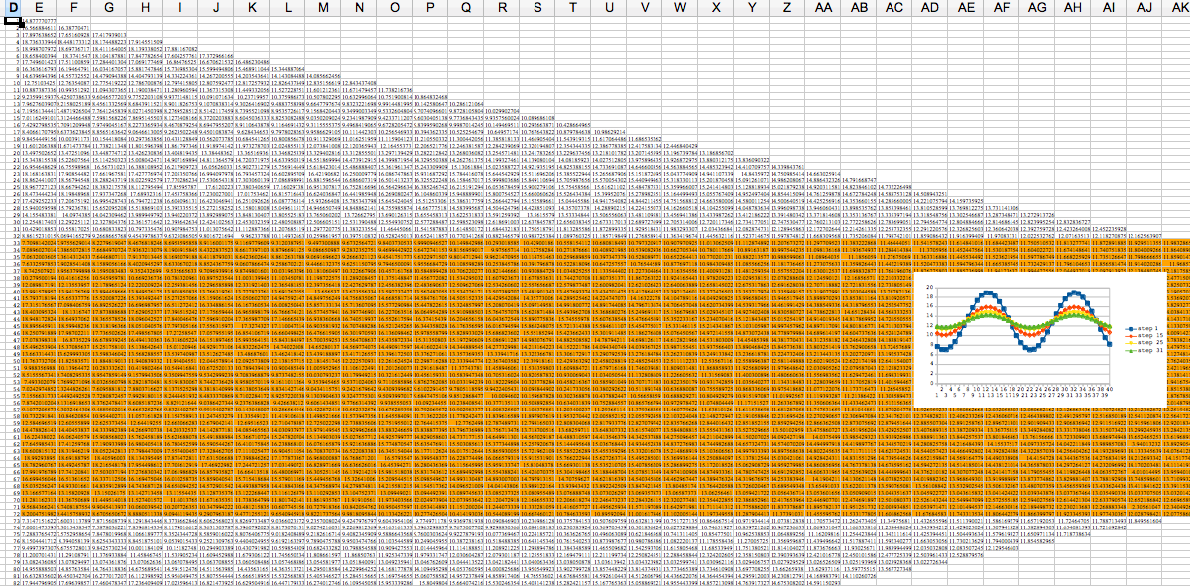
Evolution of the Initial Distribution
Half of the stocks at Sk-1 move to Sk; and half of the stocks at Sk+1 move to Sk
In Excel, Column E has the initial distribution;
Formula in Cell F42 =AVERAGE(E41,E43)

Slide 25
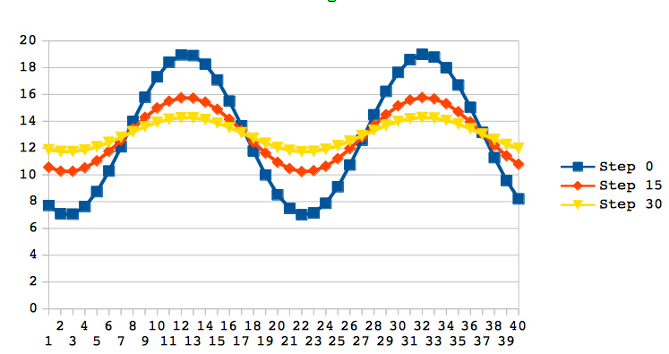
Evolution of the Initial Distribution
Half of the stocks at Sk-1 move to Sk; and half of the stocks at Sk+1 move to Sk
Time Step 0 is the initial distribution

Slide 26
Evolution of the Initial Distribution
Half of the stocks at Sk-1 move to Sk; and half of the stocks at Sk+1 move to Sk

Slide 27
Evolution of the Initial Distribution
Change at Sk from t0 to t1 is:
As the density of the nodes increases both in time, and in price space, and:
This leads to:
where as both

Slide 28
Evolution
Partial Differential Equation:
Without solving it...
Assume a “blip” with maximum at point S:
It follows that , which means the blip will
come down the next moment. Everything is leveling out...

Slide 29
Evolution
Partial Differential Equation:
Known for almost 200 years
Heat equation proposed by Fourier in 1820s – distribution of the temperature
Diffusion equation – distribution of the “particles”
Fokker-Planck equation – time evolution of probability density function
Black-Scholes equation in Finance

