Slide 1
Two-Sigma/Renthop Kaggle Machine Learning Project
Team: [] (NULL)
Xu Gao,
Yaxiong Huang,
Scott Edenbaum,
Dodge Coates

Slide 2
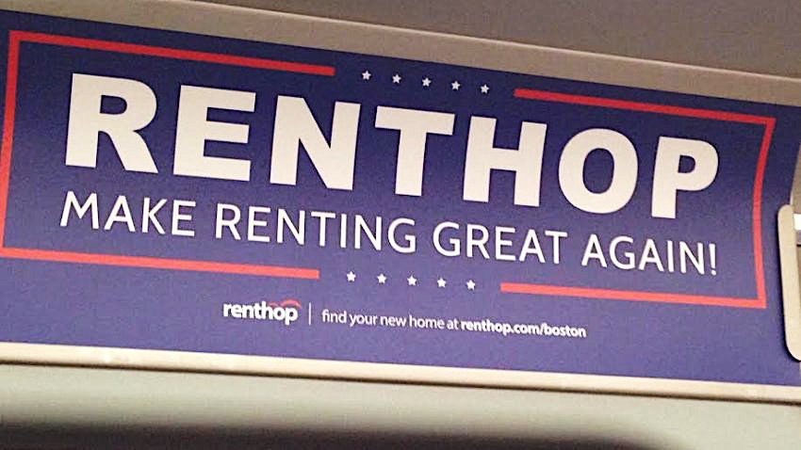
Table Of Contents
Overview
Research
Formulate approach to project
Execution
Feature pre-process
EDA
Feature selection
Model development
Model structure

Slide 3
Research
Kaggle Kernels
Inspect sample data set
Define problem
Supervised machine learning
Inspect website – add screenshot of renhop listing page
What is interest level? What does it mean?
Base assumptions? Expectations for high/medium/low interest property

Slide 4
Formulate Approach
Add project workflow chart
Work in python
Why?
Personal preference, portability, large Machin learning development community
JSON data
Parse images

Slide 5
Execution
Feature Pre-Process
Assume least important features:
Lat/Long
Building_id, manager_id, listing_id
Display_addres, street_addres
Images?
created
Downloading and parsing ~83gB image data
Use EXIF.py, PILLOW, OS packages to extract info
Graph latitutde/longitude

Slide 6
Derivative Features
Manager_count
Building_count
Word_count
Word_diversity
Dummify
Number_distinct
Sentiment
Image_count, Avg_brightness, Avg_luminance, Avg_filesize…
etc

Slide 7
EDA
Price
log Transformation
Bathrooms
Bedrooms

Slide 8
EDA cont.
Distinct “Features” – distribution
Dogs & Cats – Low importance
Interest vs Value
Remaining “Features”
Transformed to count
Limited impact from sentiment analysis

Slide 9
More EDA
Images
RGB
Average image size
Brightness, Luminance
Average image count
Metadata ratio
Pixel Height, Pixel Width

Slide 10
Last page of EDA
Manager ID
Log transform
Building ID
Log transform

