Slide 1
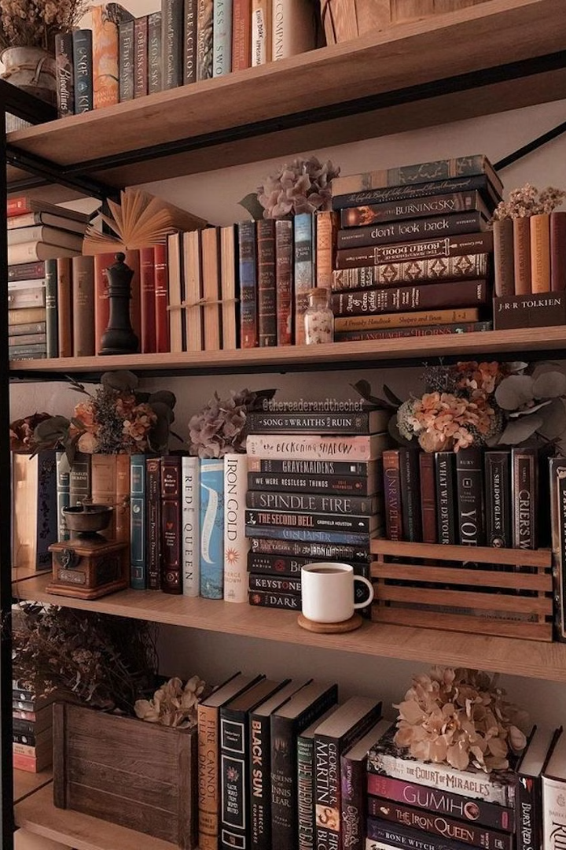
1
Readers' Haven: A Community for Book Lovers
Welcome to our presentation exploring Readers' Haven, a dynamic online community where book lovers unite. We'll delve into the features, design, and purpose of our platform, showcasing its commitment to fostering a vibrant space for literary discussions and reviews. Let's embark on this journey into the world of books and the people who love them!
Created By:
Rayyan Aamir
Muhammad Usaid Khan
Syed Muhammad Furqan
Hammad Haider

Slide 2
2
Introduction to Readers' Haven
A Shared Passion
Beyond Reviews
Readers' Haven is a community-driven platform dedicated to fostering a vibrant space for book reviews and literary discussions. We believe in the power of books to connect people, spark meaningful conversations, and ignite a love for reading.
Beyond providing detailed book reviews, our platform encourages members to engage in lively discussions, share their literary perspectives, and discover new reads. We strive to build a diverse and inclusive community where everyone feels welcome.

Slide 3
3
Homepage: Your Gateway to Literary Delights
Welcome Message
Navigation Ease
Featured Reviews
The homepage features a welcoming tagline: "Your Safe Space for Book Reviews." This sets the tone for a community where individuals can express their opinions freely, connect with fellow readers, and explore the world of books without judgment.
The homepage boasts a simple navigation bar for quick access to different sections, including featured book reviews. This intuitive design ensures that users can effortlessly navigate the platform and access their desired content.
The homepage showcases a selection of featured book reviews, highlighting popular titles like "Life of Pi," "The Kite Runner," and "The Alchemist." This gives users a glimpse into the diverse range of literary works available on the platform.

Slide 4




4
Seamless Navigation: Your Literary Journey Begins Here
Home
Book Reviews
About Us
Feedback
The homepage serves as the central hub for all things Readers' Haven. It provides a welcoming introduction to the platform, highlights featured content, and allows users to navigate effortlessly to other sections.
Dive into the world of book reviews, exploring diverse genres, insightful critiques, and captivating summaries. Find your next great read by browsing through the extensive collection of reviews.
Learn about Readers' Haven's mission, core values, and team members. Gain a deeper understanding of the platform's vision and the passionate individuals who contribute to its growth.
Share your valuable feedback and suggestions. Help us improve the platform by providing your thoughts on its features, design, and overall user experience.

Slide 5

5
Book Reviews: Your Literary Compass
1
Genre Diversity
2
In-Depth Analysis
Our book reviews cover a wide range of genres, from fiction and non-fiction to fantasy and science fiction. This diverse collection caters to a broad range of readers, ensuring that everyone can find books that resonate with their interests.
We encourage insightful reviews that delve into the intricacies of the plot, character development, and themes explored in each book. This helps readers gain a deeper understanding and appreciation of the literary works they choose.
3
Example Reviews
For example, our review of "The Alchemist" delves into its themes of dreams, destiny, and self-discovery, while the review of "The Kite Runner" explores its powerful themes of redemption, guilt, and forgiveness.

Slide 6



6
About Us: Our Passion for Books
Mission
1
To build a vibrant and inclusive community of book lovers.
Values
2
Honest reviews, diverse genres, interactive participation.
Team
3
Rayyan, Syed Hammad, Muhammed Usaid, Syed Muhammed Furqan.

Slide 7
7
Feedback: Shaping the Future of Readers' Haven
Purpose
1
Empower users to share their experiences and contribute to the platform's growth.
Form Simplicity
2
Our feedback form is designed to be user-friendly, with options ranging from "Excellent" to "Poor" and a space for detailed suggestions.
Improvement Goal
3
We actively analyze user feedback to identify areas for improvement and implement changes that enhance the platform's functionality, design, and user experience.

Slide 8

8
Design: A Visual Celebration of Books
1
2
Clean Aesthetic
Mobile Responsiveness
Readers' Haven embraces a clean and book-themed design with a focus on white space, ensuring readability and visual appeal. It's designed to be inviting and conducive to a positive user experience.
We prioritize seamless viewing across all devices, ensuring that the platform is responsive and user-friendly on desktops, laptops, tablets, and smartphones. This makes Readers' Haven accessible to a wider audience.

Slide 9



9
Behind the Scenes: The Technical Corner

Slide 10




10
Readers' Haven: A Platform for Literary Connection
Interactive
Engaging Content
Scalability
Readers' Haven fosters a sense of community through interactive features like clickable links and a feedback system, encouraging users to actively participate and connect with one another.
Our platform offers a diverse range of insightful book reviews, personalized team information, and a welcoming atmosphere that encourages users to explore and engage with the literary world.
Readers' Haven is designed for future growth, allowing for the integration of new features like forums and book recommendations, ensuring its continued relevance and appeal to the book-loving community.

