Slide 1
Kernel Sentinel: A High-Performance System Auditing & Monitoring Engine
Notes:
Welcome everyone. Today, we're diving deep into operating system internals to introduce Kernel Sentinel, a real-time auditing and monitoring engine designed to provide unprecedented visibility into system behavior.

Slide 2
Group Members
Student | Registration number
Rayyan Mustafa | 2312335
Aaqib | 2312468
Najam Uddin Chandio Umair | 23108133 2312341
Notes:
Modern operating systems are incredibly complex. For most developers and even administrators, they act as a 'black box.' This makes it extremely difficult to understand what's truly happening under the hood, leading to challenges in performance tuning and, more critically, in detecting sophisticated security threats that exploit core OS behaviors.

Slide 3
The Problem: The "Black Box" Operating System
Lack of visibility into low-level OS operations.
Difficulty in diagnosing performance bottlenecks and resource contention.
Traditional tools operate too far from the kernel.
Vulnerability to resource exhaustion attacks (e.g., Fork Bombs).
Stealthy malicious activities like ransomware file I/O are hard to detect in real-time.
Notes:
Modern operating systems are incredibly complex. For most developers and even administrators, they act as a 'black box.' This makes it extremely difficult to understand what's truly happening under the hood, leading to challenges in performance tuning and, more critically, in detecting sophisticated security threats that exploit core OS behaviors.

Slide 4
Our Solution: Kernel Sentinel
A low-level 'flight recorder' for the Linux kernel.
Directly intercepts and analyzes system calls using `ptrace`.
Proactively detects anomalies like fork bombs and mass file writes.
Provides real-time telemetry to a concurrent, non-blocking dashboard.
Built to be thread-safe, deadlock-free, and high-performance.
Notes:
Kernel Sentinel is our solution. It's not just another monitoring tool; it's a diagnostic engine that attaches directly to processes to act as a flight recorder for the kernel. By intercepting system calls, we can analyze behavior at the most fundamental level and detect malicious patterns as they happen.

Slide 5
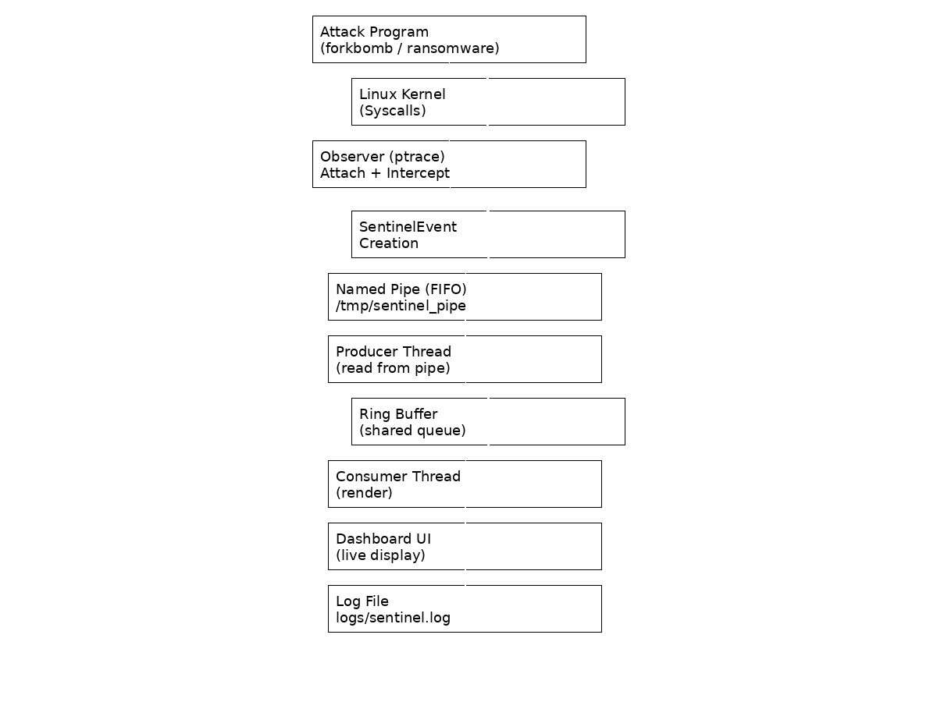
System Architecture
Notes:
The architecture is a decoupled, two-process design. The 'Observer' is the engine that uses ptrace to hook into a target process. It analyzes syscalls and sends structured events. The 'Dashboard' is a separate process that receives these events through a high-speed IPC channel—a Named Pipe. This separation ensures that the monitoring UI doesn't impact the performance of the tracing engine.

Slide 6
The Monitoring & IPC Pipeline
Target process executes a system call (e.g., `fork()`).
The `Observer` intercepts the call via `ptrace`.
Event is classified, packaged, and sent through a Named Pipe (FIFO).
The `Dashboard`'s producer thread reads from the pipe.Event is pushed to a thread-safe Ring Buffer (Producer-Consumer).
The `Dashboard`'s render thread pops the event and updates the UI.
Notes:
Here's a step-by-step look at our data pipeline. This entire flow is designed for low latency and high throughput. The use of a ring buffer with semaphores and mutexes is key to solving the classic Producer-Consumer problem, ensuring the UI remains responsive even under a high volume of system events.

Slide 7
Key Component: The Observer Engine
Core logic resides in `observer.c`.Utilizes `ptrace(PTRACE_SYSCALL)` to hook into target processes.
Maintains a rolling time window to track syscall frequency.
Detects anomalies by comparing rates against predefined thresholds (e.g., `FORK_BOMB_THRESHOLD`).
Serializes events and writes them to the IPC pipe.
Notes:
The Observer is the heart of Kernel Sentinel. It's a lean, efficient C program responsible for the actual tracing. Its most critical feature is the rate-tracking logic, which allows it to distinguish between normal system activity and the rapid, repetitive patterns characteristic of an attack.

Slide 8
Key Component: The Concurrent Dashboard
Core logic in `dashboard.c`.
Multi-threaded design using POSIX Threads (pthreads).Producer thread reads from the pipe.
Consumer thread renders the UI.
Thread-safe Ring Buffer implemented with Mutexes and Semaphores. Pure ANSI terminal interface for a lightweight, dependency-free display.
Notes:
The Dashboard is where we apply concurrency concepts. By separating the data ingestion from the UI rendering, we ensure the display never freezes. The ring buffer acts as a crucial, synchronized shared memory space between these two threads, preventing race conditions and data corruption.

Slide 9
Core Technologies & OS Concepts
Language: C for low-level control.
Tracing: ptrace` for system call interception.
Concurrency: POSIX Threads (pthreads).
Synchronization: Mutexes and Semaphores.
IPC: Named Pipes (mkfifo).
Environment: Linux / Ubuntu (via WSL).
Notes:
This project is a practical application of fundamental operating system concepts. We used pure C to get as close to the kernel as possible. The core of the project demonstrates a mastery of process tracing, inter-process communication, and safe, concurrent programming.

Slide 10
Live Demo: Detecting a Fork Bomb
Step 1: Launch the `./bin/dashboard` in Terminal 1.
Step 2: Launch the `./bin/attack_forkbomb` simulation in Terminal 2.
Step 3: The `Observer` attaches to the attack process. Result: The Dashboard immediately displays a `CRITICAL` alert.The alert identifies the PID and the exact nature of the threat: 'FORK BOMB DETECTED'.
Notes:
Now, let's talk about how this works in practice. In a live demo, we run the dashboard and the attack script in separate terminals. As soon as the observer attaches, you would see the fork count on the dashboard spike, triggering a critical alert in the stream, demonstrating our real-time detection capability.

Slide 11
Results & Impact
Successfully built a functional, low-latency monitoring tool.
Demonstrated proactive detection of simulated system attacks.
Provided deep, real-time observability into kernel-level events.
Solved the Producer-Consumer problem in a real-world application.
Validated strategies for thread synchronization and deadlock avoidance.
Notes:
The project successfully met all its objectives. We have a working tool that can see what the OS is doing and react to threats. More importantly, it serves as a powerful validation of theoretical OS concepts, proving their importance in building robust, high-performance systems.

Slide 12
Real-World Significance
Cybersecurity: Foundation for an Intrusion Detection System (IDS) or Host-based EDR.
System Monitoring: A powerful tool for performance profiling in Security Operations Centers (SOC).
Debugging: Helps diagnose complex issues like deadlocks or resource starvation.
Notes:
Beyond an academic project, Kernel Sentinel has real-world applications. Its principles are used in professional cybersecurity tools like Endpoint Detection and Response systems. It's also invaluable for performance engineers and developers who need to debug complex, low-level software.

Slide 13
Conclusion
Conclusion: Kernel Sentinel is a reliable, thread-safe diagnostic tool that provides critical insights into OS behavior.
Notes:
In conclusion, Kernel Sentinel successfully demonstrates the power of low-level system programming for observability and security. Looking ahead, we could expand its capabilities significantly, perhaps by adding network monitoring or a more sophisticated GUI, turning this powerful engine into a full-fledged professional tool.

