Slide 1
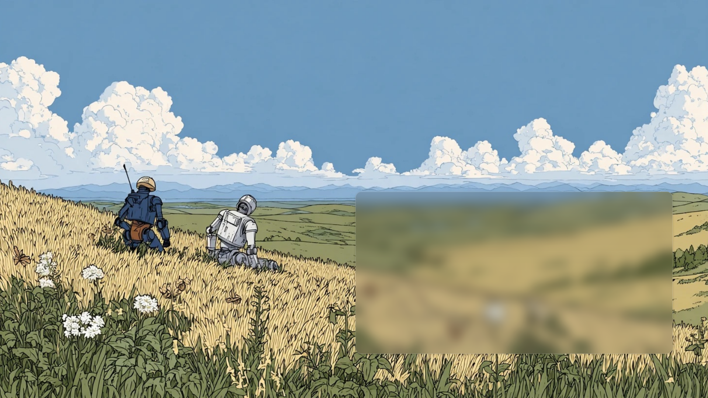

Two small robots who want to know why.
Kestrel is a science and maths playground where you tell Pip and Nova what to try, and the physics answers.
HackPSU 2026 · Concept art
Notes:
Open on the companions. Kestrel is for ages 13 to 16: you direct two robot companions through real physics and maths experiments. This painting is concept art; everything after the next slide is the real console.

Slide 2
Most lessons ask you to imagine the experiment. Kestrel lets you run it, predict it and be wrong about it with two robots beside you
You make the prediction, the simulator measures the result, and the robots talk it through with you.
Notes:
The gap: physics and maths stay abstract, and a wrong guess costs nothing to learn from only if you can see it. Kestrel makes the prediction physical and the result measured.

Slide 3
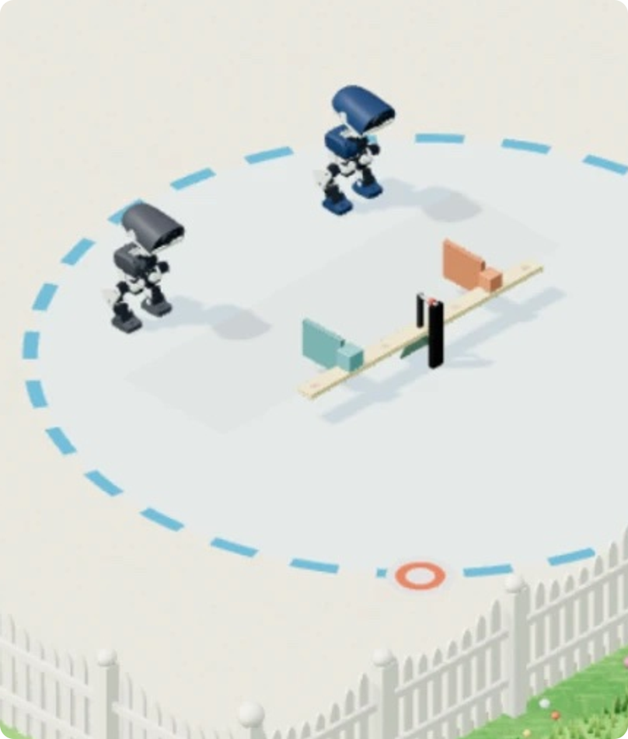
The companions
Pip and Nova are Microducks that really walk. Their motion comes from physics, not animation.
50 Hz
Seven upstream ONNX policies: walk, sit and stand, get up, kick, roll and peck.
MuJoCo
Version 3.11 in WASM, stepping the upstream Microduck model in the browser.
Fig. 1 Pip and Nova in the real console
2 robots
Share one world with the apparatus, and really collide.
Notes:
Real physics: MuJoCo 3.11 compiled to WASM runs the upstream Microduck MJCF, and seven upstream ONNX policies drive the joints at 50 Hz. The figure is cropped from a real console screenshot; final robot art is still to come.

Slide 4
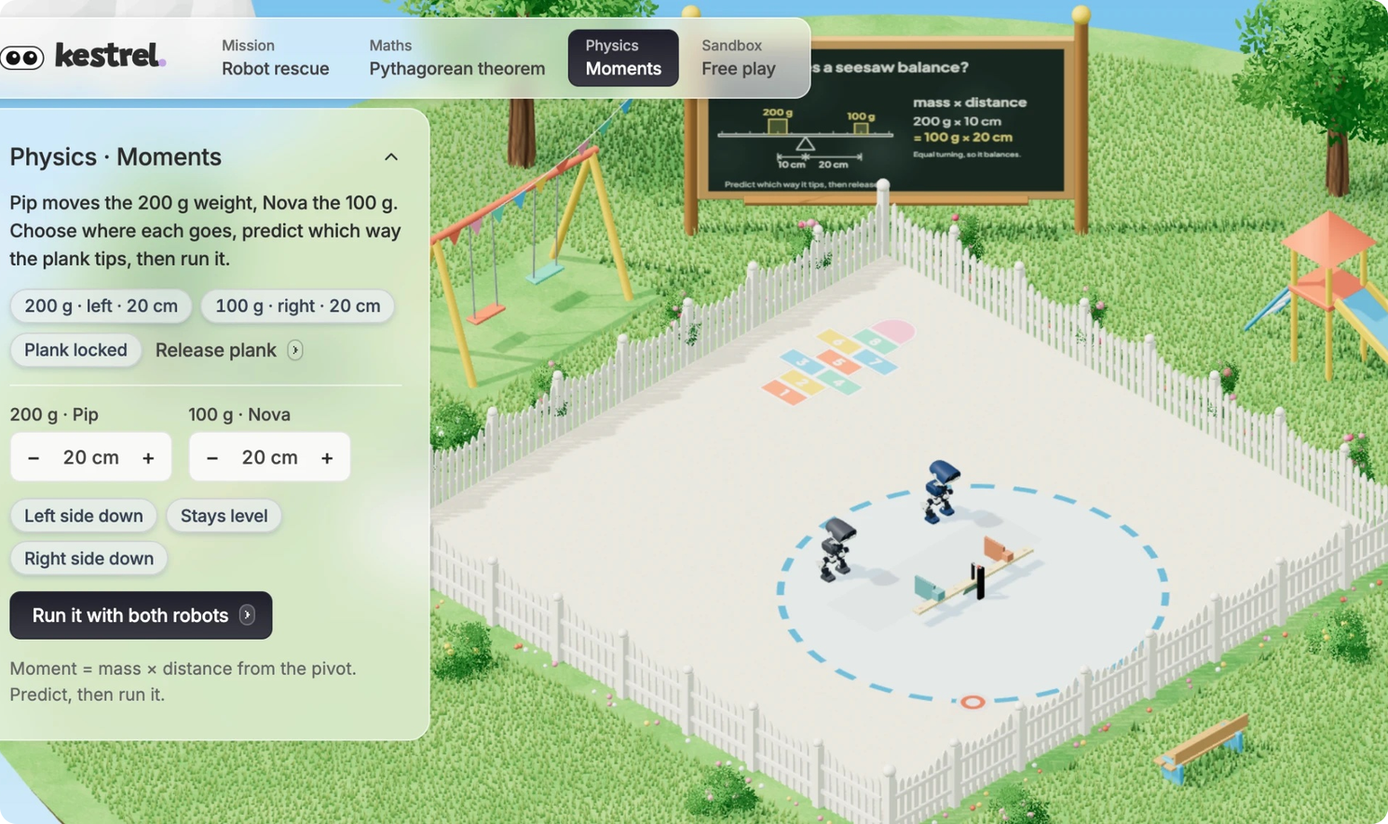
Objective 1 · Physics · Moments
Balance the beam
Choose where Pip's 200 g and Nova's 100 g go, predict which way the plank tips, then let both robots push their weights into place.
It counts only when the released plank reads level, under 0.5°, for one second.
Fig. 2 The Moments lesson in the real console
Notes:
A hinged beam with a 200 g and a 100 g weight on rails. Each robot pushes its own weight's paddle. Lock, push, withdraw, verify clear, release, then a measured tilt compared with the moments from the measured positions. The lock pin and rail clamps are idealised kinematic holds.

Slide 5
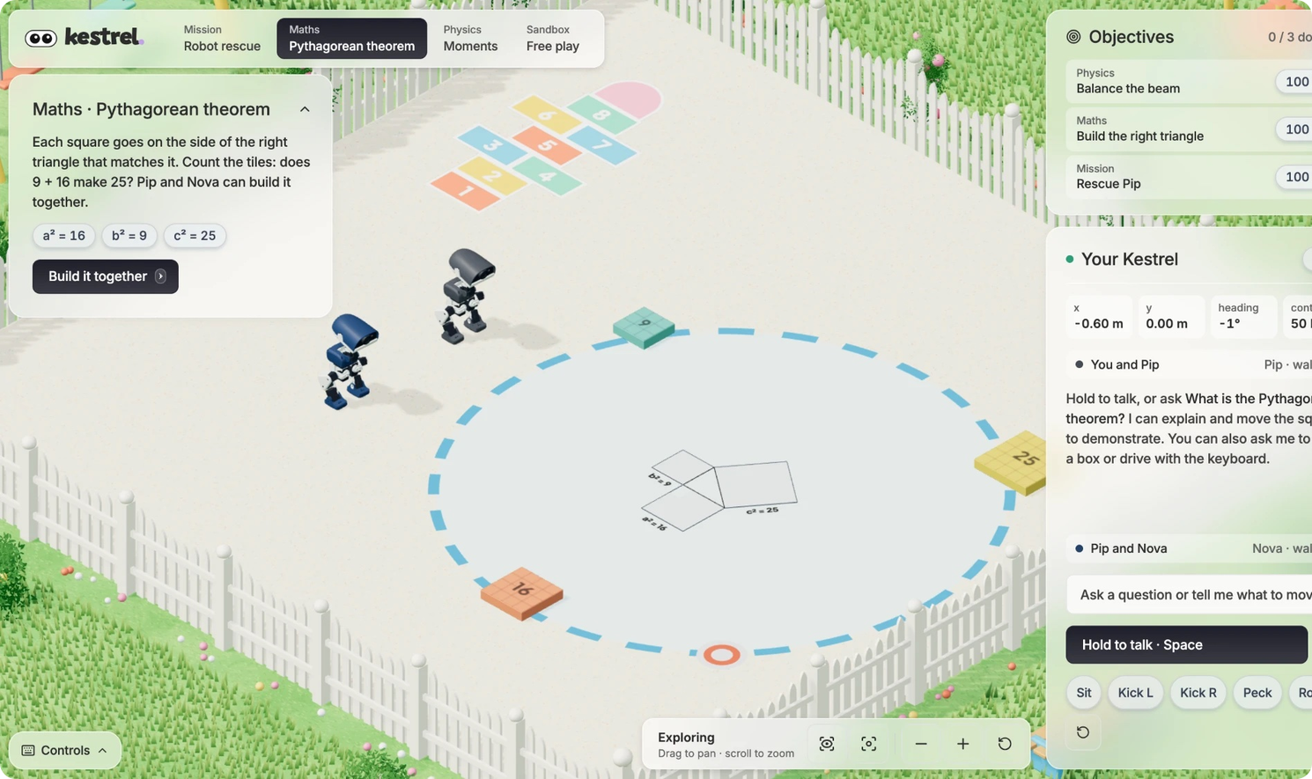
Objective 2 · Maths · Pythagoras
Build the right triangle
Does 9 + 16 make 25? Pip and Nova push the square tiles onto the sides of a floor triangle, and the slots light up when the tiles land.
Each objective has an XP bar that fills only when the simulator measures the goal met.
Fig. 3 The Pythagoras lesson, with the objectives board
Notes:
Square tiles of 3 by 3, 4 by 4 and 5 by 5 are pushed onto a floor triangle. The robots can build it together. XP fills only on a measured success.

Slide 6
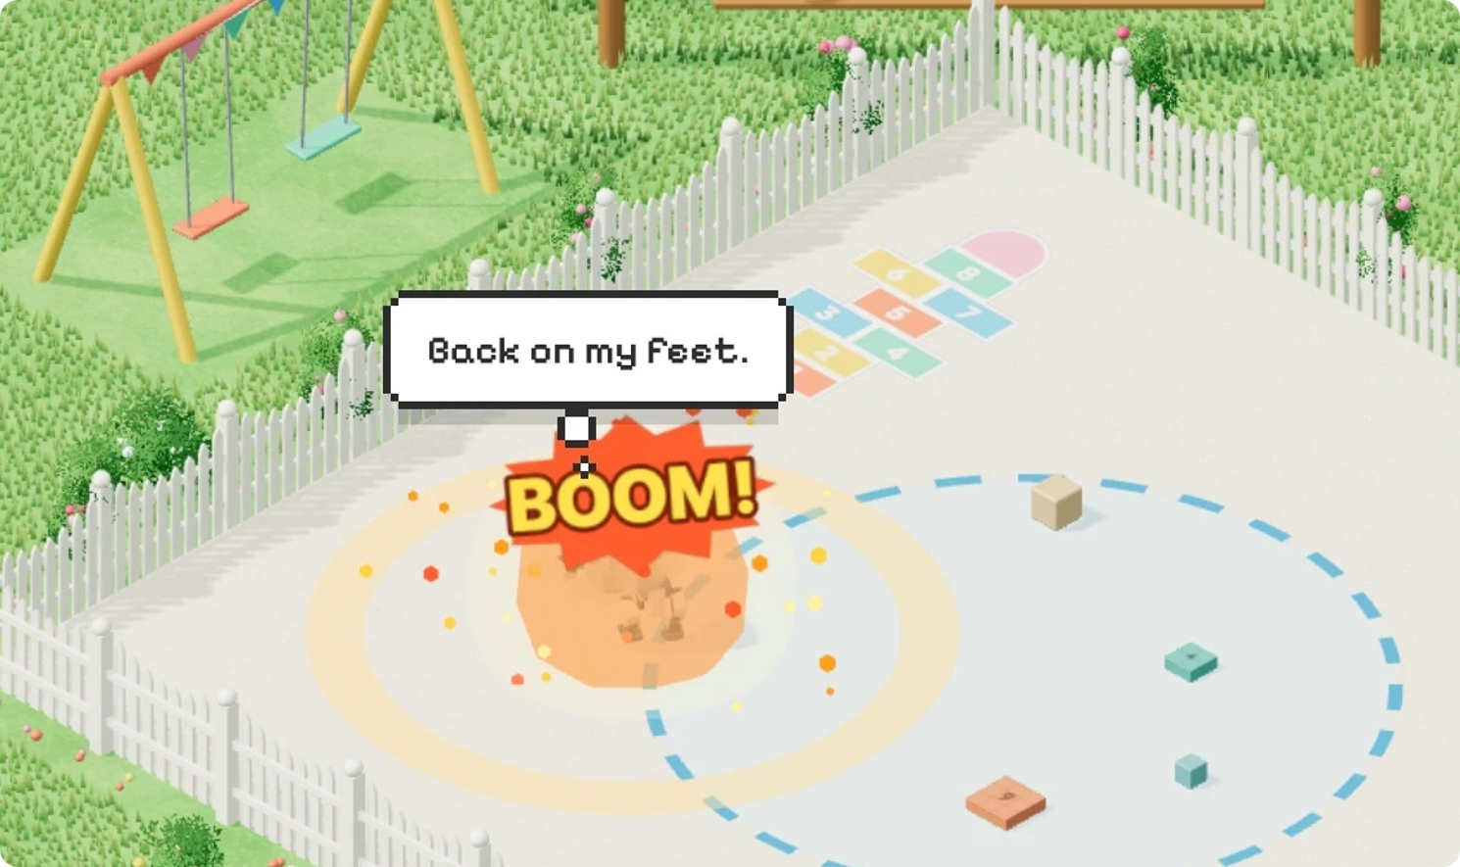
Objective 3 · Mission · Free play
Rescue Pip, then let them play
Guide the robots to bring Pip home. In free play they charge, really collide in MuJoCo, and the one that falls gets back up with its own get-up policy.
The knockdown is a scripted shove. The recovery is the real policy.
Fig. 4 Free play: a clash, then back on its feet
Notes:
A fast clash, closing faster than 0.45 m/s into 20 cm, draws a cartoon explosion. The loser is knocked over by a scripted velocity impulse, not crash physics, and gets up with its own get-up policy.

Slide 7

Say it out loud. Claude plans bounded actions, and the simulator does the science
01
02
03
04
05
Hold to talk
ElevenLabs
Claude on Bedrock
MuJoCo runs it
The robots answer
Space or the button. Typed requests take the same path.
Transcribes the learner's voice on the server.
Picks actions for Pip, Nova or both, checked by Zod.
Policies move the robots; the runner measures the result.
A short robot sound, and words in a think bubble and the log.
Stop and Reset cancel pending actions. The model is never called per frame; local physics and navigation run on their own.
Notes:
Voice and Claude need server keys in .env. The model proposes bounded actions and explains measured results; bubbles show public plans, not hidden reasoning.

Slide 8
Pip and Nova run the experiment together, each on its own weight
01
Lock the plank
200 g weight
100 g weight
02
Push each weight to its target
Pip
Nova
03
Withdraw from the rails
Pushes the heavier weight along the left rail, then reports where it actually stopped.
Pushes the lighter weight along the right rail, then reports its own measured position.
04
Verify the beam is clear
05
Release the plank
06
Compare the measured tilt
Honest boundary: Nova is not a separate language model. The simulator announces the two-robot plan and handoffs, and the Pip and Nova window shows each robot's measured result.
Notes:
Bot-to-bot help should serve the experiment: observe, test, report a measured result. Lanes are scheduled today; robot avoidance while both walk the same lane is next.

Slide 9
Progress survives a refresh, because every win is a row in a Tiger Data hypertable
attempts
0.2°
No account
A TimescaleDB hypertable on time, written by POST /api/progress and read by GET /api/progress/:learner.
The measured beam tilt stored with a real win, alongside both weight positions in centimetres.
Each browser keeps an anonymous learner ID. No name is collected.
Verified against Tiger Cloud on 25 October 2026: a win in the console, a reload with the local copy removed, and the board restored from the database alone. Without the database the API returns 503 and the browser copy is used. Only wins are logged today.
Notes:
Balance the beam was won in about 12 seconds; the browser sent POST /api/progress (201) and Tiger stored balance-beam ok=true, tilt 0.2 degrees, 10 cm and 20 cm. Strict TLS passes.

Slide 10
What is real today, and what we have not built yet
Real today
Next
Microduck physics and policies at 50 Hz in the browser
Three objectives, each measured by the simulator
Voice and Claude conversation, with server keys
Progress stored in Tiger Data
Stop and Reset that cancel pending actions
Robot avoidance in a shared lane (lanes are scheduled)
Grasping and a jump skill
Final robot art (the paintings are concept art)
Accounts, hosting and an under-18 review
Hardware
TypeScript · React 19 · React Three Fiber 9 · Three.js · Zustand · Radix · Motion · Fastify · Zod · MuJoCo WASM · ONNX Runtime · Tiger Data
Notes:
Keep the boundary honest: no physical lifting, no final robot art, no accounts or production hosting yet. A youth-facing rollout needs provider under-18 guidance and minimal retained data.

Slide 11
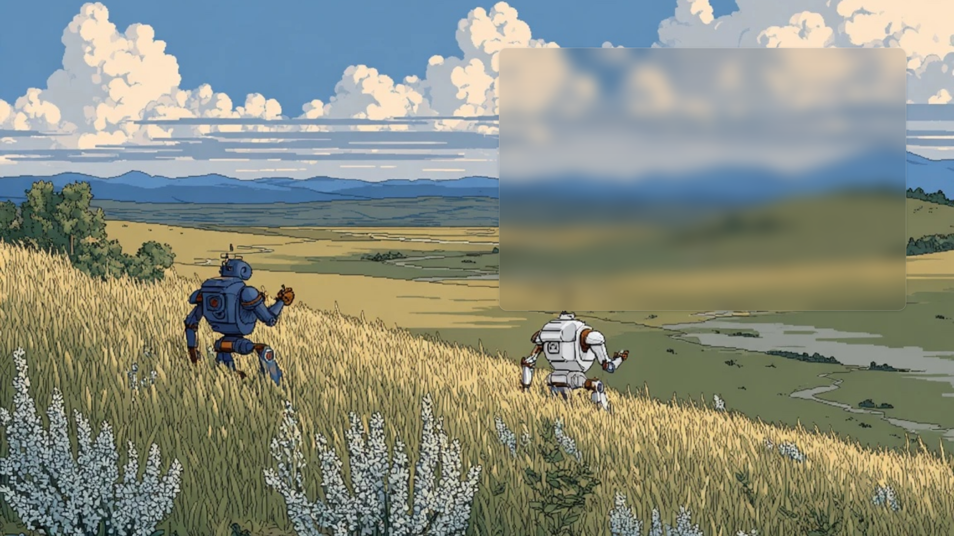

Real robots. Real physics.
Ask us for the console and try the beam yourself.
Open the playground
HackPSU 2026 · Concept art
Notes:
Invite the judges to the laptop: open /console, set 200 g at 10 cm and 100 g at 20 cm, run it with both robots, and watch the objective fill.

