Slide 1

A.R.T.E.M.I.S.
Autonomous Radar & Thermal Engine for Monitoring Illegal Smuggling
Advanced Ecological & Border Integrity — where defense technology meets conservation imperative.

Slide 2

UN SDG 15 · LIFE ON LAND
Problem that needs to be solved !
The Scale of Illegal Wildlife Trafficking
🦏 Species at Risk
Wildlife trafficking is the 4th largest criminal enterprise globally — generating $23B annually. Every year, thousands of endangered species are poached, logged, or displaced as protected forest borders go unwatched.
Over 8,000 species face extinction pressure driven by illegal trafficking and habitat destruction.
🌳 Illegal Logging
SDG 15 demands urgent technological intervention to halt biodiversity collapse and restore sovereignty over protected ecosystems.
15–30% of global timber trade is illegal, stripping critical carbon sinks and wildlife corridors.
🚨 Enforcement Gap
Vast protected zones remain effectively unmonitored — rangers are outnumbered and under-resourced.

Slide 3
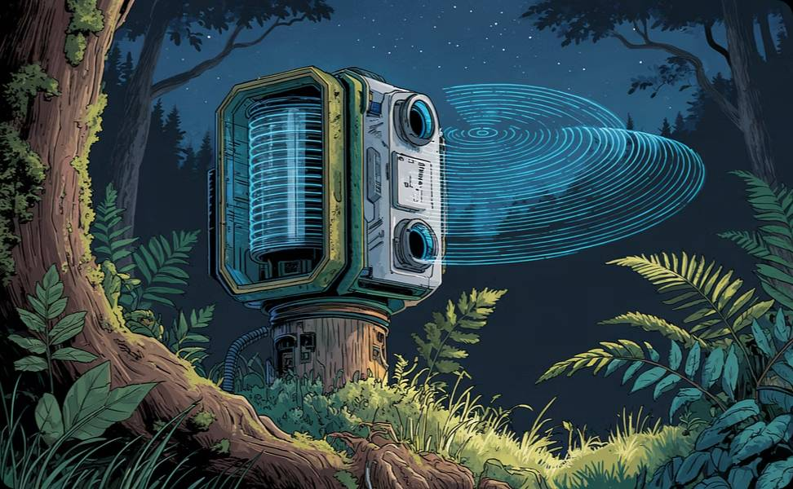

THE SOLUTION
The A.R.T.E.M.I.S. Solution
A dual-spectrum detection engine purpose-built to secure ecological borders — day and night, in any terrain.
Ultrasonic Spatial Mapping
High-Fidelity Thermal Imaging
High-frequency acoustic pulses create a real-time 3D spatial map of the environment — detecting movement, mass, and proximity with zero-latency 180° coverage.
Infrared bio-signature detection isolates human thermal radiation from ambient environmental noise — enabling positive target identification regardless of visual concealment.

Slide 4
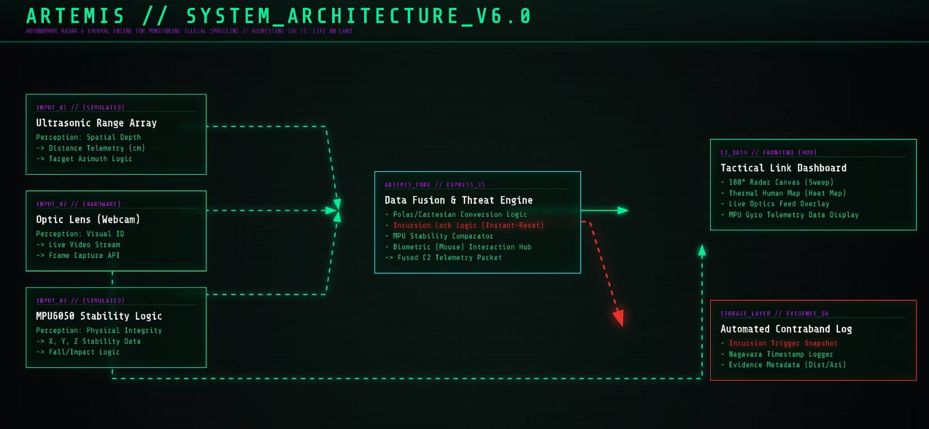
TACTICAL ARCHITECTURE
System Architecture
Perception Layer
Ultrasonic sensors sweep a continuous 180° arc, delivering sub-millisecond spatial awareness with no blind spots and no light dependency.
Intelligence Layer
JavaScript-driven "Instant-Reset" state logic processes sensor feeds in real time — classifying, flagging, and escalating threats autonomously.
Optics Layer
Live surveillance integration captures timestamped visual evidence, automatically logging events for legal enforcement and chain-of-custody integrity.

Slide 5

FEATURE HIGHLIGHT
Thermal Bio-Signature Detection
A.R.T.E.M.I.S. renders the invisible visible. Its heat-mapping engine reconstructs humanoid biological radiation as a full-body thermal profile — distinguishing human intruders from wildlife, foliage, and environmental interference with high-confidence classification.
🔴 Threat Signature
🟡 Noise Rejection
Human core temp (36–37°C) flagged against ambient baseline
Animal and plant signatures filtered via multi-frame thermal delta analysis
🔵 Zero False Positives
Layered confirmation protocols prevent spurious alerts in high-biodiversity zones

Slide 6
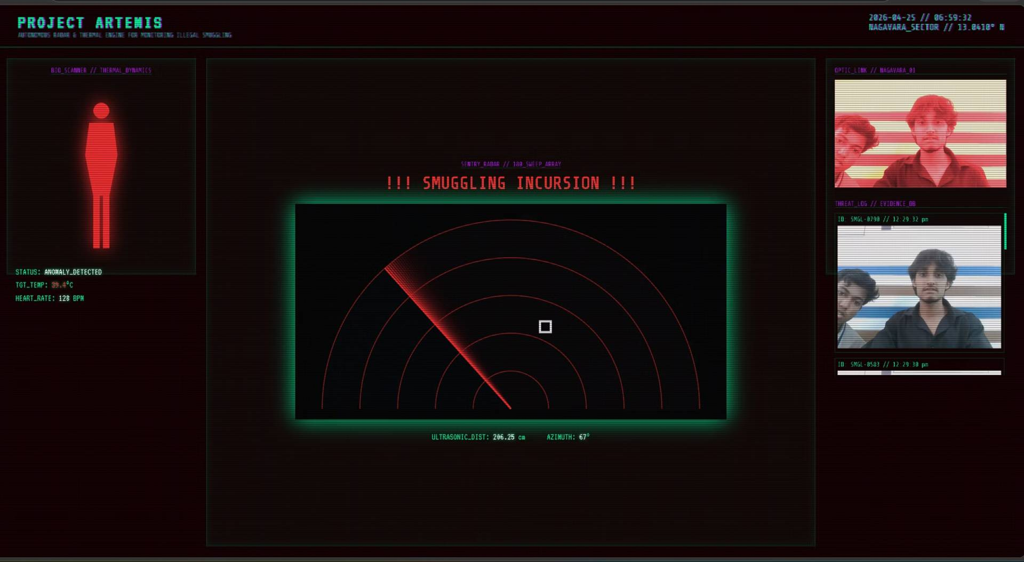
Demo screenshots

Slide 7

TECH STACK
Built on Proven, Open Technology
A.R.T.E.M.I.S. is engineered on accessible, battle-tested technologies — ensuring rapid deployment, global replicability, and low infrastructure cost.
HTML5 / CSS3
JavaScript
Advanced UI rendering with glassmorphic dashboards, real-time data visualization, and responsive field-operator interfaces.
Canvas-based spatial rendering engine with Instant-Reset state logic for real-time threat analysis and event-driven alert escalation.
Hardware Telemetry
Thermal Sensor Layer
Simulated MPU6050 inertial data and ultrasonic ranging — bridging the gap between software logic and deployable field hardware.
Integrated infrared capture pipeline with bio-signature normalization, frame-delta processing, and automated evidence archiving.

Slide 8
IMPACT & FUTURE HORIZON
From Prototype to Planetary Shield
A.R.T.E.M.I.S. is not a product — it is a scalable doctrine for ecological defense. The roadmap moves from pilot deployment to a globally distributed mesh protecting every critical biome on Earth.
Phase 1 — Pilot
1
Deploy sentinel nodes across two high-threat national park borders. Validate detection accuracy and false-positive rates in live terrain.
2
Phase 2 — AI Integration
Layer machine-learning species identification — distinguishing protected fauna from human threats in real time with edge-compute AI.
Phase 3 — Drone Response
3
Autonomous drone-intercept protocols activated on confirmed intrusion — providing visual confirmation and deterrence without human risk.
4
Phase 4 — Global Mesh
Interconnected sensor networks across national parks, UNESCO heritage zones, and sovereign border corridors — a living, breathing planetary immune system.

