Slide 1

IMPLEMENTATION PLAN
Local Agentic Document
Extraction System
Pure VLM + Multi-Agent Architecture for Healthcare RCM
MODEL
BACKEND
AGENTS
COMPLIANCE
Qwen3-VL 8B
LM Studio
4 Specialized
HIPAA Ready

Slide 2
Executive Summary
THE CHALLENGE
OUR SOLUTION
Healthcare RCM requires 97%+ accuracy on sensitive documents while maintaining HIPAA compliance and data sovereignty.
Streamlined 4-agent system using local VLM with 3-layer anti-hallucination and schema-driven extraction.
4
3
100%
12
Focused Agents
Validation Layers
Local Processing
Week Timeline
WHY 4 AGENTS INSTEAD OF 9?
50% fewer VLM calls
2x faster processing
Simpler orchestration
Easier maintenance
DESIGN IMPROVEMENTS
Old: 6-8 VLM calls/page
Old: 45-60 sec/page
Old: 6 validation layers
New: 3-4 VLM calls/page
New: 15-25 sec/page
New: 3 effective layers

Slide 3
4-Agent Architecture
PREPROCESSOR
AGENT 1: ORCHESTRATOR
0 VLM calls
PDF → Images
LangGraph State Machine • Workflow Control • Error Handling
Quality Check
✓
📄
→
No VLM calls
→
→
AGENT 2: ANALYZER
AGENT 3: EXTRACTOR
AGENT 4: VALIDATOR
JSON
PDF Input
Document classification
Schema-driven extraction
Schema validation
Output
Structure detection
Dual-pass verification
Hallucination detection
Page relationships
Confidence scoring
Cross-page merging
1 VLM call/doc
2 VLM calls/page
0-1 VLM call/doc
VLM BACKEND: Qwen3-VL 8B via LM Studio
~6GB
3-4
Local GPU • OpenAI-Compatible API • 32K Context
VRAM (INT4)
VLM calls/page

Slide 4
Prerequisites and Environment Setup
PHASE 0 • WEEK 1
STEP-BY-STEP TASKS
1
Procure Hardware
RTX 4090 (24GB) or A6000 • 32-64GB RAM • 500GB NVMe
REQUIREMENTS
2
Install LM Studio
VRAM Options
Download from lmstudio.ai • Enable vision support
FP16
INT8
INT4
Download Qwen3-VL Model
18GB
10GB
6GB
3
Q4_K_M quantization (~6GB VRAM) • All layers to GPU
Python Packages
4
Configure Local Server
langgraph
PyMuPDF
openai
pydantic
Pillow
Port 1234 • Context 8192-32768 • Enable image inputs
MILESTONE
5
Setup Python Environment
VLM responds correctly to image + text prompt via localhost:1234
Python 3.11 • venv • Install dependencies
6
Verify Vision Capability
Test with sample image • Confirm structured output

Slide 5
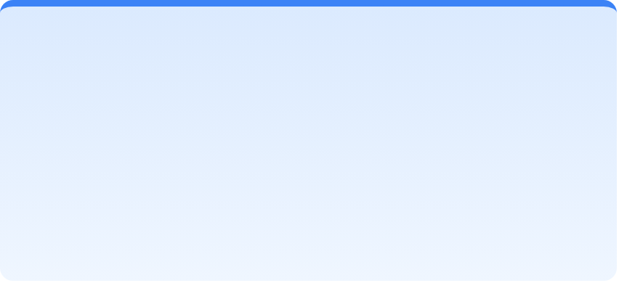


Core Infrastructure
PHASE 1 • WEEKS 2-3
WEEK 2: PDF Processing Pipeline
WEEK 2: LM Studio Client
WEEK 3: Schema System
1
Build PDF ingestion module
1
Create connection manager class
1
Define base schema structure
2
Implement page extraction (300 DPI)
2
Build vision request handler
2
Create field type validators
3
Add quality enhancement filters
3
Implement response parser
3
Build CMS-1500 schema
4
Create batch processing manager
4
Add retry logic with tenacity
4
Build EOB/Remittance schema
5
Write unit tests for pipeline
5
Add health check monitoring
5
Add cross-field rule engine
PRE-BUILT HEALTHCARE RCM SCHEMAS
Medical Claim
EOB / Remittance
Lab Report
CMS-1500 / UB-04 • ICD-10 • CPT codes
Payments • Adjustments • Reason codes
Results • Reference ranges • Flags
PDF processor
LM client
Schema library
Unit tests
DELIVERABLES

Slide 6




4-Agent Framework Development
PHASE 2 • WEEKS 4-6
WEEK 4: ORCHESTRATOR
WEEK 4-5: ANALYZER
WEEK 5: EXTRACTOR
WEEK 6: VALIDATOR
1. Setup LangGraph project
1. Create agent base class
1. Build extraction prompt
1. Build schema validator
2. Define state machine states
2. Build classification prompt
2. Implement dual-pass logic
2. Add pattern detection
3. Build transition logic
3. Implement structure detector
3. Add field comparison
3. Implement cross-field rules
4. Implement checkpointing
4. Add page relationship logic
4. Create confidence scorer
4. Build cross-page merger
5. Add error handling
5. Build schema selector
5. Add visual grounding
5. Add confidence calibration
6. Create retry policies
6. Test with sample docs
6. Handle table extraction
6. Create output formatter
0 VLM calls
1 VLM call/doc
2 VLM calls/page
0-1 VLM call/doc
AGENT DESIGN PRINCIPLES
1
Single Responsibility
2
Stateless Operations
3
Confidence Scoring
4
Graceful Degradation
LANGGRAPH STATE MACHINE
5
4
3-4
INIT → ANALYZE → EXTRACT → VALIDATE → COMPLETE/REVIEW
States
Agents
VLM/page

Slide 7



3-Layer Anti-Hallucination System
PHASE 3 • WEEKS 7-8
1
Prompt Engineering
2
Dual-Pass Extraction
3
Pattern + Rule Validation
Built into all agent prompts
Implemented in Extractor Agent
Implemented in Validator Agent
Grounding instructions
Two extraction passes
Repetitive value detection
Do not guess rules
Different prompt variations
Cross-field consistency
Return null if unsure
Field-by-field comparison
Code validation (NPI, ICD)
Structured output format
Mismatch flagging
Math and date logic checks
Owner: All Agents
Owner: Extractor Agent
Owner: Validator Agent
CONFIDENCE SCORE ACTIONS
0.95+
0.85-0.94
0.70-0.84
0.50-0.69
Below 0.50
Auto-Accept
Accept + Note
Verify
Re-Extract
Human Review
HUMAN-IN-THE-LOOP
Target: Less than 10% Review Rate
Auto-flagging, review interface, correction feedback loop

Slide 8
Integration, Testing and Deployment
PHASES 4-5 • WEEKS 9-12
PHASE 4: INTEGRATION (Weeks 9-10)
Week 9: REST API Development
PHASE 5: DEPLOYMENT (Weeks 11-12)
1. Setup FastAPI project structure
2. Create POST /extract endpoint
Week 11: HIPAA Compliance
3. Add GET /tasks/{id} status
4. Implement batch processing
1. Verify 100% local processing
5. Add async task queue
2. Implement AES-256 encryption
3. Setup role-based access control
4. Enable comprehensive audit logs
Week 10: Testing Suite
5. Configure secure temp cleanup
1. Unit tests for each agent
2. Integration tests (end-to-end)
Week 12: Production Launch
3. Accuracy tests (golden dataset)
4. Hallucination adversarial tests
1. Setup monitoring dashboards
5. Performance benchmarks
2. Configure alerting rules
3. Write operations runbook
POST /api/v1/extract
4. Train operations team
5. Go-live with pilot documents
GET /api/v1/tasks/{id}
Capacity
POST /api/v1/batch
Single GPU: 50-100 pg/hr • Multi-GPU: 200-400 pg/hr
GET /api/v1/health

Slide 9
12-Week Implementation Timeline
0
1
2
3
4
5
Week 1
Weeks 2-3
Weeks 4-6
Weeks 7-8
Weeks 9-10
Weeks 11-12
Setup
Core
4 Agents
Validation
Testing
Deploy
Phase
Duration
Key Deliverables
Phase 0
Week 1
Hardware, LM Studio, model download, Python env
Phase 1
Weeks 2-3
PDF pipeline, LM client, schema system, RCM schemas
Phase 2
Weeks 4-6
4 agents (Orchestrator, Analyzer, Extractor, Validator), LangGraph
Phase 3
Weeks 7-8
3-layer anti-hallucination, human-in-the-loop, confidence tuning
Phase 4
Weeks 9-10
REST API, batch processing, unit/integration/accuracy tests
Phase 5
Weeks 11-12
HIPAA compliance, monitoring, alerting, documentation, go-live
Buffer: 2-week contingency for edge cases and model tuning
Total: 12-14 weeks

Slide 10



Success Criteria and Next Steps
NEXT STEPS
PERFORMANCE TARGETS
1
Procure hardware (RTX 4090)
2
Collect sample corpus (100+ docs)
FIELD ACCURACY
95%+
3
Define custom schemas
4
Assign dev team (2-3 engineers)
HALLUCINATION RATE
2% or less
KEY RISKS
Hallucinations: 3-layer verification
PROCESSING SPEED
15-25s/pg
Doc quality: Enhancement pipeline
99.5%
10%
3-4
HIPAA: 100% local processing
Uptime
Review Rate
VLM/page
Ready to Begin Phase 0

