Slide 1
Turing Machines

Slide 2
The Language Hierarchy
?
?
Context-Free Languages
Regular Languages

Slide 3
Languages accepted by
Turing Machines
Context-Free Languages
Regular Languages

Slide 4
A Turing Machine
Tape
......
......
Read-Write head
Control Unit

Slide 5
The Tape
No boundaries -- infinite length
......
......
Read-Write head
The head moves Left or Right

Slide 6
......
......
Read-Write head
The head at each transition (time step):
1. Reads a symbol
2. Writes a symbol
3. Moves Left or Right

Slide 7
Example:
Time 0
......
......
Time 1
......
......
1. Reads
2. Writes
3. Moves Left

Slide 8
Time 1
......
......
Time 2
......
......
1. Reads
2. Writes
3. Moves Right

Slide 9
The Input String
Input string
Blank symbol
......
......
head
Head starts at the leftmost position
of the input string

Slide 10
States & Transitions
Write
Read
Move Left
Move Right

Slide 11
Example:
Time 1
......
......
current state

Slide 12
Time 1
......
......
Time 2
......
......

Slide 13
Example:
Time 1
......
......
Time 2
......
......

Slide 14
Example:
Time 1
......
......
Time 2
......
......

Slide 15
Determinism
Turing Machines are deterministic
Allowed
Not Allowed
No lambda transitions allowed

Slide 16
Partial Transition Function
Example:
......
......
Allowed:
No transition
for input symbol

Slide 17
Halting
The machine halts in a state if there is
no transition to follow

Slide 18
Halting Example 1:
......
......
No transition from
HALT!!!

Slide 19
Halting Example 2:
......
......
No possible transition
from and symbol
HALT!!!

Slide 20
Accepting States
Allowed
Not Allowed
Accepting states have no outgoing transitions
The machine halts and accepts

Slide 21
Acceptance
If machine halts
in an accept state
Accept Input
string
If machine halts
in a non-accept state
or
If machine enters
an infinite loop
Reject Input
string

Slide 22
Observation:
In order to accept an input string,
it is not necessary to scan all the
symbols in the string

Slide 23
Turing Machine Example
Input alphabet
Accepts the language:

Slide 24
Time 0

Slide 25
Time 1

Slide 26
Time 2

Slide 27
Time 3

Slide 28
Time 4
Halt & Accept

Slide 29
Rejection Example
Time 0

Slide 30
Time 1
No possible Transition
Halt & Reject

Slide 31
A simpler machine for same language
but for input alphabet
Accepts the language:

Slide 32
Time 0
Halt & Accept
Not necessary to scan input

Slide 33
Infinite Loop Example
A Turing machine
for language

Slide 34
Time 0

Slide 35
Time 1

Slide 36
Time 2

Slide 37
Time 2
Time 3
Infinite loop
Time 4
Time 5

Slide 38
Because of the infinite loop:
The accepting state cannot be reached
The machine never halts
The input string is rejected

Slide 39
Another Turing Machine Example
Turing machine for the language

Slide 40
Basic Idea:
Match a’s with b’s:
Repeat:
replace leftmost a with x
find leftmost b and replace it with y
Until there are no more a’s or b’s
If there is a remaining a or b reject

Slide 41
Time 0

Slide 42
Time 1

Slide 43
Time 2

Slide 44
Time 3

Slide 45
Time 4

Slide 46
Time 5

Slide 47
Time 6

Slide 48
Time 7

Slide 49
Time 8

Slide 50
Time 9

Slide 51
Time 10

Slide 52
Time 11

Slide 53
Time 12

Slide 54
Time 13
Halt & Accept

Slide 55
Observation:
If we modify the
machine for the language
we can easily construct
a machine for the language

Slide 56
Formal Definitions for Turing Machines

Slide 57
Transition Function

Slide 58
Transition Function

Slide 59
Turing Machine:
Input
alphabet
Tape
alphabet
States
Transition
function
Accept
states
Initial
state
blank

Slide 60
Configuration
Instantaneous description:

Slide 61
Time 4
Time 5
A Move:
(yields in one mode)

Slide 62
Time 4
Time 5
Time 6
Time 7
A computation

Slide 63
Equivalent notation:

Slide 64
Initial configuration:
Input string

Slide 65
The Accepted Language
For any Turing Machine
Initial state
Accept state

Slide 66
If a language is accepted
by a Turing machine
then we say that is:
Turing Recognizable
Other names used:
Turing Acceptable
Recursively Enumerable

Slide 67
Computing Functions with Turing Machines

Slide 68
A function
has:
Domain:
Result Region:

Slide 69
A function may have many parameters:
Example:
Addition function

Slide 70
Integer Domain
Decimal:
5
Binary:
101
Unary:
11111
We prefer unary representation:
easier to manipulate with Turing machines

Slide 71
Definition:
A function is computable if
there is a Turing Machine such that:
Initial configuration
Final configuration
initial state
accept state
For all
Domain

Slide 72
In other words:
A function is computable if
there is a Turing Machine such that:
Initial
Configuration
Final
Configuration
For all
Domain

Slide 73
Example
The function
is computable
are integers
Turing Machine:
Input string:
unary
Output string:
unary

Slide 74
Start
initial state
The 0 is the delimiter that
separates the two numbers

Slide 75
Start
initial state
Finish
final state

Slide 76
The 0 here helps when we use
the result for other operations
Finish
final state

Slide 77
Turing machine for function

Slide 78
Execution Example:
Time 0
(=2)
(=2)
Final Result

Slide 79
Time 0

Slide 80
Time 1

Slide 81
Time 2

Slide 82
Time 3

Slide 83
Time 4

Slide 84
Time 5

Slide 85
Time 6

Slide 86
Time 7

Slide 87
Time 8

Slide 88
Time 9

Slide 89
Time 10

Slide 90
Time 11

Slide 91
Time 12
HALT & accept

Slide 92
Another Example
The function
is computable
is integer
Turing Machine:
Input string:
unary
Output string:
unary

Slide 93
Start
initial state
Finish
accept state

Slide 94
Turing Machine Pseudocode for
Replace every 1 with $
Repeat:
Find rightmost $, replace it with 1
Go to right end, insert 1
Until no more $ remain

Slide 95
Turing Machine for

Slide 96
Example
Start
Finish

Slide 97
Another Example
if
The function
is computable
if
Input:
Output:
or

Slide 98
Turing Machine Pseudocode:
Repeat
Match a 1 from with a 1 from
Until all of or is matched
If a 1 from is not matched
erase tape, write 1
else
erase tape, write 0

Slide 99
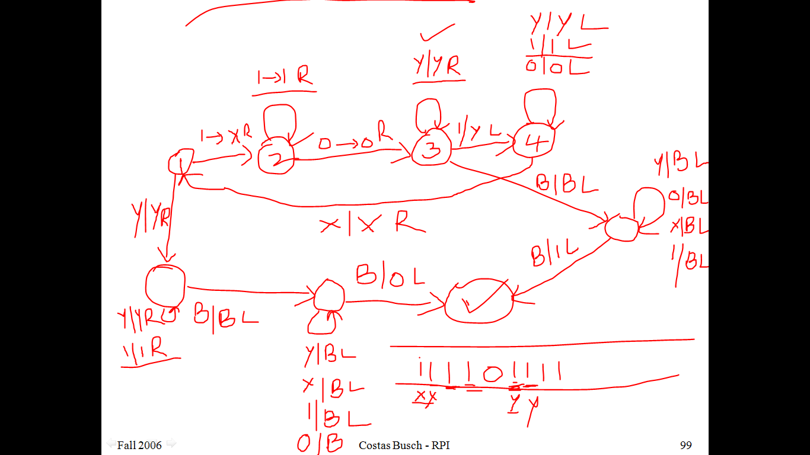

Slide 100
Combining Turing Machines

Slide 101
Block Diagram
Turing
Machine
input
output

Slide 102
Example:
if
if
Adder
Comparator
Eraser

