Slide 1


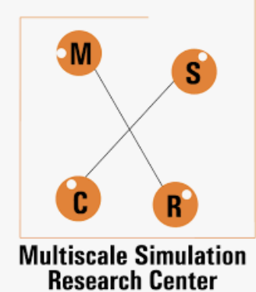

Positional Error Estimation & Compensation of 3-DOF Delta Robot under the effect of LINK TOLERANCES
International Conference
on
Recent Advances in Modeling and Simulations Techniques in Engineering and Sciences
(RAMSTES-2021)
Rayyan Muhammad Rafikh, B.Tech
Darren Alton Dsouza, B.Tech
Ankur Jaiswal, Ph.D
Department of Mechatronics, Manipal Institute of Technology, Manipal Academy of Higher Education (MAHE), Manipal, Karnataka

Slide 2

Outline of the Presentation
Introduction
Problem Statement
Objectives
Methodology
Position Error Estimation Under Effect of Link Tolerance
Error Compensation Using Inverse Kinematics
Results and Discussion
Conclusions
References
Recent Advances in Modeling and Simulations Techniques in Engineering and Science (RAMSTES-2021)

Slide 3
Introduction
Spatial Parallel Mechanisms – “ Need of the hour ”
Stronger, Quicker, and more Precise Processes
The Development of 3 DoF Parallel manipulators with Translational Motion “ Rising Trend ” – High Speed & High Stiffness Manipulation
Development of Parallel Delta Robot by Reymond Clavel
“ Increasing Research Prospect ” with wide variety of Applications

Slide 4
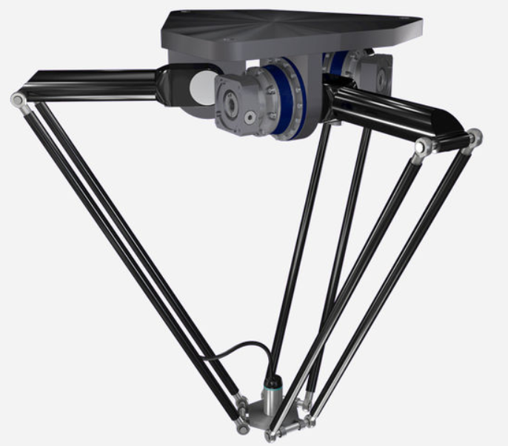
Introduction..
Advantages
Higher Productivity Rate
Increased Speed
Safety
Footprint
Applications
Packaging Industry – “ Pick & Place Operations ”
Medical & Pharmaceutical Industry – “ Due to Stiffness : Used in Surgeries
High Precision Assembly Operations – ex: in a room of electric components
3D Printers
Can be used to Create Haptic Controllers
Fig. 1. Parallel Delta Robot
Limitations
Heavy Load – Due to Design Constraints
Restricted Workspace
Recent Advances in Modeling and Simulations Techniques in Engineering and Science (RAMSTES-2021)

Slide 5
Introduction..
Mechanical Error
Factors causing the mechanical error:
Link deflections- Force and Stiffness dependent
Thermal expansions- Operating Temperature Dependent
Joint clearance- Clearance between Pin & Hole
Backlash- Play between links
Link Tolerance- Process dependent, limitation on machine accuracy

Slide 6
Problem Definition
Deviation in Performance due to link tolerances in parallel Delta Robot is the topic of Interest.
Influence of Positional Error needs to be Investigated.
A generic approach of compensating the maximum positional error is to be formulated.
Objectives
Workspace Analysis of the Delta Robot under Ideal & Abnormal conditions.
To Obtain Maximum Positional Error in a 3 DoF Delta Robot Under Influence of Link Tolerance.
Compensate the Maximum Positional Error so as to Obtain Desired Input Parameters.
Recent Advances in Modeling and Simulations Techniques in Engineering and Science (RAMSTES-2021)

Slide 7
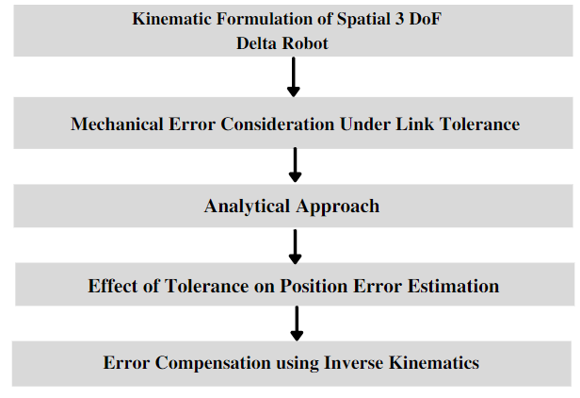
Methodology
Fig.2. Flowchart

Slide 8
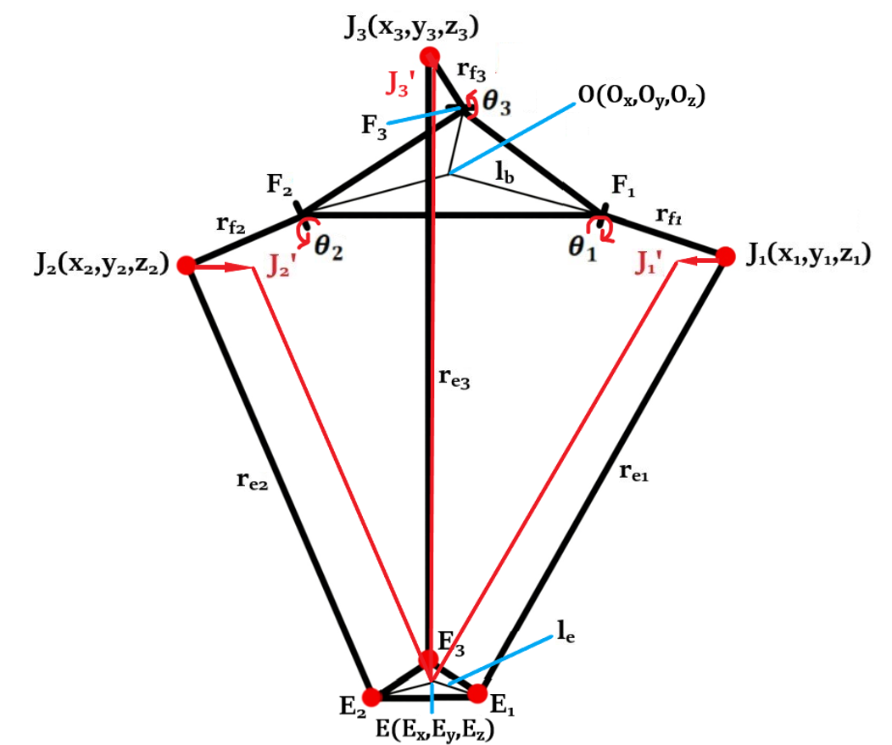
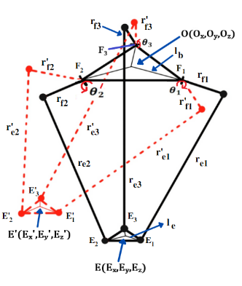
Positional Error Estimation Under Effect of Link Tolerance
Fig.3. Kinematic Sketch
Fig.4. Ideal & Deviated Plots

Slide 9
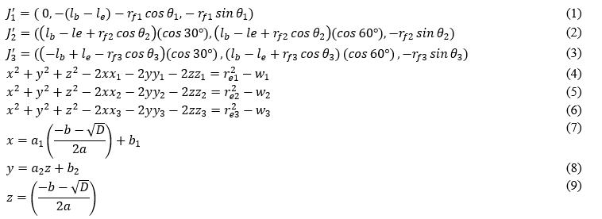
Positional Error Estimation Under Effect of Link Tolerance
Mathematical Formulation with Tolerance

Slide 10
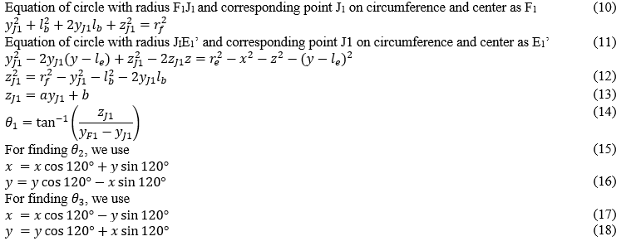
Error Compensation Using Inverse Kinematics
Mathematical Formulation of Error Compensation Using IK

Slide 11
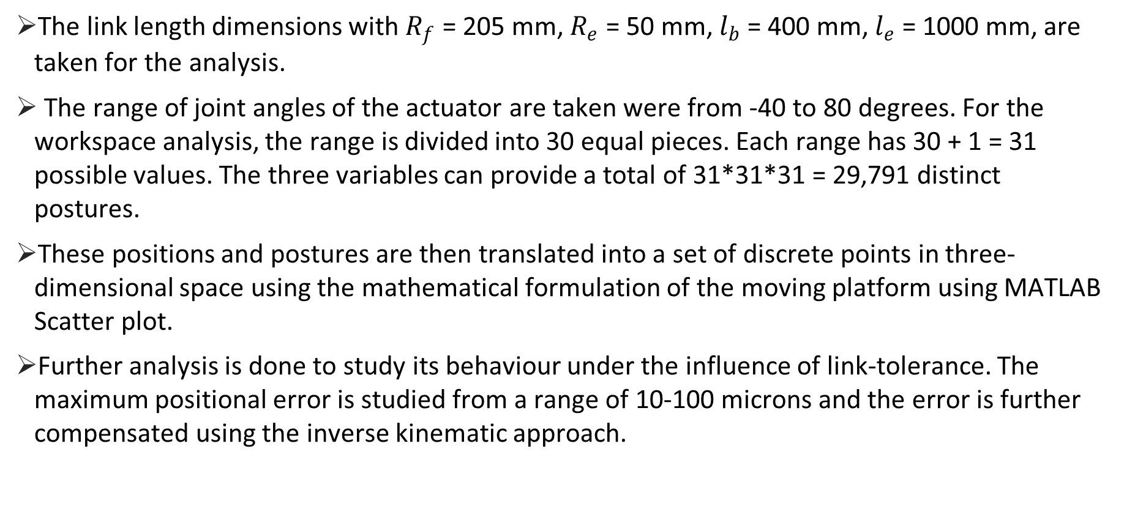
Case Study
The link length dimensions with $R_{f}$ = 205 mm, $R_{e}$ = 50 mm, $l_{b}$ = 400 mm, $l_{e}$ = 1000 mm, are taken for the analysis.
The range of joint angles of the actuator are taken were from -40 to 80 degrees. For the workspace analysis, the range is divided into 30 equal pieces. Each range has 30 + 1 = 31 possible values. The three variables can provide a total of 31*31*31 = 29,791 distinct postures.
These positions and postures are then translated into a set of discrete points in three-dimensional space using the mathematical formulation of the moving platform using MATLAB Scatter plot.
Further analysis is done to study its behaviour under the influence of link-tolerance. The maximum positional error is studied from a range of 10-100 microns and the error is further compensated using the inverse kinematic approach.

Slide 12
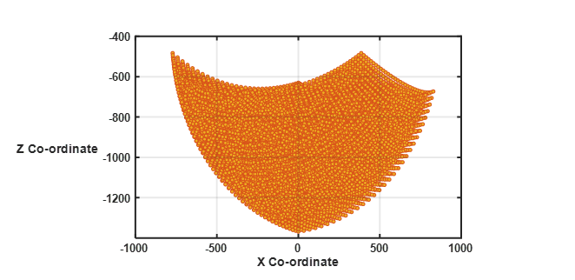
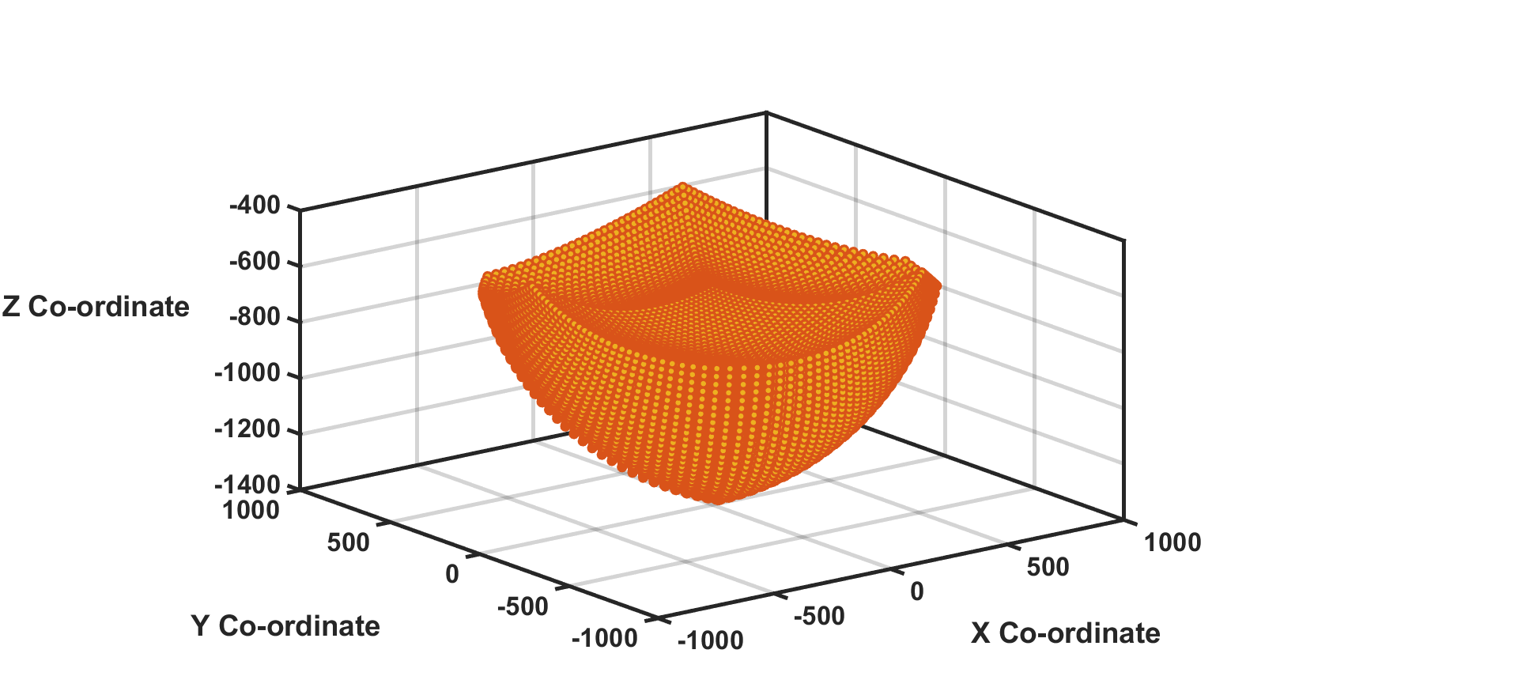
Results and Discussion
Workspace Analysis
Fig.4. Workspace Plot
Fig.5. XZ Plane Plot

Slide 13
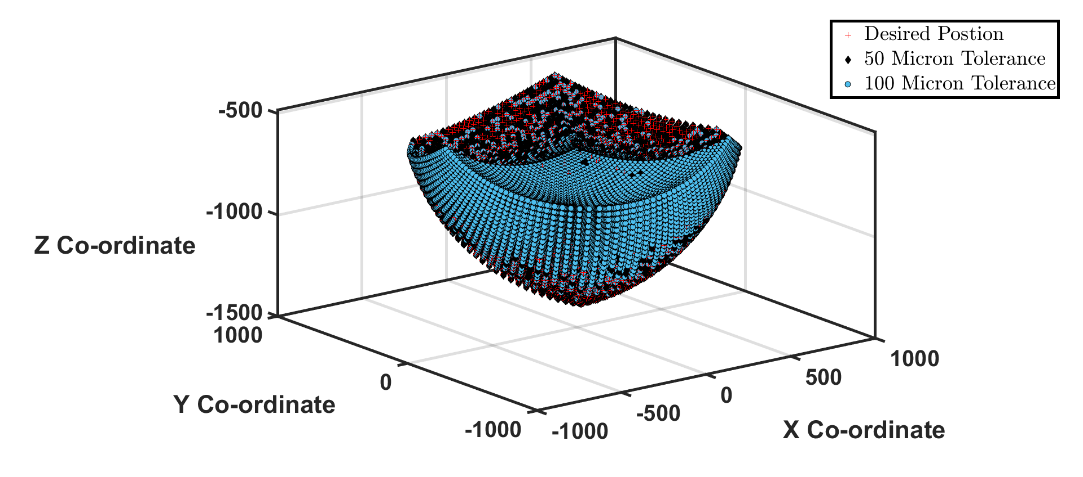
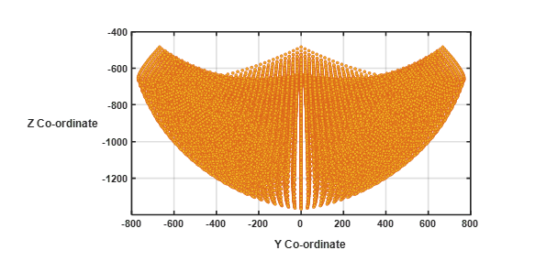
Results and Discussion..
Workspace Analysis
Fig.6. YZ Plane Plot
Fig.7. Desired and Deviated Plot

Slide 14
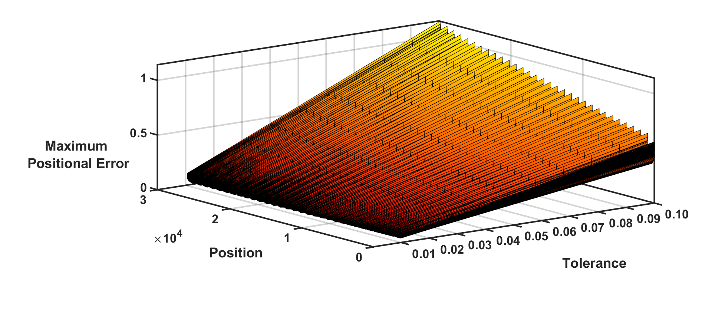
Results and Discussion..
Position Error Estimation
Fig.8. Tolerance vs Position vs Maximum Positional Error
Fig.9. Maximum Positional Error vs Tolerance Plot

Slide 15
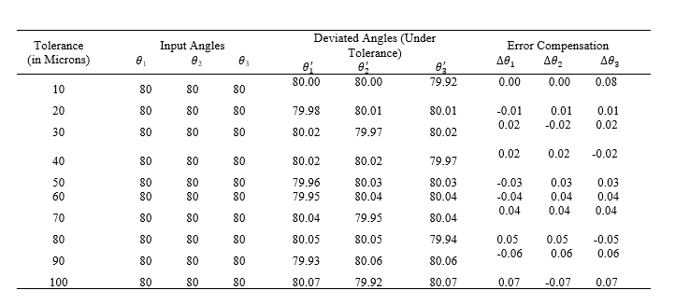
Results and Discussion..
Error Compensation
The inverse kinematic approach is used to compensate the maximum position error for each combination of tolerances, i.e. from 10-100 microns.
Table 1 shows that the maximum error compensation required in order to obtain the desired position and nullify the effect of link tolerance on the delta robot.

Slide 16
Conclusions
The proposed study assesses the positional accuracy of delta robot while taking into consideration the randomness of link lengths.
The observation of the present work is increasing maximum positional error with increase in level of the tolerance.
The positional error obtained can be linked to the term “Kinematic Reliability”. The kinematic reliability is defined as the likelihood that the actual position of the moving platform falls within a sphere, with a radius equal to a specified tolerance threshold, centered at the desired position.
The limit-state function is nonlinear in order to engage the tool attachment position’s dependent XYZ coordinates with regard to the random link lengths. Because of the problem's complexity, typical dependability approaches are inapplicable.

Slide 17
References
[1] Liu, C., Cao, G. and Qu, Y., 2019. Safety analysis via forward kinematics of delta parallel robot using machine learning. Safety Science, 117, pp.243-249.
[2] Clavel, R. Delta, a fast robot with parallel geometry. In Proceedings of the 18th International Symposium on Industrial Robots, Lausanne, France, 26–28 April 1988, 91–100.
[3] Di Gregorio, R. Kinematics of the translational 3-URC mechanism. In Proceedings of the IEEE/ASME International Conference on Advanced Intelligent Mechatronics, Como, Italy, 8–11 July 2001, Vol. 1, pp.147–152.
[4] Joshi, S. A. and Tsai, L. W. Jacobian analysis of limited- DOF parallel manipulators. ASME J. Mech. Des., 2002,124(2), 254–258.
[5] Romdhane, L., Affi, Z., and Fayet, M. Design and singularity analysis of a 3-translational-DOF in-parallel manipulator. J. Mech. Des., 2002, 124, 419–426.
[6] Tsai, L. W. and Joshi, S. A. Kinematics and optimization of a spatial 3-UPU parallel manipulator. ASME J. Mech.Des., 2000, 122, 439–446.
[7] Tan D-P, Ji S-M, Jin M-S. Intelligent computer-aided instruction modeling and a method to optimize study strategies for parallel robot instruction. IEEE Trans. Educ. 2013; 56:268–273.
[8] Kunt ED, Naskali AT, Sabanovic A. Miniaturized modular manipulator design for high precision assembly and manipulation tasks. In The 12th IEEE International Workshop on Advanced Motion Control; Sarajevo, B&H. 2012. [9] Yu D. Parallel robots pose accuracy compensation using back propagation network. Int. J. Phys. Sci. 2011; 6:5005–5011.
[10] Stan S-D, Manic M, Szep C, et al. Performance analysis of 3 DOF Delta parallel robot. 4th International Conference on Human System Interactions (HIS); 2011 May 19–21; Yokohama, p. 215–220.
[11] Chu M, Chen G, Huang FJ, et al. Active disturbance rejection control for trajectory tracking of manipulator joint with flexibility and friction. Appl. Mech. Mater.325–326:2013;1229–1232.
[12] Merlet JP. Parallel robots. Dordrecht: Springer Press; 2006.
[13] Brogardh T. Present and future robot control development – An industrial perspective. Ann. Rev. Control. 2006; 31:69–79.
[14] Ecorchard G, Maurine P. Self-calibration, Delta parallel robots with elastic deformation compensation. IEEE/RSJ International Conference on Intelligent Robots and Systems. Piscataway: IEEE; 2005. p. 1283–1288.

Slide 18
References..
[15] Kang J, Chen G, Zhao J-W. Position and orientation error analysis of a 3-PRS parallel robot based on numerical method. J. Mach. Design. 2014; 31:15–18.
[16] Xie P, Du Y, Tian P, et al. Parallel robot error comprehensive compensation method. J. Mech. Eng. 2012; 48:44–49.
[17] Liu Y, Li S, Ding, W, et al. Performance analysis and optimal design of a 3-DOF 3-RPUR parallel mechanism. J. Mach. Design. 2014; 31:72–81.
[18] Zheng H, Tang G. Error modeling and sensitivity analysis of Delta robot. J. Harbin Inst. Technol. 2009; 41:253–255.
[19] Chen Y, Xie F, Liu X, et al. Error modeling and sensitivity analysis of a parallel robot with SCARA (selective compliance assembly robot arm) motions. Chin. J. Mech. Eng. 2014; 27:693–702.
[20] Chebbi A-H, Affi Z, Romdhane L. Prediction of the pose errors produced by joints clearance for a 3-UPU parallel robot. Mech. Mach. Theory. 2009; 44:1768–1783.
[21] Chen W, Yu Y, Zhang X, et al. Dynamic modeling and coupling of underactuated flexible robot. Chin. J. Mech. Eng. 2006; 42:17–23.
[22] Wang G, Liu G. Dynamics analysis of 4-SPS/CU parallel mechanism with spherical joint clearance. J. Mech. Eng. 2015; 51:43–50.
[23] Song Y, Wulin DM. Error analysis of robot joint clearance. Chin. J. Mech. Eng. 2003; 39:11–14.
[24] Guo H, Yue W. Design optimization of planar linkage mechanism with joint clearance for improving the robustness of kinematic accuracy. J. Mech. Eng. 2012; 48:75–81.
[25] Wang J, Bai J, Gao M, et al. Accuracy analysis of joint clearances in a Stewart platform. J Tsinghua Univ. (Sci.& Tech.). 2002; 42:758–761.
[26] Zhang X, Liu H. A clearance approach of kinematic calibration and error compensation for 3-RRR parallel robot. J. South China Univ. Technol. (Nat. Sci. Ed.). 2014; 42:97–102.
[27] Genliang C, Hao W, Zhongqin L. A unified approach to the accuracy analysis of planar parallel manipulators both with input uncertainties and joint clearance. Mech. Mach. Theory. 2013; 64:1–17.
[28] Jawale, H. P., and Ankur Jaiswal. "Investigation of mechanical error in four-bar mechanism under the effects of link tolerance." Journal of the Brazilian Society of Mechanical Sciences and Engineering 40, no. 8 2018,: 1-13.
[29] Zhou, W.; Liao, W.H.; Tian, W. Theory and experiment of industrial robot accuracy compensation method based on spatial interpolation. J. Mech. Eng. 2013, 49, 42–48.
[30] Peter, V.; Reymond, C. Kinematic calibration of the parallel Delta robot. Robotica 1998, 16, 207–218.
[31] Liu, C., Cao, G.H. and Qu, Y.Y., 2019, June. Workspace Analysis of Delta Robot Based on Forward Kinematics Solution. In 2019 3rd International Conference on Robotics and Automation Sciences (ICRAS) (pp. 1-5). IEEE

Slide 19



Authors Information
Darren Alton Dsouza
B.Tech Undergraduate Student
Manipal Institute of Technology,
Manipal Academy of Higher Education (MAHE), Manipal, Karnataka, India
Rayyan Muhammad Rafikh
B.Tech Undergraduate Student
Manipal Institute of Technology,
Manipal Academy of Higher Education (MAHE), Manipal, Karnataka, India
Ankur Jaiswal
Assistant Professor
Manipal Institute of Technology,
Manipal Academy of Higher Education (MAHE),
Manipal, Karnataka, India

Slide 20


