Slide 1


DAYANANDA SAGAR UNIVERSITY
SCHOOL OF ENGINEERING
Department of Computer Science and Engineering
Minor project Review 1
CodeSense – Tracks and measures the “health” of code
Under the Supervision
Prof. Sowmya H.D
Assistant Professor
1
Presented By:
S Rayyan Ahmed(ENG22CS0424)
Suraj S(ENG22CS0425)
Sahil K(ENG22CS0429)
Shreyas Bharadwaj(ENG22CS0459)
Notes:
Title of the project
CSE Dept., SET-Jain University
1

Slide 2
Overview
Abstract
Problem Statement
Introduction
Social/Environmental Impact
State of the Art work (Literature survey)
Design
Methodology
References
*
Dept of CSE., SOE-Dayananda Sagar University

Slide 3
Abstract
Traditional syntax checkers miss deeper code quality issues and technical debt risks, which can lead to long-term maintainability problems.
To address this, we plan to build a VS Code extension for comprehensive static code analysis.
This will be achieved by combining Linters for static code checks and LLMs for intelligent fix suggestions.
The extension will evaluate code structure, naming conventions, and logical consistency to provide actionable insights.
As a result, it will improve code quality, reduce technical debt, and enhance developer productivity.
*
Dept of CSE., SOE-Dayananda Sagar University

Slide 4
Problem Statement
Problem: Many legacy codebases were developed without adhering to modern readability and maintainability standards, making them difficult to understand, update, and scale.
Solution: The CodeSense VS Code extension uses Linters and LLMs to analyze and refactor such codebases, improving code quality while preserving functionality and performance.
*
Dept of CSE., SOE-Dayananda Sagar University

Slide 5
Introduction
Modern codebases require more than basic syntax checks to ensure readability, maintainability, and efficiency. This project aims to develop a VS Code extension that enhances static analysis by combining PyLint with LLM-based insights.
Currently, the extension performs static analysis using PyLint, identifying and displaying warnings and errors to the user within the VS Code environment.
The next phase involves integrating LLM-based analysis to provide intelligent Quick Fix suggestions, helping developers address complex code issues beyond standard linting. This includes detecting inefficiencies, redundant logic, and potential technical debt while maintaining code functionality and performance.
*
Dept of CSE., SOE-Dayananda Sagar University

Slide 6
Introduction
The extension will focus on analyzing Python code and will support both legacy and modern codebases. It will offer real-time feedback and automated Quick Fix actions, streamlining the code review process and improving productivity.
The tool is designed to function within the VS Code environment using its diagnostic APIs and requires compatible hardware to run the local LLM through Ollama.
*
Dept of CSE., SOE-Dayananda Sagar University

Slide 7
Social/Environmental Impact
Social Impact:
By automating code analysis and providing intelligent fixes, the extension reduces the time developers spend on debugging and code reviews. This allows more time for innovation and higher productivity.
Clear, maintainable code is easier for teams to understand and work on together, improving collaboration across different projects and reducing knowledge silos.
The extension helps modernize older codebases, making it easier for new developers to work on and extend existing software without being limited by outdated practices.
By offering real-time feedback and suggestions, the tool helps junior developers learn and adopt best coding practices more efficiently.
*
Dept of CSE., SOE-Dayananda Sagar University

Slide 8
Social/Environmental Impact
Environmental Impact:
Optimizing inefficient code reduces unnecessary resource consumption, leading to lower CPU and memory usage, which translates to energy savings during execution.
Maintaining clean and scalable code reduces the frequency of rewriting or replacing software systems, minimizing the e-waste generated from outdated hardware and systems.
By improving code efficiency, software requires less processing power, reducing the energy consumed by data centers and lowering the overall carbon footprint.
*
Dept of CSE., SOE-Dayananda Sagar University

Slide 9
State of the Art-work
Author’s Name/ Paper Title | Conference/Journal Name and year | Technology/ Design | Results shared by author | What you infer
“SkipAnalyzer: A Tool for Static Code Analysis with Large Language Models”[1] | arXiv (Cornell University), Jan. 2023. | Hybrid static analyzer using LLMs to suppress false positives and suggest patches | Detected bugs in real-world code with 76.95% accuracy, 93.88% precision for false-positive filtering, and 97.3% correctness in patches | Demonstrates the effectiveness of combining static analysis with LLMs for noise reduction and intelligent patch generation—highly relevant to CodeSense's goal
“E&V: Prompting Large Language Models to Perform Static Analysis by Pseudo-code Execution and Verification”[2] | arXiv.org, Dec. 13, 2023. | Enhancing LLM reasoning via structured pseudocode prompts for bug explanation and verification | Accuracy improved from 28.2% to 81.18% on 170 real Linux bugs; fewer hallucinations observed | Structured prompting significantly improves LLM reliability—can be adapted in CodeSense to generate accurate, context-aware suggestions
*
Dept of CSE., SOE-Dayananda Sagar University

Slide 10
State of the Art-work
Author’s Name/ Paper Title | Conference/Journal Name and year | Technology/ Design | Results shared by author | What you infer
“Pythia: AI-assisted Code Completion System” [4] | Proceedings of the 25th ACM SIGKDD International Conference on Knowledge Discovery & Data Mining, Jul. 2019 | LSTM-based code completion using AST input in VS Code | Achieved 92% top-5 accuracy; 20% gain over baselines; trained on 15.8M method calls | AST + deep learning can generate intelligent and context-aware code completions in real IDEs.
"Would static analysis tools help developers with code reviews?“[5] | 2015 IEEE 22nd International Conference on Software Analysis, Evolution, and Reengineering (SANER), Montreal, QC, Canada, 2015 | Analyzing warning handling during code review processes | 6%-22% warnings removed; some categories over 50% removal | Static tools influence review decisions and focusing on certain warning types may increase efficiency.
*
Dept of CSE., SOE-Dayananda Sagar University

Slide 11
State of the Art-work
Author’s Name/ Paper Title | Conference/Journal Name and year | Technology/ Design | Results shared by author | What you infer
“Enhancing Static Analysis for Practical Bug Detection: An LLM-Integrated Approach”[3] | Proceedings of the ACM on Programming Languages, vol. 8, no. OOPSLA1, pp. 474–499, Apr. 2024. | Combines traditional static analysis with LLMs to detect Uninitialized Bug Instances (UBIs) | Detected all known bugs with 100% recall; found 13 new bugs with 50% precision | Reinforces the value of a hybrid model (static + LLM) in surfacing subtle bugs missed by traditional tools
*
Dept of CSE., SOE-Dayananda Sagar University

Slide 12
Design
The design of CodeSense follows a hybrid architecture that integrates static analysis with advanced LLM-based insights.
It consists of modular components, including the user interface, static analysis engine (PyLint), LLM analysis engine (CodeLlama via Ollama), and a Quick Fix engine.
This section outlines the system architecture, data flow, and screen design, ensuring accurate diagnostics and actionable code improvements.
*
Dept of CSE., SOE-Dayananda Sagar University

Slide 13
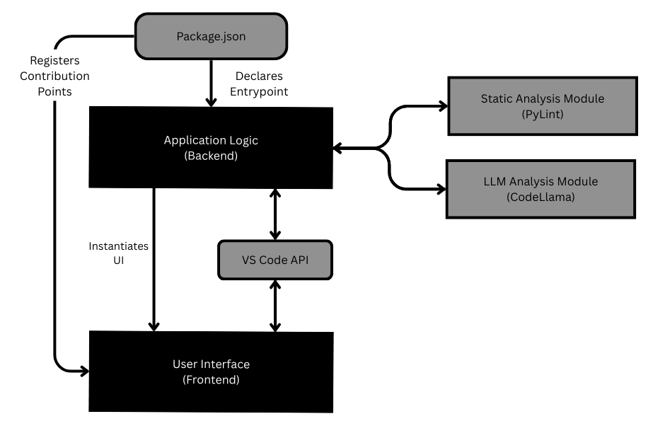
Design – System Architecture
*
Dept of CSE., SOE-Dayananda Sagar University

Slide 14
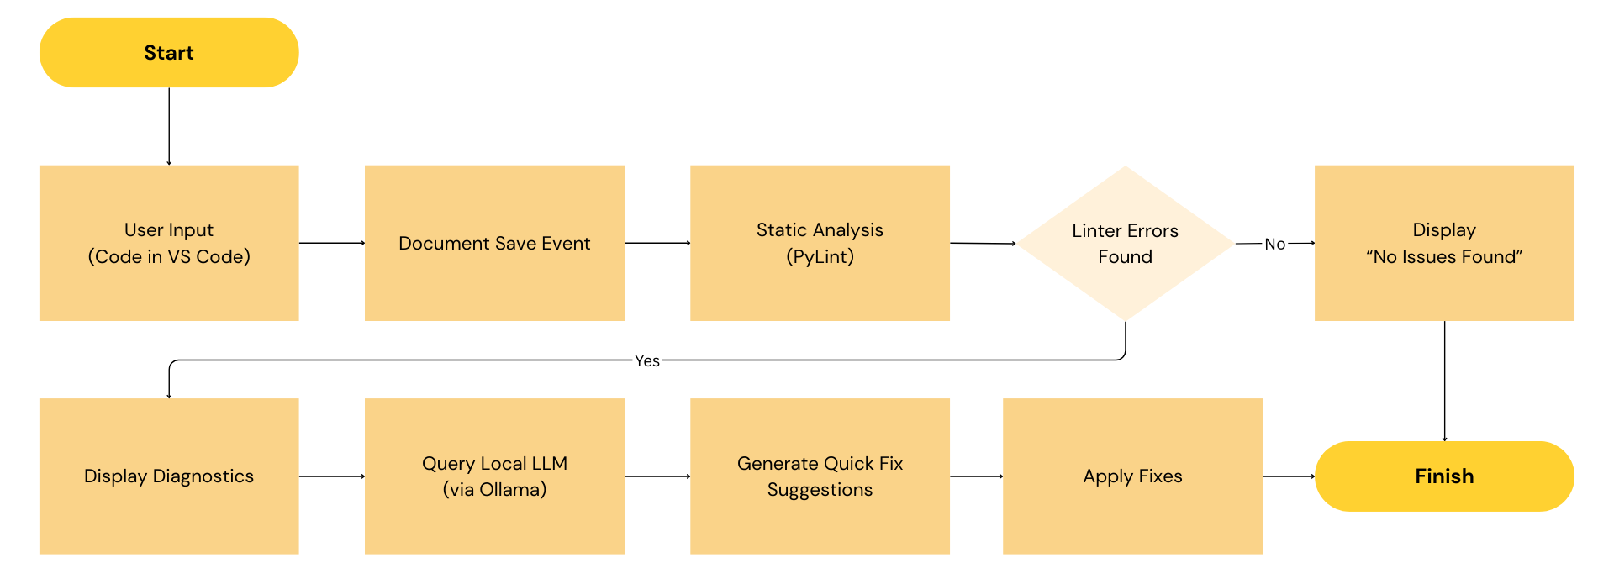
Design – Data Flow
*
Dept of CSE., SOE-Dayananda Sagar University

Slide 15
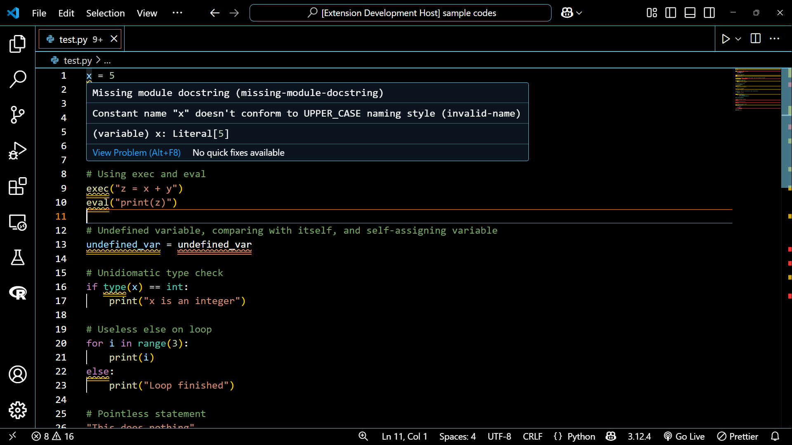
Design – Screen Design
*
Dept of CSE., SOE-Dayananda Sagar University

Slide 16
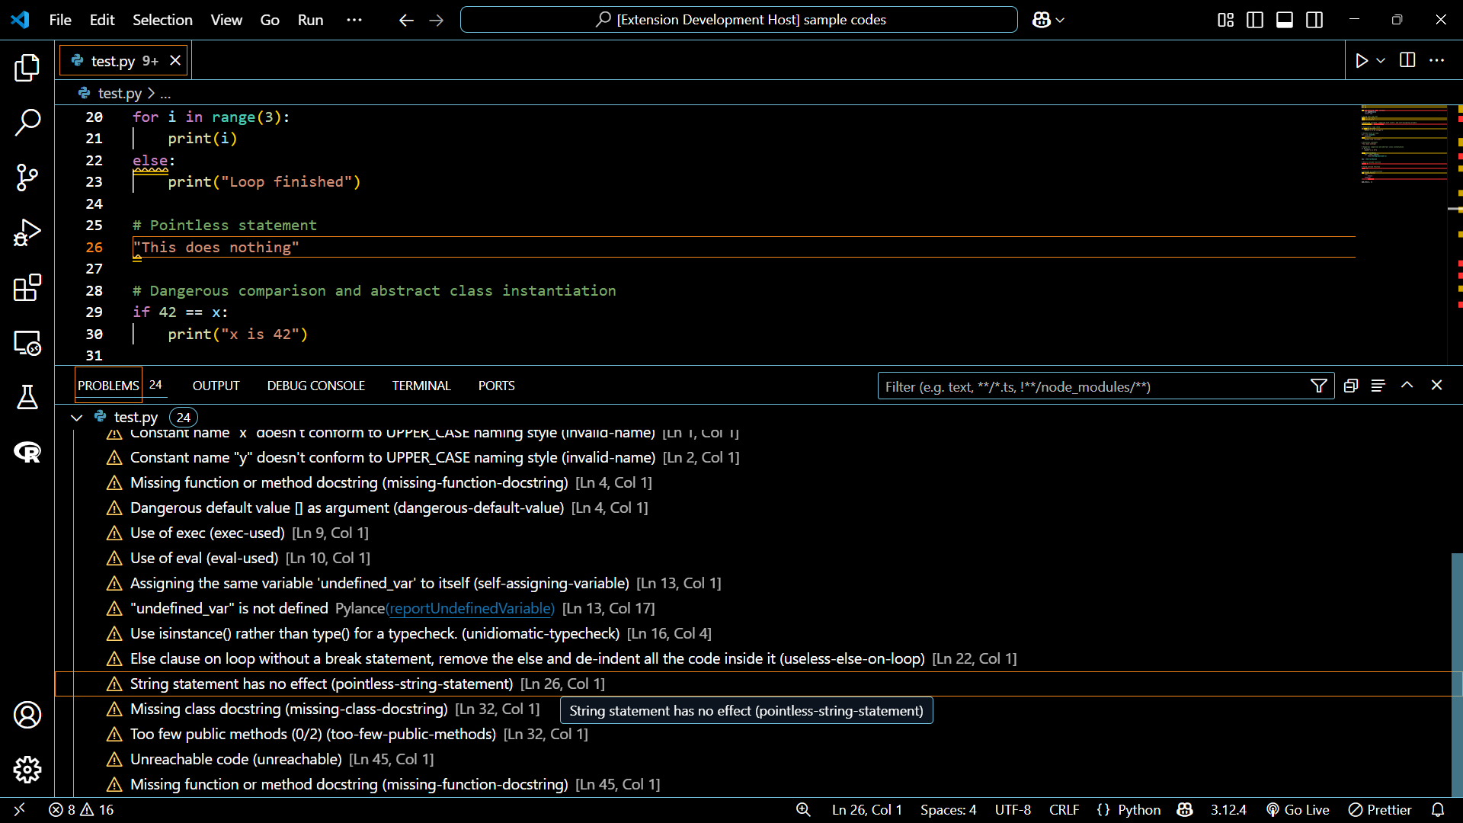
Design – Screen Design
*
Dept of CSE., SOE-Dayananda Sagar University

Slide 17
Methodology
Data Collection:
Gather diverse code samples from open-source repositories and user-generated inputs to evaluate and fine-tune CodeSense's capabilities.
Collect common code patterns, including edge cases, to ensure comprehensive analysis and accurate Quick Fix suggestions.
*
Dept of CSE., SOE-Dayananda Sagar University

Slide 18
Methodology
Analysis Process:
Perform static analysis using PyLint to identify syntactic errors, code smells, and style violations.
Use Ollama to run CodeLlama locally for deeper, context-aware analysis to capture logical inconsistencies and advanced patterns.
Integrate both outputs to provide a unified diagnostic report and actionable Quick Fix suggestions.
*
Dept of CSE., SOE-Dayananda Sagar University

Slide 19
Methodology
Development Approach:
Follow an Agile methodology with iterative development cycles to continuously improve the extension based on user feedback.
Implement the core static analysis and LLM-based modules first, followed by the Quick Fix engine and UI integration.
*
Dept of CSE., SOE-Dayananda Sagar University

Slide 20
Methodology
Evaluation Metrics:
Assess usability through user feedback and interaction logs to refine Quick Fix suggestions and improve user experience.
Evaluate performance in terms of analysis speed and system resource utilization.
*
Dept of CSE., SOE-Dayananda Sagar University

Slide 21
References
[1] M. M. Mohajer et al., “SkipAnalyzer: A Tool for Static Code Analysis with Large Language Models,” arXiv (Cornell University), Jan. 2023, doi: https://doi.org/10.48550/arxiv.2310.18532.
[2] Y. Hao, W. Chen, Z. Zhou, and W. Cui, “E&V: Prompting Large Language Models to Perform Static Analysis by Pseudo-code Execution and Verification,” arXiv.org, Dec. 13, 2023. https://arxiv.org/abs/2312.08477 (accessed Jul. 08, 2024).
[3] H. Li, Y. Hao, Y. Zhai, and Z. Qian, “Enhancing Static Analysis for Practical Bug Detection: An LLM-Integrated Approach,” Proceedings of the ACM on Programming Languages, vol. 8, no. OOPSLA1, pp. 474–499, Apr. 2024, doi: https://doi.org/10.1145/3649828.
[4] A. Svyatkovskiy, Y. Zhao, S. Fu, and N. Sundaresan, “Pythia: AI-assisted Code Completion System,” Proceedings of the 25th ACM SIGKDD International Conference on Knowledge Discovery & Data Mining, Jul. 2019, doi: https://doi.org/10.1145/3292500.3330699.
[5] S. Panichella, V. Arnaoudova, M. Di Penta and G. Antoniol, "Would static analysis tools help developers with code reviews?," 2015 IEEE 22nd International Conference on Software Analysis, Evolution, and Reengineering (SANER), Montreal, QC, Canada, 2015, pp. 161-170, doi: 10.1109/SANER.2015.7081826.
*
Dept of CSE., SOE-Dayananda Sagar University

Slide 22
THANK YOU
*
Dept of CSE., SOE-Dayananda Sagar University

