Slide 1


DAYANANDA SAGAR UNIVERSITY
SCHOOL OF ENGINEERING
Department of Computer Science and Engineering
Minor project Review 1
CodeSense – Tracks and measures the “health” of code
Under the Supervision
Prof. Sowmya H.D
Assistant Professor
1
Presented By:
S Rayyan Ahmed(ENG22CS0424)
Suraj S(ENG22CS0425)
Sahil K(ENG22CS0429)
Shreyas Bharadwaj(ENG22CS0459)
Notes:
Title of the project
CSE Dept., SET-Jain University
1

Slide 2
Overview
Abstract
Problem Statement
Introduction
Social/Environmental Impact
Literature Review
Design
Methodology
Results
Conclusion
References
*
Dept of CSE., SOE-Dayananda Sagar University

Slide 3
Abstract
Code quality is a decisive element of software maintainability and developer productivity. Conventional static analysis tools such as PyLint can detect syntax errors, code smells, and violations of coding conventions but tend to be lacking in contextual knowledge while proposing resolutions. To overcome this limitation, we have designed CodeSense, a hybrid code analysis tool that integrates static analysis with the reasoning abilities of a Large Language Model’s (LLM). CodeSense is a Visual Studio Code extension that leverages PyLint for real-time linting and enhances the diagnostic output through passing the code and linter output to an LLM model. The model presents developers with a more cognitive and intuitive coding experience by generating contextual suggestions, quick fixes, and code improvement recommendations. We evaluate the tool’s performance on a number of Python projects, demonstrating improved coding efficiency, reduced manual debugging effort, and improved code quality. The system architecture, integration pipeline, and a qualitative performance analysis are discussed in this paper. Our results indicate how deterministic and generative methods can be used together to create development environments that are smarter and more responsive.
*
Dept of CSE., SOE-Dayananda Sagar University

Slide 4
Problem Statement
Problem: Many legacy codebases were developed without adhering to modern readability and maintainability standards, making them difficult to understand, update, and scale.
Solution: The CodeSense VS Code extension uses Linters and LLMs to analyze and refactor such codebases, improving code quality while preserving functionality and performance.
*
Dept of CSE., SOE-Dayananda Sagar University

Slide 5
Introduction
Modern codebases require more than basic syntax checks to ensure readability, maintainability, and efficiency. This project aims to develop a VS Code extension that enhances static analysis by combining PyLint with LLM-based insights.
Currently, the extension performs static analysis using PyLint, identifying and displaying warnings and errors to the user within the VS Code environment.
The next phase involves integrating LLM-based analysis to provide intelligent Quick Fix suggestions, helping developers address complex code issues beyond standard linting. This includes detecting inefficiencies, redundant logic, and potential technical debt while maintaining code functionality and performance.
*
Dept of CSE., SOE-Dayananda Sagar University

Slide 6
Introduction
The extension will focus on analyzing Python code and will support both legacy and modern codebases. It will offer real-time feedback and automated Quick Fix actions, streamlining the code review process and improving productivity.
The tool is designed to function within the VS Code environment using its diagnostic APIs and requires compatible hardware to run the local LLM through Ollama.
*
Dept of CSE., SOE-Dayananda Sagar University

Slide 7
Social/Environmental Impact
Social Impact:
By automating code analysis and providing intelligent fixes, the extension reduces the time developers spend on debugging and code reviews. This allows more time for innovation and higher productivity.
Clear, maintainable code is easier for teams to understand and work on together, improving collaboration across different projects and reducing knowledge silos.
The extension helps modernize older codebases, making it easier for new developers to work on and extend existing software without being limited by outdated practices.
By offering real-time feedback and suggestions, the tool helps junior developers learn and adopt best coding practices more efficiently.
*
Dept of CSE., SOE-Dayananda Sagar University

Slide 8
Social/Environmental Impact
Environmental Impact:
Optimizing inefficient code reduces unnecessary resource consumption, leading to lower CPU and memory usage, which translates to energy savings during execution.
Maintaining clean and scalable code reduces the frequency of rewriting or replacing software systems, minimizing the e-waste generated from outdated hardware and systems.
By improving code efficiency, software requires less processing power, reducing the energy consumed by data centers and lowering the overall carbon footprint.
*
Dept of CSE., SOE-Dayananda Sagar University

Slide 9
State of the Art-work
Author’s Name/ Paper Title | Conference/Journal Name and year | Technology/ Design | Results shared by author | What you infer
“SkipAnalyzer: A Tool for Static Code Analysis with Large Language Models”[1] | arXiv (Cornell University), Jan. 2023. | Hybrid static analyzer using LLMs to suppress false positives and suggest patches | Detected bugs in real-world code with 76.95% accuracy, 93.88% precision for false-positive filtering, and 97.3% correctness in patches | Demonstrates the effectiveness of combining static analysis with LLMs for noise reduction and intelligent patch generation—highly relevant to CodeSense's goal
“E&V: Prompting Large Language Models to Perform Static Analysis by Pseudo-code Execution and Verification”[2] | arXiv.org, Dec. 13, 2023. | Enhancing LLM reasoning via structured pseudocode prompts for bug explanation and verification | Accuracy improved from 28.2% to 81.18% on 170 real Linux bugs; fewer hallucinations observed | Structured prompting significantly improves LLM reliability—can be adapted in CodeSense to generate accurate, context-aware suggestions
*
Dept of CSE., SOE-Dayananda Sagar University

Slide 10
State of the Art-work
Author’s Name/ Paper Title | Conference/Journal Name and year | Technology/ Design | Results shared by author | What you infer
“Pythia: AI-assisted Code Completion System” [4] | Proceedings of the 25th ACM SIGKDD International Conference on Knowledge Discovery & Data Mining, Jul. 2019 | LSTM-based code completion using AST input in VS Code | Achieved 92% top-5 accuracy; 20% gain over baselines; trained on 15.8M method calls | AST + deep learning can generate intelligent and context-aware code completions in real IDEs.
"Would static analysis tools help developers with code reviews?“[5] | 2015 IEEE 22nd International Conference on Software Analysis, Evolution, and Reengineering (SANER), Montreal, QC, Canada, 2015 | Analyzing warning handling during code review processes | 6%-22% warnings removed; some categories over 50% removal | Static tools influence review decisions and focusing on certain warning types may increase efficiency.
*
Dept of CSE., SOE-Dayananda Sagar University

Slide 11
State of the Art-work
Author’s Name/ Paper Title | Conference/Journal Name and year | Technology/ Design | Results shared by author | What you infer
“Enhancing Static Analysis for Practical Bug Detection: An LLM-Integrated Approach”[3] | Proceedings of the ACM on Programming Languages, vol. 8, no. OOPSLA1, pp. 474–499, Apr. 2024. | Combines traditional static analysis with LLMs to detect Uninitialized Bug Instances (UBIs) | Detected all known bugs with 100% recall; found 13 new bugs with 50% precision | Reinforces the value of a hybrid model (static + LLM) in surfacing subtle bugs missed by traditional tools
*
Dept of CSE., SOE-Dayananda Sagar University

Slide 12
Design
The design of CodeSense follows a hybrid architecture that integrates static analysis with advanced LLM-based insights.
It consists of modular components, including the user interface, static analysis engine (PyLint), LLM analysis engine (CodeLlama via Ollama), and a Quick Fix engine.
This section outlines the system architecture, data flow, and screen design, ensuring accurate diagnostics and actionable code improvements.
*
Dept of CSE., SOE-Dayananda Sagar University

Slide 13
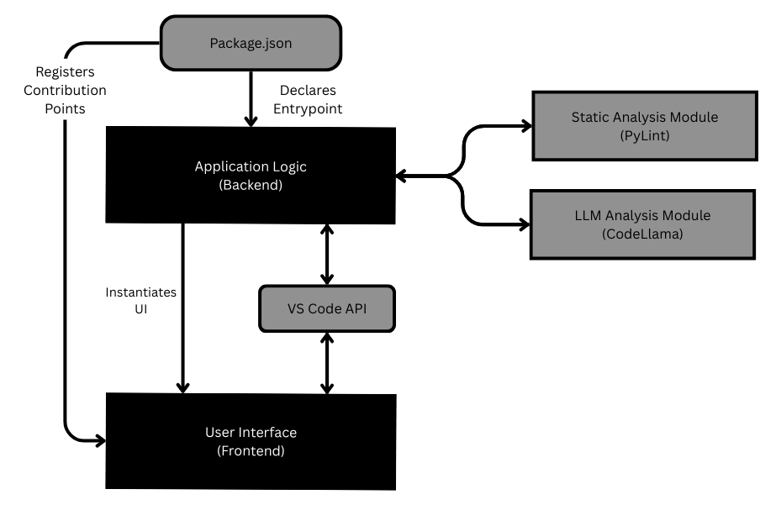
Design – System Architecture
*
Dept of CSE., SOE-Dayananda Sagar University

Slide 14
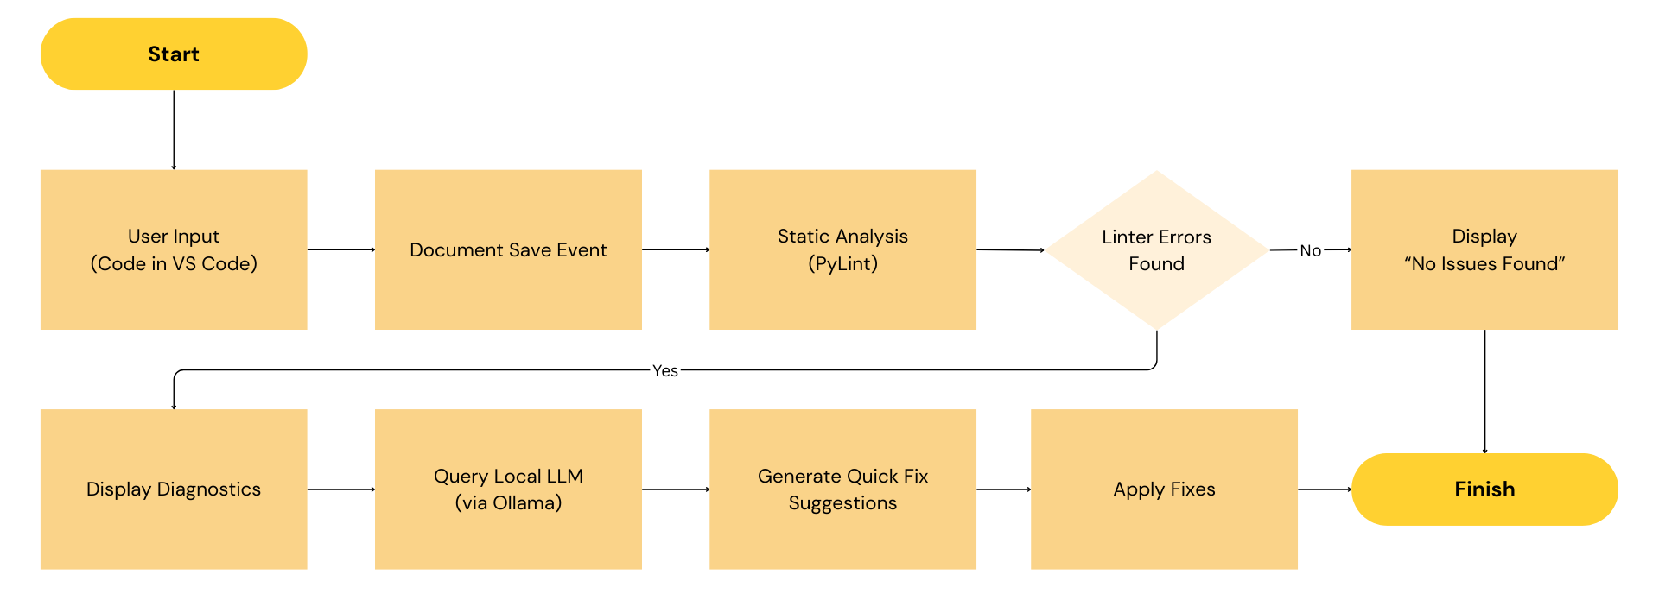
Design – Data Flow
*
Dept of CSE., SOE-Dayananda Sagar University

Slide 15
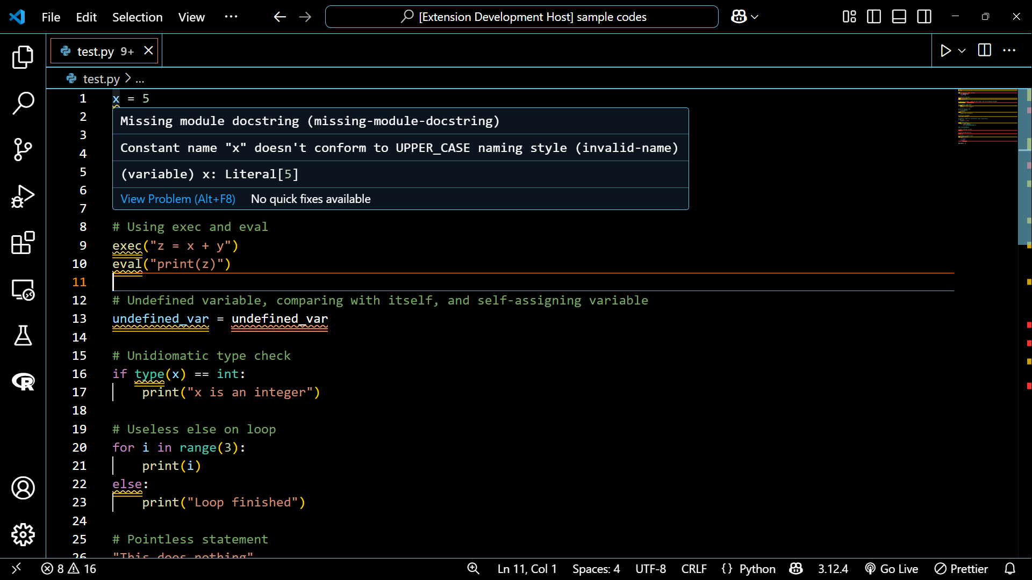
Design – Screen Design
*
Dept of CSE., SOE-Dayananda Sagar University

Slide 16
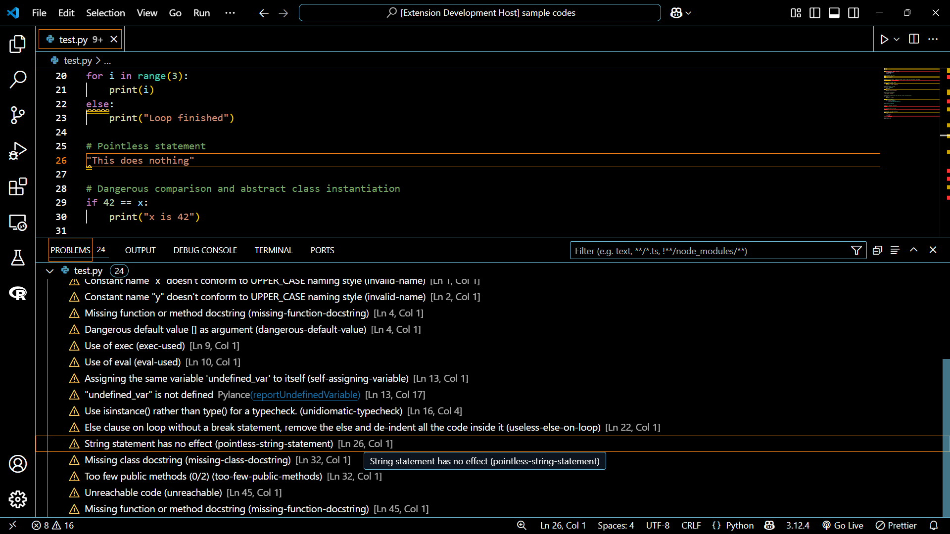
Design – Screen Design
*
Dept of CSE., SOE-Dayananda Sagar University

Slide 17
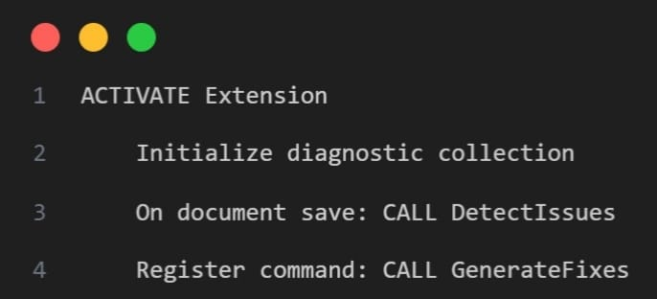
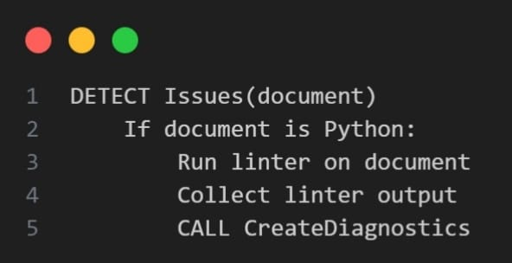
Pseudocode

Slide 18
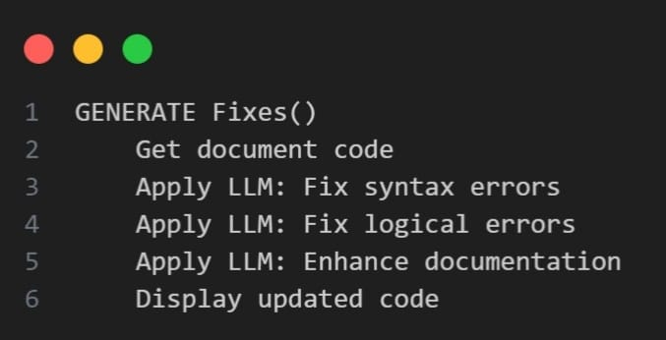
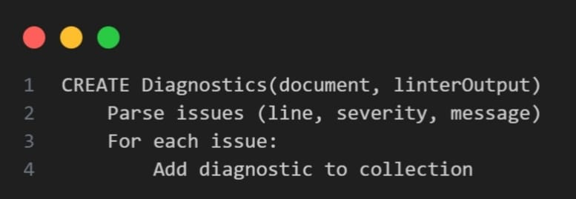
Pseudocode

Slide 19
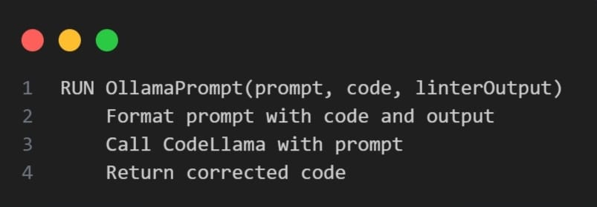
Pseudocode

Slide 20
Results
Detection Accuracy
Precision – 75%: Three out of every four issues reported by CodeSense were actual bugs, reducing false positives.
Recall – 100%: All true bugs in the dataset were successfully detected, ensuring complete coverage.
F1 Score – 0.86: Represents a strong balance between precision and recall, confirming reliability in bug identification.
Dataset Used: Evaluation was conducted on 40 Python programs from the QuixBugs benchmark, each containing a single-line bug.

Slide 21
Results
Fix Suggestion Accuracy
Total Fix Attempts – 40: CodeSense attempted to generate a fix for every detected bug.
Correct Fixes – 30: Out of these, 30 fixes fully resolved the issue without introducing new bugs.
Fix Accuracy – 75%: The LLM-powered suggestions were effective and contextually appropriate for most cases, especially for simpler bugs.

Slide 22
Results
Productivity & Efficiency Gains
Keystroke Savings – 300+: Estimated average of 10 keystrokes saved per fix, reducing the need for manual editing.
Time & Cognitive Load Reduced: Developers save time not only in typing but also in understanding and resolving bugs.
Integrated Workflow: Seamless suggestions within VS Code support real-time improvement, enhancing developer experience without interrupting the workflow.

Slide 23
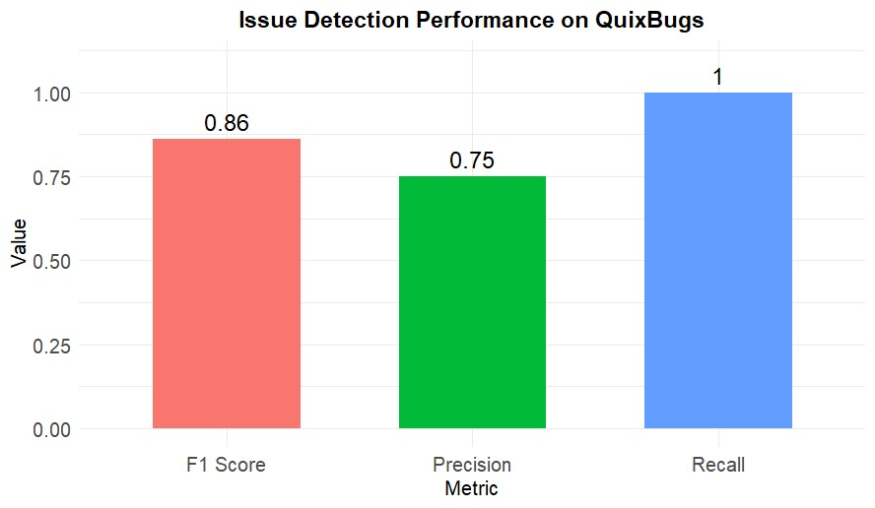
Results

Slide 24
Conclusion
What is CodeSense?
A Visual Studio Code extension combining static analysis with LLM (CodeLlama via Ollama) to provide intelligent, real-time code improvement suggestions.
Key Capabilities:
Rapid bug detection via static analysis linter.
Context-aware fix recommendations using a locally hosted LLM.
Seamless IDE integration with uninterrupted workflow.

Slide 25
Conclusion
Limitations & Future Work
Fixes may be semantically incorrect for complex/multi-line bugs.
Primarily tested on Python and single-file modules.
Fine-tuning LLM with real-world bug-fix data.
Multi-language support (e.g., JavaScript, TypeScript).
Auto test case generation to validate functional correctness.
Developer feedback loop for improved prompt quality & fix ranking.
Extracting CodeSense as an IDE-independent language server.

Slide 26
References
[1] M. M. Mohajer et al., “SkipAnalyzer: A Tool for Static Code Analysis with Large Language Models,” arXiv (Cornell University), Jan. 2023, doi: https://doi.org/10.48550/arxiv.2310.18532.
[2] Y. Hao, W. Chen, Z. Zhou, and W. Cui, “E&V: Prompting Large Language Models to Perform Static Analysis by Pseudo-code Execution and Verification,” arXiv.org, Dec. 13, 2023. https://arxiv.org/abs/2312.08477 (accessed Jul. 08, 2024).
[3] H. Li, Y. Hao, Y. Zhai, and Z. Qian, “Enhancing Static Analysis for Practical Bug Detection: An LLM-Integrated Approach,” Proceedings of the ACM on Programming Languages, vol. 8, no. OOPSLA1, pp. 474–499, Apr. 2024, doi: https://doi.org/10.1145/3649828.
[4] A. Svyatkovskiy, Y. Zhao, S. Fu, and N. Sundaresan, “Pythia: AI-assisted Code Completion System,” Proceedings of the 25th ACM SIGKDD International Conference on Knowledge Discovery & Data Mining, Jul. 2019, doi: https://doi.org/10.1145/3292500.3330699.
[5] S. Panichella, V. Arnaoudova, M. Di Penta and G. Antoniol, "Would static analysis tools help developers with code reviews?," 2015 IEEE 22nd International Conference on Software Analysis, Evolution, and Reengineering (SANER), Montreal, QC, Canada, 2015, pp. 161-170, doi: 10.1109/SANER.2015.7081826.
*
Dept of CSE., SOE-Dayananda Sagar University

Slide 27
References
[6] Pylint, “Pylint 3.3.4 documentation,” https://pylint.readthedocs.io/en/stable/ (accessed Mar. 22, 2025).
[7] Meta AI, “Introducing Code Llama, a state-of-the-art large language model for coding,” https://ai.meta.com/blog/code-llama-large-language-model-coding/ (accessed Mar. 23, 2025).
[8] Ollama, “Ollama,” https://ollama.com/ (accessed Mar. 23, 2025).
[9] GitHub, “GitHub Copilot,” https://github.com/copilot (accessed Mar. 25, 2025).
[10] P. Kruchten, R. L. Nord, and I. Ozkaya, “Technical Debt: From Metaphor to Theory and Practice,” IEEE Software, vol. 29, no. 6, pp. 18–21, Nov. 2012, doi: https://doi.org/10.1109/MS.2012.167.
*
Dept of CSE., SOE-Dayananda Sagar University

Slide 28
References
[11] Microsoft, “Visual Studio Code,” https://code.visualstudio.com/ (accessed Mar. 22, 2025).
[12] Microsoft, “Visual Studio Code API,” https://code.visualstudio.com/api/references/vscode-api (accessed Mar. 25, 2025).
[13] Hugging Face, “StarCoder: A State-of-the-Art LLM for Code,” https://huggingface.co/blog/starcoder (accessed Apr. 10, 2025).
[14] OpenAI, “GPT-4,” https://openai.com/index/gpt-4/ (accessed Apr. 10, 2025).
[15] J. Koppel, “QuixBugs: A multi-lingual program repair benchmark set based on the Quixey Challenge,” GitHub, https://github.com/jkoppel/QuixBugs (accessed May 06, 2025).
*
Dept of CSE., SOE-Dayananda Sagar University

Slide 29
THANK YOU
*
Dept of CSE., SOE-Dayananda Sagar University

