Slide 1

One-Class SVMs
for Document Classification
Raz Malka 206437204
Raz Afriat 208220418
Shoham Yamin 319151213

Slide 2
Main points
Classify documents to categories
Only positive data as training set
Comparing between different algorithms

Slide 3
What?
Modification of the regular SVM algorithm.
Many variations are available for the algorithm.
For example “outliers" algorithm.
One Class
SVM

Slide 4

In general
Train the one class with training set.
if test isn’t “close enough” to the training set then it is classified as a negative class
In summary – a test sample may be either alike training data or not

Slide 5
Only positive data
Why?
In many times we do not have both positive and negative data.
For example. If we want to pick preferred sites for user, we can base on browsing history, but we don’t know which sites he wouldn’t want.

Slide 6

Data set preparation
List all the words removing suffixes, prefixes and “stop” words in all the training documents sorted by the frequency

Slide 7
Text Representation Types
Binary Representation - Checks if frequent words appears in book. For every frequent word (keyword) if yes mark “TRUE” for that specific word. Else mark “FALSE”
Frequency Representation - Checks the appearance of keywords in the book but gives weight to the number of time every keyword has appeared.
Tf-idf Representation - Multiplying frequency with the relation between total number of words in dictionary and number of documents where the keyword appears in them by certain formula.
Hadamard Representation – For every keyword calculating the product of the keyword’s frequency in the document and the keyword’s frequency over all documents

Slide 8

Kernel Type
Linear Kernel is a kernel that is in the form of a linear function. It is the simplest kernel function.
Radial Kernel (RBF) is a kernel that is in the form of a radial basis function - whose value depends only on the distance between the input and some fixed point, either the origin, or some other fixed point called a center

Slide 9

Schölkopf algorithm
In 1999, researcher Bernhard Schölkopf published an extension to the SVM methodology to handle training using only positive information and without any labels - thus making it practically unsupervised – the One-Class SVM.
Scored better then many other types of one class classification methods.

Slide 10
One class SVM for Book's author Classification
We implemented number of representations of the books.
Trained our algorithm with our training set
Activated the One Class SVM
Analyzed and graphed our estimations.

Slide 11
Flow
Load
Load the Books and split each book to chunks of 1000 lines each
Clean
Clean stopwords, prefixes, suffixes and special symbols from each chunk using NLTK
Generate
Generate Corresponding Datasets – Train and Test Sets
Modify
Modify the data according to required representation
Embed
Embed high-dimensional data for visualization in a low-dimensional space of two dimensions by fitting the training set and transforming upon testing set using t-SNE
Model
Model the data using One-Class SVM algorithm using SciKit
Visualize
Visualize the results

Slide 12
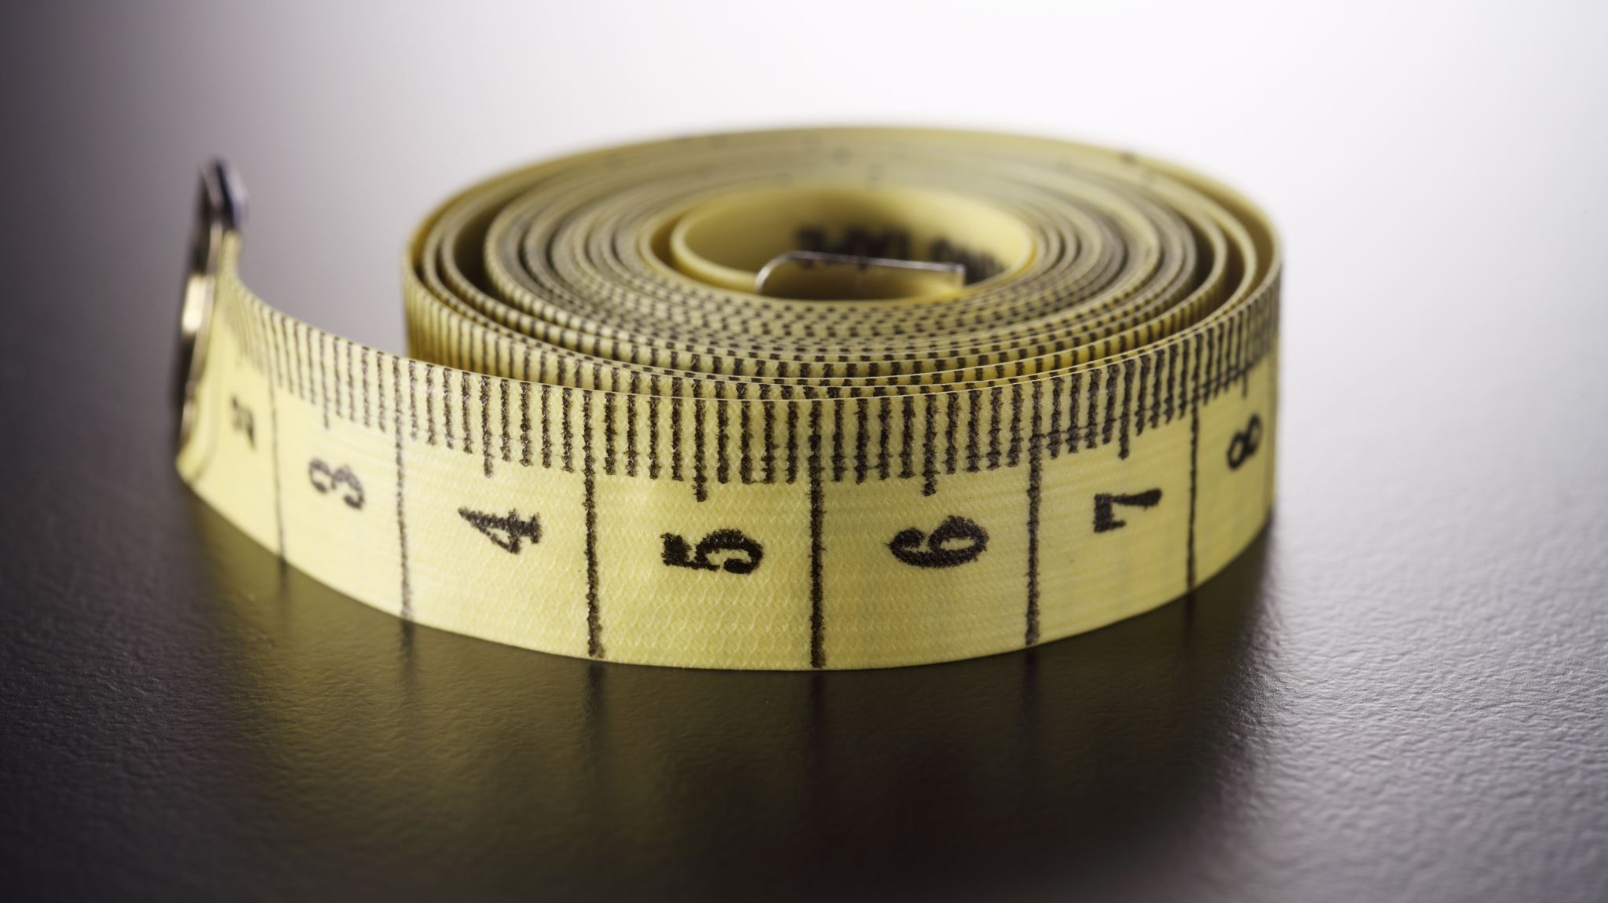

Measurements
$$Recall=\frac{\text{Number} \text{of} \text{items} \text{of} \text{category} \text{identified}}{\text{Number} \text{of} \text{category} \text{members} \text{in} \text{test} \text{set} }$$
$$Precision= \frac{\text{Number} \text{of} \text{items} \text{of} \text{category} \text{identified}}{\text{Total} \text{items} \text{assigned} \text{to} \text{category}}$$
$$F1\left(R,P\right)=\frac{2RP}{R+P}$$

Slide 13
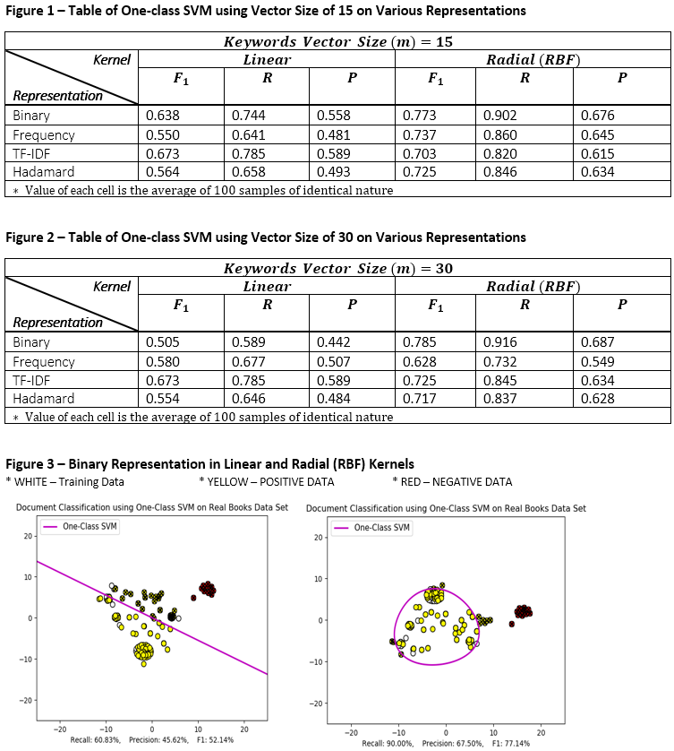
Results

Slide 14
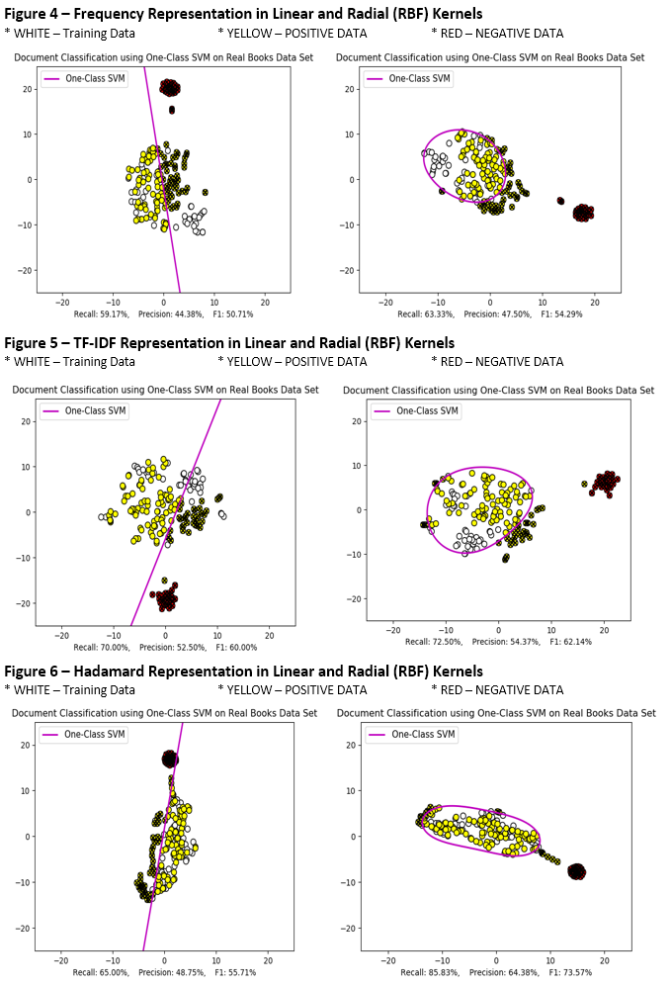

Slide 15
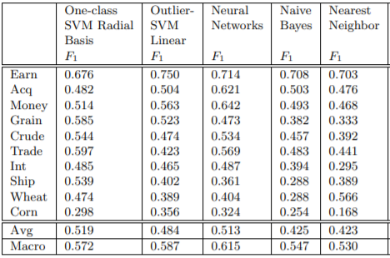
Comparison to other algorithms according to Research Paper

Slide 16

Thanks

