Slide 1

ECG Diagnosis by Convolutional Neural Network
NAYA Final Project
Raz Maoz
Tal-Shachar Ben-Gal Turgeman
Mentor: Raz Shmueli

Slide 2

Background
Electrocardiography (ECG) is a medical diagnostic tool, that records the electrical activity of the heart to assess the cardiac condition of a patient
ECG recording analysis is well standardized and reproducible but varies greatly according to levels of experience and expertise
Automatic ECG diagnosis can help the medical stuff and provide easy and faster diagnosis
Notes:
מחלות לב הן גורם מוות מרכזי בעולם המודרני, אק"ג הוא כלי לקריאת האותות החשמליים של הלב שמאפשר להעריך את מצבו. האנליזה של הסיגנלים היא די סטנדרטית והדירה, אבל תלויה במומחיות והניסיון של הרופא.
זיהויאוטומטי של אק"ג יכול לאפשר אבחון מהיר וקל יותר ובכך לאבחן חולים מהר יותר.

Slide 3



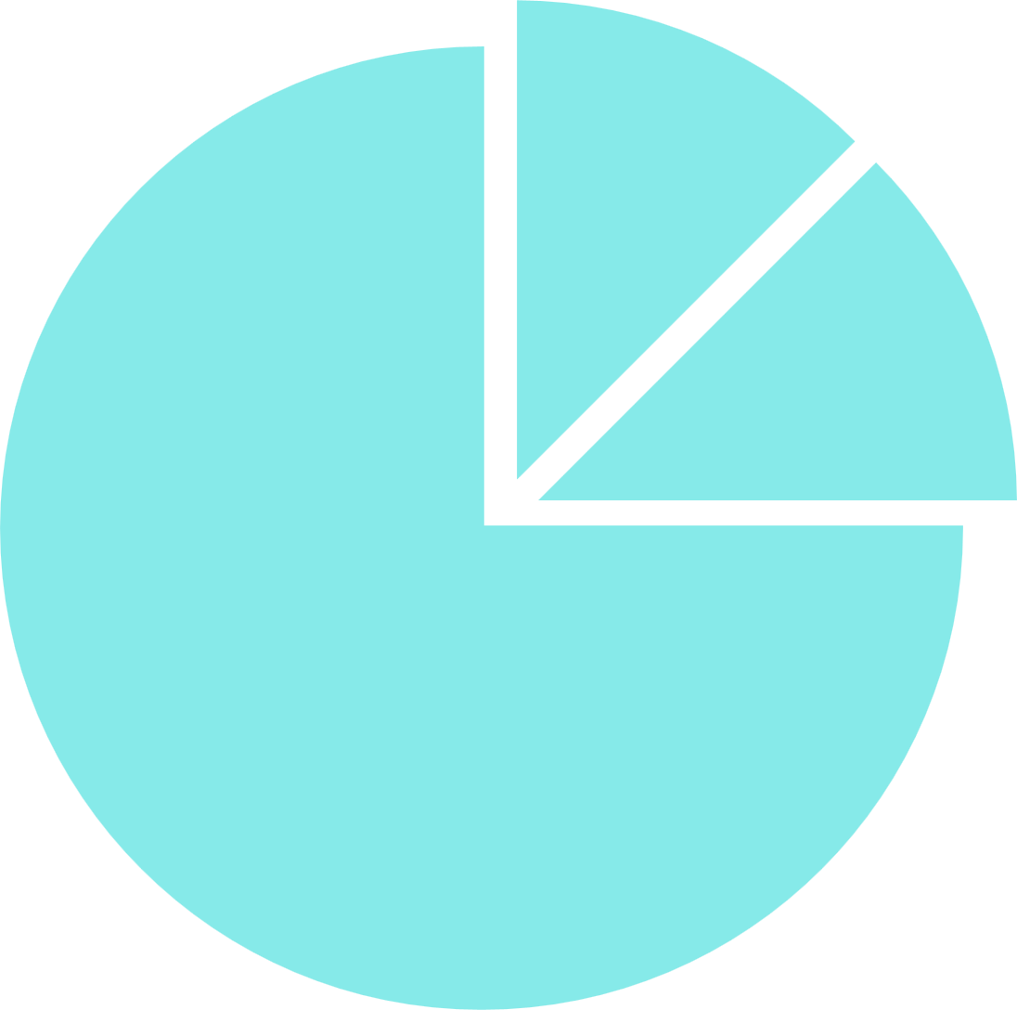









Workflow
Model
Improvements
Find ECG
NN Model
  Multi-label encoding
  Change sample rate
  etc.
EDA
POC
Investigation
  Data overview
  Data preprocessing
  Naïve models
  Initial NN training
  Imbalance hypothesis
  Model tuning

Slide 4
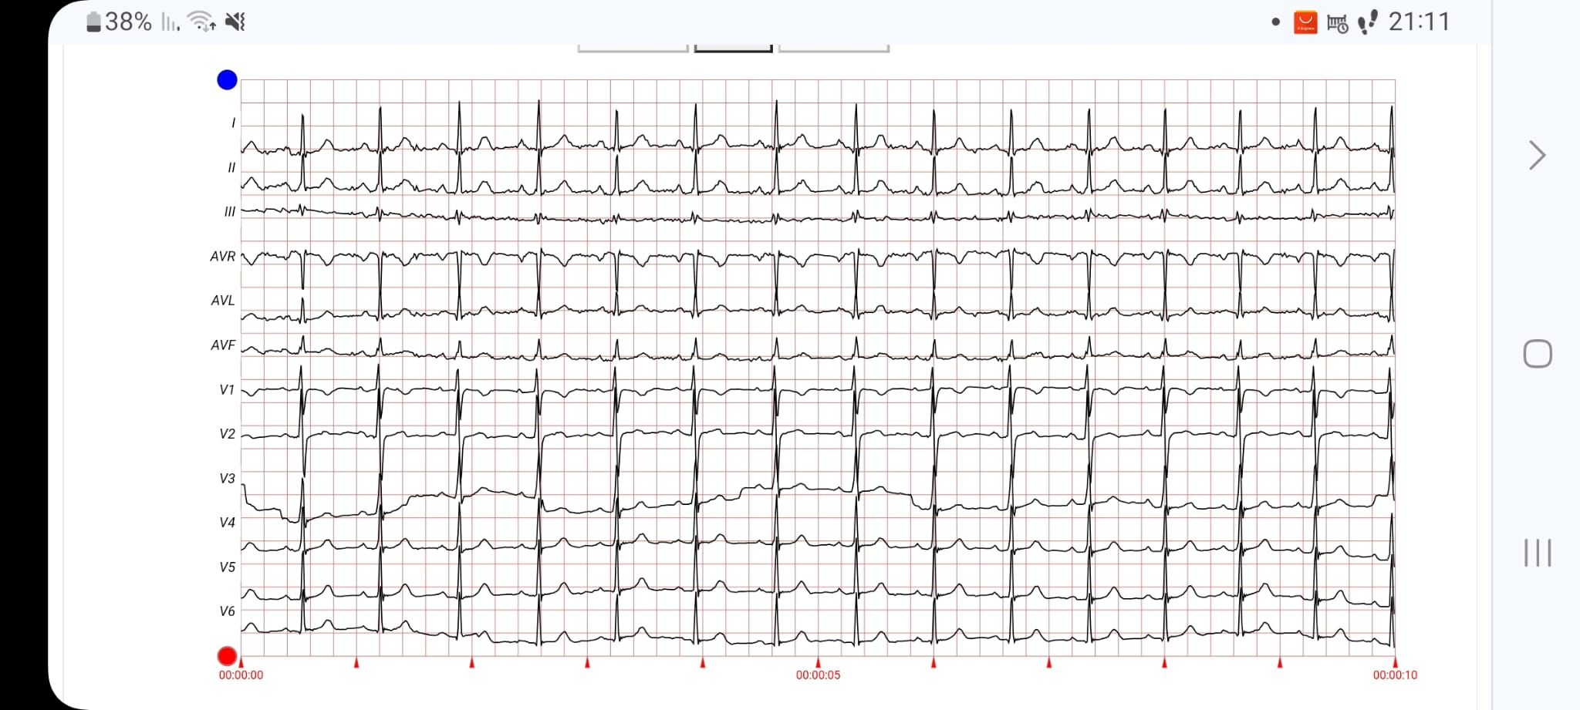
Data Overview
The data: PTB-XL ECG dataset
Composed of 21,800 records from 12 leads 10 seconds each
2 record formats: 100Hz and 500Hz
N=21,800
Data was taken from:
https://physionet.org/content/ptb-xl/1.0.3/#files-panel
Notes:
https://physionet.org/content/ptb-xl/1.0.3/#files-panel

Slide 5
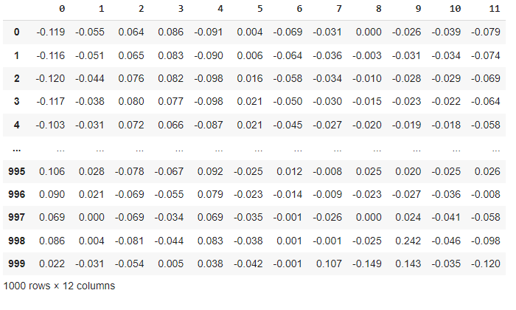
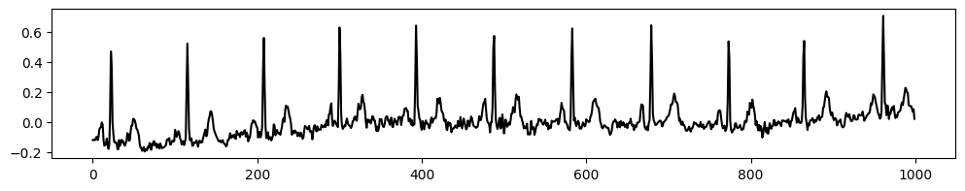
Data Overview
100Hz.shape = (21,800, 1000, 12), 500Hz.shape = (21,800, 5000, 12)
N=21,800
Data was taken from:
https://physionet.org/content/ptb-xl/1.0.3/#files-panel
Notes:
https://physionet.org/content/ptb-xl/1.0.3/#files-panel

Slide 6
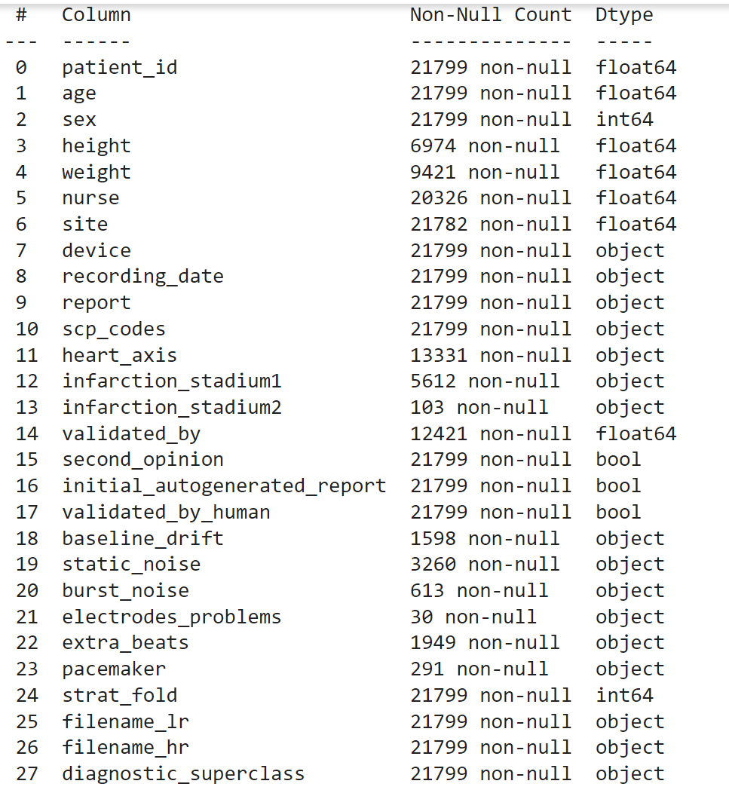
Data Overview
Table with parameters about the ECG measurements and patient details
In our project we decided to focus on ‘Diagnostic Superclass’ column, that presents the classification of the ECG record
Notes:
החלוקה לקטגוריות נעשתה על סמך עמודת report ו scp_code (שמישהו ישב ועבר על זה)- העמודה נוצרה ע"י קוד מובנה שסופק יחד עם הדאטה.

Slide 7
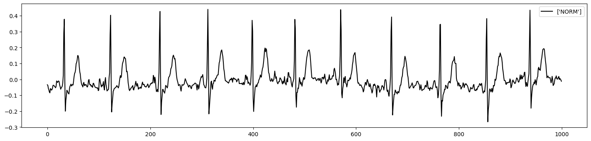
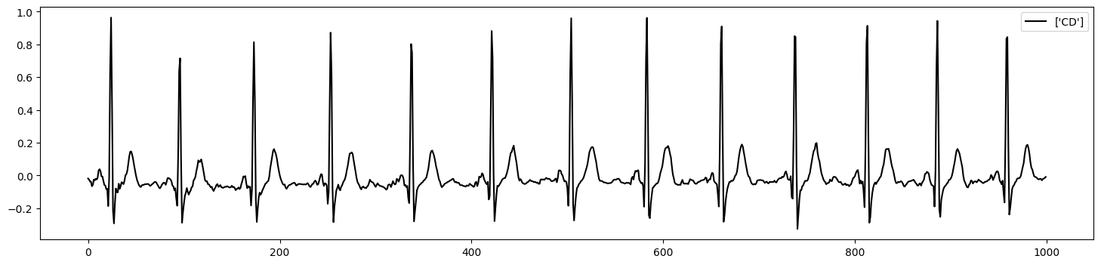
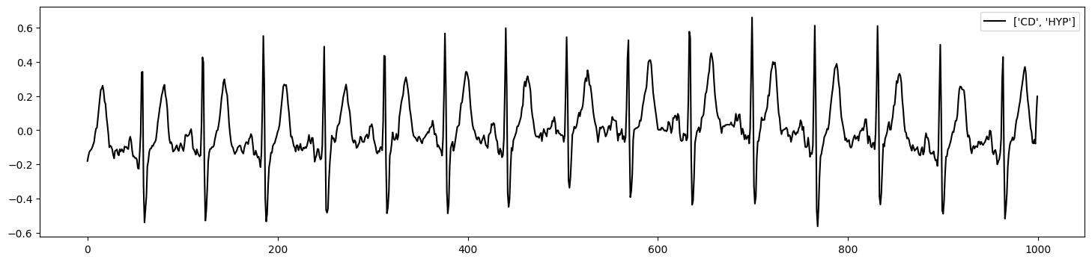
Data Overview
NORM
CD
CD, HYP
Notes:
https://physionet.org/content/ptb-xl/1.0.3/#files-panel
CD- הפרעת הולכה HYP- גדילת יתר של השריר

Slide 8
Data Overview
About 11% of patients have more than one ECG record
To prevent data leakage, it is important that same patient will not appear both in train group and test group
Therefore, data came with suggested split into train & test groups
Notes:
החלוקה לקטגוריות נעשתה על סמך עמודת report ו scp_code (שמישהו ישב ועבר על זה)- העמודה נוצרה ע"י קוד מובנה שסופק יחד עם הדאטה.

Slide 9
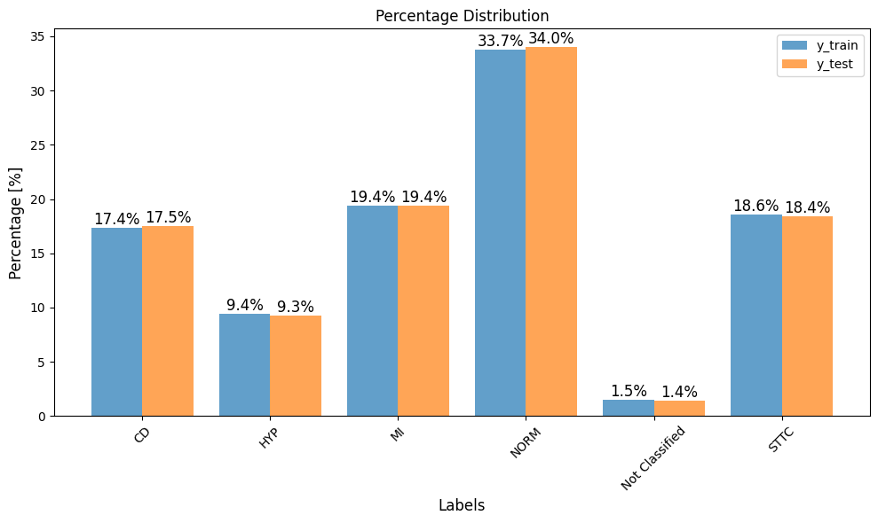
Data Overview
There are 6 labels in the data:
Each sample can be classified into several labels, hence
Multi-Label Classification
Description | Superclass
Normal ECG | NORM
Myocardial Infraction | MI
ST/T Change | STTC
Conduction Disturbance | CD
Hypertrophy | HYP
Not Classified | Not Classified

Slide 10
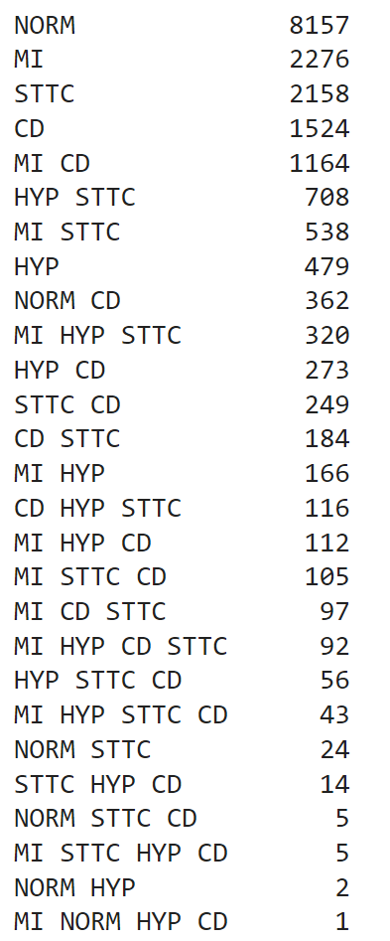
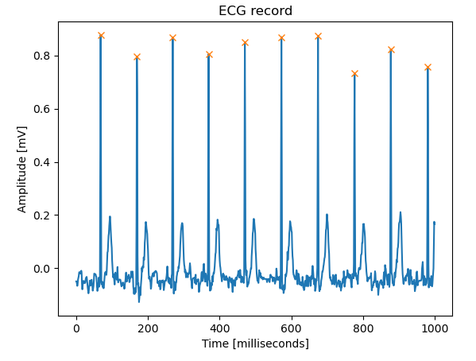
POC
First Model
Multi-Class CNN (27 Classes)
Accuracy: 0.89
Test group could not be predicted due to absence of certain combinations
Naive Model
Random Forest Classifier (27 Classes)
Acquire 3 simplest features from ECG record:
  N peaks
  Max-min amplitude difference
Accuracy: 0.28
Notes:
from scipy.signal import find_peaks
peaks, res = find_peaks(signal,height=0.2, distance=40)

Slide 11
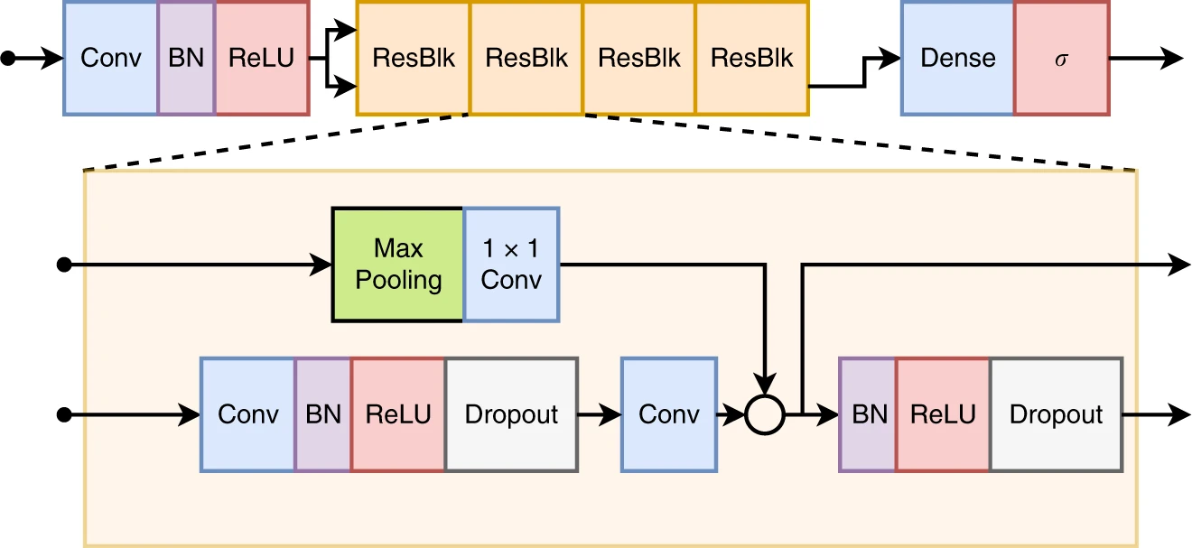
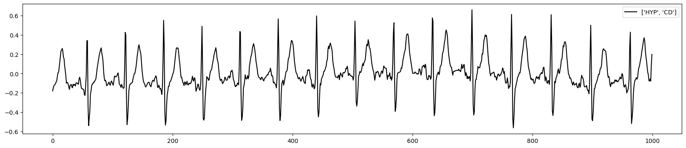
Neural Network Architecture Overview
Label | Input
NORM | 0
MI | 0
STTC | 0
CD | 1
HYP | 1
Not-C | 0
Output | Proba
0.01 | P(NORM)
0.00 | P(MI)
0.02 | P(STTC)
0.90 | P(CD)
0.60 | P(HYP)
0.00 | P(Not-C)
Model was taken from:
https://www.nature.com/articles/s41467-020-15432-4#code-availability
Notes:
מודל שלקחנו ממאמר בnature.
הרשת מורכבת משכבת קונבולציה, שכבת BN וReLU ביציאה שנכנסות לשרשרת של Residual layer.
לבסוף מתקבלת הסתברות עבור כל סיווג.

Slide 12
Neural Network Architecture Overview
Model was taken from:
https://www.nature.com/articles/s41467-020-15432-4#code-availability
Notes:
מודל שלקחנו ממאמר בnature.
הרשת מורכבת משכבת קונבולציה, שכבת BN וReLU ביציאה שנכנסות לשרשרת של Residual layer.
לבסוף מתקבלת הסתברות עבור כל סיווג.

Slide 13

Residual Blocks – What & How
Refine the input rather than learning from scratch
Prevent the gradient from becoming too small during backpropagation (gradient loss) by creating shortcuts for the flow of information
Preserve learned features and reduce the risk of information loss by reusing activations from previous layers
The block's output is the sum of
the unaltered input and the
learned modifications – aka residual
Recommended reading:
https://towardsdatascience.com/residual-blocks-in-deep-learning-11d95ca12b00

Slide 14

Residual Blocks – Why?
Maintaining the integrity of the original data throughout the network
Making training more efficient and effective
Leading to more robust learning

Slide 15
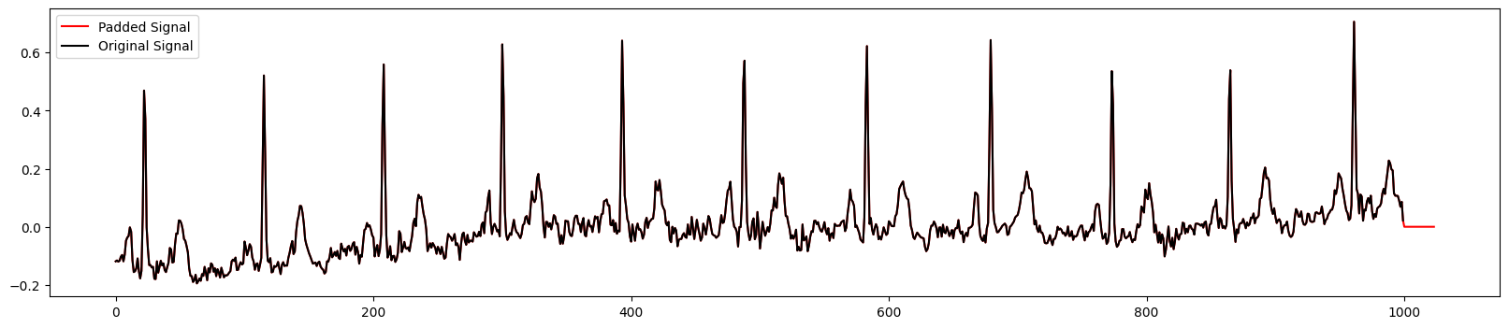
Data Pre-Processing
Input
Output
100Hz Samples Flow:
1024×12
64×256
5120
1024×64
256×196
16×320
6
100Hz data shape is (n_records, 1000, 12)
To maintain 2^{n} sizes input was set to 1024, and data was padded

Slide 16
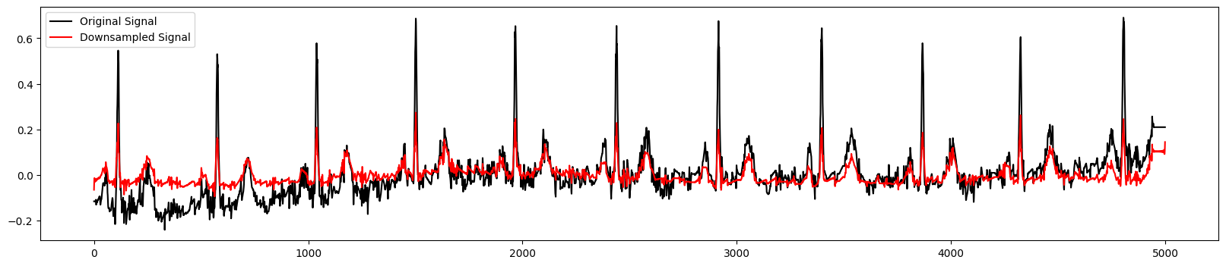
Data Pre-Processing
Input
Output
500Hz Samples Flow:
4096×12
1024×128
64×256
5120
4096×64
256×196
16×320
6
500Hz data shape is (n_records, 5000, 12)
To fit the model input, data was down sampled to 4096 using FFT

Slide 17
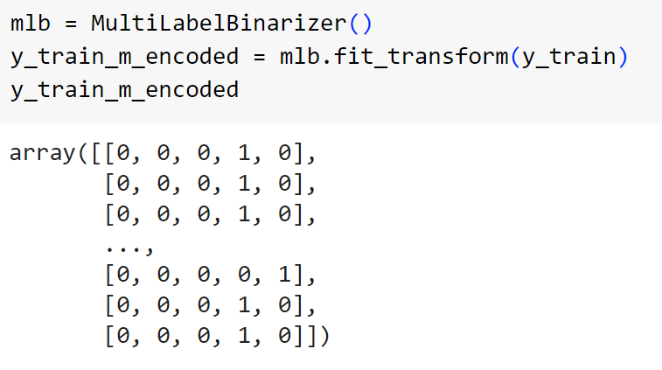
Data Pre-Processing
Input
Multi-Label
Binarizer
Output
Multi Labels Array
Encoded Array
Labels |  | CD | HYP | MI | NORM | Not-C | STTC
[CD] |  | 1 | 0 | 0 | 0 | 0 | 0
[CD, MI] |  | 1 | 0 | 1 | 0 | 0 | 0
[NORM] |  | 0 | 0 | 0 | 1 | 0 | 0
[CD] |  | 1 | 0 | 0 | 0 | 0 | 0
[STTC, HYP] |  | 0 | 1 | 0 | 0 | 0 | 1

Slide 18
Data Processing
Training Loss Function:
Binary Cross Entropy
Label | Input
NORM | 0
MI | 0
STTC | 0
CD | 1
HYP | 1
Not-C | 0
Output | Proba
0.01 | P(NORM)
0.00 | P(MI)
0.02 | P(STTC)
0.90 | P(CD)
0.60 | P(HYP)
0.00 | P(Not-C)
Model was taken from:
https://www.nature.com/articles/s41467-020-15432-4#code-availability
Notes:
מודל שלקחנו ממאמר בnature.
הרשת מורכבת משכבת קונבולציה, שכבת BN וReLU ביציאה שנכנסות לשרשרת של Residual layer.
לבסוף מתקבלת הסתברות עבור כל סיווג.

Slide 19
Data Post-Processing
NN Output Layer Activation Function
Encoding by Threshold
(>0.5)
Sigmoid for 6 Neurons
Output
Multi labels Prediction array
Probabilities
 | Probability for
 | CD | HYP | MI | NORM | Not-C | STTC
Sample 1 | 1.00 | 0.00 | 0.00 | 0.01 | 0.00 | 0.00
Sample 2 | 0.99 | 0.03 | 1.00 | 0.00 | 0.00 | 0.00
Sample 3 | 0.00 | 0.00 | 0.00 | 0.65 | 0.01 | 0.00
Sample 4 | 1.00 | 0.00 | 0.00 | 0.00 | 0.00 | 0.40
Sample 5 | 0.00 | 0.20 | 0.00 | 1.00 | 0.00 | 0.00
Binary Labels for
CD | HYP | MI | NORM | Not-C | STTC
1 | 0 | 0 | 0 | 0 | 0
1 | 0 | 1 | 0 | 0 | 0
0 | 0 | 0 | 1 | 0 | 0
1 | 0 | 0 | 0 | 0 | 0
0 | 0 | 0 | 1 | 0 | 0

Slide 20
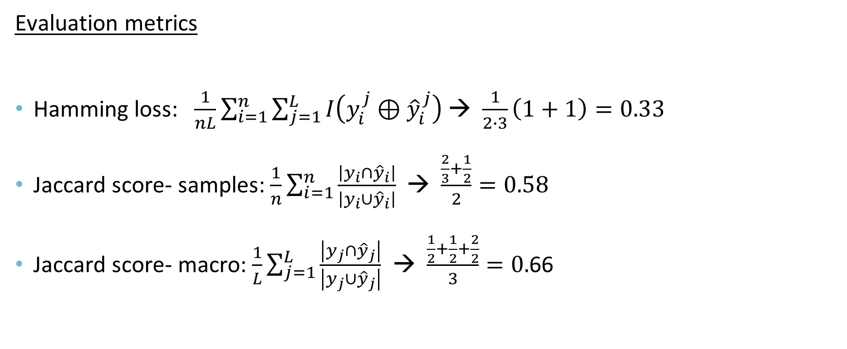

Multi-Labels Evaluation
$$y_{true}=\left[\begin{matrix}0, & 1, & 1 \\ 1, & 1, & 0\end{matrix}\right], y_{pred}=\left[\begin{matrix}1, & 1, & 1 \\ 1, & 0, & 0\end{matrix}\right]$$
Evaluation metrics
Hamming loss: $\frac{1}{nL}\sum_{i=1}^{n}{\sum_{j=1}^{L}{I\left(y_{i}^{j}⊕{\hat{y}}_{i}^{j}\right)}}$→ $\frac{1}{2∙3}\left(1+1\right)=0.33$
Jaccard score- samples: $\frac{1}{n}\sum_{i=1}^{n}{\frac{\left|y_{i}∩{\hat{y}}_{i}\right|}{\left|y_{i}∪{\hat{y}}_{i}\right|}}$→ $\frac{\frac{2}{3}+\frac{1}{2}}{2}=0.58$
Jaccard score- macro: $\frac{1}{L}\sum_{j=1}^{L}{\frac{\left|y_{j}∩{\hat{y}}_{j}\right|}{\left|y_{j}∪{\hat{y}}_{j}\right|}}$→ $\frac{\frac{1}{2}+\frac{1}{2}+\frac{2}{2}}{3}=0.$66
Notes:
Jaccard score- ככל שהקבוצות יהיו דומות יותר הציון יהיה גבוה יותר
Hamming loss– בודק כמה ערכים לא שווים, לכן ככל שהקבוצות דומות יותר הוא יהיה קטן יותר ⊕- כמה לא שווים אחד לשני יש

Slide 21
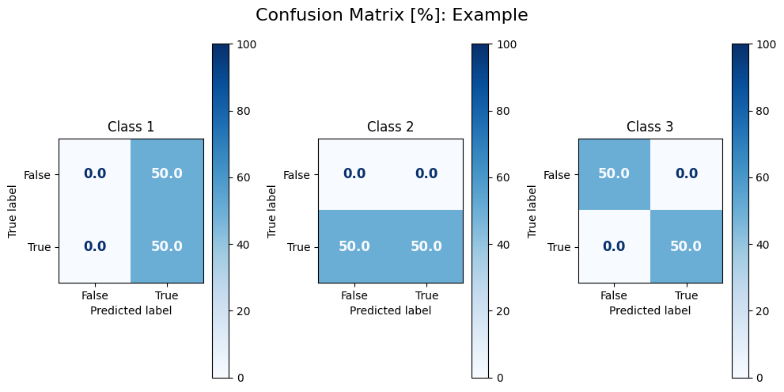
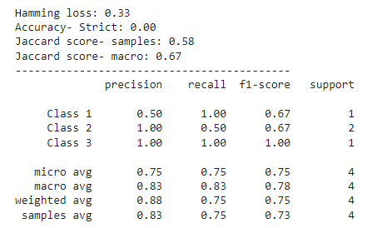

Multi-Labels Evaluation
$$y_{true}=\left[\begin{matrix}0, & 1, & 1 \\ 1, & 1, & 0\end{matrix}\right], y_{pred}=\left[\begin{matrix}1, & 1, & 1 \\ 1, & 0, & 0\end{matrix}\right]$$
Evaluation metrics – Example
Recommended reading:
https://towardsdatascience.com/evaluating-multi-label-classifiers-a31be83da6ea
Notes:
להחליף לאחוזים- לוודא שלקחתי תמונה נכונה

Slide 22
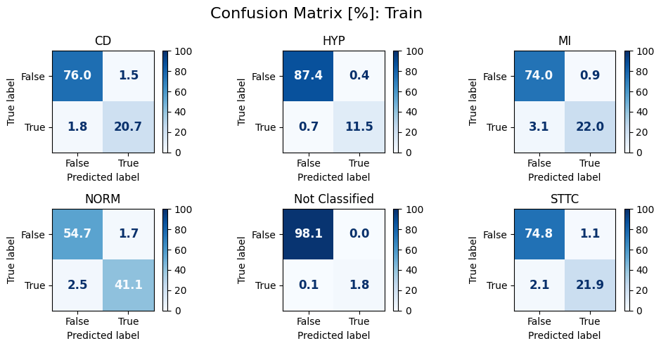
Multi-Labels Evaluation: Train
 | Train
Hamming Loss | 0.03
Accuracy- S | 0.90
Jaccard score- samples | 0.91
Jaccard score- macro | 0.89
6 labels, 50 epochs

Slide 23
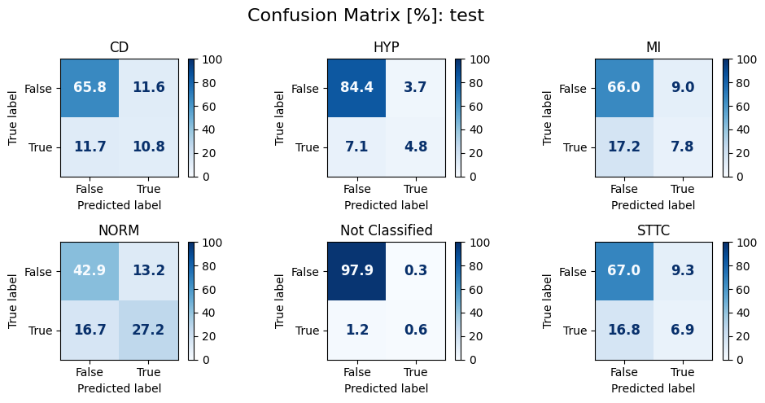
Multi-Labels Evaluation: Test
 | Train | Test
Hamming Loss | 0.03 | 0.20
Accuracy- S | 0.90 | 0.33
Jaccard score- samples | 0.91 | 0.42
Jaccard score- macro | 0.89 | 0.3
6 labels, 50 epochs
Notes:
במעבר לtrain רואים שהאלכסונים כבר לא טובים כ"כ ויש יותר מקרים שזוהו כfalse בעודם true.
גם הציונים מראים על כך שהתוצאות פחות טובות

Slide 24
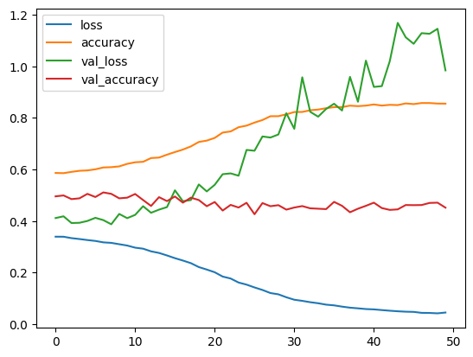
Multi-Labels Evaluation
100Hz, 6 Labels
The results indicates overfitting
Optional reasons:
  The model learned the patients and not the signals (duplication of samples per patient)
  Too many epochs
  Imbalanced data

Slide 25
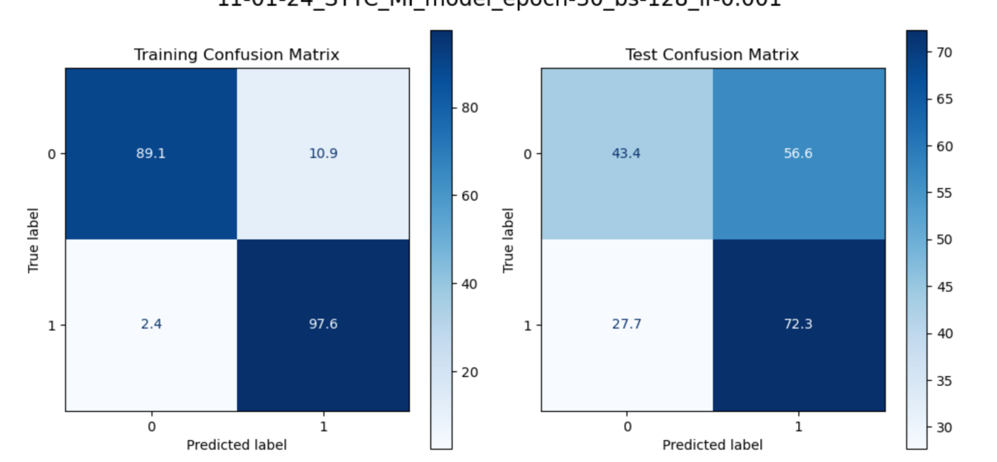
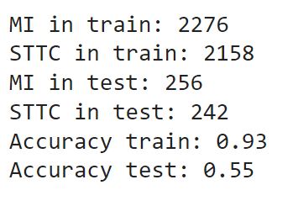
Multi-Labels Model (2 Labels)
In order to check if we have imbalance problem, we filter the data that it will contain only 2 labels, with approximately same samples amount.

Slide 26
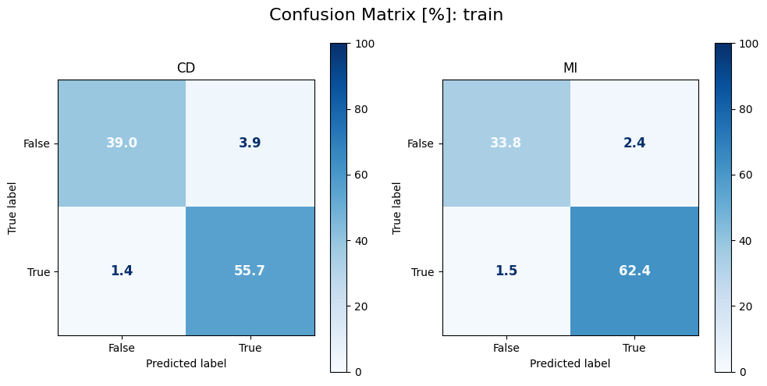
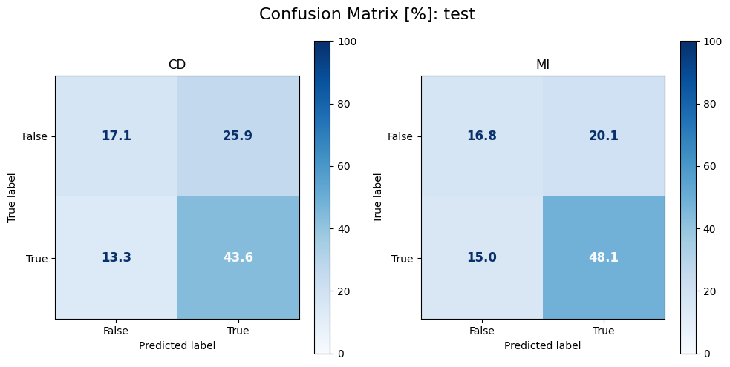
Multi-Labels Model (2 Labels, 100Hz)
To check if we have imbalance problem, data was filtered so it contains only 2 labels, with approximately same samples amount.
 | Train | Test
Hamming Loss | 0.05 | 0.37
Accuracy- S | 0.93 | 0.41
Jaccard score- samples | 0.95 | 0.62
Jaccard score- macro | 0.93 | 0.55
Notes:
ניתן לראות כי בtrain קיבלנו overfitting ואילו בtest התוצאות פחות מוצלחות. הרוב מזוהה כtrue בעוד הוא false בשתי הקטגוריות.

Slide 27
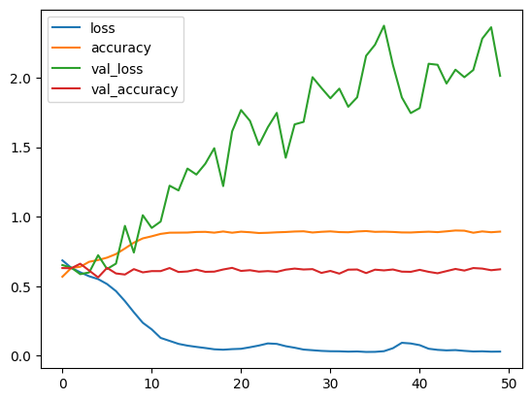
Multi-Labels Model
100Hz, 2 Labels
The problem is not the imbalanced data
Options to improve the model:
  Train the model with HR data (i.e., 500Hz)
  Add random noise
  Data smoothing
  Reduce model complexity

Slide 28
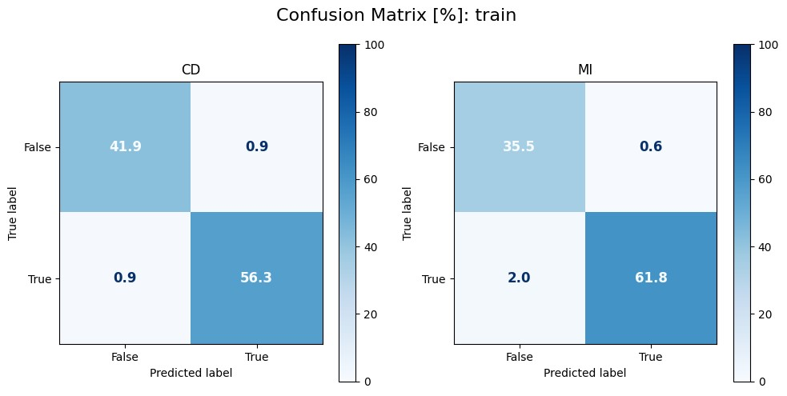
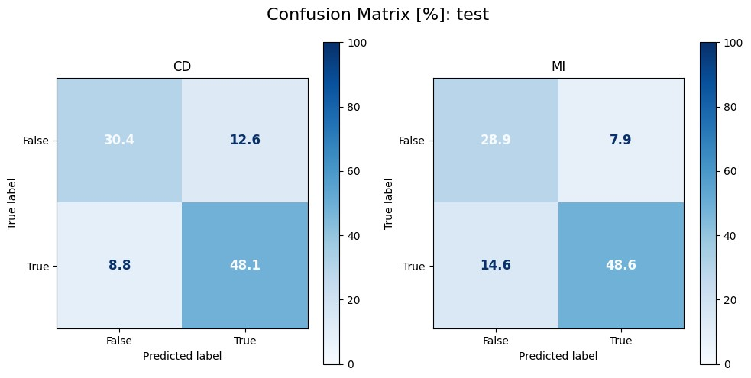
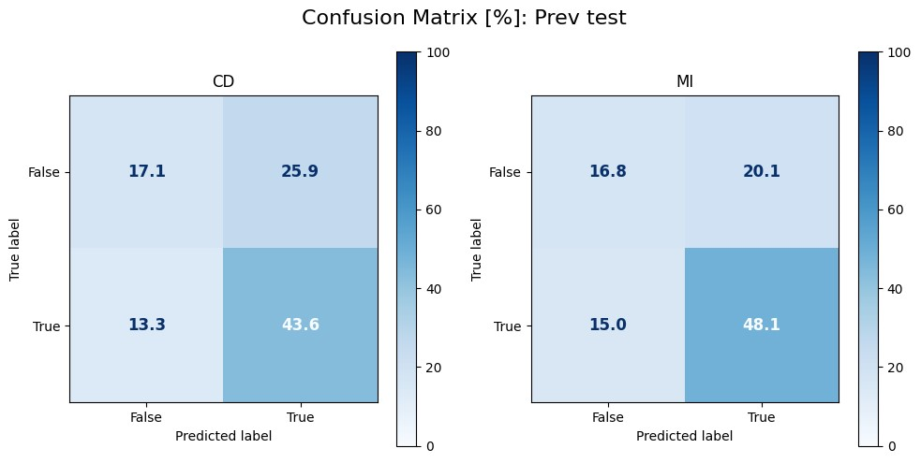
Multi-Labels Model (2 Labels, 500Hz)
 | Train | Test | Prev test
Hamming Loss | 0.02 | 0.22 | 0.37
Accuracy- S | 0.96 | 0.65 | 0.41
Jaccard score- samples | 0.97 | 0.77 | 0.62
Jaccard score- macro | 0.96 | 0.69 | 0.55
Notes:
מעבר לHR שיפר את התוצאות באופן ניכר בכל המדדים

Slide 29
Evaluation Summary
 |  |  |  | Hamming Loss |  | Accuracy |  | Jaccard score Samples |  | Jaccard score macro
 |  | Parameter | epochs | Train | Test | Train | Test | Train | Test | Train | Test
6 labels (100Hz) | Data: 100Hz |  | 50 | 0.03 | 0.2 | 0.9 | 0.33 | 0.91 | 0.42 | 0.89 | 0.3
 | Data: 100Hz | Single Record per Patient | 50 | 0.03 | 0.2 | 0.9 | 0.33 | 0.91 | 0.42 | 0.89 | 0.3
2 labels (500Hz) | Data: 100Hz | Data:100Hz | 50 | 0.05 | 0.37 | 0.93 | 0.41 | 0.95 | 0.62 | 0.93 | 0.55
 | Baseline – 500Hz | Baseline – 500Hz | 50 | 0.02 | 0.22 | 0.96 | 0.65 | 0.97 | 0.77 | 0.96 | 0.69
 | Smoothing (Moving Average) | Window Size = 10 | 15 | 0.03 | 0.21 | 0.96 | 0.66 | 0.97 | 0.78 | 0.96 | 0.7
 |  | Window Size = 20 | 15 | 0.05 | 0.22 | 0.91 | 0.66 | 0.94 | 0.77 | 0.92 | 0.69
 |  | Window Size = 50 | 15 | 0.22 | 0.37 | 0.68 | 0.5 | 0.76 | 0.62 | 0.68 | 0.51
 | Random Noise | Sigma = 0.01 | 15 | 0.02 | 0.22 | 0.97 | 0.64 | 0.98 | 0.77 | 0.97 | 0.7
 |  | Sigma = 0.03 | 15 | 0.02 | 0.18 | 0.96 | 0.69 | 0.98 | 0.82 | 0.97 | 0.74
 |  | Sigma = 0.05 | 15 | 0.17 | 0.27 | 0.73 | 0.61 | 0.82 | 0.73 | 0.74 | 0.61

Slide 30
Evaluation Summary – Hamming Loss

Slide 31
Evaluation Summary – Jaccard Score

Slide 32
Insights
Multi-label encoding is the preferable differential diagnosis for our project objective
500Hz measurements fit better to the current CNN model
FFT Down sampling Effects:
  Smooths data
  Reduces signal's local trends
  Probably due to bug in the function it smoothed more than it should, that is might explain why adding noise slightly improved the results

Slide 33
Next Steps
Multi-label model with HR samples for 6 labels
Multi-label model with HR samples for 6 labels with different FFT down sampling
Multi-label model with HR samples for 6 labels with noise
Down sampling to reduce model complexity

Slide 34


