Slide 1

Unveiling Customer Insights for Foodie-Fi
Foodie-Fi, a leading online platform for food enthusiasts, has amassed a significant customer base over the years. By delving into the rich customer data, we can uncover valuable insights that will drive strategic decision-making and fuel the company's growth. This comprehensive presentation explores the intricacies of customer behavior, subscription trends, and strategic recommendations to propel Foodie-Fi forward.
Prepare by:
Raz Muhammad

Slide 2

Understanding Customer Behavior
1
Total Customer Count
Extracting the total number of customers that Foodie-Fi has ever had provides valuable insights into the platform's reach and customer base. Understanding the growth trajectory and historical customer count sheds light on the platform's evolution and market penetration, serving as a foundational metric for strategic decision-making and future growth projections.
2
Trial Plan Distribution
Analyzing the monthly distribution of trial plan start_date values offers insights into customer acquisition patterns and seasonal variations in sign-ups. Grouping the start_date values by the start of the month provides a granular view of trial plan adoption dynamics, enabling targeted marketing and resource allocation for customer acquisition efforts.
3
Churn Analysis
Determining the number and percentage of customers who have churned provides critical insights into customer retention and satisfaction levels. Analyzing the churn percentage of customers who have churned immediately after their initial free trial offers insights into the effectiveness of trial experiences and onboarding processes, informing the development of targeted retention strategies and customer engagement initiatives.

Slide 3
Subscription Trends Analysis
Plan Start Date Breakdown
Plan Adoption Dynamics
Plan Retention Metrics
Analyzing the number of customers who upgraded to an annual plan in 2020 provides insights into long-term subscription preferences and revenue forecasting. Calculating the average number of days it takes for a customer to upgrade to an annual plan from the day they join Foodie-Fi offers insights into subscription conversion timelines, with a breakdown into 30-day periods revealing patterns and customer decision-making processes.
Determining the number and percentage of customers who have continued with their plans after the initial free trial sheds light on plan retention and customer satisfaction levels. Providing a customer count and percentage breakdown of all plan_name values as of December 31, 2020 offers insights into plan popularity and diversity, informing strategic decisions related to plan offerings, pricing, and customer segmentation.
Identifying plan start_date values occurring after the year 2020 and providing a breakdown by count of events for each plan_name offers insights into recent subscription trends. Aligning these subscription trends with strategic objectives enables proactive adjustments to marketing and product development initiatives, ensuring a responsive approach to the market's evolving needs.

Slide 4
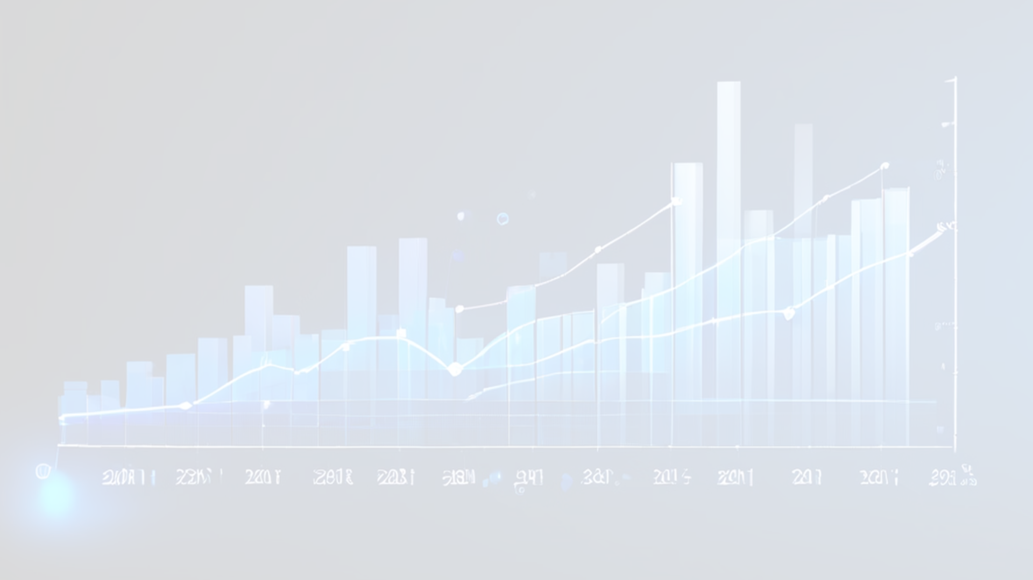
Churn and Downgrade Analysis
1
Churn Analysis
2
Downgrade Analysis
Understanding churn patterns, including the percentage of customers who have churned immediately after their initial free trial, offers insights into the effectiveness of trial experiences and onboarding processes. This information informs the development of targeted retention strategies and customer engagement initiatives to improve customer satisfaction and loyalty.
Analyzing the number of customers who downgraded from a pro monthly to a basic monthly plan in 2020 provides insights into plan satisfaction levels and value perception. This understanding facilitates the implementation of feedback loops to address customer concerns and enhance plan offerings, ultimately leading to improved retention strategies and plan improvement initiatives.

Slide 5

Strategic Insights and Recommendations
Actionable Insights
Customer-Centric Approach
Future Growth Strategies
Summarizing actionable insights derived from customer behavior and subscription trends analysis empowers strategic decision-making. Providing strategic recommendations based on these insights enables proactive measures to drive customer acquisition, retention, and revenue growth. Outlining an implementation roadmap ensures alignment with organizational goals and operational efficiency.
Emphasizing a customer-centric approach based on the insights fosters a culture of customer success and satisfaction. Leveraging insights to personalize customer engagement and support initiatives enhances the overall customer experience and loyalty. Implementing a feedback loop based on customer insights enables continuous improvement and innovation aligned with customer needs.
Identifying market expansion opportunities based on subscription trends and customer behavior analysis facilitates strategic growth planning. Aligning product development initiatives with customer insights ensures the creation of offerings that resonate with customer preferences and market demands. Leveraging insights for competitive differentiation enables the development of unique value propositions and market positioning strategies.

Slide 6




Empowering Customer Success
Insights-Driven Initiatives
Personalized Experiences
Continuous Feedback Loop
Sustainable Growth
Translating customer insights into targeted initiatives that enhance the user experience and foster long-term engagement.
Leveraging data-driven insights to deliver personalized experiences that cater to the unique needs and preferences of each customer.
Implementing a robust feedback mechanism to continuously gather customer input and drive iterative improvements.
Aligning strategic decisions with customer insights to ensure sustainable growth and long-term business success.

Slide 7




Subscription Conversion Dynamics
Trial Engagement
Conversion Triggers
Retention Strategies
Analyze the factors that influence customer engagement during the trial period, such as feature usage, content consumption, and user interactions.
Identify the key triggers that drive customers to convert from trial to paid subscription, such as perceived value, ease of use, or specific feature adoption.
Develop targeted retention strategies to encourage customers to maintain their subscriptions, leveraging insights from churn and downgrade analysis.

Slide 8
Driving Sustainable Growth
Customer Acquisition
Leverage insights from trial plan distribution and customer behavior to optimize acquisition strategies and channels.
Revenue Optimization
Analyze plan adoption dynamics and retention metrics to identify opportunities for revenue growth through upselling, cross-selling, and pricing adjustments.
Product Innovation
Align product development initiatives with customer insights to introduce new features, content, or plan offerings that address evolving customer needs.
Competitive Differentiation
Utilize insights to develop unique value propositions and market positioning strategies that set Foodie-Fi apart from competitors.

