Slide 1
Title: Housing Prediction
Author: Rajat Nathan

Slide 2
Introduction
My housing prediction model uses linear regression to compute the relationship between dependent and independent variables. The model identifies this relationship through a linear equation that require computation of weights for each independent variable that must be applied to the values of independent variables such that:
Y = w1 * X1 + w2 * X2 + w3 * X3 .... + b
For this project - I identified 8 independent variables in the 'training data' that demonstrated the largest correlation with the dependent variable: 'SalePrice'
'Fitting' this data into the linear regression model from the sci-kit library (sklearn) resulted in a R^2 value of : **0.8824472376719946**
Using this model R^2 value of the test data as : **0.7705677801288706**
*Please add slides as required.

Slide 3
The Data
The shape of the training data frame is = 100 X 82.
I then removed the columns with large number of NaNs - 15 or more count and interpolated the NaNs in the remaining numerical columns, so that i could work with a cleaner training data set. The data shape of the frame at this time = 100 X 77.
From the remaining data set i identified the categorical data columns and used **one hot encoding** to transform categorical data into numerical columns(this process removed the small number of NaNs in categorical data). I then joined the categorical columns with the 'cleaned data set'; shape : 100 X 248 and then dropped the categorical columns from the 'cleaned data set'. The data shape of the frame at this time = 100 X 210. There are 38 categorical columns in the data.
In the resulting data set, I then proceeded to calculate the correlation of the dependent variable with the remaining columns to identify eight distinct independent variables/columns (X) with the highest correlation with the dependent variable - 'SalePrice'(Y). I noted that one of the independent variables identified was a result of one hot encoding process implemented in the data cleansing/transformation process. This variable was called: BsmtQual_Ex - indicating excellent basement quality
Finally, a dataframe with the top 8 correlated variables to the dependent variable ‘SalePrice’ was created and used as an input to the linear regression model

Slide 4
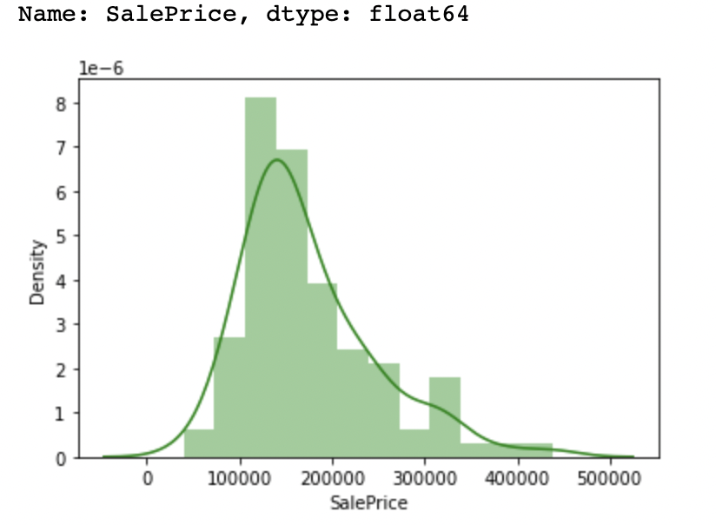
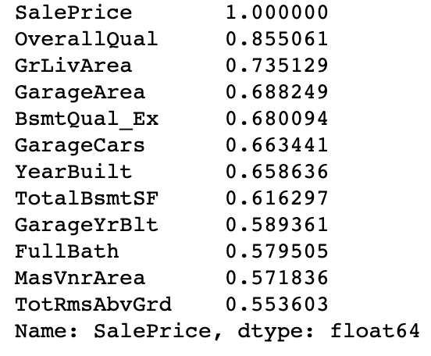
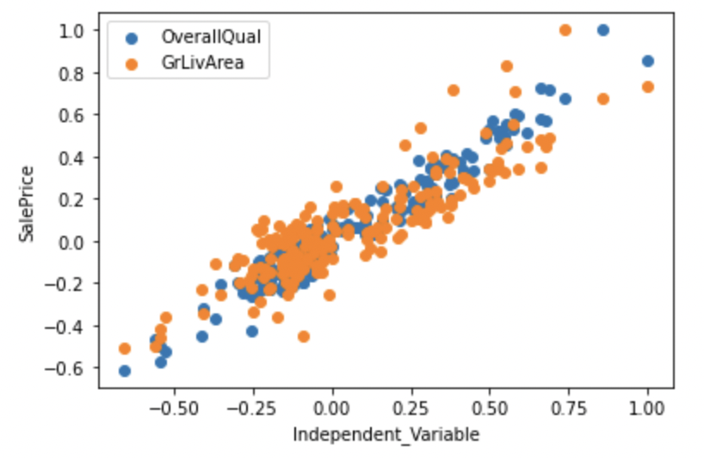
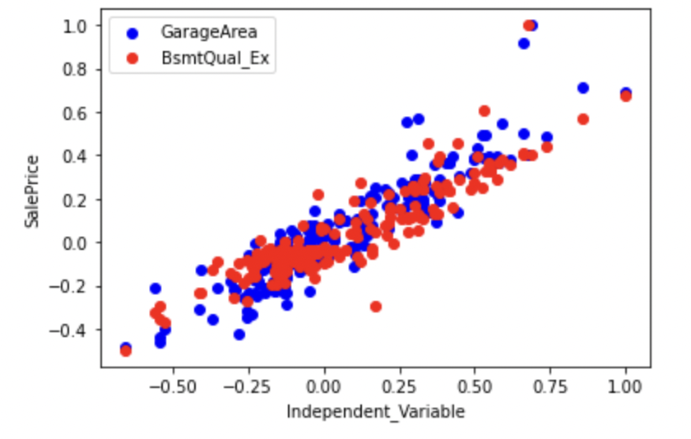
Data Exploration

Slide 5
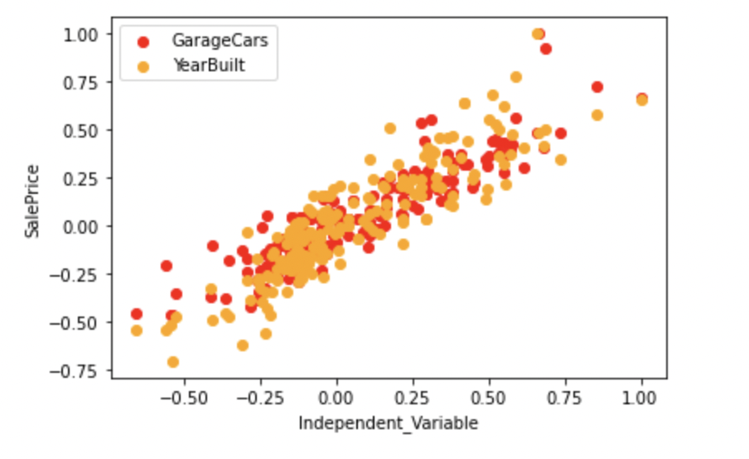
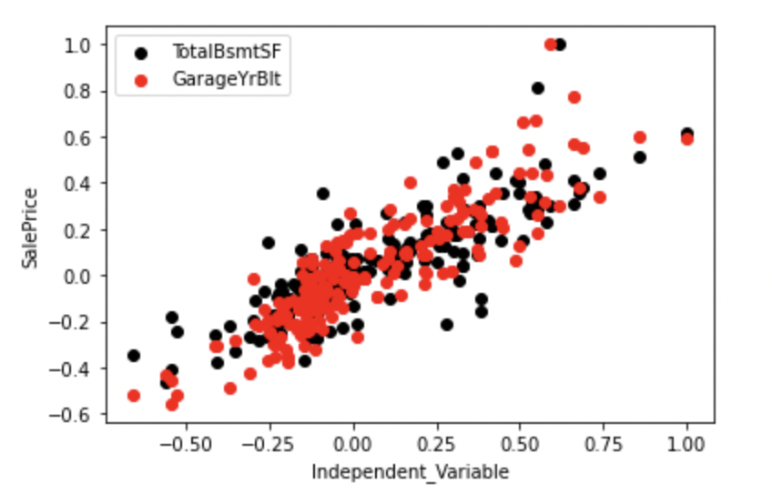
Data Exploration

Slide 6
Data Preparation
Exclude high % NaN columns - basically anything >15% NaN; interpolate data for the remaining columns replacing NaN values where present in the data
Identify columns that have string values as candidates for one hot encoding ; remember to drop these columns afterwards
Create prefixes for one hot encoding and join with original dataframe
Drop the categorical columns to prepare the final data set
Create correlation matrix and associated dataframe using Top 8 correlated variables to dependent variable 'SalePrice’
Create independent and dependent columns for linear regression
*Please add slides as required.

Slide 7
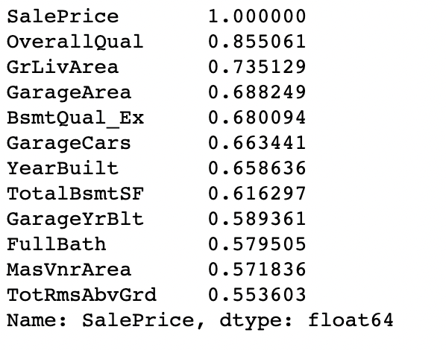
Correlation
Summary of Correlation:

Slide 8
Project Description
The housing prediction model implemented here, uses linear regression to compute the relationship between dependent and independent variables. The model identifies this relationship through a linear equation that require computation of weights for each independent variable that must be applied to the values of independent variables such that:
Y = w1 * X1 + w2 * X2 + w3 * X3 .... + b
Where :
w1,w2,w3… are the slope or weights in the equation and;
b : is the constant y-intercept or bias
m = n * sum(x,y) – sum(x)*sum(y) / n * sum(x^2) – (sum(x))^2
b = sum(y) – m*sum(x)/n
The Linear Model is appropriate in this situation because it captures the linear relationship of individual variables to the dependent variable as is demonstrated by the correlation coefficients presented on the previous slide.
*Please add slides as required.

Slide 9
Analysis and Results
Three distinct groups of highly correlated variables (ordered from highest to lowest) were used:
Group 1 (baseline) : 8 independent variables : R^2 = 0.8824472376719946
Group 2 (adversary_1) : 5 independent variables : R^2 = 0.836871490561969
Group 3 (adversary_2) : 11 independent variables : R^2 = 0.8848705848801298
As you can see, the correlation increases the number of independent variables are increased, however the increase is marginal as we go from 8 to 11 variables. As such, using 8 independent variables for predication seems to be optimal for this data set
Group 1 (baseline) : 8 independent variables : R^2 = 0.8824472376719946
is the most optimal model and was therefore chosen for the model
*Please add slides as required.

Slide 10
Verification
R^2 of value of the test data as : 0.7705677801288706
Key Observations:
The reason for lower R^2 is perhaps due to certain biases in the training data that are unraveled when applying the model on the test data.
It should be noted though that both training and sample data are small samples(in the global sense) and only consists of a 100 rows each.
I believe that the model can be greatly improved with additional data (5-10 X)

Slide 11
Conclusion
In conclusion, The approach that worked best was using:
Data preparation and cleansing - removing NaNs in the data
Using one hot encoding to transform the categorical data intro numeric data
Using highly correlated variables to the dependent variable and finding the optimal number of variables to be used
I learned a lot during this exercise about data modeling. Key lessons for me:
Experimentation to identify if the dependent variable should be used in the predication model or a function of the dependent variable such as log of 'SalePrice'(i confirmed that model R^2 using this approach was lesser than without conversion. .85 vs .88 respectively)
Use a larger set of data where possible. This becomes evident given the large difference between model R^2 between training and test data sets
*Please add slides as required.

Slide 12
References
** I did not explicitly use any references outside of course materials for this project, I do have prior knowledge of statistics and modeling **
Use this as a sample for articles:
Author Last Name, Author First Name. “Article Title.” Journal Title Volume #, no. Issue # (year): page range.
Ex: Doe, John. “Data Engineering.” Data Engineering Journal 18, no. 4 (2021): 12-18.
Use this as a sample for websites:
Author Last Name, Author First Name. “Title of Web Page.” Name of Website. Publishing organization, publication or revision date if available. Access date if no other date is available. URL .
Doe, John. “Data Engineering.” Data Engineer Resource. Cengage, 2021. www.dataengineerresource.com .
*Please add slides as required.

