Slide 1
Web Engineering
Instructor
Sanam Ahmed

Slide 2
Web Engineering
Actively promotes systematic, disciplined and quantifiable approaches towards successful development of high-quality, usable Web-based systems and applications.
In particular, Web engineering focuses on the methodologies, techniques and tools that are the foundation of Web application development and which support their design, development, evolution, and evaluation.

Slide 3
What is WEB
Is it means WWW?
Then what is WWW?

Slide 4
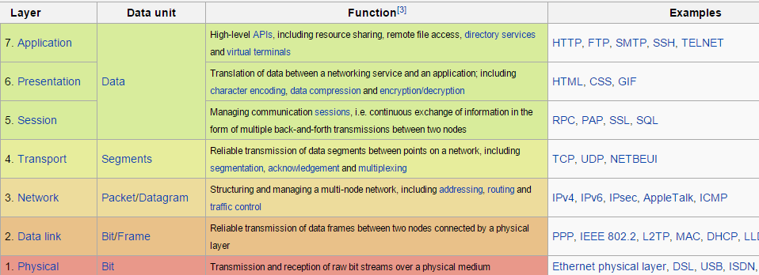
Network Protocols

Slide 5
HTTP
HTTP (Hypertext Transfer Protocol) is the set of rules for transferring files (text, graphic images, sound, video, and other multimedia files) on the World Wide Web.

Slide 6
Web Application
a web application or web app is a client-server software application in which the client (or user interface) runs in a web browser. Client requests services from a program hosted at server machine.

Slide 7
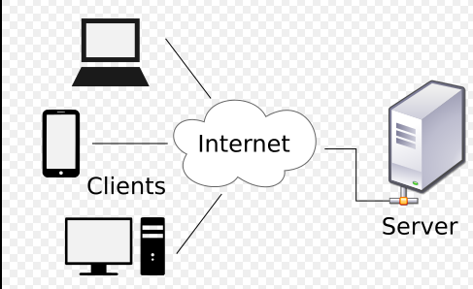
Web Application Traditional Architecture

Slide 8
Client or FrontEnd Development Languages
HTML
CSS
BootStrap
Angular JS

Slide 9
Back-End Development Languages
Java
Python
Php

Slide 10
Web Application Servers
Software to manage web applications
Apache Tomcat
Glassfish

Slide 11
Databases (DBMS)
Oracle
MySql (we would opt this)
Sql Server 2000

Slide 12
MEAN Stack
MongoDB Express JS Angular JS Node Js

Slide 13
MERN Stack
MongoDB Express JS React JS Node JS

