Slide 1
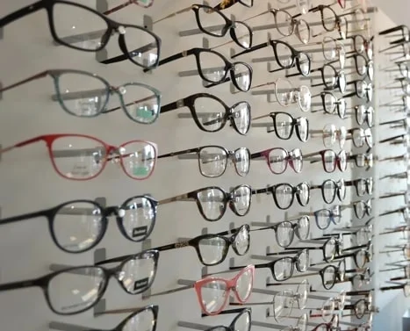
Eye conic
SEE YOUR FUTURE TODAY:
PROJECT MEMBERS:
Hasnan Rizwan.
Muhammad Ebad Sheikh.
Humda Zehra.
Sundus Zahid.
Muhammad Sufiyan.

Slide 2
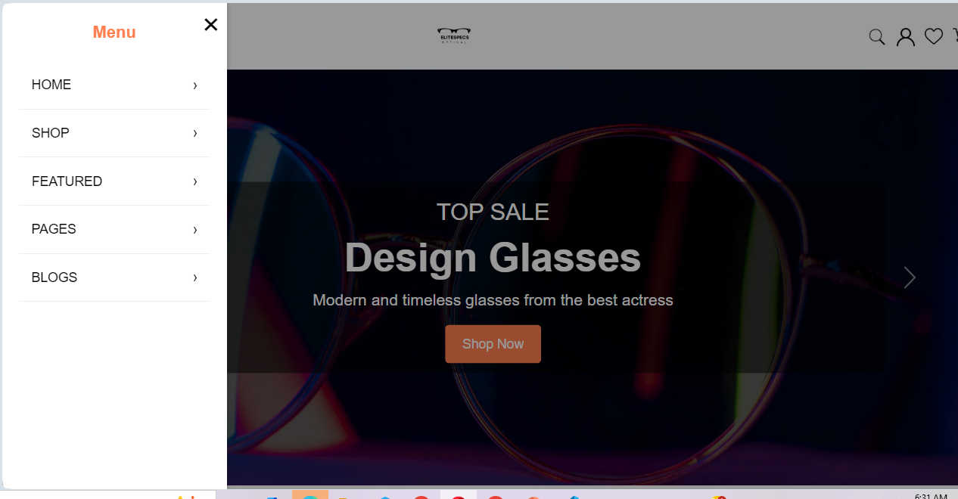
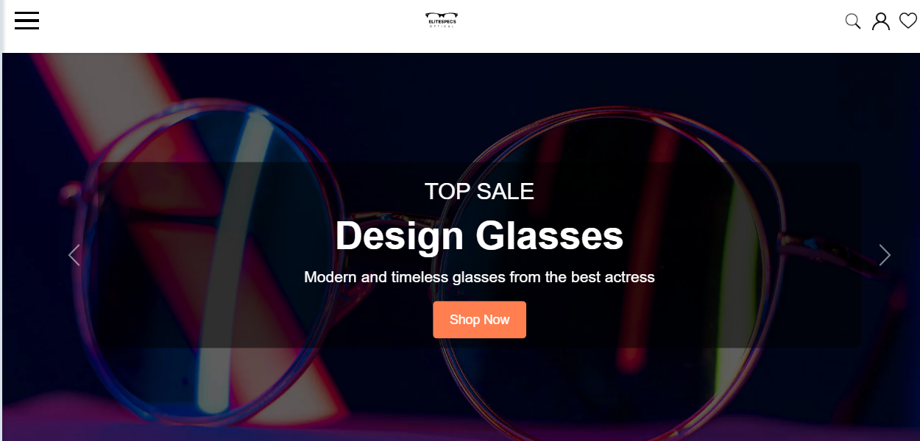
NAVIGATION BAR AND LOGO:
GIVEN INSTRUCTIONS:
THE HOME PAGE SHOULD BE CREATED WITH PROPER SECTION AND SUITABLE LOGO.
Header (Navigation Bar), Hero Section (First Impression), About Eyeonic, Products , SOCIAL PROOF(CUSTOMER REVIEWS), ACTION SECTION(CONTACT FORM), FOOTER(SOCIAL LINKS).
RESULTS:

Slide 3
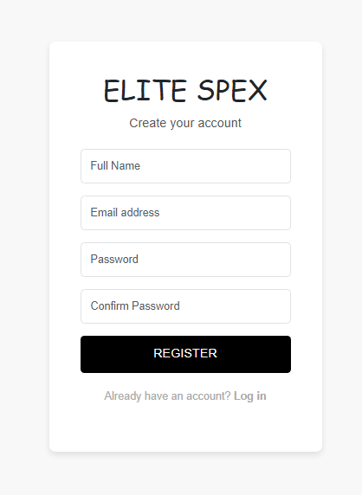
Registration:
If any person want to register on our website they can easily register their
by completing registration form requirement.

Slide 4
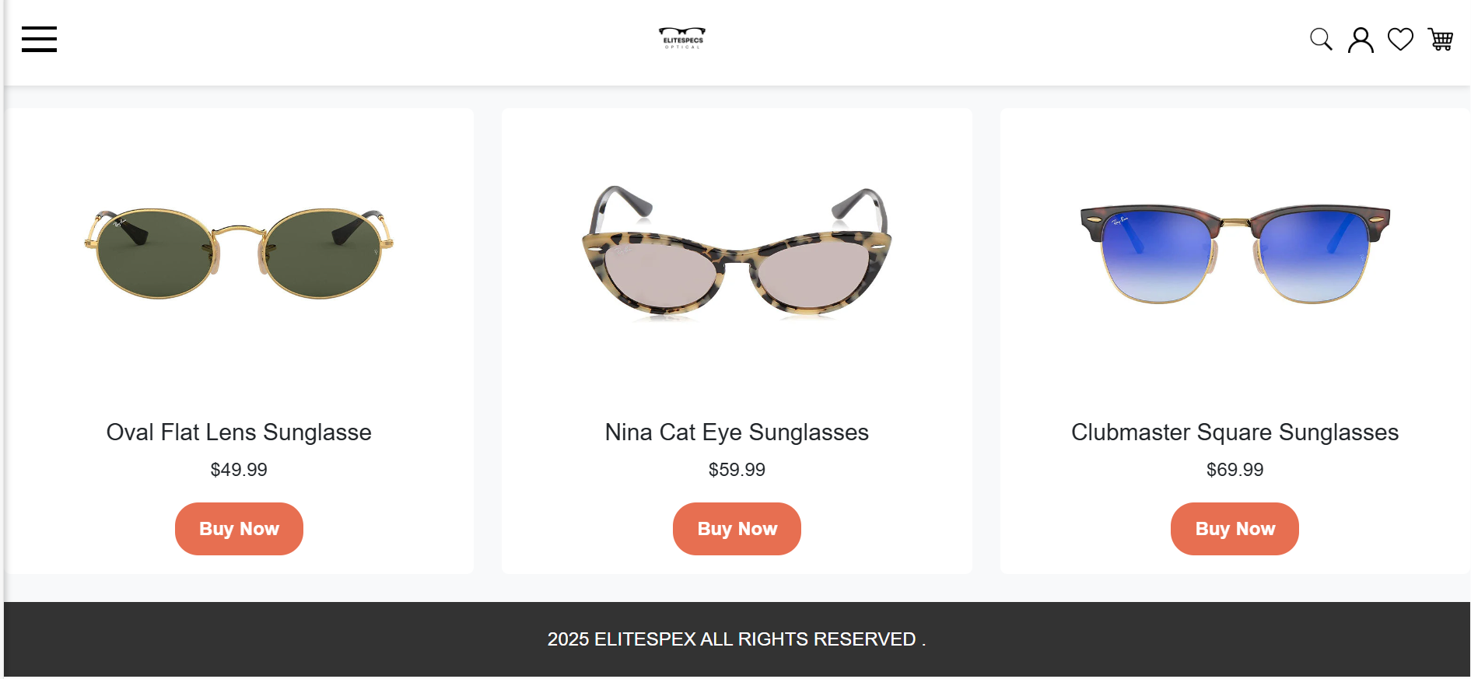
Products their description and purchase:

Slide 5
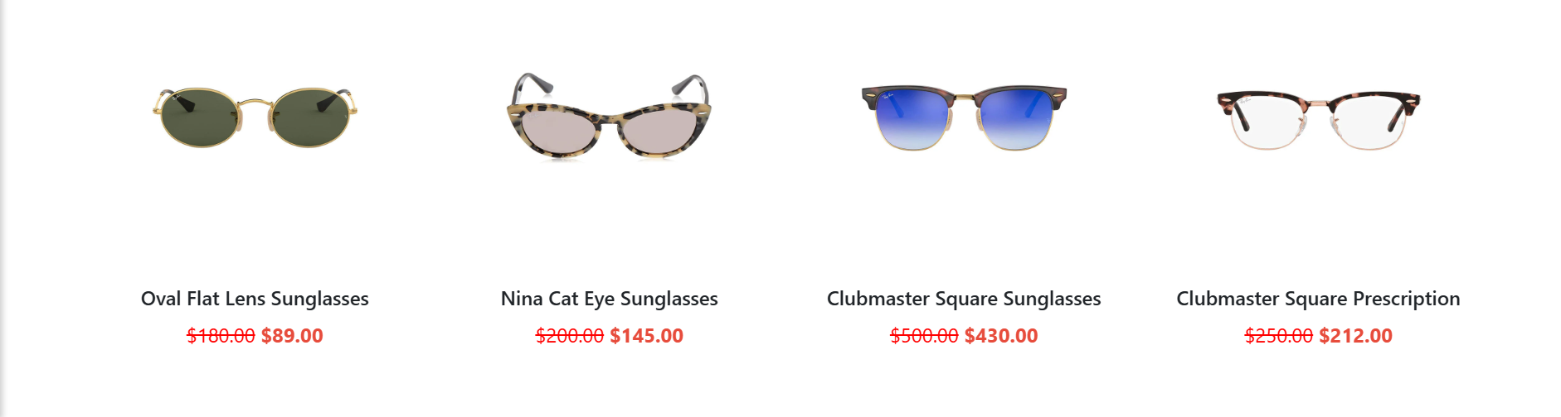
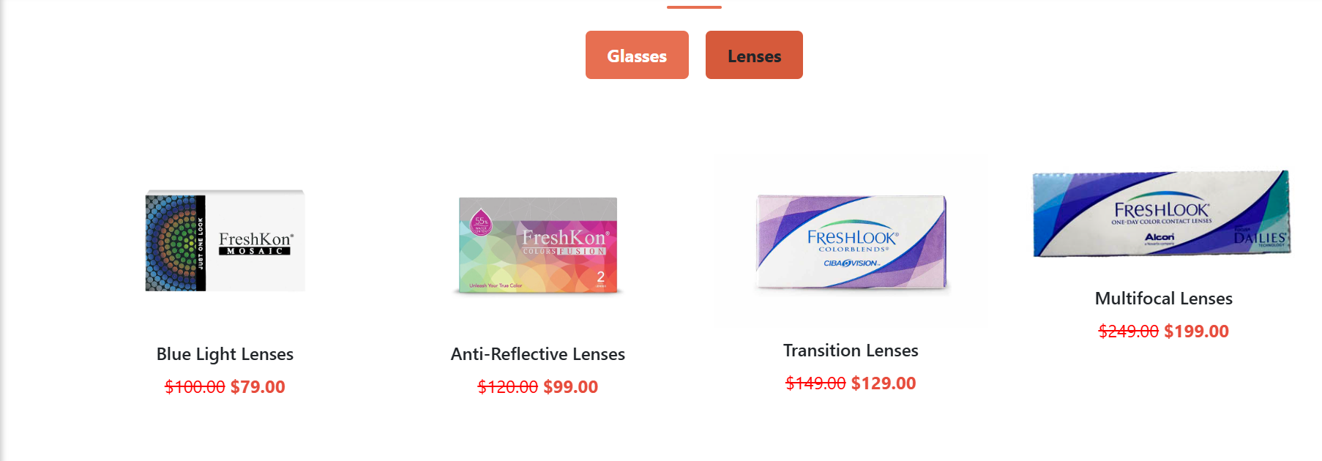
Given instructions:
Another category option for ‘Contact Lenses’, ‘Sun Glasses’ etc. should be created and accordingly the products should be listed.
Result:

Slide 6
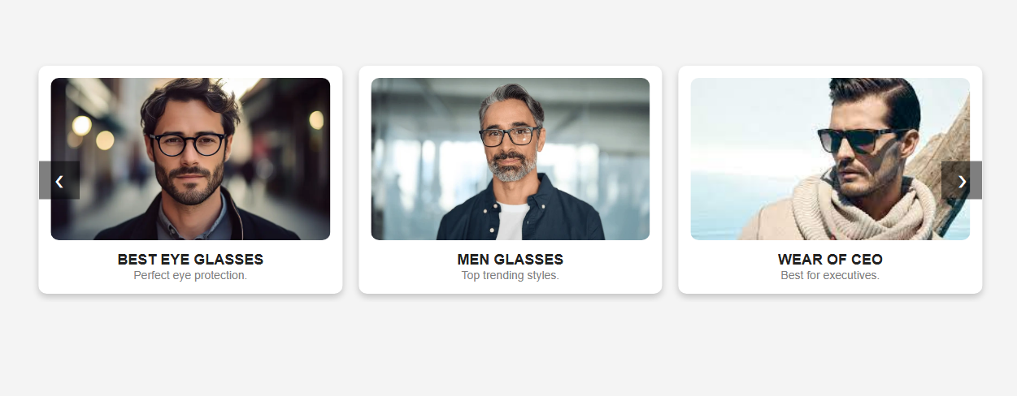
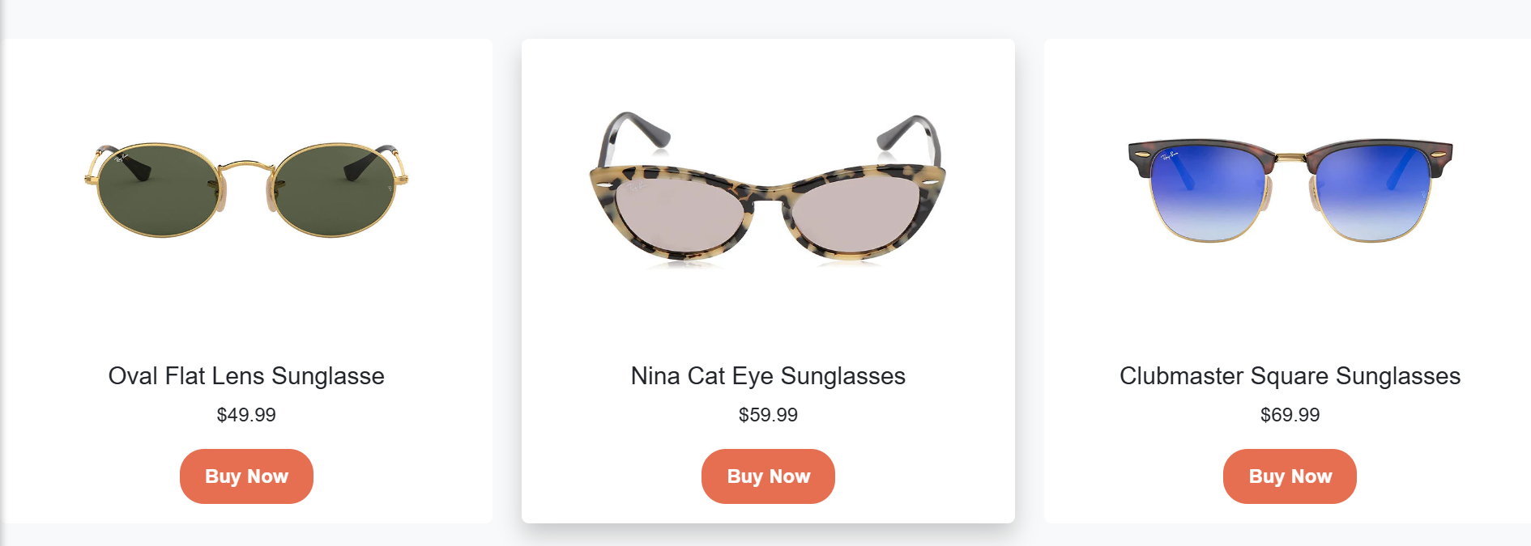
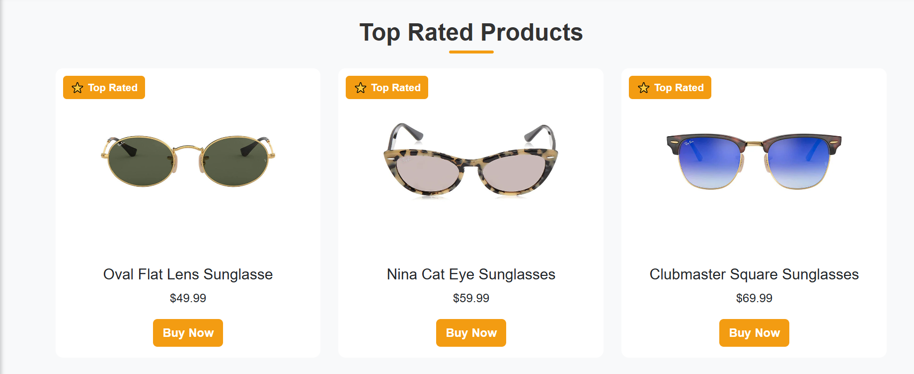
Given Instructions:
When user select any brand the product of that’s brand should be displayed.
Results:
As per requirement we can make that cards when a person select that it display that brand
We make three buttons
New arrivals, Best sellers, Top Rates
Were every one easily visited and see the brands top rates, best sellers, and the new arrivals

Slide 7
DISCRIPTION:
This eye conic website is a user friendly website deign to provide the best services and better known for the brands of the glasses .the website is design using html, css for style java script for the function/ intereactivety it is the responsive website to make it responsive bootstrap is used this website ensures seamless performance across all devices.

Slide 8
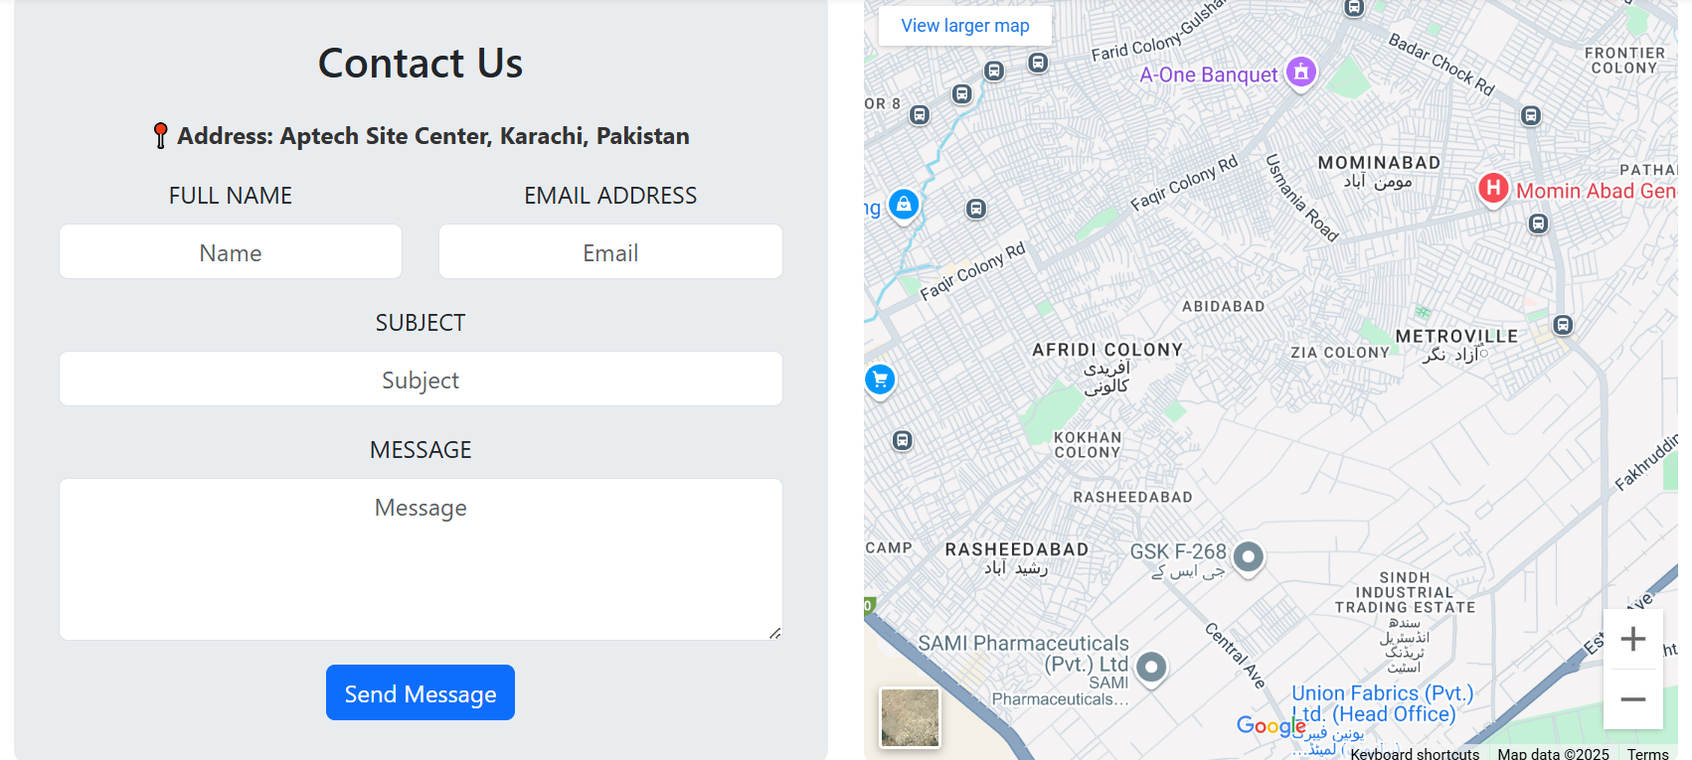
Contact us:
Given instruction:
There should be a "Contact Us" page which will have the Address of the Company as well as the mail address which when clicked will invoke the local mail client from where they can send an email.
Result:

Slide 9
Key features:
Responsive design:
A responsive website is a site designed to adapt seamlessly to different screen sizes and devices. It ensures optimal user experience by adjusting layout, images, and navigation based on the screen width. Using technologies like CSS media queries, flexbox, and grid, responsive design eliminates the need for separate mobile and desktop versions.
Interactive content:
Finding the perfect pair of glasses has never been easier! Our website offers fun and interactive features to help you choose the best frames enjoy a smooth engaging and hassle free shopping find prefect glasses.
User friendly:
Bootstrap navigation bar ensure users can easily navigate through different sessions upcoming styles and update and more over improve user experience.
Visually appealing:
Layout:
The website is design with CSS to ensure a clean professional and visually appealing layout typography , animations are crafted to enhance user experience

Slide 10
Thank you!
We appreciate you stopping by and exploring our collection of stylish glasses. 😊 Whether you're looking for the perfect pair or just browsing, we’re here to help! Feel free to try our interactive features and find the best fit for you.
See you soon again thankyou!

