Slide 1

AMCAT Data Analysis

Slide 2
About me
Background:
I am Abid Raza, a high school graduate with an interest in computer science.
Motivation for Data Science:
My motivation for Data Science is to leverage data-driven insights to solve complex problems and make a meaningful impact on the world since it offers the ability to uncover hidden patterns in data, drive informed decisions, and solve real-world problems across various domains.
Work Experience:
I have experience in operations and Data Analysis. Currently working as a Marketing Analyst at a US based startup.
LinkedIn: Abid Raza | LinkedIn
GitHub: Raza464 (github.com)

Slide 3
Overview
Brief Overview:
The current project aims to understand the demographic and educational factors influencing employment outcomes of engineering graduates, such as Job titles, Job location, salary outcomes etc.., providing insights that can guide career choices and hiring practices.
Objective:
To analyze various attributes such as educational background, Gender and specialization to identify key determinants of salary distribution among engineering graduates and to draw actionable conclusions that can benefit students, educators, and employers.
Data Summary:
The dataset, released by Aspiring Minds from the Aspiring Mind Employment Outcome 2015 (AMEO), focuses on the employment outcomes of engineering graduates. It includes around 4000 data points with 40 independent variables, both continuous and categorical, covering demographic features, standardized scores in cognitive, technical, and personality skills, and employment outcomes such as Salary, Job Titles, and Job Locations.

Slide 4
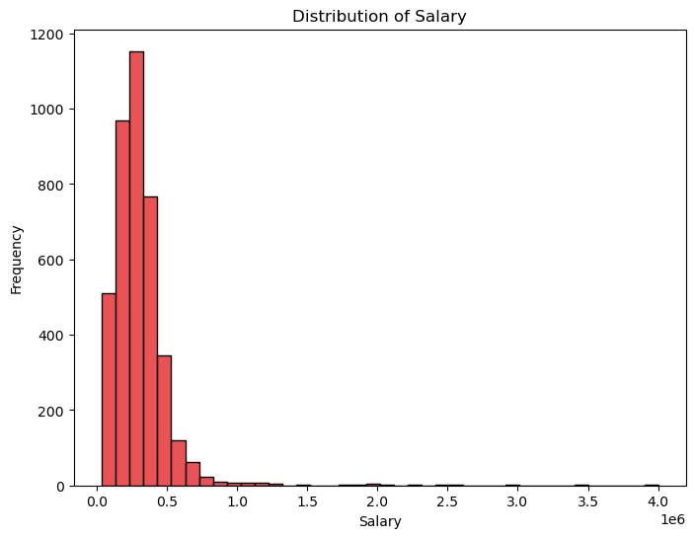
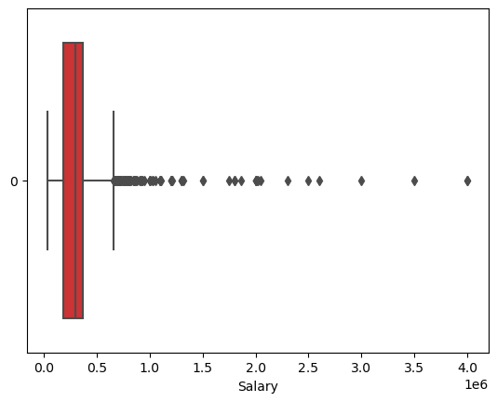
Salary Distribution
Although there are a few very high salaries, most are within a narrow range, highlighting income disparity. Only 36 candidates earn more than ₹10,00,000, making high salaries rare and contributing to the uneven distribution.
Most salaries in the dataset are below ₹5,00,000, with a few extending much higher, creating an uneven spread. Many outliers exist, with some salaries going beyond ₹10,00,000. Despite the overall range, most salaries fall between ₹2,00,000 and ₹3,70,000. The median salary is about ₹3,00,000, meaning half of the candidates earn less than this amount. The upper limit of typical salaries is around ₹5,00,000.

Slide 5
Factors affecting Salary
There is a low to moderate positive correlation between most numerical features (like test scores and GPA) and salary, meaning that higher values in these features tend to be associated with higher salaries, but the relationship is not very strong.
10th and 12th grade percentages show a slight positive trend with salary. However, there is a wide range of salaries at each percentage level, indicating that other factors also play a significant role in determining salary.
College GPA has a more noticeable positive correlation with salary. Suggesting that individuals with higher GPAs generally earn higher salaries.
Several factors, including gender, college tier, and type of degree, significantly influence salary levels. Specifically, male students and those from top-tier colleges typically have higher median salaries.
Among different degree types, B.Tech/BE graduates have the highest median salaries, followed by M.Tech/ME, M.Sc.(Tech.), and MCA graduates. Across all the categories, salary distributions are generally right-skewed, with a notable number of high-earning outliers.

Slide 6
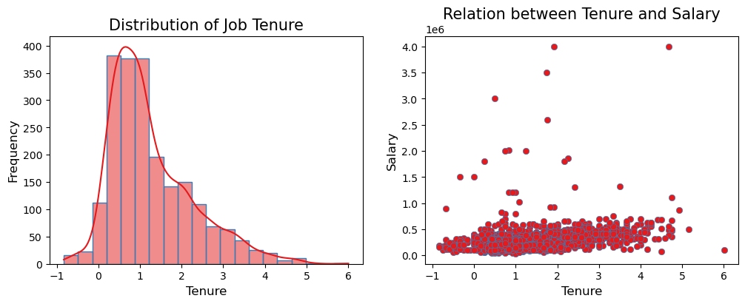
Job Tenure vs Salary
Overall, most employees have short tenures, with a common departure point at about 1 year. While job tenure and salary are weakly linked, there is substantial salary overlap regardless of tenure.
The job tenure distribution is right-skewed, showing that most employees have shorter tenures with the company. A peak around the 1-year mark indicates that many employees tend to leave around this time. The distribution tails off, suggesting fewer employees stay for longer periods. There is a weak positive correlation between job tenure and salary, but salaries overlap significantly across different tenure lengths.

Slide 7
Conclusion
The project aimed to analyze how demographic and educational factors influence the employment outcomes of engineering graduates, including job titles, locations, and salaries. By examining around 4000 data points from the Aspiring Mind Employment Outcome 2015 dataset, we sought to provide actionable insights for students, educators, and employers.
Salary Distribution: Most engineering graduates earn below ₹5,00,000, with some high outliers pushing the upper limit. The median salary is around ₹3,00,000, highlighting income disparity.
Influencing Factors: College GPA and degree type (e.g., B.Tech/BE) have a notable impact on salary, with higher GPAs and certain degrees correlating with higher earnings. Gender and college tier also significantly affect salary levels.
Job Tenure: Most employees have short tenures, typically leaving around the 1-year mark. The correlation between job tenure and salary is weak, with significant salary overlap across different tenures.
For a more detailed analysis and further insights, please refer to the Python notebook.

Slide 8

THANK YOU

