Slide 1
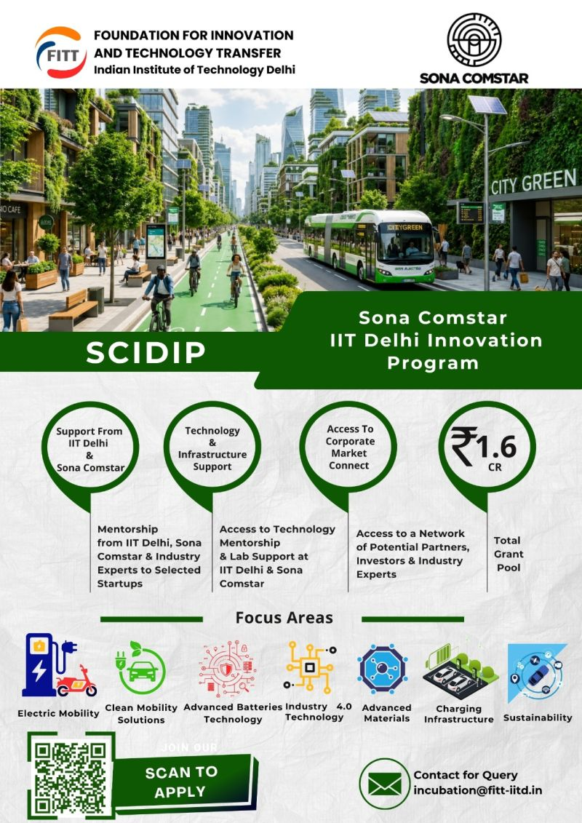
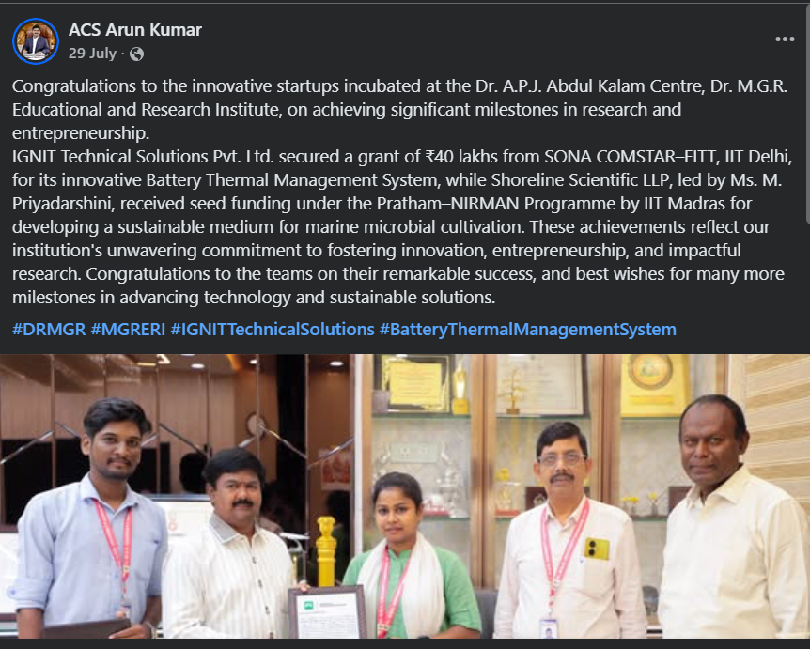
» SONA-COMSTAR-IIT Delhi Innovation Program (SCIDIP)

Slide 2
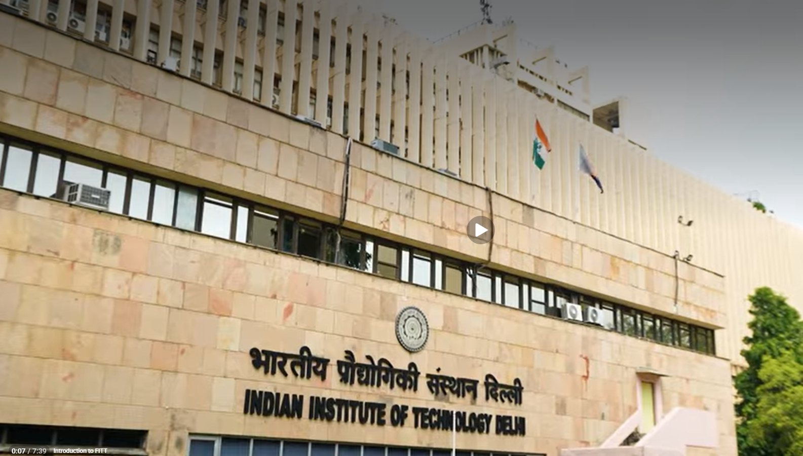
FITT | IIT Delhi
x Sona Comstar
SCIDIP 2026 — IIT Delhi Innovation Program
IIT Delhi Innovation Program (SCIDIP) 2026,
one of India's most prestigious deep-tech startup incubation programs.
Rs.80L
24 Months
2 Rounds
6th Edition
Max Grant
Per Startup
Incubation
Period
Selection
Process Cleared
Program
Legacy
Presenter: Crystal Paradigm | crystalparadigm.in

Slide 3
WHO IS SONA COMSTAR & WHY ONLY IIT DELHI?
Who is Sona Comstar?
Why ONLY IIT Delhi Can Characterize Our Material?
• India's leading Automotive Systems & Components manufacturer
• Listed company (NSE: SONACOMS) with Rs.3,200+ Cr revenue
• 9 manufacturing plants: India, China, Mexico, USA
• Manufactures precision driveline gears, differential assemblies, electric motors (SRM), and motor control units
• EPIC Roadmap: Electric, Personalized, Intelligent, Connected vehicles
• Key OEM clients: Tata, Mahindra, Ather, Honda, BMW, GM, Ford
• Actively scaling next-gen magnet-less Switched Reluctance Motors (SRMs)
• Our HE-MCGA material (9-element RHEA + 11-layer FGM) operates at 1400 C
• Physical validation requires STA at 1500 C, high-temp XRD, and SEM/EDS
• Only IIT Delhi CRF houses all required equipment in one facility in India
• No private lab in India can characterize refractory HEA + FGM composites at this temperature
• IIT Delhi is not optional — it is the only viable path to TRL 4+ validation
Program Track Record — Previous Cohort Winners (Calls 1-5)
Call 1: QUANTEON POWERTRAIN, inGO Electric | Call 2: CREATARA, P3C Technology & Solutions | Call 3: MOTOR AMA, Octarange Technologies
Call 4: Calvem Controls, Aatral ESP, Dopar Energy | Call 5: Baud Resources, EV Recharge, GroKalp H2CNT, Planzit
RESULTS: IGNIT Technical Solutions Pvt. Ltd. received Rs.40 LAKHS from SONA COMSTAR-FITT for Battery Thermal Management System.
Source: sonacomstar.com | fitt-iitd.in

Slide 4
WHAT WE HAVE DONE — THE HE-MCGA PROJECT
The HE-MCGA Project — What Crystal Paradigm Has Built
We have computationally engineered a constrained 9-element High-Entropy Alloy (RHEA) fused with an 11-layer Functionally Graded Material (FGM) using our proprietary AI platform. This "HE-MCGA" system achieves a 3D-validated aerospace Safety Factor of 1.71 (clearing the 1.50 airworthiness threshold), an oxidation mass gain of just 7.5 mg/cm2, and reduces critical Hafnium exposure by >75% — entirely through physics-informed inverse design. We are at TRL 3+.
Safety Factor
Oxidation Gain
Hf Reduction
1.71
7.5 mg/cm2
>75%
Target: 1.50 (Cleared)
Industry limit: <10 (Cleared)
vs. baseline CMSX-4
• Applied under the "Advanced Materials" track of SCIDIP 2026
• Round 1 — Technical Expert Committee: Evaluated on innovation, feasibility, TRL and preliminary data. We CLEARED.
• Round 2 — Techno-Commercial Panel: Industry + investor + FITT representatives evaluated technical strength, IP, team & business plan. We CLEARED.
• Now selected for the final presentation event at IIT Delhi — the final approval round before grant disbursement begins.
• Crystal Paradigm has a published Indian Patent (App No: 202641084226) and a Q1-SCI publication supporting this work.

Slide 5
WHAT WE GAIN
UPTO Rs.80L Grant
IIT Delhi Lab Access
Mentorship
Direct non-dilutive grant to fund raw material atomization, additive manufacturing (DED/LENS), and physical prototype fabrication — no equity lost.
Access to CRF: High-Temp STA (1500C), XRD, SEM/EDS, LENS/DED — the ONLY Indian facility capable of characterizing our 9-element RHEA+FGM system.
Technical mentorship from IIT Delhi faculty + Sona Comstar engineering division for DED tolerance alignment and real-world integration planning.
Investor Network
Recognition
Market Connect
FITT connects incubatees with its VC/investor network for follow-on funding beyond the SCIDIP grant.
IIT Delhi incubatee status provides national credibility, publication opportunities, and government scheme eligibility (NIDHI, BIRAC, etc.)
Direct access to Sona Comstar EV supply chain — mapping our validated FGM into H13 forging dies and SRM stator components for commercialization.
Beyond HE-MCGA: IIT Delhi incubation opens Crystal Paradigm's entire AI-materials platform to national research partnerships, government grants (DST, NITI Aayog), and international collaborations.

Slide 6
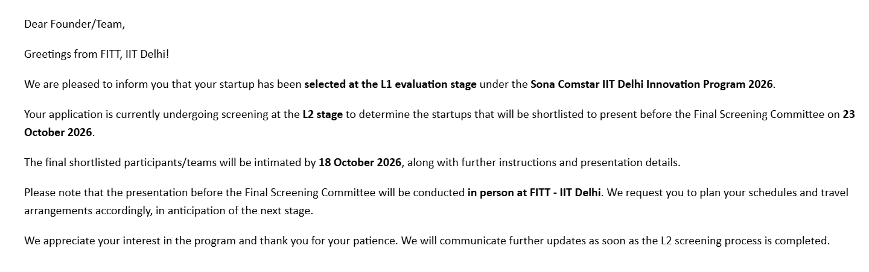

Slide 7
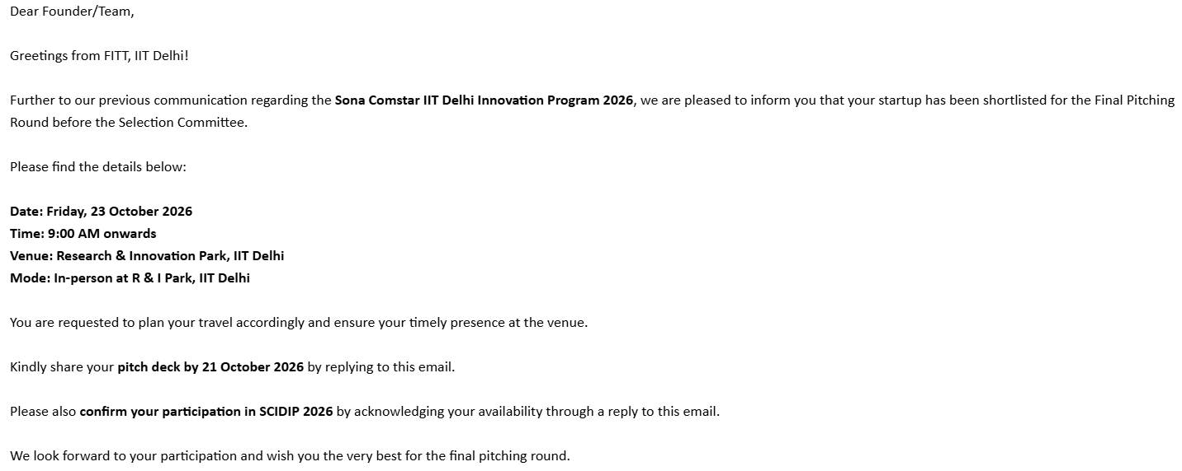

Slide 8


CRYSTAL PARADIGM
AI-Integrated Materials Architectures for Advanced Mobility & Aerospace
Advanced Materials for Extreme-Environment Applications
Crystal Paradigm is a research-driven organization at the intersection of artificial intelligence and materials science. We field a deep-tech startup that has computationally validated a next-generation turbine blade material and extreme-environment mobility components achieving a 3D aerospace Safety Factor of 1.71 - exceeding the 1.50 airworthiness threshold by 14%.
Our Mission
To accelerate the discovery of next-generation materials by combining machine learning, high-performance computing (HPC), and experimental validation in one closed loop.
Targeting extreme-environment mobility and aerospace applications: refractory high-entropy alloys paired with functionally graded ceramic coatings, merging in-house data curation with high-fidelity physics models to generate direct, print-ready manufacturing matrices.
4 Research Papers
(under Review)
2 Patents
(1 Accepted)

Slide 9
CRYSTAL PARADIGM · SCIDIP APPLICATION
STRATEGIC ALIGNMENT: SCIDIP FOCUS AREAS
Bridging the gap between AI-driven discovery and physical bulk materials.
FOCUS AREA 1
FOCUS AREA 2
ADVANCED MATERIALS
INDUSTRY 4.0 & AI
Multi-Material Systems, Gradients & Additive Processes
AI-Driven Design, Simulation & Digital Twins
Multi-Material TBCs: Solved the 1400°C CTE mismatch using an integrated Lanthanum Zirconate (LZO) ceramic coating coupled with a refractory HEA core.
AI for Composite Architectures: Deployed Constrained Differential Evolution (DE) combined with Random Forest surrogates to navigate a 9-element hypercube in minutes.
Physical & Mechanical Gradients: Our 11-layer Functionally Graded Material (FGM) completely eliminates macro-stress concentrations at the coating interface.
Numerical Performance Simulation: Validated candidates via 3D FEniCS FEA stress grids (Aerospace SF = 1.71) and MACE/CHGNet ML Force Field Molecular Dynamics.
Hybrid Additive Processes: The entire architecture is formulated for immediate multi-hopper Laser Engineered Net Shaping (LENS / DED) 3D printing.
Hybrid Chemical Gradients: Automatically converts continuous AI property curves into discrete, print-ready metal-ceramic gradient parameters.
THE UNIFIED SOLUTION
Crystal Paradigm does not just provide a material (Focus Area 1) or software (Focus Area 2) - we provide a complete, unbroken data-to-manufacturing pipeline.

Slide 10

CRYSTAL PARADIGM FOR EXTREME-ENVIRONMENT ADVANCED MATERIALS
AI-Driven Inverse Design of Graded Transpiration Shields
Integrated Multi-Material Architecture
Merging a high-temperature refractory HEA base with an 11-layer functionally graded LZO thermal barrier coating.
The Problem
Thermal fatigue from CTE mismatches at 1400°C causing interfacial shear stress and layer delamination.
Current Status
TRL-3+ screening complete via physics-informed regressors and FEA/MD solvers; lab-backed prototyping ready.
Competing for the Rs.1.6 Cr SCIDIP grant pool to advance from TRL 3 to TRL 5 - backed by IIT Delhi CRF labs, Sona Comstar industry mentorship, and SCIDIP investor network access for commercialization.

Slide 11

WHY THIS MATTERS NOW
Addressing Extreme-Environment Industrial Imperatives and Supply Chain Resilience
The Aerothermal Fire Limit
Next-generation turbine entries run at 1400^C (1673^K). These severe limits introduce extreme expansion stresses and oxidation kinetics that outpace legacy protective systems.
Supply Chain Resilience
Conventional designs rely heavily on rare elements like Hafnium. Our solution intentionally limits high-risk dependencies to mitigate price volatility and supply chain exposure.
Directly aligned with next-generation open-rotor program targets for TET > 1400°C and 20% SFC improvement.
FUEL BURN
MRO MAINTENANCE
MANUFACTURABILITY
15% reduction in compressor parasitic bleed air, driving an immediate 1.5% net reduction in Specific Fuel Consumption (SFC).
Lowering thermal degradation to extend engine shop visit intervals and blade operational life cycles significantly.
Direct export of a universal, print-ready 11-layer compositional matrix to drive multi-hopper 3D printers for shop-floor deployment,drastically reducing physical prototyping lead times from months to days.

Slide 12


THE TECHNICAL PROBLEM IN ONE PICTURE
THERMOMECHANICAL FAILURE-MODE ANALYSIS
Thermal Expansion Discontinuity
Metallic base (α ≈ 6.44-14.0 μm/m·K) vs LZO coating (α = 9.1 μm/m·K). Interface shear forces exceed 850 MPa, far surpassing the thermal limits of legacy Inconel 718 and CMSX-4.
Microstructural Phase Decay
DELAMINATION RISK
Oxygen diffusion precipitates brittle sigma phases , causing rapid material loss and interface failure.
SHEAR > 850 MPa
The Cooling Hole Threat
Laser-drilled holes create stress concentration , accelerating crack propagation and layer delamination.
The Unified Imperative
Substrate, cooling channels, and insulating layers must be optimized as a single system to prevent failure. Same physics govern forging die failure, EV motor thermal cycling, and railway brake degradation.
Schematic cross-section showing interfacial stress singularities and crack initiation zones.

Slide 13


OUR ADVANCED ARCHITECTURE & RECIPIENT LAYOUT
11-Layer Graded FGM Design Profile
(Proprietary Composition Ratios Masked Pending Formal NDA Review)
Layer
Depth (mm)
Alloy Vol %
Ceramic Vol %
Profile Description
1
0.00
100.0%
0.0%
Pure Refractory HEA Base
Substrate Phase Security
Optimized quinary refractory HEA matrix ensuring stable single-phase BCC solid solution.
2
0.50
xx.x%
xx.x%
Graded Matrix
3
1.00
xx.x%
xx.x%
Graded Matrix
4
1.50
xx.x%
xx.x%
Micro-Porosity Zone
5
2.00
xx.x%
xx.x%
Micro-Porosity Zone
The Pareto Gradient
Transition zone governed by power-law exponent n=1.1, shifting shear stresses away from the surface.
6
2.50
xx.x%
xx.x%
Micro-Porosity Zone
7
3.00
xx.x%
xx.x%
Micro-Porosity Zone
8
3.50
xx.x%
xx.x%
Graded Matrix
9
4.00
xx.x%
xx.x%
Graded Matrix
Transpiration Porosity Network
Integrated micro-pores programmed via selective laser sintering, allowing cooling air to weep uniformly.
10
4.50
Graded Matrix
xx.x%
xx.x%
11
5.00
0.00%
100.0%
Pure Porous LZO Ceramic
Hardware-Agnostic Output
Direct export of 11-layer data ledger to drive multi-hopper LENS printers.
Optimized for 5.0 mm transition zone.
Elemental family details are fully provided (Ta-W-Cr-V-Ti-Zr-Hf-Al-Nb), but exact compositional ratios are proprietary to protect Crystal Paradigm IP; full composition disclosure is available for joint engineering teams during subsequent technical reviews under an NDA

Slide 14





WHY WE WIN TECHNICALLY
System-Level Innovation and Active Environmental Armor
Our platform executes a unified optimization run that solves for substrate chemistry, gradient shapes, and active transpiration mechanics concurrently, minimizing interface mismatch to just 2.66 μm/mK.
PHASE STABILITY
OXIDATION RESISTANCE
Audited VEC of 5.02 ensures a stable single-phase BCC solid solution with zero sigma phase risk up to its solidus limit (What this means: 3x longer component life). its solidus limit of 2727^K.
Self-healing Alumina armor limits high-temperature scale growth to < 10 mg/cm² (exceptional 7.5 mg/cm² achieved - Survives at 200°C higher temperatures).
ADHESION PERFORMANCE
MANUFACTURABILITY
Power-law gradient curves (n=1.1) minimize internal shear forces and prevent coating spallation at 1400°C.
The universal proprietary LENS printing matrix maps composition directly to commercial multi-hopper 3D printers.

Slide 15
WHAT IS PROVEN TODAY AND WHAT IS NOT
High-Fidelity Verification Metrics and TRL Maturity Status
High-Fidelity Models
Ab Initio Phase Consistency
In-memory properties surrogate model audited at Test R^2 = 0.977 and MAE = 8.11 GPa. Verified via cloud-scaled 3D FEniCS FEA stress grids.
CALPHAD sweeps and Gradient Boosting regressors (R^2 = 0.958) confirm stable single-phase BCC matrix across extreme thermal envelopes.
Evaluation Vector
Model / In Silico Status
Experimental Lab Status
Validation Target
Status
BCC Phase Security
Verified (CALPHAD)
Pending Lab Sweep
0% Brittle Sigma Phase
GREEN
Elastic Modulus Surface
Audited (R^2=0.977$)
Pending Coupon Tensile
MAE ≤ 8.11 GPa
GREEN
Oxidation Scale Kinetics
Verified (MACE MD)
Pending TGA Weight
Mass Gain < 10 mg/cm²
GREEN
Interfacial Bond Safety
Verified (1D/3D FEA)
Pending Adhesion Test
Safety Factor ≥ 1.50
GREEN
Transpiration Film Stability
Modeled (CFD Jet Lift)
Pending Thermal Cycling Test
Zero Boundary Separation
YELLOW
Physical Prototyping
Fully Formulated
Not Yet Tested
TRL 4 Coupon Assembly
NEXT PHASE

Slide 16

VALIDATION PLAN TO TRL 4+
Validation Plan to TRL 4+ - Incubation Milestone Framework
Note: Timeline to be mutually agreed .
PHASE 1
PHASE 2
PHASE 3
Multi-Physics Structural Audits
Additive Prototyping & Porosity Programming
High-Temperature Characterization
Final certification of ALREADY ACHIEVED structural aerospace Safety Factor of 1.71 via 3D FEniCS FEA and MACE Molecular Dynamics on High-end cloud supercomputing. Extending validation to 20,000+ thermal cycles.
Exposure of fabricated coupons to 1,000 continuous thermal shock cycles inside an automated Automated Thermal Cycling Rig at a real gas temperature of 1400°C (1673 K).
Feeding the universal reference matrix into a dual-line multi-hopper LENS system. Optimizing laser power and powder flow to program the integrated transpiration micro-pores.
Go/No-Go Gatekeeping Criteria
Microstructural characterization via SEM/EDS must confirm clear layer-wise compositional layout and verify the complete absence of processing voids or macro-cracking before advancing to full turbine blade geometries.

Slide 17

TECHNOLOGY VALIDATION & DEPLOYMENT ROADMAP
From In Silico Design to Physical Validation & Deployment
INDUSTRY DEPLOYMENT & CERTIFICATION
IN SILICO DESIGN SCREENING
LENS FGM WITNESS COUPONS
THERMAL CYCLING VALIDATION
SUBSCALE COMPONENT VALIDATION
Witness Coupon Baseline
Comparative Performance
Fabricate flat, graded FGM witness coupons using our hardware-agnostic composition standard, providing a cost-effective platform for initial evaluation.
Subject our transpiration-cooled HEA coupons to concurrent testing alongside current industry-standard single-crystal Nickel superalloys to measure structural gains.
Adaptive Learning Loops
Flight-Readiness Funnel
Real-world discrepancies provide data to retrain surrogate models, close the digital twin gap, and calibrate multi-hopper additive manufacturing parameters.
Upon successful TRL 4 validation, move to manufacturing subscale blade-feature coupons to establish a long-term, industry qualification and certification roadmap.

Slide 18
ECONOMIC VALUE & OPERATING SAVINGS LEDGER
Fleet Scalability and Direct Operating Cost Reductions (Aerospace Case Study - Platform Applicable to Precision Forging & EV Thermal Management)
Parasitic Air Reductions
11-layer insulation matrix drops substrate temperatures by 150K-200K, cutting reliance on compressor parasitic bleed air by 15%.
Annual Volumetric Yield
For a standard narrowbody (3,000 hr/yr), our platform saves 108 metric tons (135,000 liters) of Jet A-1 fuel per aircraft annually.
Assessment Parameter
Governing Aerospace Formula
Baseline Input Variable
Net Annual Savings Yield
Parasitic Bleed Air Cut
Δ m_bleed = m_baseline × 0.15
15% Reduction
Frees Core Mass Flow
Net SFC Efficiency Gain
η_cycle = Δ SFC × 1.0
1.5% Net Reduction
Maximizes Core Thrust
Volumetric Fuel Savings
V_saved = 3,000 hr × 2,400 kg/hr × 0.015
7,200 Metric Tons Baseline
135,000 Liters / Aircraft
Direct Operating Cost Cut
Cash Savings = V_saved × $0.85 /L
$0.85/L Jet A-1 Price
$114,750 / Aircraft
Fleet Scalability Revenue
Total Yield = Cash Savings × 100 Jets
100 Narrowbody Fleet
$11,475,000 / Year
*Calculations based on global average aviation fuel procurement costs and standard narrowbody operational profiles.

Slide 19
DEFENSIBILITY AND IP PERIMETER
Multi-Layered Protection Strategy
Compositional Windows
Protecting the exact chemical boundaries of our optimized quinary and senary refractory HEA spaces via composition patent filings.
LAYER 1: RHEA CHEMISTRY PATENTS
LAYER 2: 11-LAYER SPATIAL FGM ARCHITECTURE
Gradient Architecture Claims
Patenting the 11-layer power-law distribution profile (n=1.1) and the specific spatial arrangement of the co-deposited metal-ceramic transition zone.
LAYER 3: SINTERED TRANSPIRATION PROCESS
Process Recipe Protections
Filing defensive patents covering the multi-hopper powder feeding conditions, operational pressure fields, and geometric turbine casing constraints.
LAYER 4:
IN-MEMORY MATERIALS
INFORMATICS DATA MOAT
Data Moat & Trade Secrets
Securing the proprietary surrogate model weights and the unreduced multi-physics training datasets that anchor our optimization runs.

Slide 20
BUSINESS MODEL AND ASK
What We Bring and What We Need from SCIDIP
Project Structure
Success Criteria
Program participation to access the Rs.1.6 Cr SCIDIP grant pool, IIT Delhi advanced characterization infrastructure, and Sona Comstar technology mentorship — advancing Crystal Paradigm from TRL 3 to physical TRL 5 validation.
Zero interface delamination under burner rig testing and verification of a physical Safety Factor ≥ 1.50.
Collaborative Phase
Crystal Paradigm Delivers
What We Need from SCIDIP
Phase 1:
Shared POC Sprint
Deliver production-ready AI models, complete multi-physics validation.
SCIDIP seed funding tranche, access to IIT Delhi HPC resources, and faculty mentorship to validate AI model outputs against physical materials characterization benchmarks.
Phase 2:
Scale-Out JDA
Provide 11-layer FGM manufacturing recipes and oversee coupon fabrication & validation.
Grant-funded access to IIT Delhi CRF high-temperature burner rigs, LENS/DED labs, SEM/EDS/XRD, and TGA facilities — plus Sona Comstar market connect to map validated prototypes into the EV supply chain.
Precision Forging and EV Thermal Management.

Slide 21

CLOSING & COLLABORATION ROADMAP
Why Us, Why Now
The Crystal Paradigm Team
Our scientific foundation is anchored by top-tier mentors, including Dr. Shilpa Choudhary (Stanford Top 2% Scientist, 16+ yrs AI) and Dr. Kasarapu Venkataramana (CSIR-IICT, 12+ yrs materials science). The rapid technical execution and day-to-day innovation are driven by our core team of undergraduate AI Research Interns and applied engineering specialists. Together, we build high-throughput data pipelines, multi-physics simulations, and ML/AutoML workflows under structured, expert oversight.
We have successfully engineered a constrained 9-element RHEA+FGM system achieving a 3D-validated aerospace Safety Factor of 1.71 and an oxidation mass gain of just 7.5 mg/cm² - computationally clearing the 1.50 airworthiness threshold while reducing Hafnium exposure by >75%. We are ready to transition from digital twin to physical test.
SCIDIP Collaboration Ask:
1. IIT Delhi CRF Access
2. Sona Comstar Technology Mentorship & Market Connect
3. SCIDIP Grant Support
Specifically STA (1500°C), Tube Furnaces, XRD, and SEM/EDS for physical validation.
Industry mentorship from Sona Comstar engineering leadership and access to SCIDIP corporate market connect for downstream application in precision forging and EV thermal management.
.
To finance raw material atomization, additive manufacturing of FGM witness coupons, and TRL 4 physical validation - targeting the Rs.1.6 Cr SCIDIP grant pool under the Advanced Materials track.
From computational design to physical validation — in advanced mobility and aerospace.
crystalparadigm.in khub.crystalparadigm@gmail.com

